Slide 1
Performance Evaluation in Multinational Firm
Dr.Shilpa Vardia

Slide 2
Objectives of an Evaluation System
To judge the profitability of the operation
To provide an early warning signal for non control area
Optimizes resource allocation
Evaluates managerial performance

Slide 3
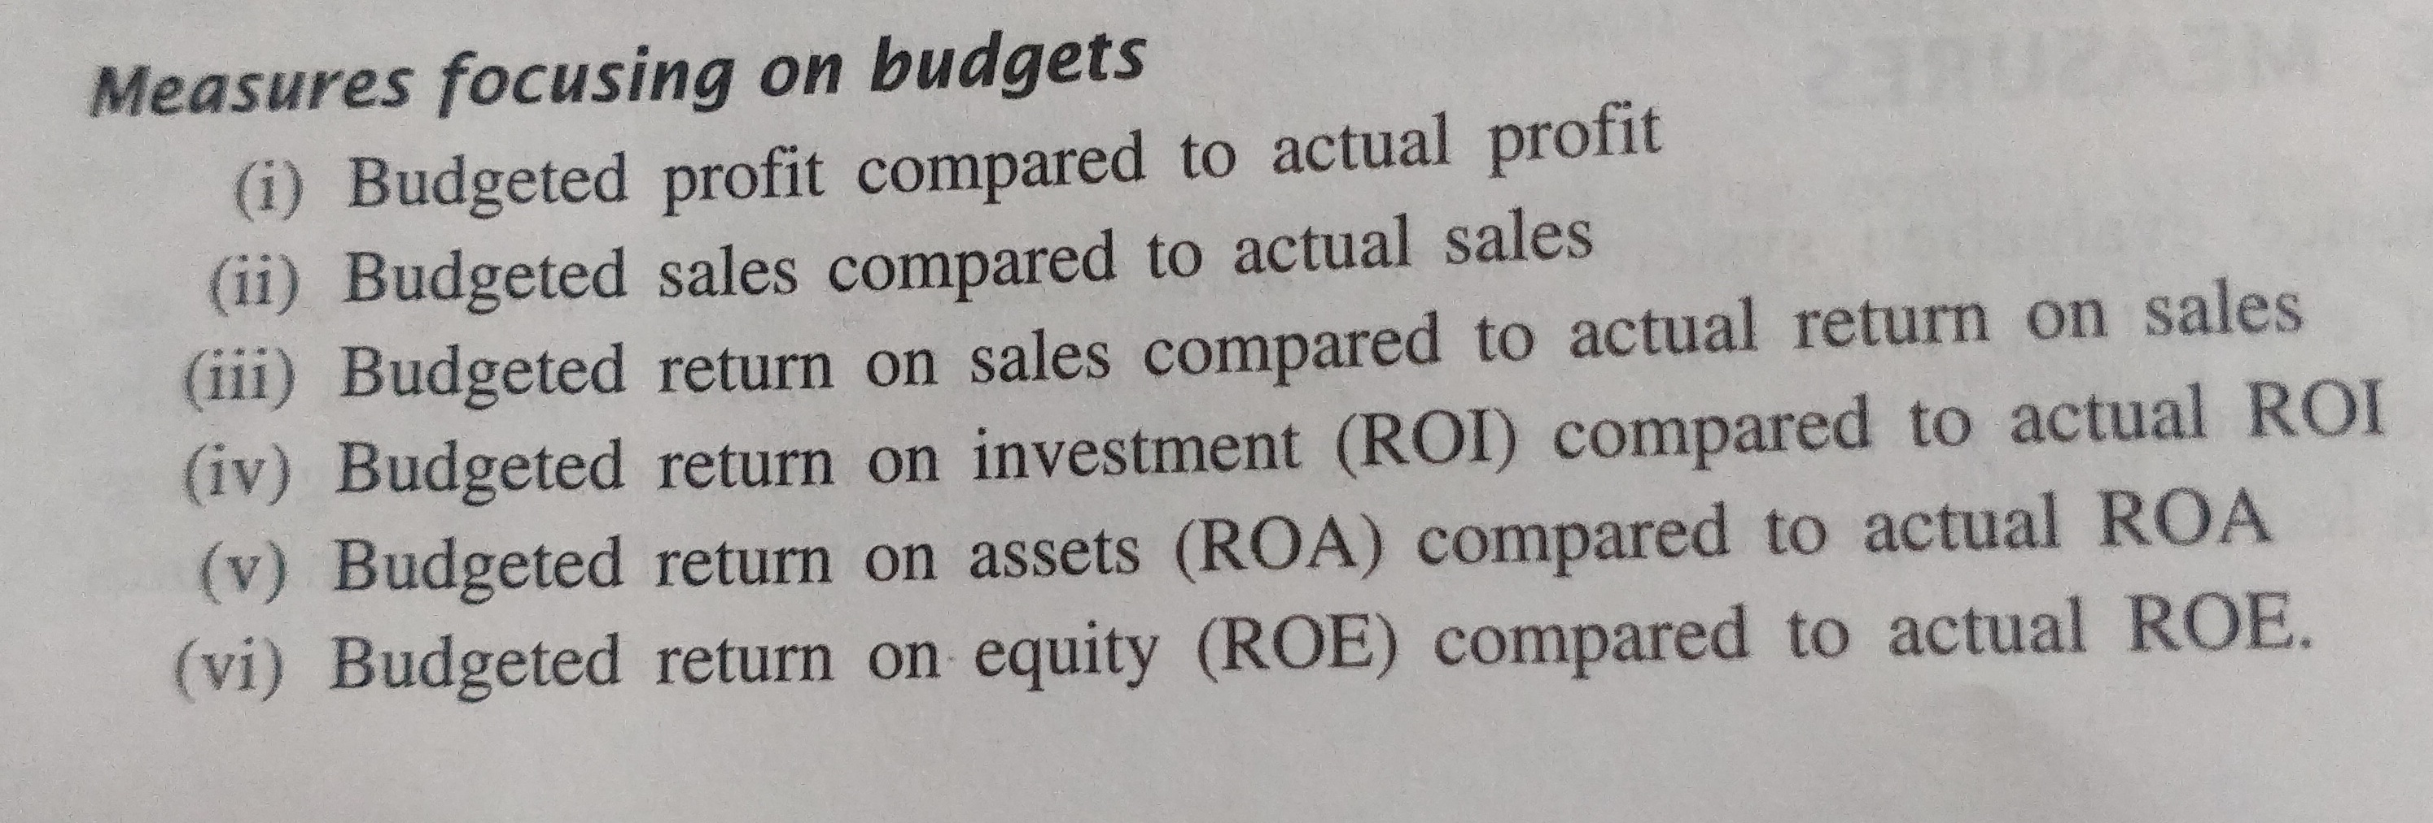
Performance Measures
Financial Measures

Slide 4
Financial Measures

Slide 5
Non-Financial Measures

Slide 6
Major Issues in Performance Evaluation of Foreign Affiliates
Unit of managerial Performance
Non-controllable factors in the external environment
Effect of inflation
Currency considerations
Budgetary Process
Transfer Pricing
Environmental Factors
Accounting Regulations

