Slide 1
Dr. Shilpa Vardia

Slide 2
Meaning:
FE Exposure relates to the effect of unexpected ER changes
on the value of the firm. In particular, it is defined as the
possible direct loss or indirect loss in the firm’s cash flows, assets & liabilities, net profit & in turn, its stock market value from an exchange rate move.

Slide 3
TYPES OF EXPOSURE:
FOREIGN EXCHANGE EXPOSURES
TRANSLATION/ACCOUNTING EXPOSURE
ECONOMIC EXPOSURE
(involving change in cash flow)
IN FE RATE → IN
ACCOUNTING STATEMENT ONLY
REAL OPERATING EXPOSURE
(involving change in future cash flow)
TRANSACTION EXPOSURE
(involving change in present cash flow)
IN FE RATE → IN FUTURE CASH
FLOW
IN FE RATE → IN OUTSTANDING OBLIGATION

Slide 4
TRANSACTION EXPOSURE:
Transaction Exposure means changes in the present cash flow of a firm consequent upon the exchange rate changes.
TE is basically the cash flow risk and deals with the effect of exchange rate moves on Transactional account exposure related to receivables (export contracts), payables (import contracts), or repatriation of dividends.
Transaction Exposure= Rupee worth of accounts receivable (payable) when actual settlement is made minus Rupee worth of accounts receivable (payable) when the trade transaction was initiated.

Slide 5
Contd.
Transaction Exposure emerges mainly on account of:
Export & Import of commodities on open account.
Borrowing & Lending in Foreign Currencies.
Intra-firm flow in MNCs.
Transaction Exposure is of three types:
Quotation Exposure– it is created when the exporter quotes a price in FC & exists till the importer places an order at that price.
Backlog Exposure– this exists between the placement of order by the importer & the shipping and billing by the seller.
Billing Exposure– it exists between the billing of the shipment & the settlement of the trade payments.

Slide 6
IMPACT OF TRANSACTION EXPOSURE:
ON EXPORT-IMPORT:
Indian exporter exports goods to USA → bill invoices in US $
→ has to receive the payment in 2 months →US $ depreciates vis-à-vis INR → this will cause a reduction in his earnings in terms of INR. The opposite will be the case if US $ appreciates vis-à-vis INR & Indian exporter’s earnings will be more in terms of INR.
Indian importer imports goods from USA → bill invoices in US $ → has to pay in 2 months → within the period US $ depreciates vis-à-vis INR→ less INR will be paid to meet the obligation. The opposite will be the case if US $ appreciates vis-à-vis INR & the Indian importer will have to pay more in terms of INR to make the payment.
For both the Indian Exporter & Importer, there will be no TE if the bill is invoiced in INR.

Slide 7
ON BORROWING & LENDING:
Indian borrower borrowed from USA→ has to pay in US
$ → if US $ depreciates vis-à-vis INR → he has to pay less in terms of INR, i.e. his debt burden will be lesser. The opposite will be the case if US $ appreciates vis-à-vis INR. He will have to pay more in terms of INR to meet the debt obligation.
Indian landed money to USA → has to receive in US $ → if US $ appreciates vis-à-vis INR→ he will receive more in terms of INR. The opposite will be the case if US $ depreciates vis-à-vis INR. The Indian Lender will earn less in terms of INR.
There will be no Transaction Exposure if borrowing & lending is done in local currency.

Slide 8
ON INTRA-FIRM FLOW:
Indian subsidiary of an USA firm declared dividend → it has to be repatriated to the parent Co. → in the mean time rupee depreciates → amount of dividend received by US parent Co. will be less in terms of $ → this will amount to a loss to the parent company. The opposite will happen if Rupee appreciates vis-à-vis US
$.
USA subsidiary of an Indian Firm declared dividend→ it has to be repatriated to the parent Co. → in the mean time US $ depreciates vis-à-vis INR → amount of dividend received by Indian parent company in terms of INR will be less→ this will amount to a loss to the parent company. The opposite will happen if US $ appreciates vis-à-vis INR. The parent will get more in terms of INR as dividend.

Slide 9
CONSOLIDATED NET EXPOSURE:
Consolidated Net Exposure means the changes in net cash flow from all the sources. The word ‘net’ comprises both the inflow and outflow of funds and it is the net amount that determines the size of TE. It covers all the imports & exports, borrowing & lending, intra-firm flow located with different counties.
Calculate the Consolidated Net Exposure:
 | AUS $ | JAPANESE ¥ | BRITISH £
IMPORT | 1550 | 1200 | 1050
EXPORT | 1250 | 1150 | 1200
PRE-CHANGE RATE | Rs. 50/ AUS $ | Rs. 0.60/¥ | Rs. 80/£
POST-CHANGE RATE | Rs. 55/ AUS $ | Rs. 0.70/¥ | Rs. 75/£

Slide 10
Contd:
Solution :
Net Inflow | Pre-change value (Rs. in Million) | Post-Change value (Rs. in Million) | Size of Exposure (Rs. in Million)
AUS $ (-) 300 | Rs. 50×(-)300= (-)15000 | Rs. 55×(-)300= (-)16500 | (-) 1500
¥ (-) 50 | Rs. 0.60×(-) 50= (-)30 | Rs. 0.70×(-)50= (-)35 | (-) 5
£ (+) 150 | Rs. 80×150=12000 | Rs. 75×150=11250 | (+)750
NET TRANSACTION EXPOSURE→ Rs. 755 Million

Slide 11
REAL OPERATING EXPOSURE (ROE):
Real Operating Exposure arises when changes in exchange rate, together with the rate of inflation, alter the amount and risk element of a company’s future revenue and cost stream, i.e. future cash flow.
The Real Operating Exposure is based on the extent to which the value of the firm- as measured by the present value of its expected cash flows- will change when exchange rate changes.
It manifests in changes in inflation-adjusted future cash flow of a firm following ER changes.

Slide 12
IMPACT OF ROE:
The impact of inflation and changes in ER on the future cash flow may vary under different market conditions.
As far as revenue is concerned, the impact may vary if the firm
produces for :--
The Export Market.
The domestic market but competition from import is absent.
The domestic market but competition from import is present.
In case of cost structure, the impact will be different, if the firm:--
Imports inputs.
Procure inputs domestically but competition from foreign
supplier is present.
Get inputs domestically & there is no competition from abroad.

Slide 13
Translation Exposure:
Translation/Accounting Exposure is the mismatch between the translated value of assets and liabilities following the ER change. It emerges on account of consolidation of financial statements of different subsidiaries of a parent MNC. When the ER changes, value of the consolidated financial statement also changes. The extent of this change represents the magnitude of Translation Exposure (TsE).
Size of the TsE depends on:-
The extent of change in the related currencies.
Extent of involvement of subsidiaries in parent’s business.
Location of subsidiaries in countries with stable/unstable currencies.
Methods of translation.

Slide 14
METHODS OF TRANSLATION:
There are four methods of translation:-
Current Method
Current/ Non-current Method.
Monetary/ Non-monetary Method.
Temporal Method

Slide 15
SUMMARY OF TRANSLATION METHODS:
FOREIGN EXCHANGE RATE | CURRENT RATE METHOD | CURRENT/ NON- CURRENT METHOD | MONETARY/ NON- MONETARY METHOD | TEMPORAL METHOD
CURRENT RATE | All items | Current assets & current liabilities | All liabilities & Current Assets except inventory | All liabilities & Current Assets if inventory is shown at MP
HISTORICAL RATE |  | Fixed assets & long term liabilities | Inventory & Fixed Assets | Fixed Assets & Inventory is not shown at MP
AVERAGE RATE |  | Income statement items except those related to fixed assets | Income statement items except those related to fixed assets | Income statement items except those related to fixed assets

Slide 16
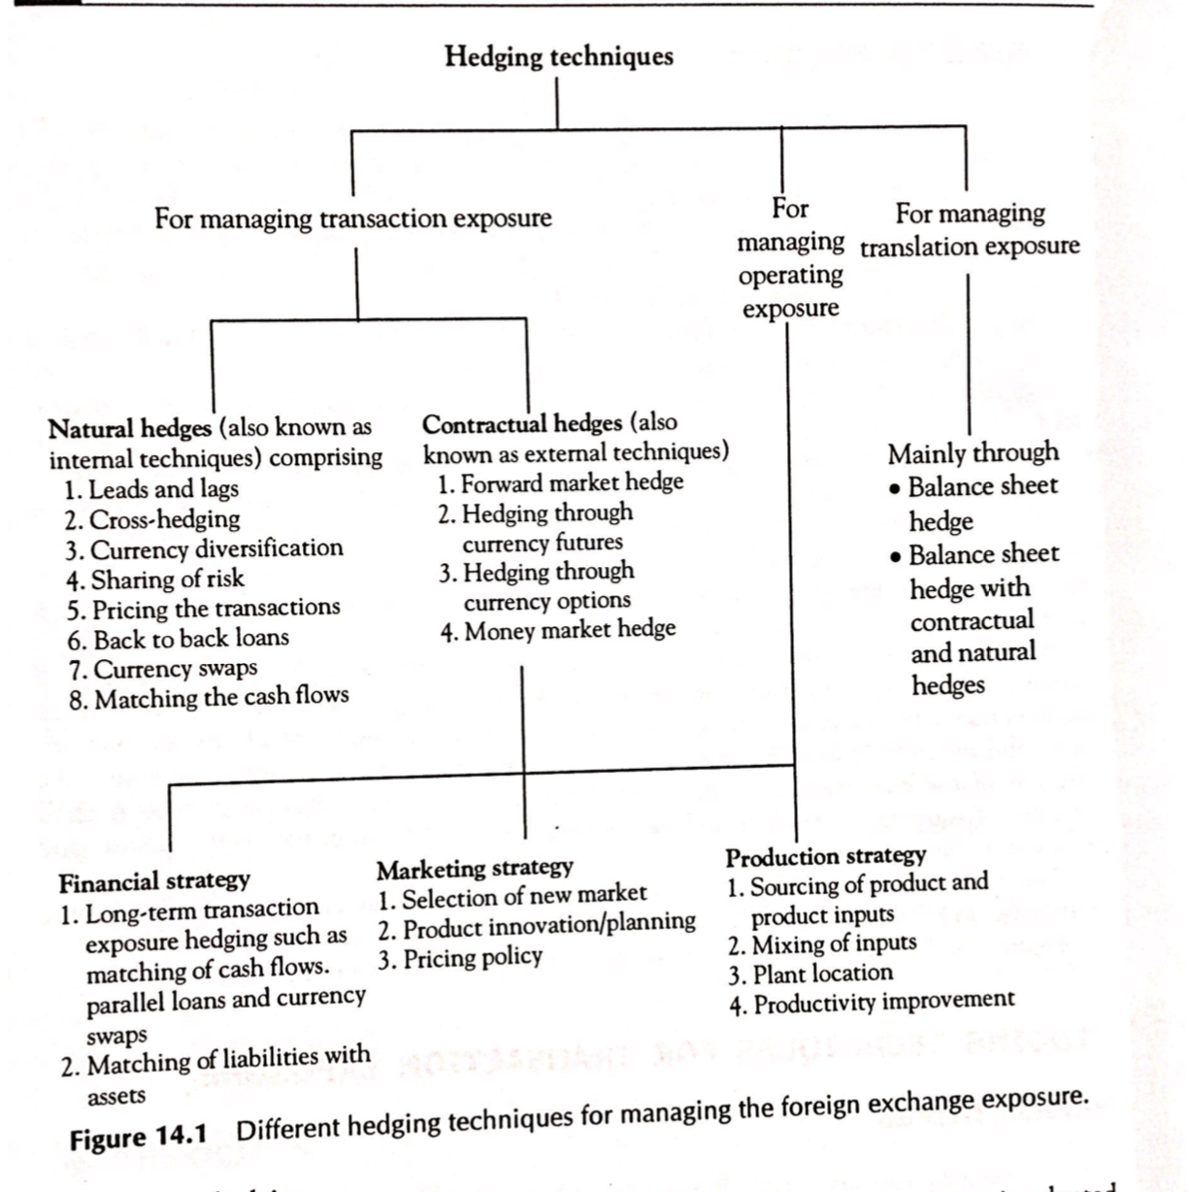

Slide 17
MANAGEMENT OF EXPOSURES:
HEDGING TECHNIQUES
CONTRACTUAL HEDGES
FORWARD MARKET HEDGE
HEDGING THROUGH CURRENCY FUTURES
HEDGING THROUGH CURRENCY OPTIONS
MONEY MARKET HEDGE
NATURAL HEDGES
NETTING
LEADS AND LAGS
CROSS HEDGING
CURRENCY DIVERSIFICATION
RISK-SHARING
PRICING CONSIDERATION
PARALLEL LOANS
CURRENCY SWAPS
MATCHING OF CASH FLOWS

Slide 18
Forward Contract
An agreement between a bank and a customer to deliver a specified amount of currency against another currency at a specified future date and at a fixed exchange rate.

Slide 19
Forward Rates
Rate agreed for settlement on an agreed date in the future
All rates are derived from Spot rates
Forward rate is the spot rate adjusted for the premium / discount
Forward Rate = Spot Rate + / - premium or discount
Value Date

Slide 20
Premium/Discount
Forward price = Spot price plus or minus forward margin.
Premium –forward value of currency is higher than spot rate. A currency with lower rate of interest is said to be at premium in the forwards. Forward margins added to spot rate.
Discount – forward value of currency is lower than spot rate. A currency with higher rate of interest is said to be at discount. Forward margins deducted from spot rate.

Slide 21
Futures
Basic characteristics of futures:
The amount of the currency that is being traded
Limited No. of Currency
Contract expiration
Use of pits
Settlement day
Brokers
Transaction through Clearing House
Margin requirements
Making to the Market
Methods of Transactions
Types of order
Cost in futures deal
Hedging in currency future market

Slide 23
Options
Basic characteristics of options:
Financial instrument that gives the buyer the right, but not the obligation, to buy or sell a standardized amount of a foreign currency, that is traded, at a fixed price at a particular time, or until a particular time in the future
Call option and put option
American and European options
Three different prices:
Exercise/strike price
Cost, price or value of the option
Underlying or actual spot exchange rate

Slide 24
Options
Options are a way of buying or selling a currency at a certain point in the future.
An option is a contract which specifies the price at which an amount of currency can be bought at a date in the future called the expiration date.
Unlike forwards and futures, the owner of an option does not have to go through with the transaction if he or she does not wish to do so.

Slide 25
Types of options
The buyer of a call has the right but not the obligation to buy the underlying asset at the strike price on or before a specified date in the future.
However, the seller has a potential obligation to sell the underlying asset at the strike price on or before a specified date in the future if the holder of the option exercises his or her right.
The buyer of a put has the right but not the obligation to sell the underlying asset at the strike price on or before a specified date in the future.
On the other hand, the seller of a put has a potential obligation to buy the underlying asset at the strike price on or before a specified date in the future if the holder of the option exercises his/her right.

