Slide 1



TECHNICAL ANALYSIS
What to Expect?
Introduction to Technical Analysis
3 Hours is too less a time to expect anything w.r.t Technical Analysis, there’s too much out there
Expect just an introduction to what is technical analysis
Get yourself convinced by end of the presentation that technical analysis
is good enough to buy and sell stocks.

Slide 2

Introduction
Should I take a long position? Should I take a short position? What is going to be the price tomorrow, next week or next year?
Technical analysis is the attempt to forecast stock prices on the basis of market-derived data.
Technicians (also known as quantitative analysts or chartists) usually look at price, volume and psychological indicators over time.
John J. Murphy:
  TA is the study of market action, primarily through the use of charts, for the
purpose of forecasting future price trends.
  Bottom Line:
    Technical analysis is a method to predict the future behaviour of securities, with the
use of past data.

Slide 3









How to do Technical Analysis?
TECHNICAL ANALYSIS
Fundamental Analysis
Theories
Industry Analysis
Charting
Company
Analysis
Moving Averages
Economic Analysis

Slide 4
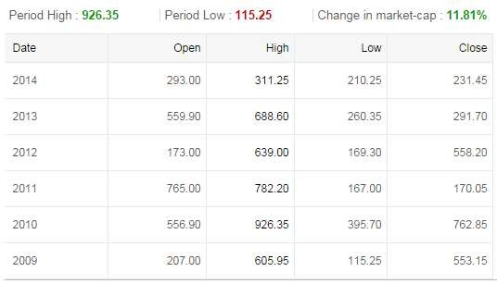
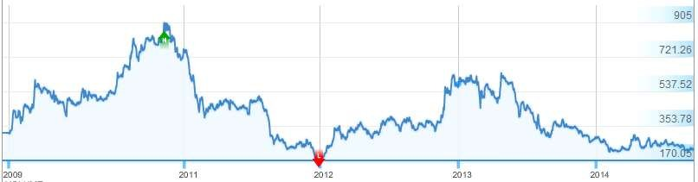
Trend
time horizons that vary greatly
Do charts Speak?
Stock Price trend of Jet Airways

Slide 5
Do charts Speak?
Consider the basic assumptions presented by Robert D. Edwards and John Magee in the classic book, Technical Analysis of Stock Trends:
  Stock prices are determined solely by the interaction of demand and supply.
  Stock prices tend to move in trends.
  Shifts in demand and supply cause reversals in trends.
  Shifts in demand and supply can be detected in charts.
  Chart patterns tend to repeat themselves.
Stock Price trend of Jet Airways
Technical analysis is based on one major assumption—trend. Markets trend.
Traders and investors hope to buy a security at the beginning of an uptrend at a low price, ride the trend, and sell the security when the trend ends at a high price.
Although this strategy sounds very simple, implementing it is exceedingly complex.

Slide 6
Different Kind of Charts used:
1. Line charts
Charting the Market
Chartists use bar charts, candlestick, or point and figure charts to look for patterns which may indicate future price movements.
2. Bar charts
3. Candlesticks
They also analyze volume and other
psychological indicators (breadth, % of bulls vs
% of bears, put/call ratio, etc.).
Strict chartists don’t care about fundamentals at all.

Slide 7
Candlesticks
Drawing Bar (OHLC) Charts
A candlestick chart is a style of bar-chart used primarily to describe price movements of a security, derivative, or currency for a designated span of time.
It is a combination of a line-chart and a bar-chart, in that each bar represents the range of price movement over a given time interval.
A chart that displays the high, low, opening and closing prices for a security for a single day.
High
High
Close
Open
Each bar is composed of 4 elements:
Open
High
Low
Close
Open
Close
Low Standard Bar Chart
Low Standard Bar Chart
Japanese Candlestick
Japanese Candlestick

Slide 8
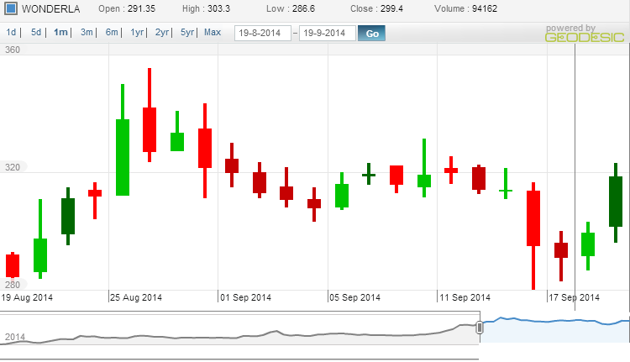
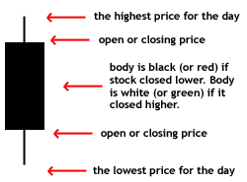
The wide part of
the candlestick is
called the "real body" and tells investors whether the closing price was higher or lower than the opening price (black/red if the stock closed lower, white/green if the stock closed higher).

Slide 9
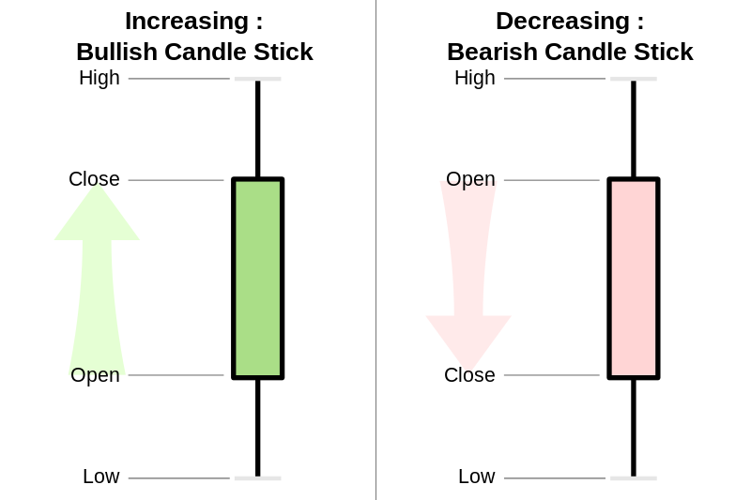

Slide 10
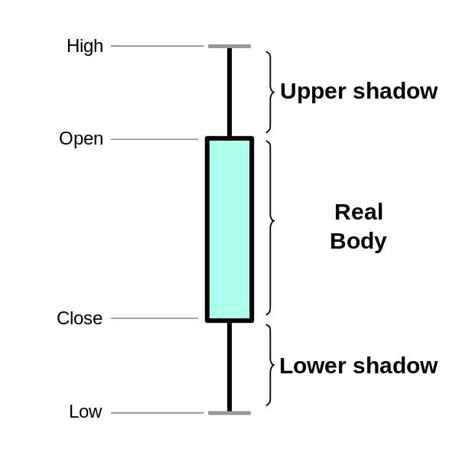

Slide 11
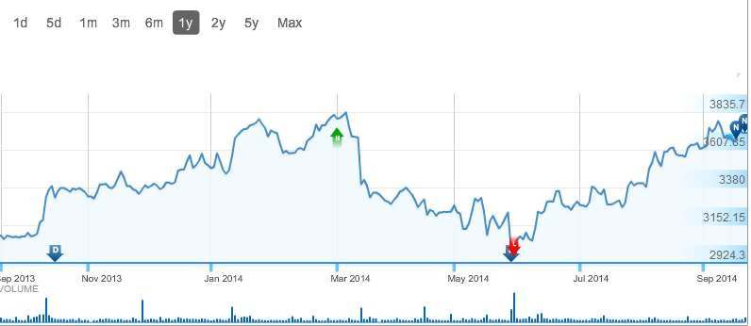
Line Chart
A style of chart that is created by connecting a series of data points
together with a line.
This is the most basic type of chart used in finance and it is generally created by connecting a series of past prices together with a line.
A line chart can give the reader a fairly good idea of where the
price of an asset has traveled over a given time frame.
Infosys

Slide 12
Head and Shoulders
This formation is characterized by two small peaks on either side of a
larger peak.
head-and-shoulders chart pattern
Rises to a peak and subsequently declines. Then, the price rises above the former peak and again declines.
And finally, rises again, but not to the second peak, and declines once more.
The first and third peaks are shoulders, and the second peak forms the head
H&S Top
Head
Left Shoulder
Right Shoulder
Inverse Head-and-Shoulders
This is a reversal pattern, meaning that it signifies a change in the trend.
Formation of the pattern:
  Left shoulder: Price declines and
moves higher.
  Head: another Decline occurs to a lower level.
  Right shoulder: Price then moves higher and moves back lower, but not as low as the head
Neckline
H&S Bottom
Neckline
Left Shoulder
Right Shoulder
Head
In this pattern, the neckline is a level of support or resistance.

Slide 13
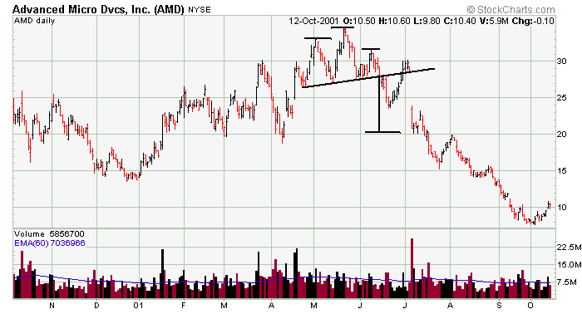

How to Trade the Pattern?
It is very important that traders wait for the pattern to complete.
In the head and shoulders we are waiting for price action to move lower than the neckline after the peak of the right shoulder.
For the inverse head and shoulder, we wait for price movement above the neckline after the right shoulder is formed.
H
S
S
Support
Level
Sell Signal

Slide 14
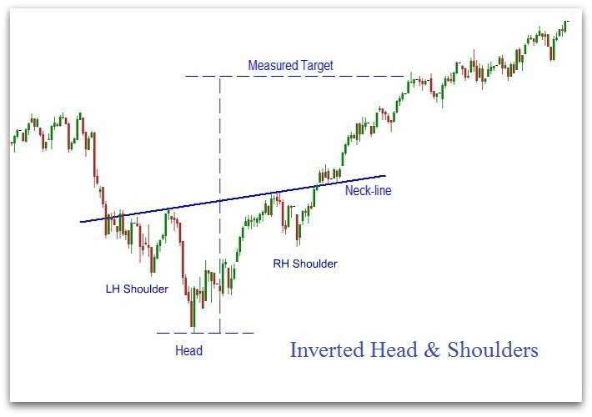
Double Bottom Example
Buy Signal
support
Level

Slide 15
Double Tops and Bottoms
These formations are similar to the H&S formations, but there is no head.
These are reversal patterns with the same measuring implications as the H&S.
Double Top
Target Target
Double Bottom

Slide 16
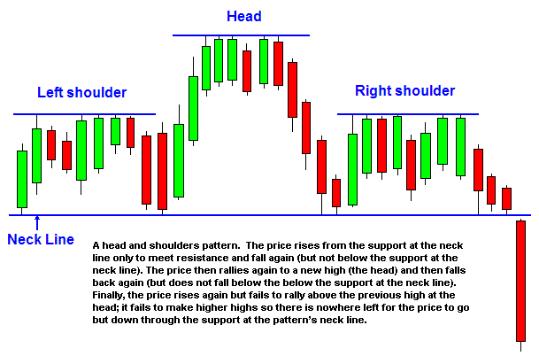

Slide 17
Trends
The meaning of trend in finance isn't all that different from the general definition of the term - a trend is really nothing more than the general direction.
A trend represents a consistent change in prices (i.e. a
change in investor’s expectations)
A trendline is a simple charting technique that adds a line to a chart to represent the trend in the market or a stock.

Slide 18
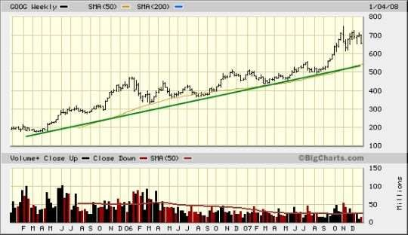
Types of Trend
Uptrends

Slide 19
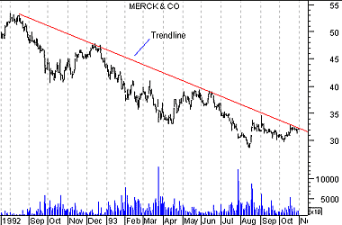
Types of Trend
Downtrend

Slide 20
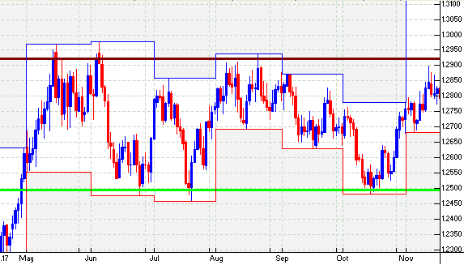
Types of Trend
Sideways Trend

Slide 21
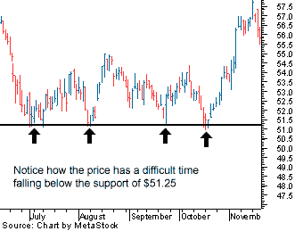
Support and Resistance
Support level is a price level where the price tends to find support as it is going down

Slide 22
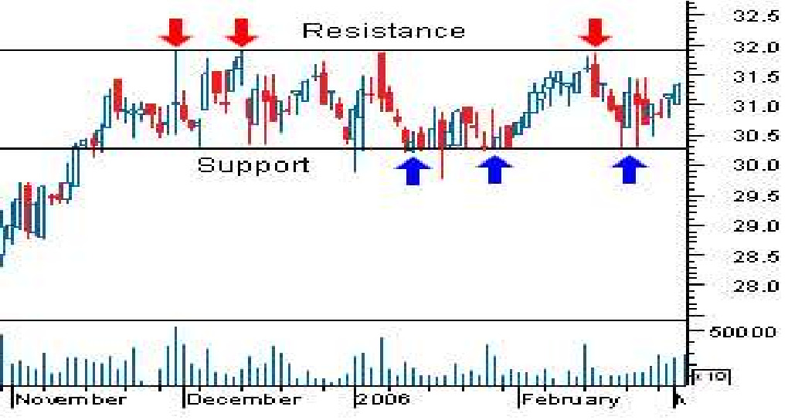
Importance of Support and Resistance
Support and resistance analysis is an important part of trends because it can be used to make trading decisions and identify when a trend is reversing.

Slide 23
Aware: Support and Resistance levels
Support and Resistance levels are highly volatile
Traders should not buy and sell directly at these points as there may be breakout also
A support is plotted at the daily low price
and resistance at the daily high price.

Slide 24
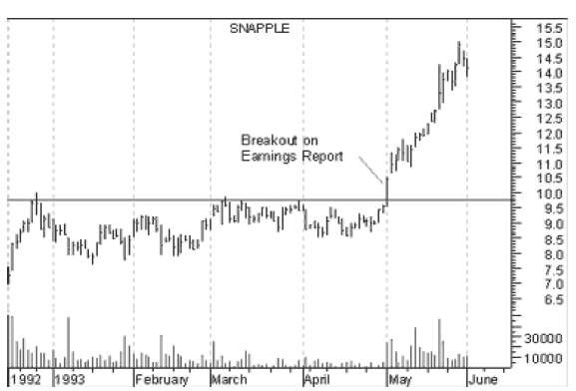
Breakout
The penetration of support and resistance level is called breakout

Slide 25
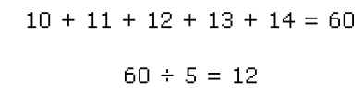
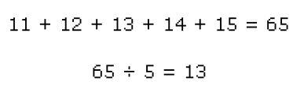
Moving Averages
A simple moving average is formed by computing the average
(mean) price of a security over a specified number of periods.
While it is possible to create moving averages from the Open, the High, and the Low data points, most moving averages are created using the closing price.
For example: a 5-day simple moving average is calculated by adding the closing prices for the last 5 days and dividing the total by 5.
Continuing our example, if the next closing price in the average is 15,
then this new period would be added and the oldest day, which is 11, would be dropped.

Slide 26
Moving Averages
An indicator is anything that can be used to predict future financial or economic trends.
Leading (Bullish)-Above average
  Leading - These types of indicators signal future events.
Lagging (Bearish)-Below Average
  A lagging indicator is one that follows an event.
    Relative Strength Ratio
    Relative Strength Index (RSI)
    Moving average convergence divergence (MACD)
    Market Indicators
    1.Breath of the Market
    2. Market Breath Index
    3. The odd lot ratio
    4. Put-call Ratio

Slide 27
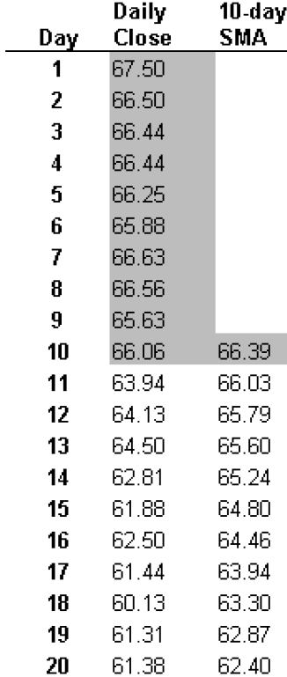
Note that all moving averages are lagging indicators and will always be "behind" the price.
When prices are trending, moving
averages work well.
However, when prices are not trending, moving averages can give misleading signals.

Slide 28
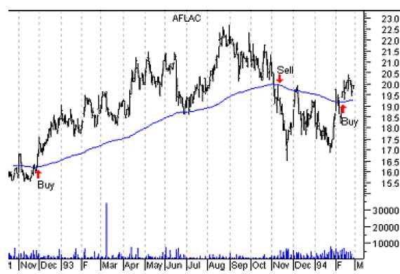
Moving Averages

Slide 29
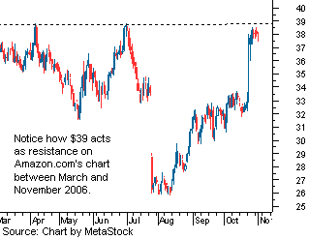
Support and Resistance
Resistance Level is a price level where the price tends to find resistance as it is going up

