Slide 1
Market Participants of Foreign Exchange Market

Slide 2
Market Participants
Four broad categories of participants:
¬ Bank and non-bank foreign dealers,
exchange
Individuals and firms,
Speculators and arbitragers, and
Central banks and treasuries.
Foreign Exchange Brokers

Slide 3
Bank and Non-bank Foreign Exchange Dealers
Banks and a few non-bank foreign exchange dealers operate in both the inter-bank and client markets.
The profit from buying foreign exchange at a “bid” price and reselling it at a slightly higher “offer” or “ask” price.
Dealers in large international banks often function as “market makers.”
These dealers stand willing at all times to buy and sell those currencies in which they specialize and thus maintain an “inventory” position in those currencies.

Slide 4
Individuals and Firms
Individuals (such as tourists) and firms (such as importers, exporters and MNEs) conduct commercial and investment transactions in the foreign exchange market.
Their use of the foreign exchange market is necessary for their underlying commercial or investment purpose.
Some of the participants use the market to “hedge” foreign exchange risk.

Slide 5
Speculators and Arbitragers
Speculators and arbitragers seek to profit from trading in the market itself.
They operate in their own interest, without a need or obligation to serve clients or ensure a continuous market.
While dealers seek the bid/ask spread, speculators seek all the profit from exchange rate changes and arbitragers try to profit from simultaneous exchange rate differences in different markets.

Slide 6
Central Banks and Treasuries
Central banks and treasuries use the market to acquire or spend their country’s foreign exchange reserves as well as to influence the price at which their own currency is traded.
The motive is not to earn a profit
Central banks and treasuries differ in motive from all other market participants.

Slide 7
Foreign Exchange Brokers
¬ Foreign exchange
brokers are agents who
facilitate trading between
dealers without
themselves transaction.
becoming principals in the
For this service, they charge a commission.
It is a brokers business to know at any moment exactly which dealers want to buy or sell any currency.
Dealers use brokers for their speed, and because they want to remain anonymous since the identity of the participants may influence short term quotes.

Slide 8
Market-makers
¬
Traders in the major money center banks around the world who deal in two-way prices. They announce bid and offer prices at which they will exchange two currencies.
¬
The difference between the two prices is referred to as the bid/asked spread, which is traders’ profits.
¬
Bid (ask or offer) price = a price at which a trader is willing to buy (sell).

Slide 9
Transactions in the Inter-bank Market
A spot transaction in the inter-bank market is the purchase of foreign exchange, with delivery and payment between banks to take place on the second following business day.
The date of settlement is referred to as the value date.
An outright forward transaction (or a forward) requires delivery at a future value date of a specified amount of one currency for a specified amount of another currency.

Slide 10

Transactions in the Inter-bank Market
The exchange rate is established at the time of the agreement, but payment and delivery are not required until maturity.
Forward exchange rates are usually quoted for value dates of one, two, three, six and twelve months.
A swap transaction in the inter-bank market is the simultaneous purchase and sale of a given amount of foreign exchange for two different value dates (settlement date).

Slide 11
Transactions in the Inter-bank Market
Both purchase and sale are conducted with the same counterparty.
Some different types of swaps are:
o o o
spot against forward, forward-forward,
non-deliverable forwards (NDF).

Slide 12
Foreign Exchange Rates and Quotations
¬ A
foreign exchange rate is the price of one
currency expressed in terms of another currency.
A foreign exchange quotation (or quote) is a statement of willingness to buy or sell at an announced rate.
Most foreign exchange transactions involve the US dollar.

Slide 13
Professional dealers and brokers may state foreign exchange quotations in one of two ways:
  the foreign currency price of one dollar, or
  the dollar price of a unit of foreign currency.
Most foreign currencies in the world are stated in terms of the number of units of foreign currency needed to buy one dollar.

Slide 14
¬ Foreign exchange quotes:
o o
direct or indirect quote
A direct quote is a home currency price of a unit of foreign currency
An indirect quote is a foreign currency price of a unit of home currency.
The form of the quote depends on what the speaker regard as “home.”
For example, the exchange rate between US dollars and the Swiss franc is normally stated:
o SF 1.6000/$ (European terms or direct quote)

Slide 15
However, this rate can also be stated as:
o $0.6250/SF (American terms or indirect quote)
most inter-bank quotations around the world are stated in European terms.
Forward quotations may also be expressed as the percent-per-annum deviation from the spot rate.
This method of quotation makes it easier to compare premiums or discounts in the forward market

Slide 16
If a currency increases in value in the future, it is traded at a premium, if decreases, it is at a discount against the other currency.
Some currency pairs are only inactively traded, so their exchange rate is determined through their relationship to a widely traded third currency (cross rate).
Cross rates can be used to check on opportunities for inter-market arbitrage.
one bank’s (Dresdner) quotation on €/£ is not the same as calculated cross rate between $/£ (Barclay’s) and $/€ (Citibank).

Slide 17
Understanding Exchange Rates
Dollar/Swiss Francs -- USD/CHF
Note the order of the currencies
“USD” comes before the “CHF”
The first currency($) - Base currency
Second currency (CHF) - Terms currency
It is important to remember that Bid & Offer in trading always refers to the BASE CURRENCY.

Slide 18
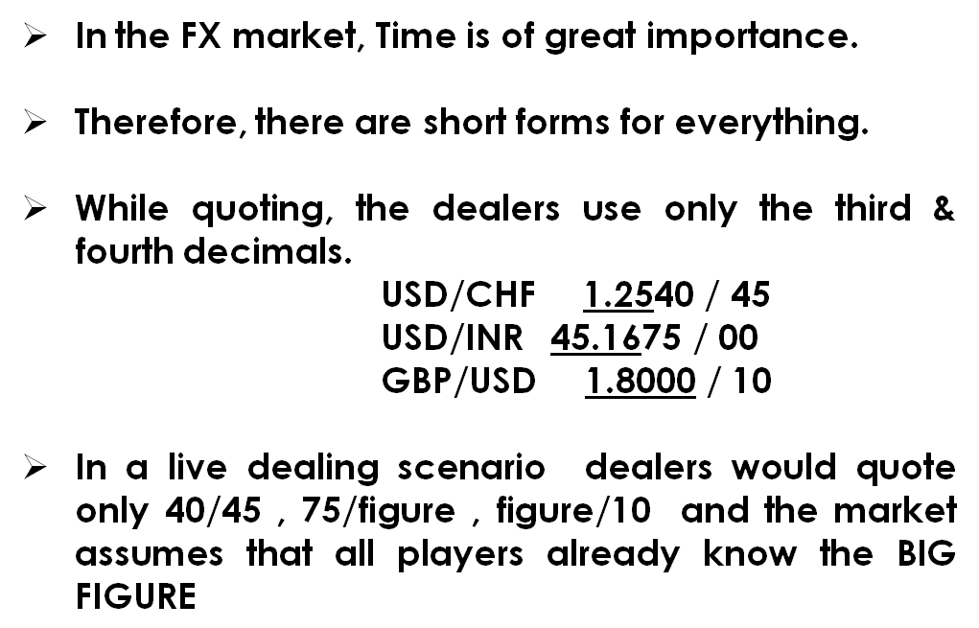

Slide 19
Forward Rates
Rate agreed for settlement on an agreed date in the future
All rates are derived from Spot rates
Forward rate is the spot rate adjusted for the premium / discount
Forward Rate = Spot Rate + / - premium or discount

Slide 20
Premium/Discount
Forward price = Spot price plus or minus forward margin.
Premium –forward value of currency is higher than spot rate. A currency with lower rate of interest is said to be at premium in the forwards. Forward margins added to spot rate.
Discount – forward value of currency is lower than spot rate. A currency with higher rate of interest is said to be at discount. Forward margins deducted from spot rate.

Slide 21
Factors Determining Exchange Rates
Fundamental Reasons:
  Balance of Payment – surplus leads to stronger currency.
  Economic Growth Rates –High/Low growth rate.
  Fiscal / Monetary Policy- deficit financing leads to depreciation of currency.
  Interest Rates –currency with higher interest will appreciate in the short term.
  Political Issues –Political stability leads to stable rates

Slide 22
Factors Determining Exchange Rates
b. Technical Reasons:
Government Control can lead to unrealistic value.
Free flow of Capital from lower interest rate to higher interest rates.
c. Speculation – higher the speculation higher the volatility in rates

Slide 23
EXCHANGE RATE SYSTEMS
1. Freely floating or flexible exchange rate:
¬
Market forces of supply and demand determine rates.
¬
Forces influenced by
price levels
interest rates
economic growth
¬ Rates fluctuate over time randomly.

Slide 24
Advantages
No problems with international liquidity
Automatic correction in the balance of payment
Insulated from external events

Slide 25
Disadvantages
Uncertainty
Speculation can be destabilizing specially in the short run
Today’s crises questioning the power of the market

Slide 26
Managed Float (Dirty Float)
  Market forces set rates unless excess volatility occurs.
  The government intervenes to influence the exchange rate

Slide 27
3. Target-Zone Arrangement
¬
Central bank intervenes to set the exchange rate at the preannounced price, by selling or buying foreign exchange currency in return for the national currency
¬
Market forces constrained to upper and lower range of rates
¬
Members to the arrangement adjust their national economic policies to maintain target.

