Slide 1


Motivation
-ranu nagori

Slide 2
At the end of the session audience will be able to answer…
Motivation and its nature
Types of motivation
Theories of Motivation

Slide 3
What is Motivation?
An internal state that arouses, directs, and maintains behaviour.

Slide 4


Content
•
Definition Of motivation
•
Motivation is
•
Qualities Of Motivation
•
Process of motivation
•
Six c’s of motivation
•
Basic model of motivation
•
Theory of motivation
•
Case study
Defining Motivation
Motivation
The processes that account for an individual’s intensity, direction, and persistence of effort towards attaining a goal.
Key Elements
Intensity: how hard a person tries
Direction: toward beneficial goal
Persistence: how long a person tries

Slide 5
NATURE OF MOTIVATION
Individuals differ in their motivation
Sometimes the individual himself is unaware of his motivation
Motivations change
Motivations are expressed differently
Motivation is complex
Multiple motivations make the choice of goals difficult for an individual

Slide 6
Determinants of Motivation (System’s View)
The individual
Organisational climate
Job characteristics
Exogenous variables

Slide 7

Rewards in motivation

Slide 8

Extrinsic Motivation
Motivation created by employer, supervisor, colleagues
Money, employee benefit, promotion, recognition, praise, status

Slide 9

Intrinsic Motivation
Individual gives to himself
Enjoyment of a task or the sense of accomplishment that it brings- job satisfaction, sense of achievement, self esteem etc.

Slide 10

Monetary and Non-Monetary Rewards
Monetary rewards – pecuniary rewards : associated directly or indirectly with money
Wages, salary, bonus, profit-sharing, retirement benefits, vacation pay, health insurance etc.
Non-Monetary Rewards : incentives not measurable in terms of money
Intangible and designed to meet higher order needs of employees
Career advancement opportunities, participation in management, quality circles, supportive supervision etc.

Slide 11
Try It Yourself
Put an E next to the examples of extrinsic motivation | Put an I next to the examples of intrinsic motivation:
A teacher assigns points for good behavior that can be exchanged for better grades at the end of each week.
A student goes to the library after school to find more information about an especially interesting topic that was introduced in class.
A student crams hard for an upcoming exam in order to maintain her perfect GPA.

Slide 12
Motivation Theories

Slide 13
Motivation is..
Complex
Psychological
Physical
Unique to each and every person
Context sensitive
Not fully understood

Slide 14
Qualities of motivation
Energizes behavior
Directs behavior
Enable persistence towards a goal
Exists in varying details

Slide 15
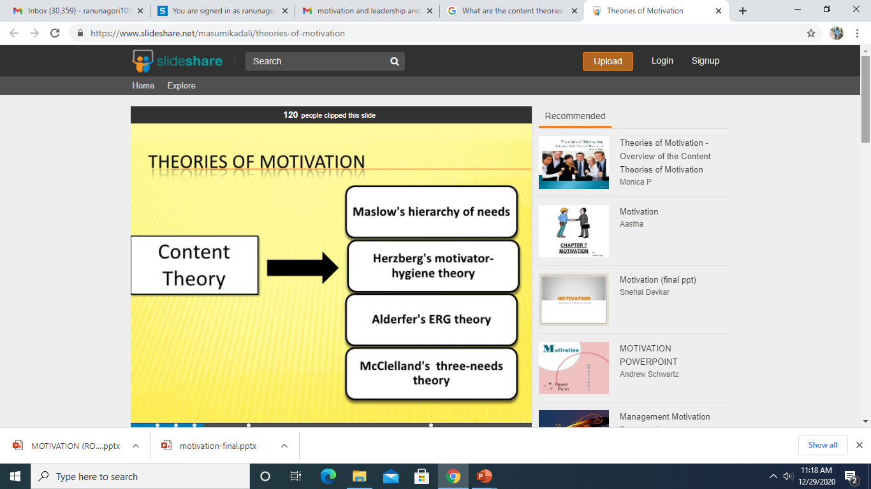
Theories of motivation
Notes:
Content theories deal with “what” motivates people and it is concerned with individual needs and goals. Maslow, Alderfer, Herzberg and McClelland studied motivation from a “content” perspective. Process theories deal with the “process” of motivation and are concerned with “how” motivation occurs.

Slide 16
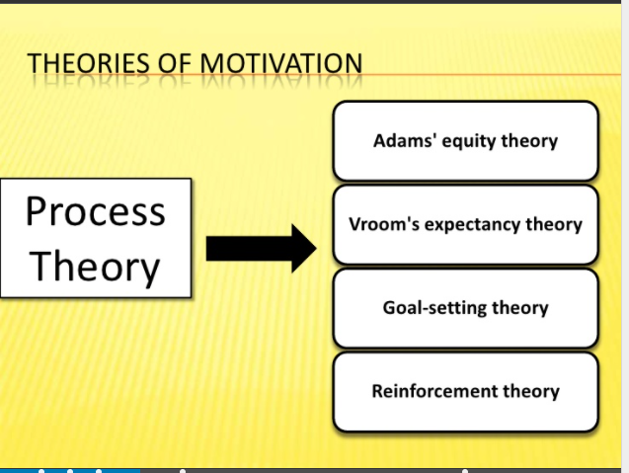

Slide 17
Hierarchy of Needs Theory (Maslow)
Hierarchy of Needs Theory
There is a hierarchy of five needs—physiological, safety, social, esteem, and self-actualization; as each need is substantially satisfied, the next need becomes dominant.
Self-Actualization
The drive to become what one is capable of becoming.

Slide 18
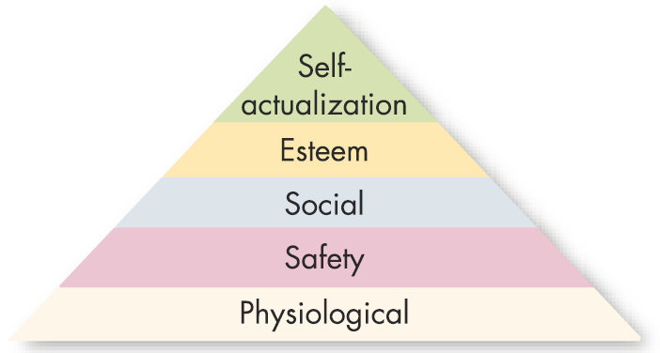
Six C’s of Motivation..
ChoicescollaborationConstructing
meaningConsequencesControlChallenges
Maslow’s Hierarchy of Needs
Higher-Order Needs
Needs that are satisfied
internally; social, esteem,
and self-actualization
needs.
Lower-Order Needs
Needs that are satisfied externally; physiological
and safety needs.

Slide 19
Theory X and Theory Y (Douglas McGregor)
Theory X
Assumes that employees dislike work, lack ambition, avoid responsibility, and must be directed and coerced to perform.
Theory Y
Assumes that employees like work, seek responsibility, are capable of making decisions, and exercise self-direction and self-control when committed to a goal.

Slide 20
Two-Factor Theory (Frederick Herzberg)
Two-Factor (Motivation-Hygiene) Theory
Intrinsic factors are related to job satisfaction, while extrinsic factors are associated with dissatisfaction.
Hygiene Factors
Factors—such as company policy and administration, supervision, and salary—that, when adequate in a job, placate workers. When factors are adequate, people will not be dissatisfied.
Notes:
Satisfiers are motivators
Dissatisfiers are hygiene factors

Slide 21
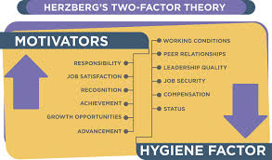

Slide 22
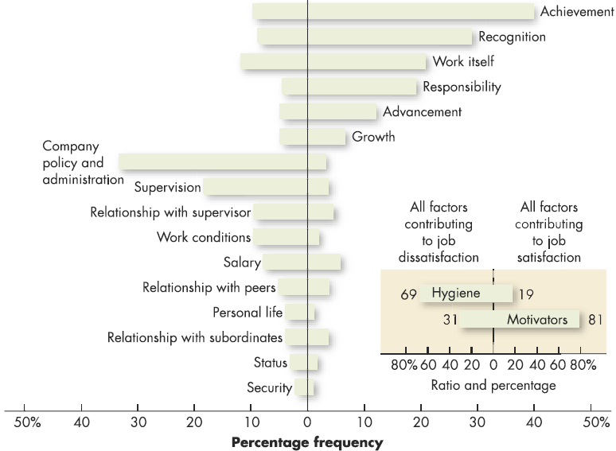
Comparison of Satisfiers and Dissatisfiers
Factors characterizing 1844 events on the job that led to extreme job dissatisfaction
Factors characterizing 1753 events on the job that led to extreme job satisfaction
Source: Reprinted by permission of Harvard Business Review. An exhibit from One More Time: How Do You Motivate Employees? by Frederick Herzberg, September–October 1987. Copyright © 1987 by the President and Fellows of Harvard College: All rights reserved.

Slide 23
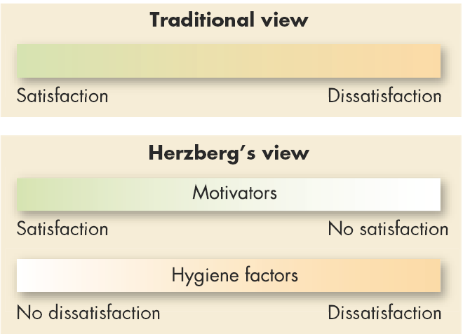
Contrasting Views of Satisfaction and Dissatisfaction

Slide 24
ERG Theory (Clayton Alderfer)
ERG Theory
There are three groups of core needs: existence, relatedness and growth.
Core Needs
Existence: provision of basic material requirements.
Relatedness: desire for relationships.
Growth: desire for personal development.
Concepts:
More than one need can be operative at the same time.
If a higher-level need cannot be fulfilled, the desire to satisfy a lower-level need increases.

Slide 25
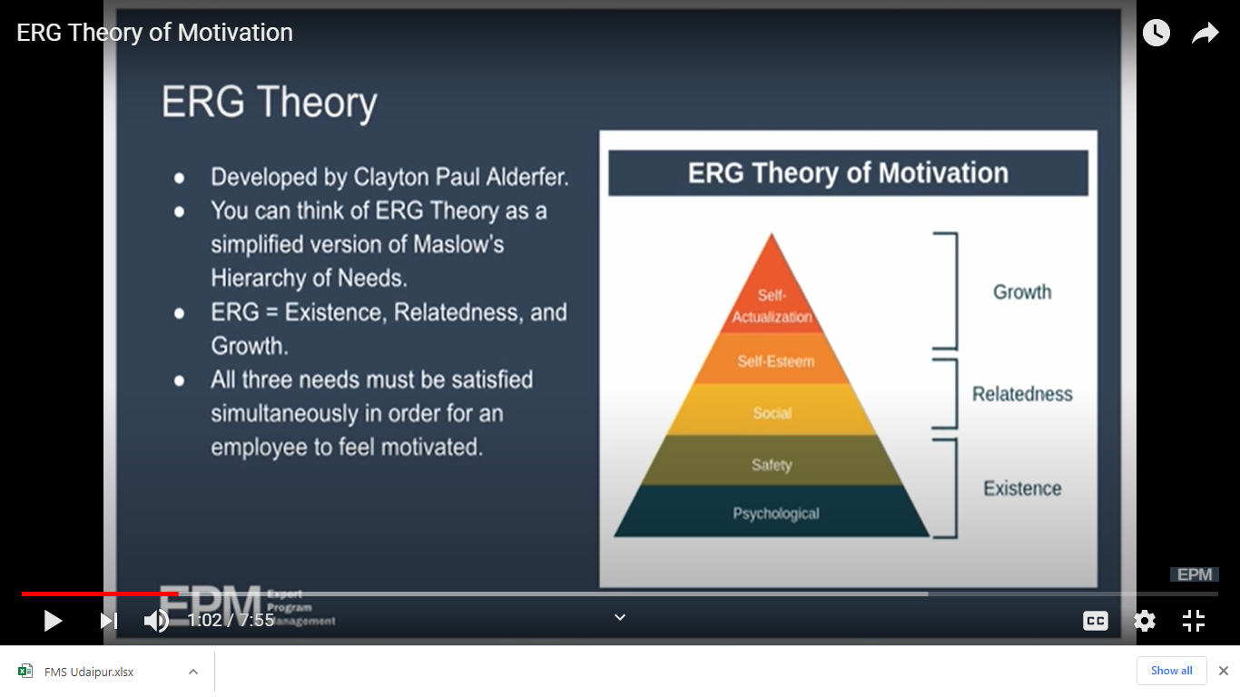

Slide 26
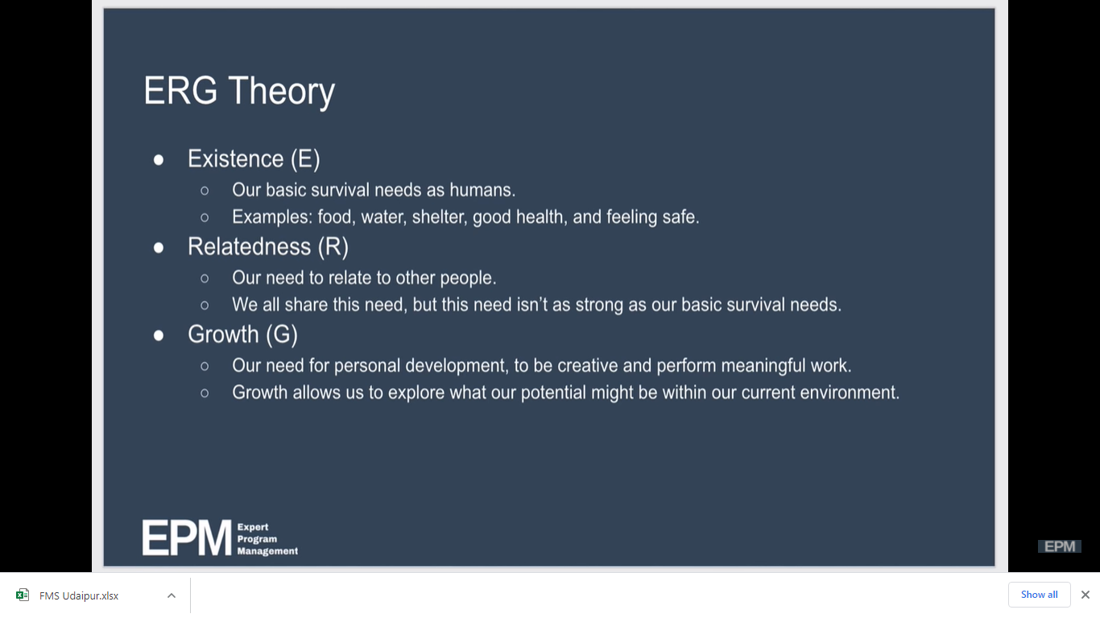

Slide 27
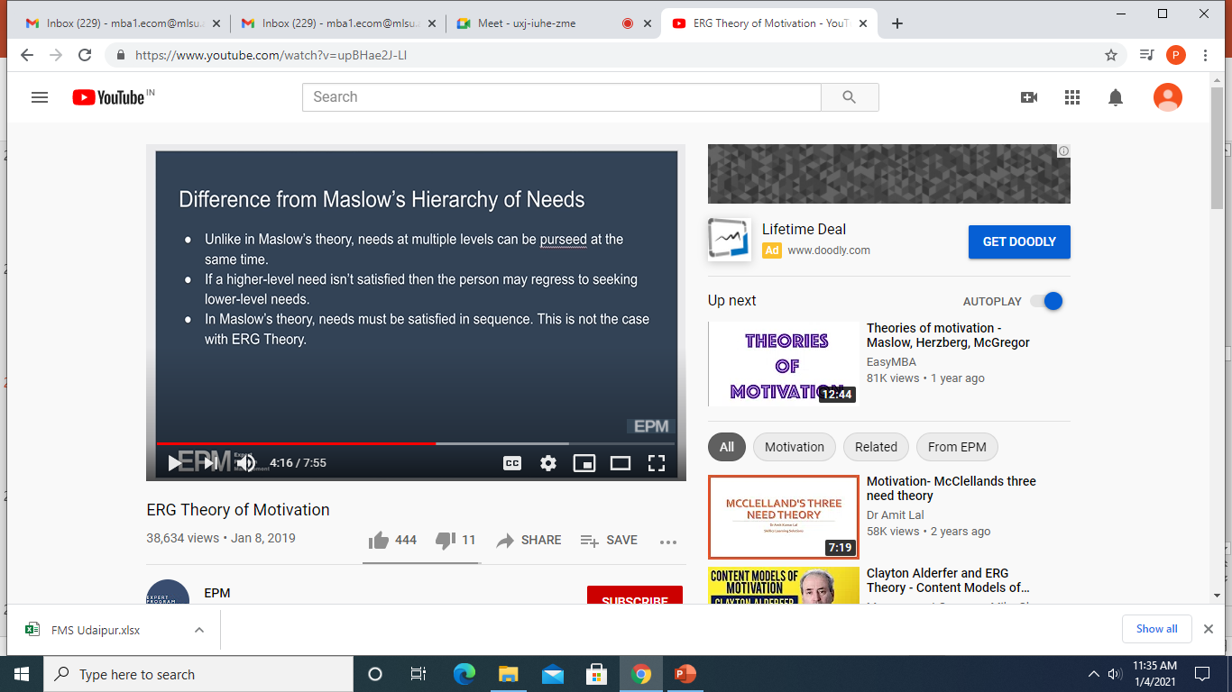

Slide 28
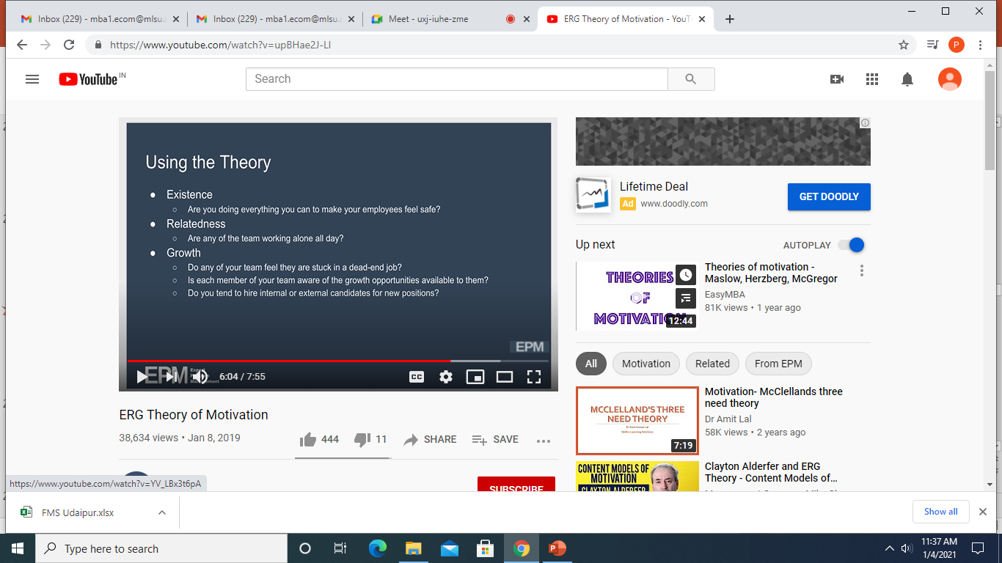

Slide 29
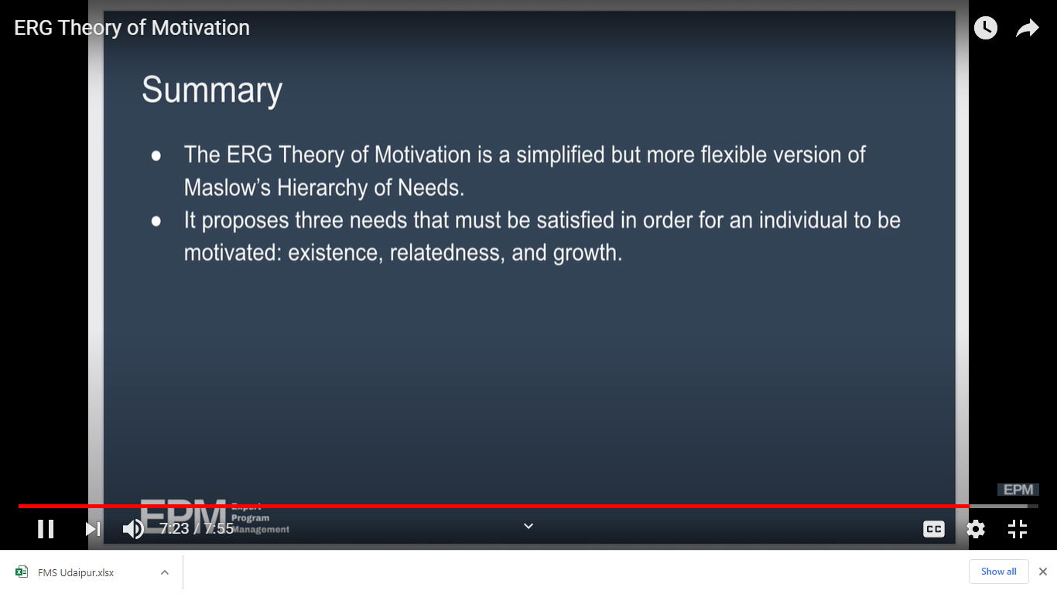

Slide 30
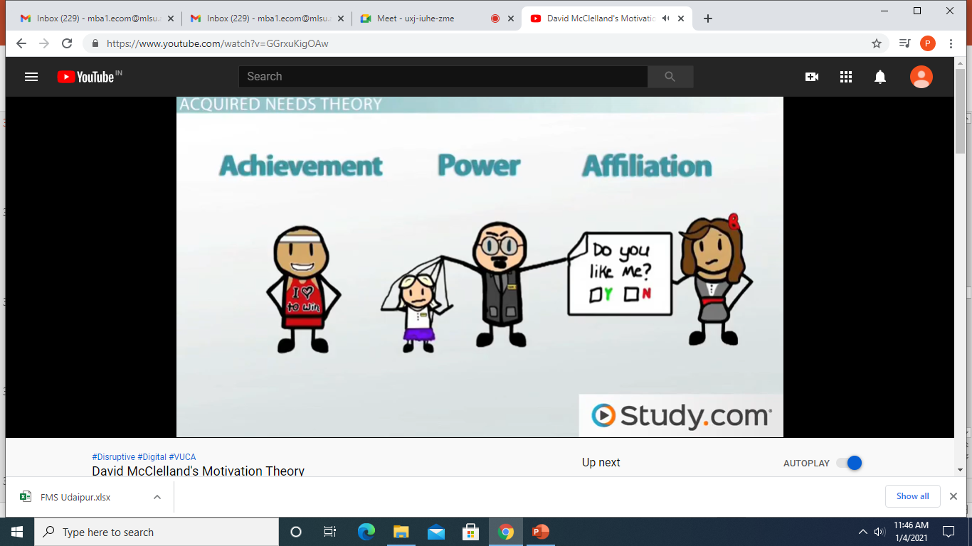

Slide 31
David McClelland’s Theory of Needs
Need for Achievement
The drive to excel, to achieve in relation to a set of standards, to strive to succeed.
Need for Affiliation
The desire for friendly and close personal relationships.
Need for Power
The need to make others behave in a way that they would not have behaved otherwise.
nPow
nAch
nAff

Slide 32
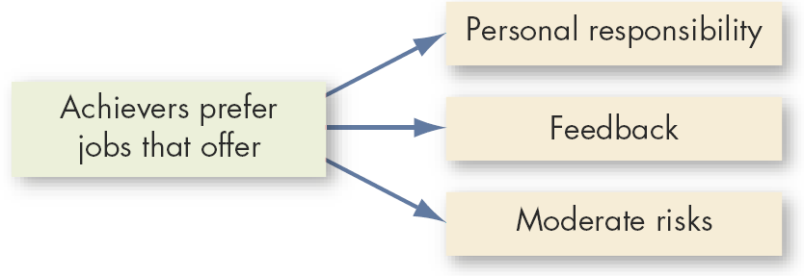
Matching High Achievers and Jobs
Notes:
https://www.youtube.com/watch?v=GGrxuKigOAw David McClelland’s Theory of Needs

Slide 33
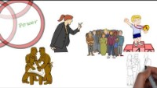
Notes:
https://www.youtube.com/watch?v=FFlQ6Hf-0t0

Slide 34
Cognitive Evaluation Theory
Cognitive Evaluation Theory
Providing an extrinsic reward for behavior that had been previously only intrinsically rewarding tends to decrease the overall level of motivation.
The theory may only be relevant to
jobs that are neither extremely
dull nor extremely interesting.

Slide 35
Goal-Setting Theory (Edwin Locke)
Goal-Setting Theory (Edwin Locke)
Goal-Setting Theory
The theory that specific and difficult goals, with feedback, lead to higher performance.
Factors influencing the goals–performance relationship:
Goal commitment, adequate self-efficacy, task characteristics, and national culture.
Self-Efficacy
The individual’s belief that he or she is capable of performing a task.

Slide 36
Reinforcement Theory
The assumption that behavior is a function of its consequences.
Concepts:
Behavior is environmentally caused.
Behavior can be modified (reinforced) by providing (controlling) consequences.
Reinforced behavior tends to be repeated.

Slide 37
Job Design Theory
Characteristics:
Skill variety
Task identity
Task significance
Autonomy
Feedback
Job Characteristics Model
Identifies five job characteristics and their relationship to personal and work outcomes.

Slide 38
Job Design Theory (cont’d)
Job Characteristics Model
  Jobs with skill variety, task identity, task significance, autonomy, and for which feedback of results is given, directly affect three psychological states of employees:
    Knowledge of results
    Meaningfulness of work
    Personal feelings of responsibility for results
  Increase in these psychological states result in increased motivation, performance, and job satisfaction.

Slide 39
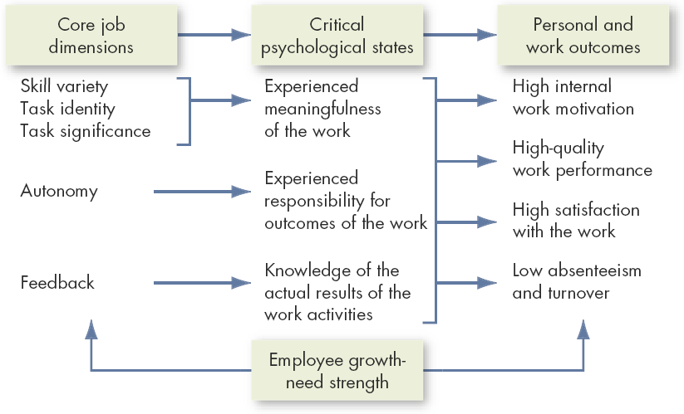
The Job Characteristics Model
Source: J.R. Hackman and G.R. Oldham, Work Design (excerpted from pp. 78–80). © 1980 by Addison-Wesley Publishing Co., Inc. Reprinted by permission of Addison-Wesley Longman, Inc.

Slide 40
Job Design Theory (cont’d)
Skill Variety
The degree to which a job requires a variety of different activities.
Task Identity
The degree to which the job requires completion of a whole and identifiable piece of work.
Task Significance
The degree to which the job has a substantial impact on the lives or work of other people.

Slide 41
Job Design Theory (cont’d)
Autonomy
The degree to which the job provides substantial freedom and discretion to the individual in scheduling the work and in determining the procedures to be used in carrying it out.

Slide 42
Job Design Theory (cont’d)
Feedback
The degree to which carrying out the work activities required by a job results in the individual obtaining direct and clear information about the effectiveness of his or her performance.

Slide 43
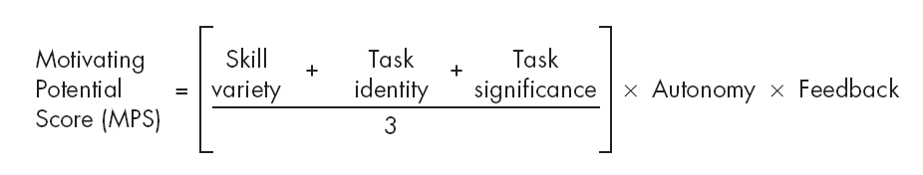
Computing a Motivating Potential Score
People who work on jobs with high core dimensions are generally more motivated, satisfied, and productive.
Job dimensions operate through the psychological states in influencing personal and work outcome variables rather than influencing them directly.

Slide 44
Job Design Theory (cont’d)
Social Information Processing (SIP) Model
The fact that people respond to their jobs as they perceive them rather than to the objective jobs themselves.
Concept:
Employee attitudes and behaviors are responses to social cues by others.

Slide 45
Social Information Processing Model (SIP)
Concepts of the SIP Model
  Employees adopt attitudes and behaviors in response to the social cues provided by others (e.g., coworkers) with whom they have contact.
  Employees’ perception of the characteristics of their jobs is as important as the actual characteristics of their jobs.

Slide 46
Equity Theory
Equity Theory
Individuals compare their job inputs and outcomes with those of others and then respond to eliminate any inequities.
Referent Comparisons:
Self-inside
Self-outside
Other-inside
Other-outside

Slide 47
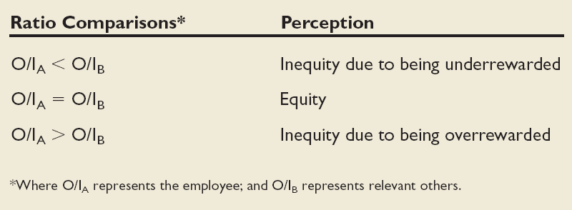
Equity Theory (cont’d)

Slide 48
Equity Theory (cont’d)
Choices for dealing with inequity:
Change inputs (slack off)
Change outcomes (increase output)
Distort/change perceptions of self
Distort/change perceptions of others
Choose a different referent person
Leave the field (quit the job)

Slide 49
Equity Theory (cont’d)
Propositions relating to inequitable pay:
Overrewarded hourly employees produce more than equitably rewarded employees.
Overrewarded piece-work employees produce less, but do higher quality piece work.
Underrewarded hourly employees produce lower quality work.
Underrewarded employees produce larger quantities of lower-quality piece work than equitably rewarded employees

Slide 50
Equity Theory (cont’d)
Distributive Justice
Perceived fairness of the amount and allocation of rewards among individuals.
Procedural Justice
The perceived fairness of the process to determine the distribution of rewards.

Slide 51
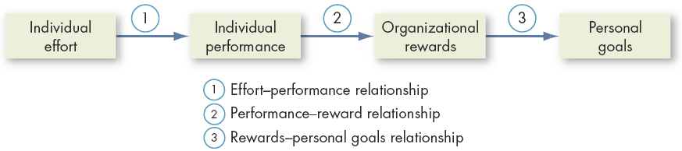
Expectancy Theory
Expectancy Theory (Victor Vroom)
The strength of a tendency to act in a certain way depends on the strength of an expectation that the act will be followed by a given outcome and on the attractiveness of that outcome to the individual.

Slide 52
Expectancy Theory Relationships
Effort–Performance Relationship
  The probability that exerting a given amount of effort will lead to performance.
Performance–Reward Relationship
  The belief that performing at a particular level will lead to the attainment of a desired outcome.
Rewards–Personal Goals Relationship
  The degree to which organizational rewards satisfy an individual’s goals or needs and the attractiveness of potential rewards for the individual.

Slide 53
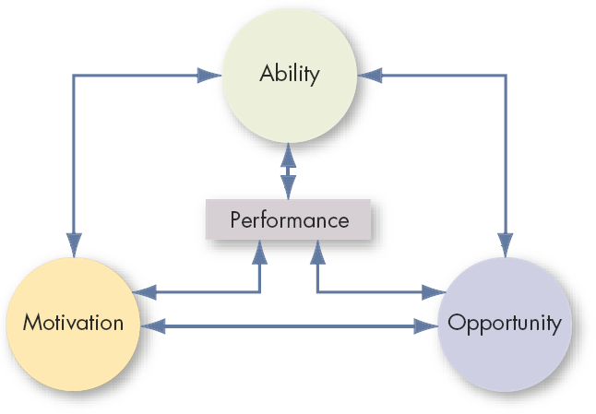
Performance Dimensions
Source: Adapted from M. Blumberg and C.D. Pringle, “The Missing Opportunity in Organizational Research: Some Implications for a Theory of Work Performance,” Academy of Management Review, October 1982, p. 565.

Slide 54
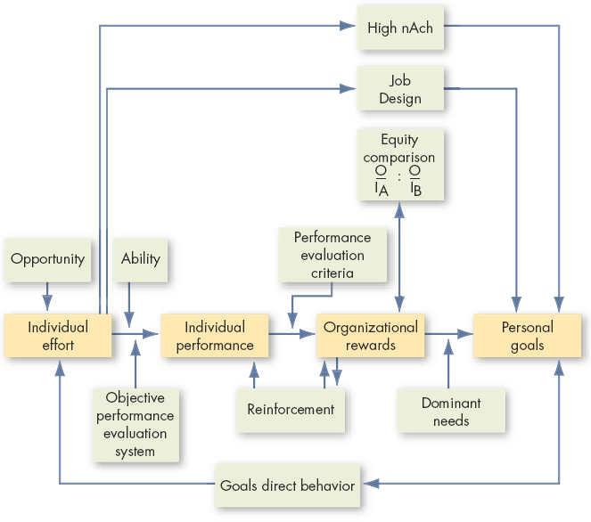
Integrating Contemporary Theories of Motivation

Slide 55


