Slide 1
NON-PARAMETRIC TEST
Shurveer S. Bhanawat
M. Com. (Gold Medal), M. Phil., NET cum JRF, Ph.D.
Professor & Head
Department of Accountancy & Business Statistics
Mohanlal Sukhadia University, Udaipur
(NAAC Accredited ‘A’ Grade State University)

Slide 2
“An approximate answer to the right problem is worth a good deal more than a exact answer to an approximate problem”
John Tukey
Non parametric methods provide approximate solution to an exact problem whereas parametric method provides an exact answer to approximate problem

Slide 3
Parametric Test
Parametric Tests are statistical techniques to test hypothesis
based on some restrictive assumptions about the population.
Population should be normally distributed
Random selection of sample
Interval or Ratio scales data

Slide 4
Use of Non-parametric Tests
The NPTs are useful under the following conditions
Not Normal Distribution
Nominal or ordinal scaled data
Incomplete or partial data
Very small samples

Slide 5
Data Types
Data | Order | Distance | Unique Origin | Remark
Nominal | No | No | No | Classification Number counting only
Ordinal | Yes | No | No | Determination of greater or lesser Rank or order (researcher know the order but not the amount of difference)
Interval (Arbitrary Zero Point) | Yes | Yes | No | Determination of equality of intervals or differences
Ratio (Absolute Zero Point) | Yes | yes | Yes | Determination of equality of ratios.

Slide 6
How to Select a Test
In attempting to choose a particular significance test, the researcher should consider at least three questions:
  Does the test involve one sample, two sample or k samples?
  If two samples or k samples are involved, are the individual cases independent or related?
  Is the measurement scale nominal, ordinal, interval or ratio?
  Others
  What is the sample size?
  Have the data been transformed?

Slide 7
Recommended Statistical Techniques by Measurement Level
 | One sample | Two samples |  | k- samples
Measurement level |  | Related Samples | Independent Samples | Related Samples | Independent Samples
Nominal | Binomial Chi square | McNemar | Chi square | Cochran Q | Chi square for k samples
Ordinal | Kolmogorov-smirnov Run test | Sign test Wilcoxon matched pairs test | Median test Mann-Whitney U test Kolmogorov-smirnov test | Friedman two-way ANOVA | Median estension Kruskal-wallis test one way ANOVA
Interval and Ratio | t test Z test | t test for paired samples | t test Z test | ANOVA | One way & N-way ANOVA

Slide 8
Choice of the test Statistic
Is the population Normal?
No
Is sample size≥ 30
No
Use Non-parametric Test
Yes
Use Z test statistic
Yes
Is population SD known?
No Use t Test
Yes Use Z test

Slide 9
Types of NPT
One Sample Tests
  Chi-square Test
  Run Test for Randomness
  Sign Test
  Kolmogorov- Smirnov Test
Two Sample Tests
  Median Tests
  Mann-Whitney U test-
  Wald -Wolfowitz Run Test
Matched pairs Tests
  Sign Test
  Wilcoxon Matched Pairs Signed Ranks Test
K Sample Tests
  Median Tests
  Kruskal- Wallis Test

Slide 10
One Sample Test
The one sample tests are used where there are single sample based observations. These tests can be used to determine the
solution to the following type of queries:
  Whether the difference between the observed and expected frequencies is significant?
  Whether there is a reasonable basis to believe that the sample has been drawn from a specified population?
  Whether it is reasonable to accept that the given sample is a random sample from a specific population?

Slide 11
Situations
NPT | When to use
Chi-square Test | To Check Independence of data
Run Test | To check randomness of sample
Sign Test | To check equal distribution of values on both sides of mean values ( continuous symmetrical population) only direction
Kolmogorov- Smirnov Test | To check significance between Fo and Fe
Median Tests | To check median between two or more groups are significant
Mann-Whitney U test | Alternate to t test ordinal data
Wilcoxon Matched Pairs Signed Ranks Test | To test direction and magnitude of difference in the results based on responses of two groups of matched pairs
Kruskal- Wallis Test | Applicable to multi samples. It is extended to Mann- Whitney U test

Slide 12
Run Test for Randomness: One Sample

Slide 13
Run Test for Randomness: One Sample
In order that valid conclusion may be drawn on the basis of sample results, the sample should be random or unbiased.
The run test may be used to determine whether the sample is random or not.
Total number of runs in a sample broadly indicates whether a sample is random or not
A run is defined as a sequence of identical symbols or elements, which are followed or preceded by different type of symbols or elements or by no symbols on either side.
For example at departmental store, the sequence of 20 customers was as under
M,M,F,F,F,M,M,F,F,F,M,M,M,M,F,M,M,F,F,M here 9 runs of two types of items M and F are there. M(n1)=11, F(n2)=9

Slide 14
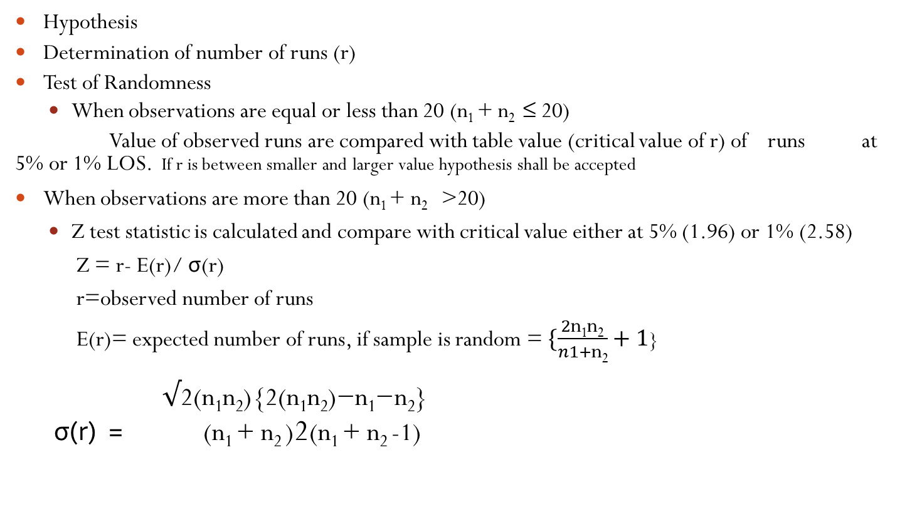
Process
Hypothesis
Determination of number of runs (r)
Test of Randomness
  When observations are equal or less than 20 (n₁ + n₂ ≤ 20)
Value of observed runs are compared with table value (critical value of r) of runs at 5% or 1% LOS. If r is between smaller and larger value hypothesis shall be accepted
When observations are more than 20 (n₁ + n₂ >20)
  Z test statistic is calculated and compare with critical value either at 5% (1.96) or 1% (2.58)
    Z = r- E(r)/ σ(r)
    r=observed number of runs
    E(r)= expected number of runs, if sample is random = $\{\frac{2\text{n}\text{1}\text{n}\text{2}}{n1+\text{n}\text{2}}+1$}
          $√\text{2(}\text{n}\text{1}\text{n}\text{2}\text{)\{2(}\text{n}\text{1}\text{n}\text{2}\text{)−}\text{n}\text{1}\text{−}\text{n}\text{2}\text{\}}$
          σ(r) = (n₁ + n₂ )2(n₁ + n₂ -1)

Slide 15
illustration
A stock broker is interested to know whether the daily movement of a particular share average in a stock market showed a pattern of movement or whether these movements are purely random. For 14 business days, he noted the value of this average and compared it with the value at the close of previous day. He noted the increase as plus(+) and decrease as minus (-). The record was as follows:
+, +, -, -, +, +, +, -, +, +, -, +, -, -
Test whether the distribution of these movements is random or not at α=.05 level of significance.

Slide 16
Solution
Null hypothesis H₀: Movement is random Ha: Movement is not random
There are 8 runs, n₁ =8 plus (number of increase) and n₂ =6 minus (number of decrease) so that of n= n₁ + n₂ =14. The critical value of r =8 for n₁ = 8 and n₂= 6, implies that H₀ is rejected when r ≤ 3 and r ≥12 at α =0.05 level of significance.
Since 3 ≤ r ≥12, therefore H₀ is accepted or it can not be rejected..

Slide 17
illustration
The male and female passengers arriving at a railway booking counter are expected to follow a random sequence. The position in respect of 30 passengers on a day was as given below:
M, M, F, F, F, M, F, F, M, M, F, F, F, F, M, M, M, F, F, M, M, F, M, M, M, F, F, F, M, M
Comment whether the arrival pattern is random.

Slide 18
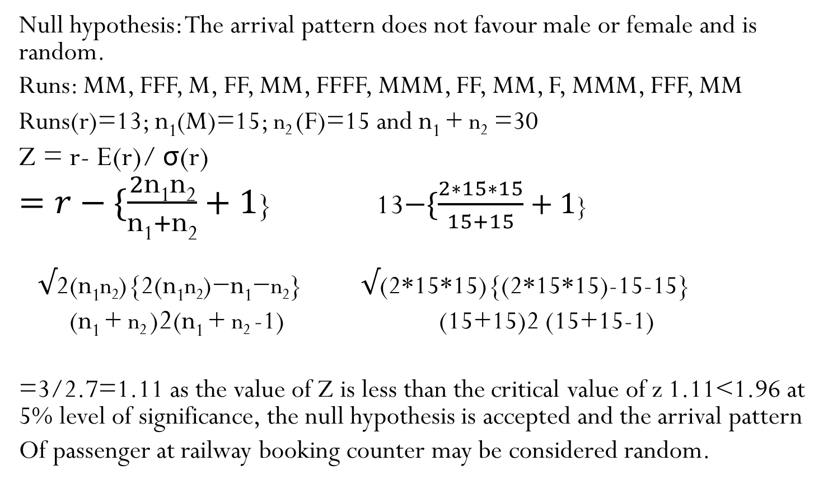
solution
Null hypothesis: The arrival pattern does not favour male or female and is random.
Runs: MM, FFF, M, FF, MM, FFFF, MMM, FF, MM, F, MMM, FFF, MM
Runs(r)=13; n₁(M)=15; n₂ (F)=15 and n₁ + n₂ =30
Z = r- E(r)/ σ(r)
$=r−\{\frac{2\text{n}\text{1}\text{n}\text{2}}{\text{n}\text{1}+\text{n}\text{2}}+1$} 13$−\{\frac{2∗15∗15}{15+15}+1$}
$√\text{2(}\text{n}\text{1}\text{n}\text{2}\text{)\{2(}\text{n}\text{1}\text{n}\text{2}\text{)−}\text{n}\text{1}\text{−}\text{n}\text{2}\text{\}}$ $√$(2*15*15){(2*15*15)-15-15}
(n₁ + n₂ )2(n₁ + n₂ -1) (15+15)2 (15+15-1)
=3/2.7=1.11 as the value of Z is less than the critical value of z 1.11<1.96 at 5% level of significance, the null hypothesis is accepted and the arrival pattern
Of passenger at railway booking counter may be considered random.

Slide 19
Exercise
A political observer looking at the result of previous general elections in Rajasthan noted that the verdict has gone in favour of congress (C) and Non-Congress (NC) parties as under
C,C,C,NC,C,C,NC,NC,C,NC
Can it be concluded from the above that the electorate in the state does not favour any political part? Test at 5% level of significance.
( Hint r =6 , C( n₁)=6 , NC(n₂)=4

Slide 20
Sign Test: One Sample

Slide 21
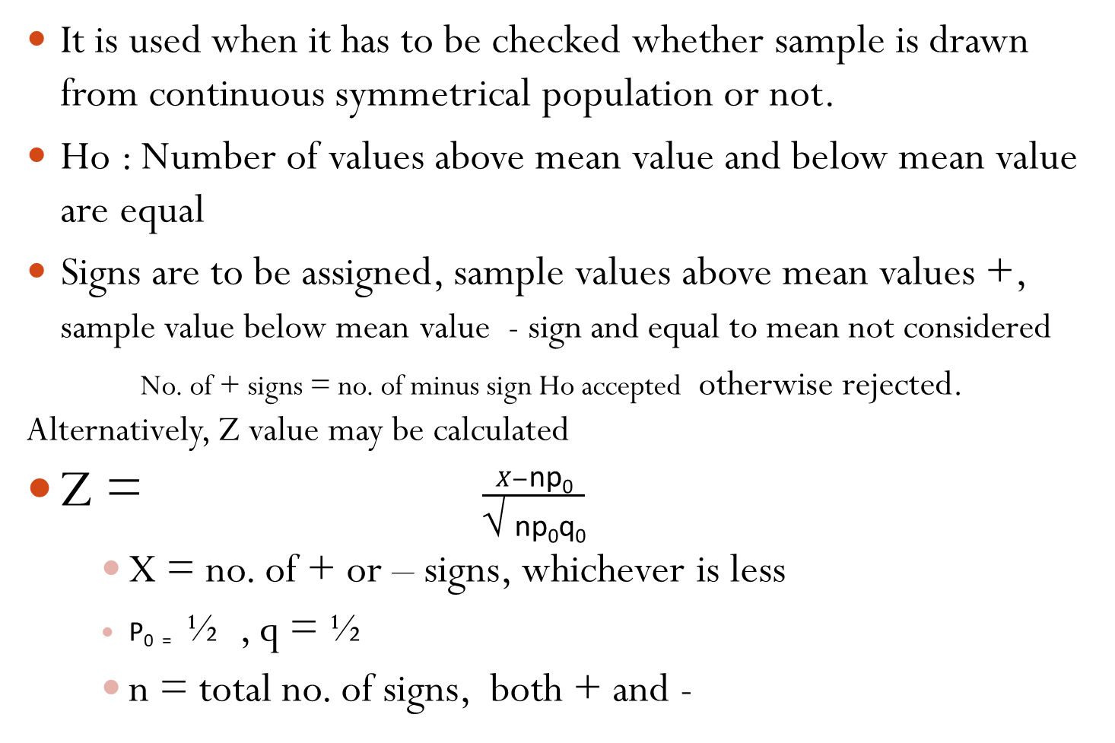
Sign Test: One Sample
It is used when it has to be checked whether sample is drawn from continuous symmetrical population or not.
Ho : Number of values above mean value and below mean value are equal
Signs are to be assigned, sample values above mean values +, sample value below mean value - sign and equal to mean not considered
No. of + signs = no. of minus sign Ho accepted otherwise rejected. Alternatively, Z value may be calculated
Z = $\frac{X−\text{np}\text{0}}{\text{√} \text{np}\text{0}\text{q}\text{0}}$
    X = no. of + or – signs, whichever is less
    P₀ ₌ ½ , q = ½
    n = total no. of signs, both + and -

Slide 22
Decision
The Value of Z so obtained is compared with the critical value(1.96 or 2.58) of Z, if the computed value of Z is equal to or less than the critical value of Z , the null hypothesis is accepted. Otherwise rejected.

Slide 23
Illustration
A group of 15 students selected at random secured 22,20,25,32,18,10,17,42,38,24,15,18,34,37,24 marks out of 50 in an intelligence test. Use sign test to test the hypothesis that intelligence is random function (with mean marks=25 for the group) at 5% level of significance.
Solution
Null Hypothesis: The number of sample values above the mean value and below value is equal
Signs = -, -, 0, +, -, -, -, +, +, -, -, -, +, +, -
Plus sign =5 minus sign =9
hence, n=14, p=1/2, q=1/2, X=5

Slide 24
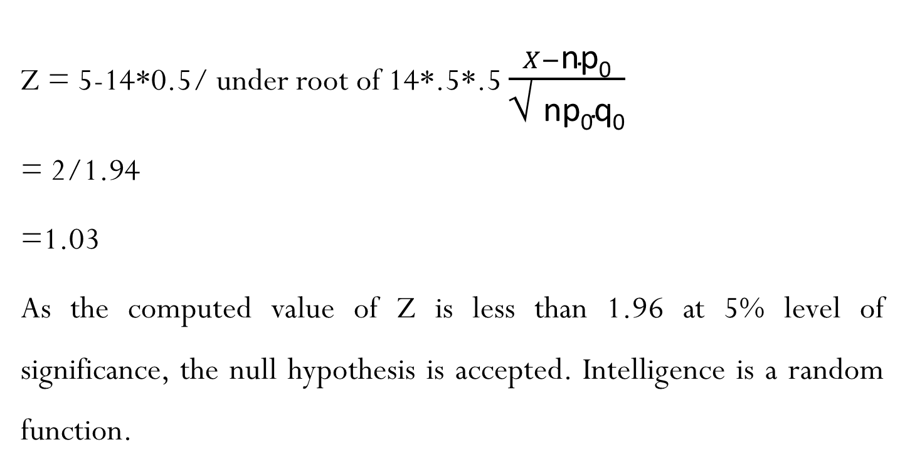
Solution cont. ..
Z = 5-14*0.5/ under root of 14*.5*.5 $\frac{X−\text{np}\text{0}}{\text{√} \text{np}\text{0}\text{q}\text{0}}$
= 2/1.94
=1.03
As the computed value of Z is less than 1.96 at 5% level of significance, the null hypothesis is accepted. Intelligence is a random function.

Slide 25
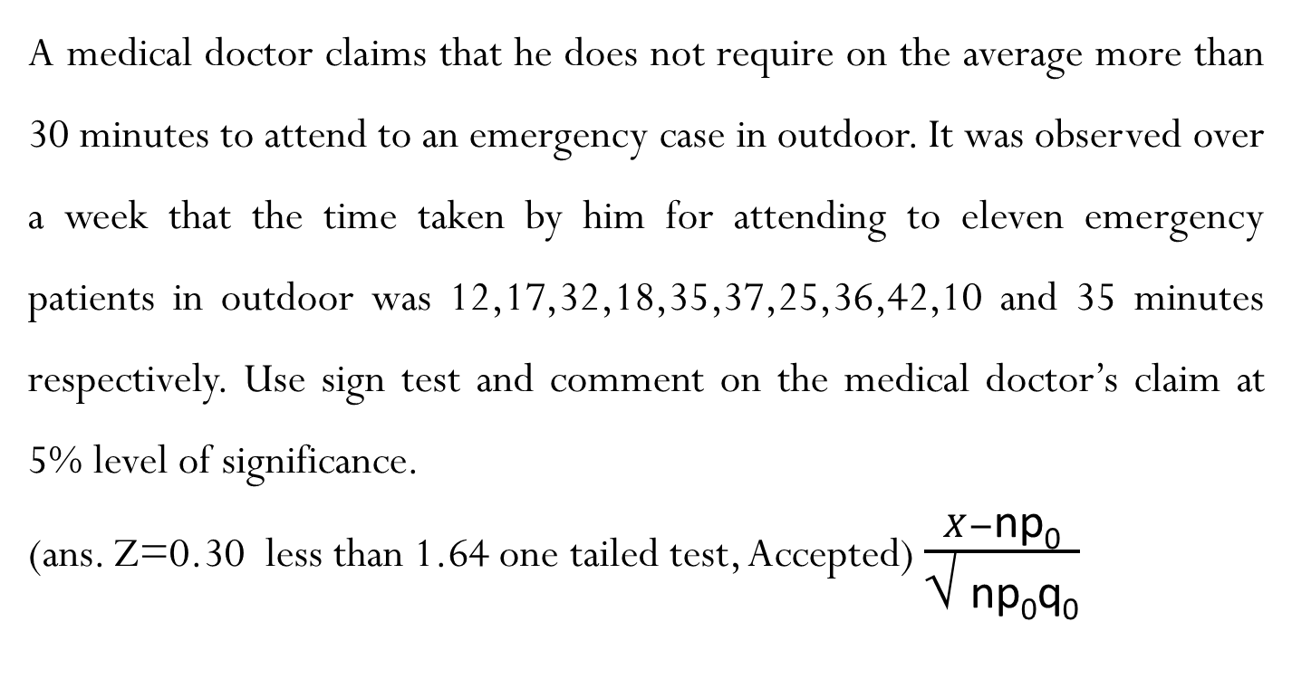
Exercise
A medical doctor claims that he does not require on the average more than 30 minutes to attend to an emergency case in outdoor. It was observed over a week that the time taken by him for attending to eleven emergency patients in outdoor was 12,17,32,18,35,37,25,36,42,10 and 35 minutes respectively. Use sign test and comment on the medical doctor’s claim at 5% level of significance.
(ans. Z=0.30 less than 1.64 one tailed test, Accepted) $\frac{X−\text{np}\text{0}}{\text{√} \text{np}\text{0}\text{q}\text{0}}$

Slide 26
Sign Test : Matched Pairs Test
The non parametric sign test is appropriate for testing the significance of difference between two samples.
Conditions
1. The effect of the treatment can not be measured. It can only be judged as superior or inferior performance
2. The experimental and control groups consists of more than 10 items
3. The same sample may be judged as observation (control) group and post-observation (experimental) group

Slide 27
Steps
Hypothesis
Difference in performance: difference between pre and post is determined. This is expressed in signs. Judged superior +, Judged inferior – and judged not difference 0
The pairs where no difference is indicated are deleted from further consideration.
Computation of Z values
  Z = (S±0.5)- np
  √npq
  In case S <n/2 it would be Plus and where S >n/2 it would be minus
  S = No. of superior items, n= total no. of items considered for test exclude 0 items
  P=0.5

Slide 28
illustration
A market research agency is interested in comparing the consumer rating of two brands of coffee. Twelve subjects, six men and six women, were asked to rate the two brands on five point scale consisting of excellent good ,fair, poor and very poor. These categories were to be assigned 5,4,3,2,1 ranks. The results were as given as follows:
Apply the sign test and comment on the rating of two brands by the subjects.
Subject | 1 | 2 | 3 | 4 | 5 | 6 | 7 | 8 | 9 | 10 | 11 | 12
Brand A | 4 | 4 | 5 | 4 | 3 | 2 | 5 | 3 | 5 | 1 | 3 | 4
Brand B | 3 | 4 | 3 | 2 | 2 | 1 | 5 | 2 | 4 | 3 | 2 | 1

Slide 29
Solution
H: There is no difference between rating of A and B (p=q=0.5)
Note: Discarding the results of two subjects giving similar rating
No. of + sign = 9, No. of minus sign = 1 total sign = 10
Z = (9-0.5)-10*0.5/ under root 10*0.5*0.5 = 2.214
As z is greater than 1.96 rejected
_{Subject} | ₁ | ₂ | ₃ | ₄ | ₅ | ₆ | ₇ | ₈ | ₉ | ₁₀ | ₁₁ | ₁₂
_{Brand A} | ₄ | ₄ | ₅ | ₄ | ₃ | ₂ | ₅ | ₃ | ₅ | ₁ | ₃ | ₄
_{Brand B} | ₃ | ₄ | ₃ | ₂ | ₂ | ₁ | ₅ | ₂ | ₄ | ₃ | ₂ | ₁
Sign A-B | + | 0 | + | + | + | + | 0 | + | + | - | + | +

Slide 30
Mann-Whitney U test

Slide 31
Mann-Whitney U test
Random
Administer different Treatment to both sample
Population
Sample 1
Sample 2

Slide 32
  Mann-Whitney U test
  To test the significance of difference between the results of two samples drawn at random from same population but administered different treatments.
  This test was developed by H.B. Mann and D.R. Whitney
  This test is the substitute for t-test statistic when the stringent assumption of parent population being normally distributed with equal variance are not met when the data are only ordinal in measurement
  Can be applied in both large as well as small samples.

Slide 33
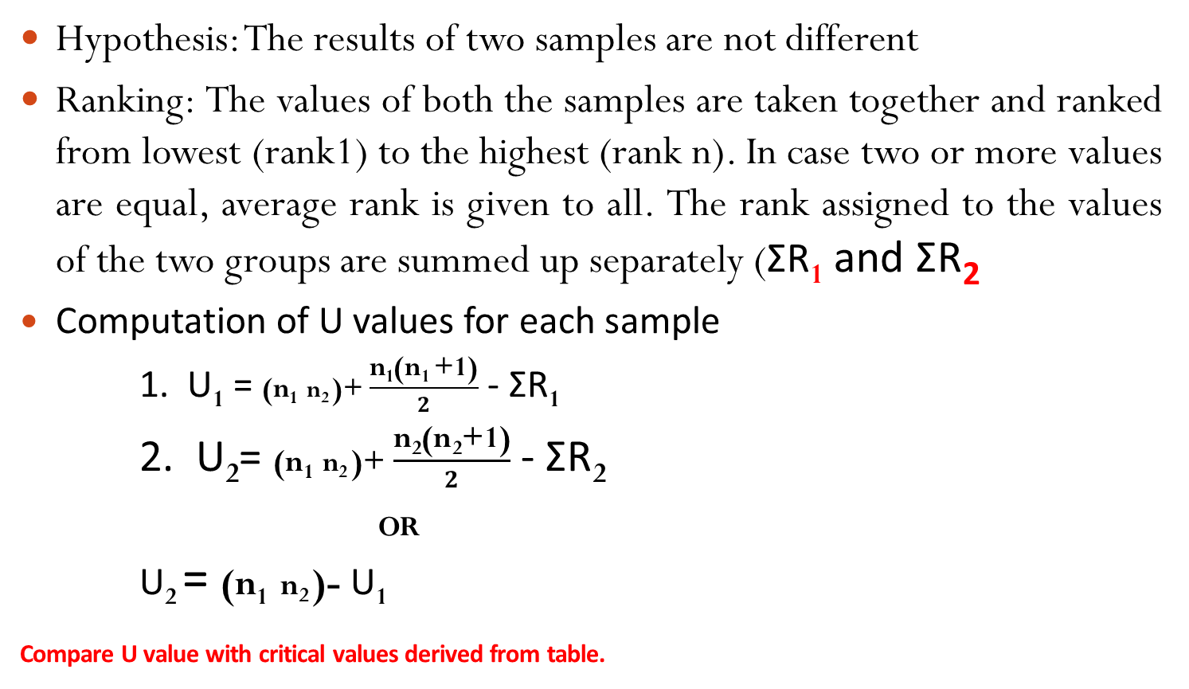
Mann-Whitney U test : Small Sample
(n₁ + n₂ ≤ 20)
Hypothesis: The results of two samples are not different
Ranking: The values of both the samples are taken together and ranked from lowest (rank1) to the highest (rank n). In case two or more values are equal, average rank is given to all. The rank assigned to the values of the two groups are summed up separately (ƩR₁ and ƩR₂
Computation of U values for each sample
1. U₁ = (n₁ n₂ )+ $\frac{\text{n}\text{1}\text{(}\text{n}\text{1 }\text{+1)}}{2}$ - ƩR₁
2. U₂= (n₁ n₂ )+ $\frac{\text{n}\text{2}\text{(}\text{n}\text{2}\text{+1)}}{2}$ - ƩR₂
_{OR}
U₂ = (n₁ n₂ )- U₁
Compare U value with critical values derived from table.

Slide 34
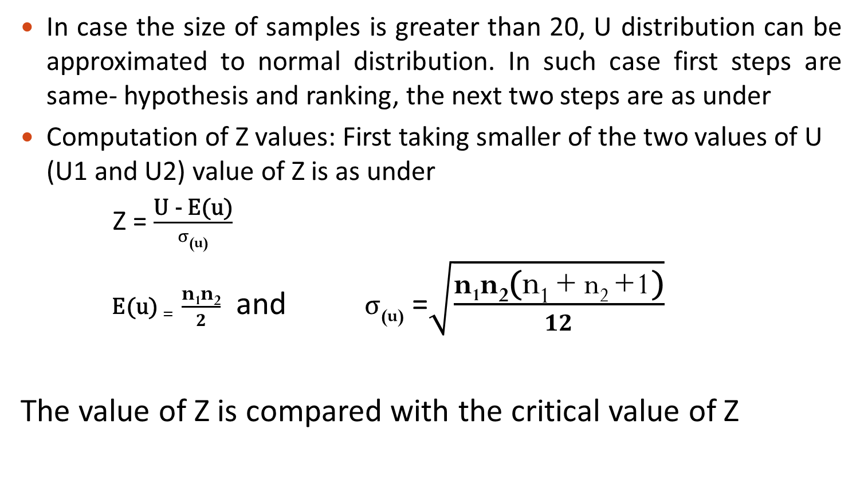
Mann-Whitney U test Large Sample (n >20)
In case the size of samples is greater than 20, U distribution can be approximated to normal distribution. In such case first steps are same- hypothesis and ranking, the next two steps are as under
Computation of Z values: First taking smaller of the two values of U (U1 and U2) value of Z is as under
Z = $\frac{\text{U}\text{ − }\text{E}\text{(}\text{u}\text{)}}{σ\text{(}\text{u}\text{)}}$
$\text{E}\text{(}\text{u}\text{)}$₌ $\frac{\text{n}\text{1}\text{n}\text{2}}{2}$ and $σ$_{(u)} =$\sqrt{\frac{\text{n}\text{1}\text{n}\text{2}\text{(}\text{n}\text{1 }\text{+} \text{n}\text{2 }\text{+}\text{1}\text{)}}{12}}$
The value of Z is compared with the critical value of Z

Slide 35
Illustration
A survey was conducted to test the difference between two alternative method of teaching. A sample of 20 students was selected at random. Two groups of ten students each were formed. Students belonging to each group were taught by two alternative methods during the session. A standardised test was then given to both the groups. The marks secured by the students at the test out of 100 maximum were as given below:
1 2 3 4 5 6 7 8 9 10
Group A40 45 48 46 52 58 72 85 67 73
Group B42 68 45 64 85 78 87 62 84 90
Test the significance of the difference between the performance of two groups by two alternative methods.

Slide 36
Solution
Hypothesis = The difference between the performance of the two groups is not significant
Group A | Ranks | Group B | Ranks
40 45 48 46 52 58 72 85 67 73 | 1 3.5 6 5 7 8 13 16.5 11 14 | 42 68 45 64 85 78 87 62 84 90 | 2 12 3.5 10 16.5 15 19 09 18 20
n₁=10 | ƩR₁=85 | n₂=10 | ƩR₂125

Slide 37
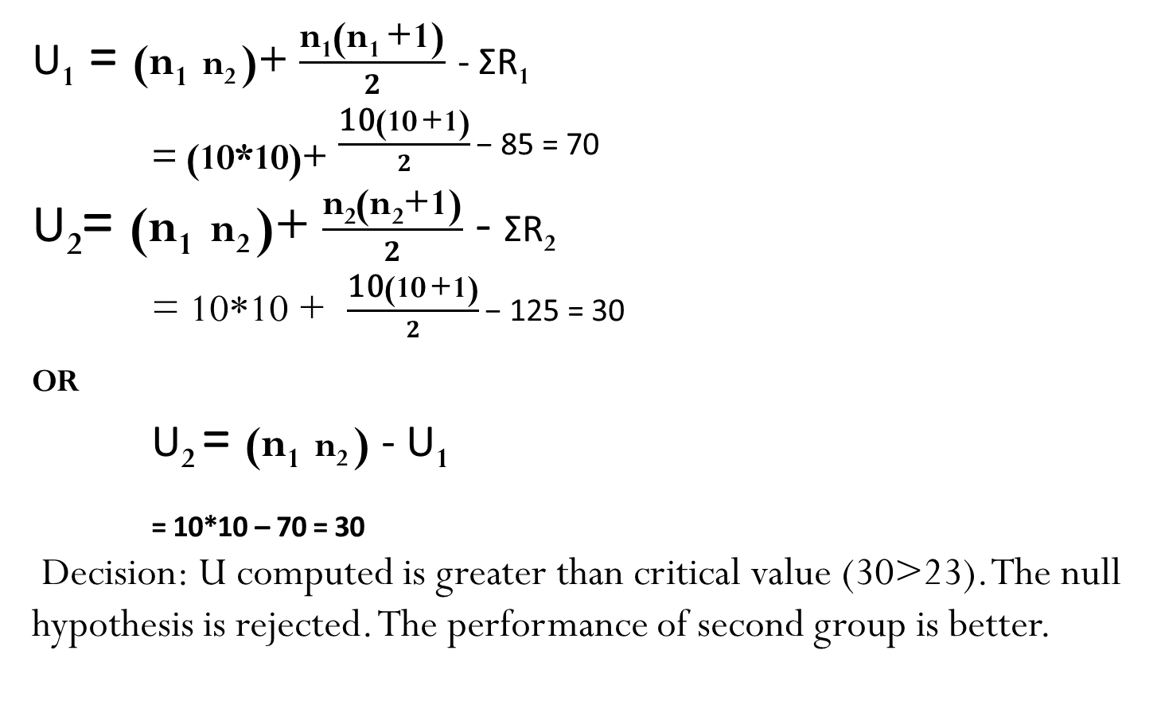
Solution
U₁ = (n₁ n₂ )+ $\frac{\text{n}\text{1}\text{(}\text{n}\text{1 }\text{+1)}}{2}$ - ƩR₁
_{= (10*10)+} $\frac{\text{10}\text{(}\text{10} \text{+1)}}{2}\text{− }\text{85 = 70}$
U₂= (n₁ n₂ )+ $\frac{\text{n}\text{2}\text{(}\text{n}\text{2}\text{+1)}}{2}$ - ƩR₂
= 10*10 + $\frac{\text{10}\text{(}\text{10} \text{+1)}}{2}\text{− }\text{125 = 30}$
_{OR}
U₂ = (n₁ n₂ ) - U₁
_{= 10*10 – 70 = 30}
Decision: U computed is greater than critical value (30>23). The null hypothesis is rejected. The performance of second group is better.

Slide 38
Illustration
A survey was conducted to test the effectiveness of two alternative incentive systems for sales executives in a company. The executive of one group were provided one type of incentive and that of other group were provided the other type of incentives. At the end of the year performance was checked by sample investigation. Additional sale generated (₹1 lakh) by the executive belonging to the two groups during 15 months was given below:
Month 1 2 3 4 5 6 7 8 9 10 11 12 13 14 15
Addl sales Gr. A 4 5 8 7 3 9 8 4 12 9 13 15 17 3 20
Addl sales Gr. A 9 10 12 18 24 17 16 8 7 5 11 14 20 21 25
Test the significance of the difference in performance of sales executive working under two incentive system.

Slide 39
Solution
Hypothesis = The difference between the performance of the sales under two incentive system is not significant
Month | Group A | Ranks | Group B | Ranks
1 2 3 4 5 6 7 8 9 10 11 12 13 14 15 | 4 5 8 7 3 9 8 4 12 9 13 15 17 3 20 | 3.5 5.5 10 7.5 1.5 13 10 3.5 17.5 13 19 21 23.5 1.5 26.5 | 9 10 12 18 24 17 16 8 7 5 11 14 20 21 25 | 13 15 17.5 25 29 23.5 22 10 7.5 5.5 16 20 26.5 28 30
 | n₁=10 | ƩR₁=176.5 | n₂=15 | ƩR₂=288.5

Slide 40
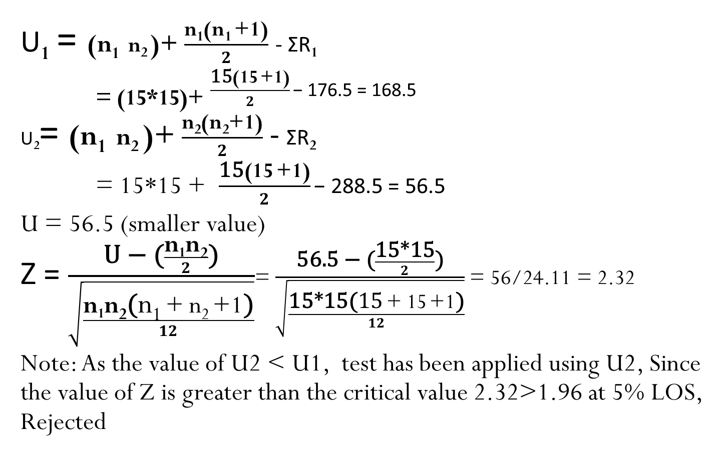
Solution
U₁ = (n₁ n₂ )+ $\frac{\text{n}\text{1}\text{(}\text{n}\text{1 }\text{+1)}}{2}$ - ƩR₁
_{= (15*15)+} $\frac{\text{15}\text{(}\text{15} \text{+1)}}{2}\text{− }\text{176.5 = 168.5}$
U₂= (n₁ n₂ )+ $\frac{\text{n}\text{2}\text{(}\text{n}\text{2}\text{+1)}}{2}$ - ƩR₂
= 15*15 + $\frac{\text{15}\text{(}\text{15} \text{+1)}}{2}\text{− }\text{288.5 = 56.5}$
U = 56.5 (smaller value)
Z = $\frac{\text{U}\text{ − (}\frac{\text{n}\text{1}\text{n}\text{2}}{2}\text{)}}{\sqrt{\frac{\text{n}\text{1}\text{n}\text{2}\text{(}\text{n}\text{1 }\text{+} \text{n}\text{2 }\text{+}\text{1}\text{)}}{12}}}$= $\frac{\text{56.5}\text{ − (}\frac{\text{15∗15}}{2}\text{)}}{\sqrt{\frac{\text{15∗15}\text{(}\text{15} \text{+} \text{15} \text{+1}\text{)}}{12}}}$ = 56/24.11 = 2.32
Note: As the value of U2 < U1, test has been applied using U2, Since the value of Z is greater than the critical value 2.32>1.96 at 5% LOS, Rejected
Notes:
+

Slide 41
Kolmogorov-Smirnov Test

Slide 42
Kolmogorov-Smirnov Test
For testing the relationship between an empirical distribution and some theoretical distribution or between two empirical distributions, goodness of fit tests are employed. Kolmogorov-Smirnov test is one such test.
It can be applied to test the relationship/ correspondence between a theoretical and a sample (empirical) frequency distribution (for one sample Test) or between two sample distribution (two sample test)

Slide 43
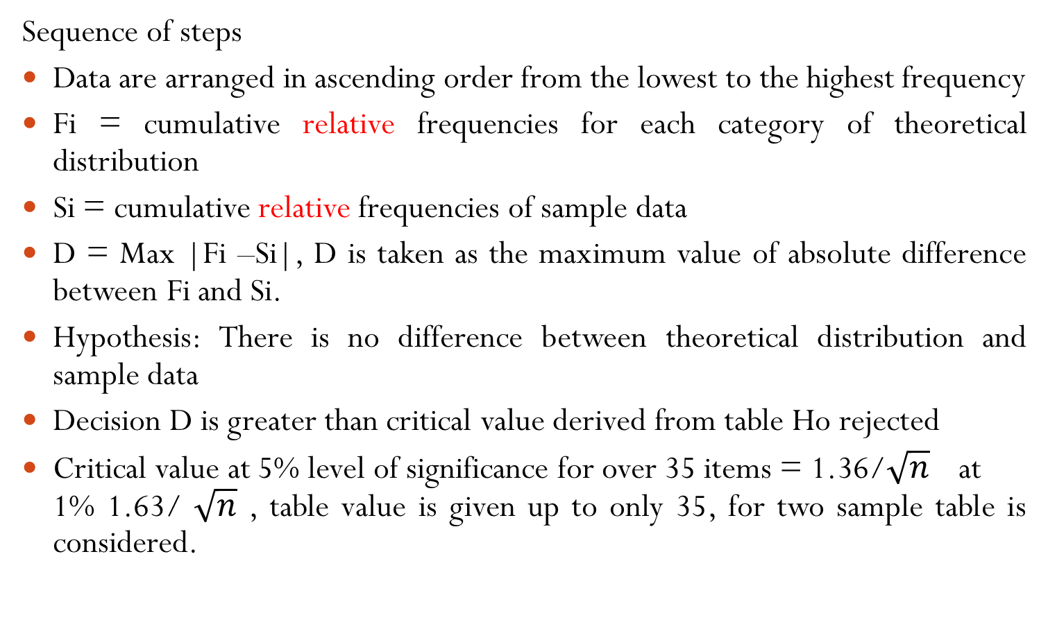
Kolmogorov-Smirnov Test: one sample test
Sequence of steps
Data are arranged in ascending order from the lowest to the highest frequency
Fi = cumulative relative frequencies for each category of theoretical distribution
Si = cumulative relative frequencies of sample data
D = Max |Fi –Si|, D is taken as the maximum value of absolute difference between Fi and Si.
Hypothesis: There is no difference between theoretical distribution and sample data
Decision D is greater than critical value derived from table Ho rejected
Critical value at 5% level of significance for over 35 items = 1.36/$\sqrt{n}$ at 1% 1.63/ $\sqrt{n}$ , table value is given up to only 35, for two sample table is considered.

Slide 44
Illustration
The mistakes committed by a typist in typing manuscript follow poisson distribution. The mistakes observed in a script running over 325 pages typed by the typist were as follows
Mistake per page 0 1 2 3 4 total
Number of pages 211 90 19 5 0 325
Test the hypothesis that the observed frequencies have a close fit to theoretical frequencies under poisson distribution. Use Kolmogorov-Smirnov test.

Slide 45
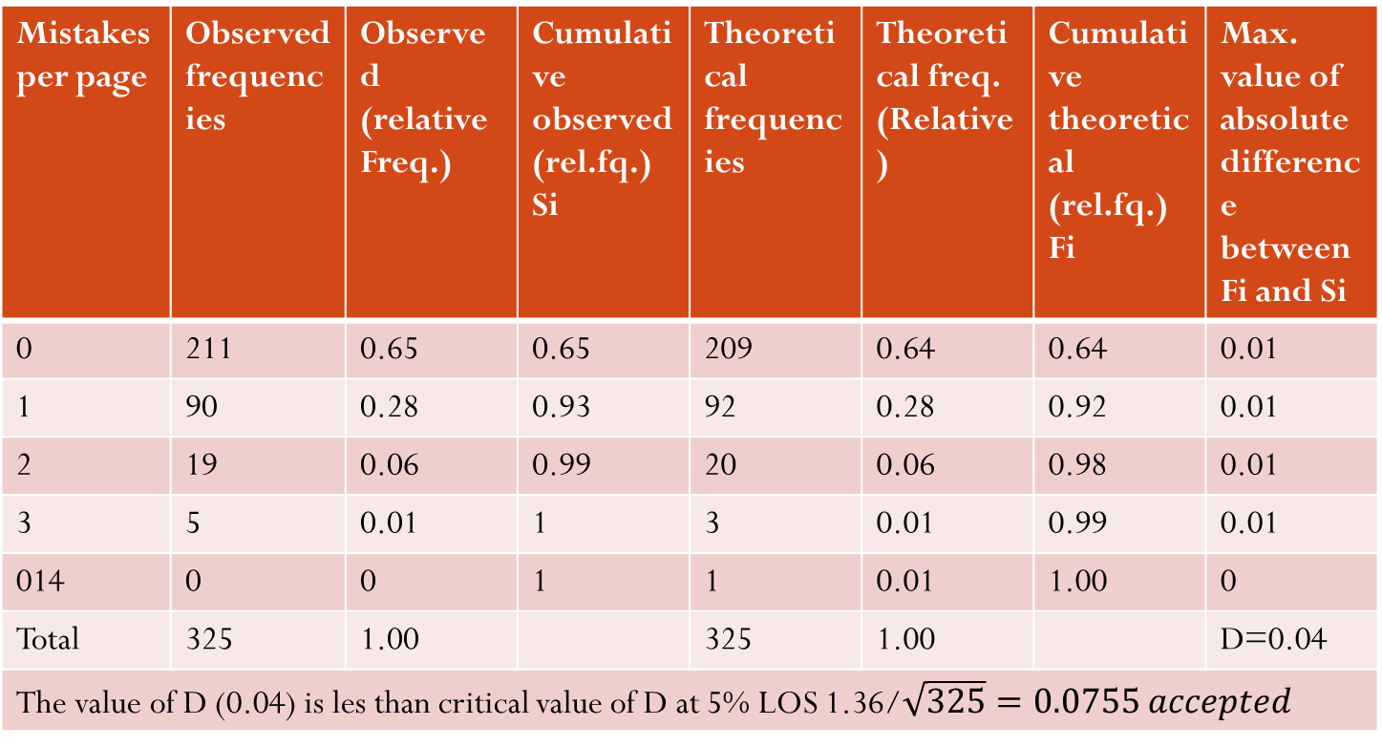
Solution
Mistakes per page | Observed frequencies | Observed (relative Freq.) | Cumulative observed (rel.fq.) Si | Theoretical frequencies | Theoretical freq. (Relative) | Cumulative theoretical (rel.fq.) Fi | Max. value of absolute difference between Fi and Si
0 | 211 | 0.65 | 0.65 | 209 | 0.64 | 0.64 | 0.01
1 | 90 | 0.28 | 0.93 | 92 | 0.28 | 0.92 | 0.01
2 | 19 | 0.06 | 0.99 | 20 | 0.06 | 0.98 | 0.01
3 | 5 | 0.01 | 1 | 3 | 0.01 | 0.99 | 0.01
014 | 0 | 0 | 1 | 1 | 0.01 | 1.00 | 0
Total | 325 | 1.00 |  | 325 | 1.00 |  | D=0.04
The value of D (0.04) is les than critical value of D at 5% LOS 1.36/$\sqrt{325}=0.0755 accepted$

Slide 46
Exercise
A manufacturer is to develop a colour shade for his product, which may be liked by his customers. He has a choice of four shades Black, Red, Yellow and Green. A group of 160 prospective customers when asked gave the following preference: 30 liked black, 45 liked red, 60 liked yellow and remaining 25 liked green shade. Comment whether the customer have indicated preference for any particular shade. Use Kolmogorov-Simirnov test.

Slide 47
Median Test

Slide 48
Median Test
The median test is used to determine the significance of difference between medians of two or three independent groups.
The object is to find out whether the median of different samples drawn randomly are similar or can be taken as drawn from the same population.
The median test can be applied using Chi square test for two variables each having two sub-groups.

Slide 49
Median Test
Process
Hypothesis: The difference between scores of two groups is not significant
Combined median: Median of the combined distribution is computed and number of items at or above the median and below the median for each group is calculated separately.
Calculate chi square value
Test of Significance: Compare chi square calculated value with table value at one degree of freedom.
 | At or above the Median | Below the median
First Group
Second Group

Slide 50
Illustration
A study conducted to determine the effect of declaration of bonus on price of a share. Two groups of ten share brokers were selected at random: one consisting of those who had done dealing in the share and the other of those who had not done dealing in the shares. The brokers were required to give the rating of ten variables on a five points scale. The sum of responses (scores) of two groups are given in the table below:
Variable 1 2 3 4 5 6 7 8 9 10
Group I 43 41 31 31 27 26 25 25 24 23
Group 2 40 38 28 19 18 18 17 16 15 15
Apply the median Test and state whether the difference between the scores of the two groups is significant or not

Slide 51
Solution
Hypothesis: The difference between scores of two groups is not significant.
The combined median of two groups
M = The value of (n+1/2) th items
= The value of (20+1/2)th item i.e. 25
Chi Square Value = 3.243
Table value at 1 d.f. at 5% LOS = 3.841
Hypothesis accepted
 | At or above the Median | Below the median
First Group | 8 (A) | 2 (B)
Second Group | 3 (C ) | 7( D)

Slide 52

Calculation of chi square value
$\frac{n\left\{\left(AD−BC\right)−\frac{N}{2}\right\}SQUARE}{(A+B)(C+D)(A+C)(B+D)}$
$\frac{20\left\{\left(8∗7−2∗3\right)−\frac{20}{2}\right\}SQUARE}{10∗10∗11∗9}$
32000/9900
3.243

Slide 53
Kruskal- Wallis Test

Slide 54
Kruskal- Wallis Test: One Way ANOVA on ranks
This test is the non parametric alternative to the one way analysis of variance to identify difference among population that does not require any assumption about the shape of the population distribution. This test use the ranks of the observations rather than the data themselves with the assumption that the observations are on an interval scale.
This test is used for comparing K different population having identical distribution.
It is sometimes called the one-way ANOVA on ranks, as the ranks of the data values are used in the test rather than the actual data points.

Slide 55
Kruskal- Wallis Test
It extends the Mann–Whitney U test, which is used for comparing only two groups. The parametric equivalent of the Kruskal–Wallis test is the one-way analysis of variance (ANOVA).

Slide 56
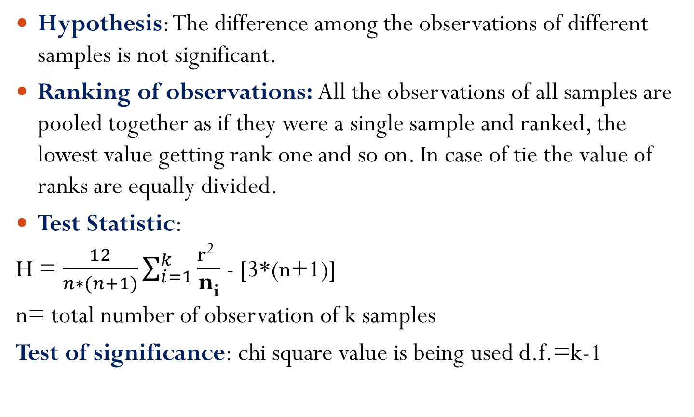
Process
Hypothesis: The difference among the observations of different samples is not significant.
Ranking of observations: All the observations of all samples are pooled together as if they were a single sample and ranked, the lowest value getting rank one and so on. In case of tie the value of ranks are equally divided.
Test Statistic:
H = $\frac{12}{n∗(n+1)}\sum_{i=1}^{k}{\frac{\text{r}\text{2} }{\text{n}\text{i}}}$ - [3*(n+1)]
n= total number of observation of k samples
Test of significance: chi square value is being used d.f.=k-1

Slide 57
Illustration
The percentage of marks secured by students offering three different specialisation groups at MBA final examination were as under:
Using the Kruskal-Wallis test at 5% level of significance comment whether the performance in the three specialisation group is significant.
Finance | 60 | 63 | 65 | 71 | 59 | 68 | 73
Marketing | 50 | 56 | 61 | 66 | 70 | 72
HRM | 51 | 52 | 55 | 58 | 62

Slide 58
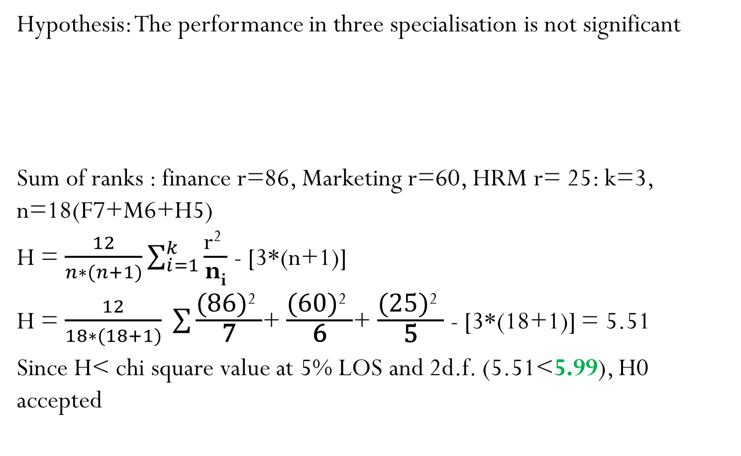
Solution
Hypothesis: The performance in three specialisation is not significant
Sum of ranks : finance r=86, Marketing r=60, HRM r= 25: k=3, n=18(F7+M6+H5)
H = $\frac{12}{n∗(n+1)}\sum_{i=1}^{k}{\frac{\text{r}\text{2} }{\text{n}\text{i}}}$ - [3*(n+1)]
H = $\frac{12}{18∗(18+1)} \sum{\frac{\text{(86)}\text{2} }{\text{7}}}$+ $\frac{\text{(}\text{60}\text{)}\text{2} }{\text{6}}$+ $\frac{\text{(}\text{25}\text{)}\text{2} }{\text{5}}$ - [3*(18+1)] = 5.51
Since H< chi square value at 5% LOS and 2d.f. (5.51<5.99), H0 accepted
Marks | 50 | 51 | 52 | 55 | 56 | 58 | 59 | 60 | 61 | 62 | 63 | 65 | 66 | 68 | 70 | 71 | 72 | 73
Rank | 1 | 2 | 3 | 4 | 5 | 6 | 7 | 8 | 9 | 10 | 11 | 12 | 13 | 14 | 15 | 16 | 17 | 18
Grade | M | H | H | H | M | H | F | F | M | H | F | F | M | F | M | F | M | F

Slide 59
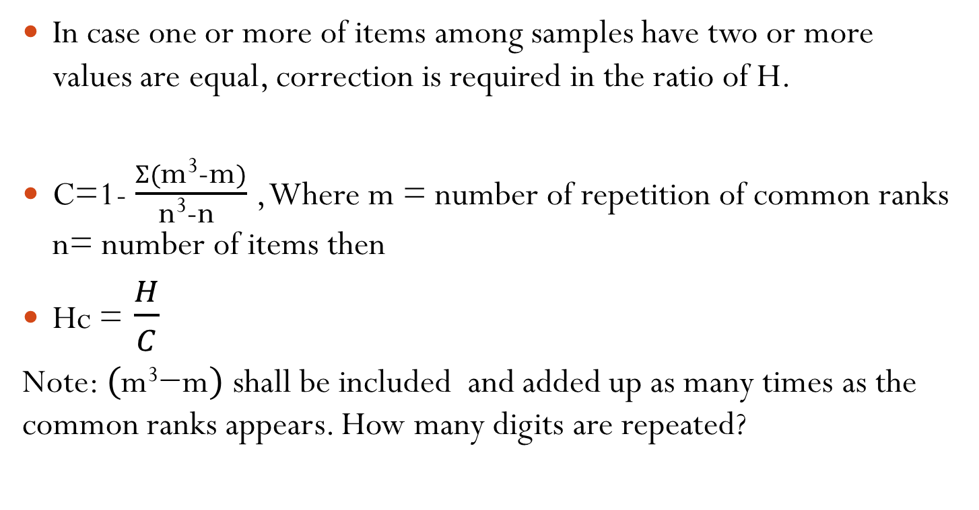
Correction for common ranks
In case one or more of items among samples have two or more values are equal, correction is required in the ratio of H.
C=1- $\frac{Ʃ(\text{m}\text{3}\text{−}\text{m})}{\text{n}\text{3}\text{−}\text{n} }$ , Where m = number of repetition of common ranks n= number of items then
Hc = $\frac{H}{C}$
Note: $(\text{m}\text{3}\text{−}\text{m})$ shall be included and added up as many times as the common ranks appears. How many digits are repeated?

Slide 60
Illustration
The position of sales revenue in lakhs ₹ of a company during different months of 2020 in four zones was as under:
Use Kruskal-Wallis test to test the null hypothesis that sales revenue over different months in 2020 has not differed from zone to zone, at 5% level of significance.
Months | 1 | 2 | 3 | 4 | 5 | 6 | 7 | 8 | 9 | 10 | 11 | 12
Zone A | 21 | 4 | 6 | 5 | 9 | 7 | 6 | 19 | 20 | 5 | 4 | 7
Zone B | 7 | 6 | 25 | 28 | 9 | 7 | 7 | 28 | 6 | 24 | 30 | 22
Zone C | 5 | 9 | 8 | 27 | 23 | 6 | 8 | 14 | 9 | 10 | 11 | 29
Zone D | 1 | 31 | 12 | 15 | 16 | 9 | 7 | 26 | 4 | 8 | 17 | 18

Slide 61
Solution
Months | Zone A |  | Zone B |  | Zone C |  | Zone D
 | Sales | Rank | Sales | Rank | Sales | Rank | Sales | rank
1 | 4 | 46 | 6 | 39 | 5 | 43 | 1 | 48
2 | 4 | 46 | 6 | 39 | 6 | 39 | 4 | 46
3 | 5 | 43 | 7 | 33.5 | 8 | 29 | 7 | 33.5
4 | 5 | 43 | 7 | 33.5 | 8 | 29 | 8 | 29
5 | 6 | 39 | 7 | 33.5 | 9 | 25 | 9 | 25
6 | 6 | 39 | 9 | 25 | 9 | 25 | 12 | 20
7 | 7 | 33.5 | 22 | 11 | 10 | 22 | 15 | 18
8 | 7 | 33.5 | 24 | 9 | 11 | 21 | 16 | 17
9 | 9 | 25 | 25 | 8 | 14 | 19 | 17 | 16
10 | 19 | 14 | 28 | 4.5 | 23 | 10 | 18 | 15
11 | 20 | 13 | 28 | 4.5 | 27 | 6 | 26 | 7
12 | 21 | 12 | 30 | 2 | 29 | 3 | 31 | 1
Total |  | 387 |  | 242.5 |  | 271 |  | 275.5

Slide 62
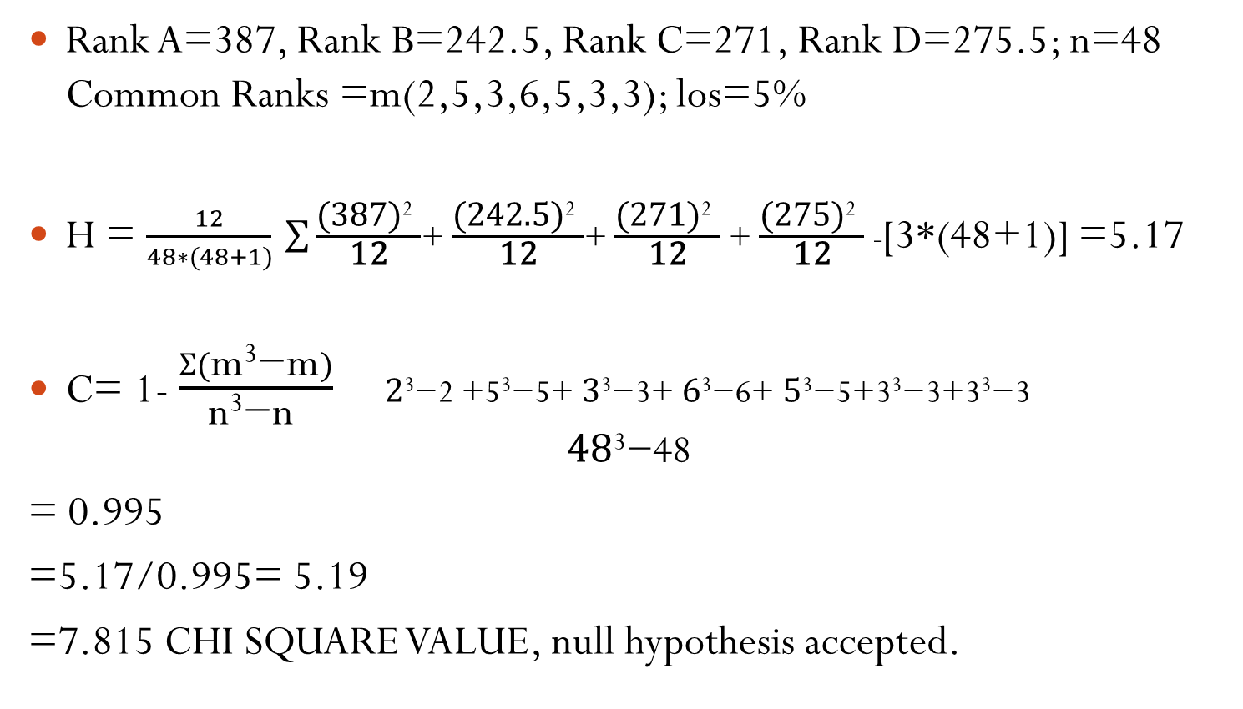
Solution
Rank A=387, Rank B=242.5, Rank C=271, Rank D=275.5; n=48 Common Ranks =m(2,5,3,6,5,3,3); los=5%
H = $\frac{12}{48∗(48+1)} \sum{\frac{\text{(387)}\text{2} }{\text{12}}}$+ $\frac{\text{(}\text{242.5}\text{)}\text{2} }{\text{12}}$+ $\frac{\text{(}\text{271}\text{)}\text{2} }{\text{12}}$ + $\frac{\text{(27}\text{5}\text{)}\text{2} }{\text{12}}$ -[3*(48+1)] =5.17
C= 1- $\frac{Ʃ(\text{m}\text{3}\text{−}\text{m})}{\text{n}\text{3}\text{−}\text{n} }$ $\text{2}\text{3}\text{−}\text{2 +5}\text{3}\text{−}\text{5}$+ $\text{3}\text{3}\text{−}\text{3}$+ $\text{6}\text{3}\text{−}\text{6}$+ $\text{5}\text{3}\text{−}\text{5+3}\text{3}\text{−}\text{3+3}\text{3}\text{−}\text{3}$
$$\text{4}\text{8}\text{3}\text{−}\text{48}$$
= 0.995
=5.17/0.995= 5.19
=7.815 CHI SQUARE VALUE, null hypothesis accepted.

Slide 63
Suggested Readings
Business Research Methods by Donald R Cooper Pamela S Schindler -Irwin Mcgraw-Hill
Business Research Method by K.R. Sharma, National Publishing House Jaipur
Statistics- Theory Methods and Applications By D.C. Sanceti, V.K.Kapoor
Business Statistics using Excel by Glyn Davis & Branko Pecar - Oxford University Press
Business Statistics by J K Sharma, Pearson Education

Slide 64
Advantages
Very simple, easy to understand and easy to apply
No assumption
No parametric test can be applied to data which are mere classification (nominal), NPT exist to deal with such data
NPT cant be applied even where scores are given in non numerical form or grade
Limitation
NPTs give less precise indications, as the data are based on counting and ranking rather than on measurement of the results

Slide 65
THANKS

