Slide 1
Faculty of management studies
ECOM III SEM
Managing E-channel
Unit - 3
Topic – Digital marketing strategy
By:- Mrs. Tanuja

Slide 2
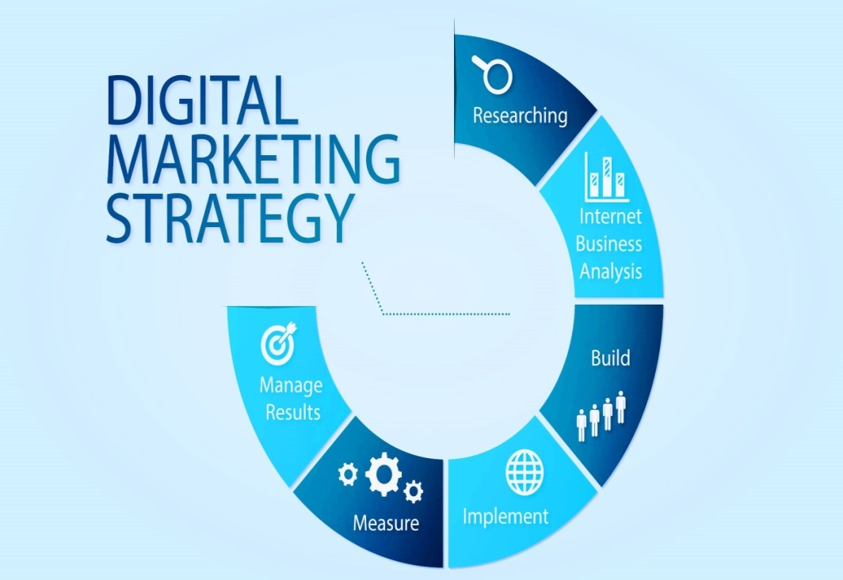
What is digital marketing -
Digital marketing is the marketing of products or services using digital technologies via the internet, social media, mobile phones, or any other digital medium.
It is also an umbrella term that encompasses different marketing strategies such as Social Media Marketing, Search Engine Optimization, and Email Marketing
Digital marketing strategy -
A digital marketing strategy describes a series of actions that use online marketing channels to achieve various goals. Channels can include owned, paid, and earned media. A digital marketing action plan allows you to build and launch your online marketing strategy with success.

Slide 3
Different types of digital marketing strategy -
1. Social Media Marketing Strategy:
In these days, social media is considered as a powerful marketing tool. The companies can easily able to achieve their monthly target with the help of social media for marketing. You have to post the right content about your products or services on social media for reaching the right audience.
2. Email Marketing Strategy:
In the marketing world, emails are an effective way that will deliver a higher Return on Investment (ROI) to businesses. In today’s digital world, the email is four times higher than the other marketing strategies. Those strategies include social media, paid search, and direct marketing.

Slide 4
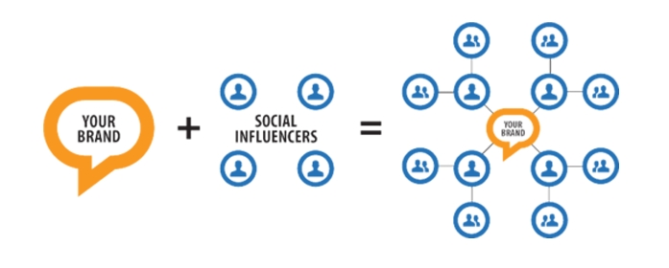
3. Influencer Marketing:
Influencer marketing plays an important role in today’s marketing trend. The influence of marketing mainly concentrates on attracting people to buy a service or products. In simple words – Influencer marketing act as the face of your services.
4. Pay Per Click Performance Strategy:
A search engine advertising method can be used in the pay per click marketing (PPC) to bring a lot of visitors to your website. Pay per Click is considered as the powerful marketing tool, for engendering the sales-ready leads. PPC just needs money for making your time and work at the top position of the search engine results. It can effectively create the bids and ads for generating a favorable Return on Investment (ROI).

Slide 5
5. Mobile marketing -
Mobile marketing is the art of marketing your business to appeal to mobile device users. something that spans across all forms of digital marketing. Businesses all over the world are shifting more of their advertising budget into mobile because consumers spend more time on their mobile devices more than any other device.
6. Radio marketing -
Whilst radio used to be solely based on radio waves, it’s now all digital. Which means, radio advertising now falls into the field of digital marketing. Radio ads are a great way to get your business or brand heard, and it’s never been easier to do with digital advertising.
7. Television marketing -
Radio isn’t the only thing to move over to digital. There are loads of options for those that want to advertise on television without paying expensive ad slot costs on prime time TV. While Television Advertising remains as a major component of the overall marketing mix, it is essential to adapt your strategy based on your audience’s demographic and where they consume video content.

Slide 6
8. Content Marketing Strategy:
The content on your website should be engaging and interesting. Content marketing uses creative and original content for the purpose of generating brand awareness, traffic growth, lead generation and targeting customers.
9. Search Engine Optimization Strategy:
SEO can help to drive traffic to your website. SEO is defined as the process of optimizing your website to ‘rank’ higher in search engine results pages, therefore increasing the amount of organic (or free) traffic that your website receives.
10. Retargeting / Remarketing Ads Strategy:
The Retargeting is nothing but marketing, which is used to display the relevant ads for those who have visited the website early or interacted with the posts on social.

Slide 7
11. Affiliate Marketing Strategy:
In general, affiliate marketing can be treated as a sibling of influencer marketing. It also concentrates on bringing the customers to buy the products or services. Affiliate marketing is considered as a great way to earn more profit. It is the process of earning a commission by promoting other people’s (or company’s) products.
12. Viral Marketing Strategy:
Viral marketing or viral advertising is a business strategy that uses existing social networks to promote a product. Its name refers to how consumers spread information about a product with other people, much in the same way that a virus spreads from one person to another.

Slide 8
How to create digital marketing strategy -
Define the brand
Developing customer personas
Defining S. M. A. R. T (Specific, Measurable, Achievable, Relevant, Time-bound goals)
Identify target markets
Performing competitive analysis
Managing and allocating resources appropriately to achieve objectives
Reviewing and optimising campaign performance

Slide 9
Benefits of digital marketing strategy -
1. Increasing website traffic
2. Driving storefront traffic
3. Boosting brand awareness
4. Raising revenue and conversions

