Slide 1




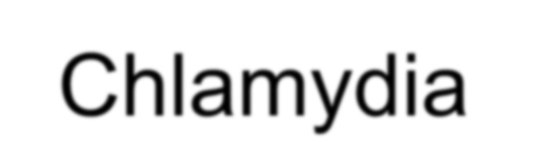




Spirochetes

Slide 2
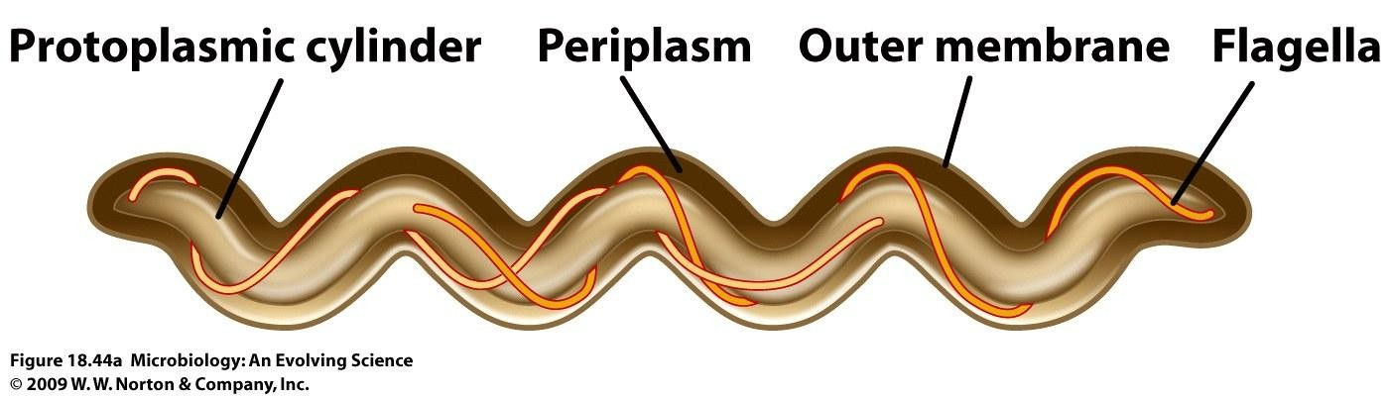
Spirochetes

Slide 3
Taxonomy
Order: Spirochaetales
Family: Spirochaetaceae
Genus: Treponema
Borrelia
Family: Leptospiraceae
Genus: Leptospira

Slide 4
Spirochetes
Gram negative Long, thin, helical
- spirochete from Greek for “coiled hair”
Periplasmic flagella (axial fibrils or endoflagella), -mobile
-differering numbers of endoflagella according to genus & species
Outer sheath encloses axial fibrils wrapped around
protoplasmic cylinder
A helical protplasmic cylinder with a peptidoglycan layer similar to G⁻ B,
outer membrane, cytoplasmic membrane, and cytoplasm
axial filaments
locomotion
between peptidoglycan layer/outer membran

Slide 5
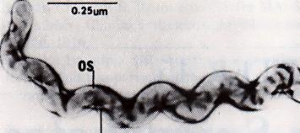
Tightly Coiled Spirochete
OS = outer sheath AF = axial fibrils
Leptospira interrogans
AF

Slide 6
*Spirochaetales Associated Human
Diseases
Genus | Species | Disease
Treponema (3 subspecies) | pallidum ssp. pallidum pallidum ssp. endemicum pallidum ssp. pertenue T. carateum | Syphilis Bejel Yaws, framboisie Pinta
Borrelia | burgdorferi recurrentis Many species | Lyme disease (borreliosis) Epidemic relapsing fever Endemic relapsing fever
Leptospira | interrogans | Leptospirosis (Weil’s Disease)

Slide 7
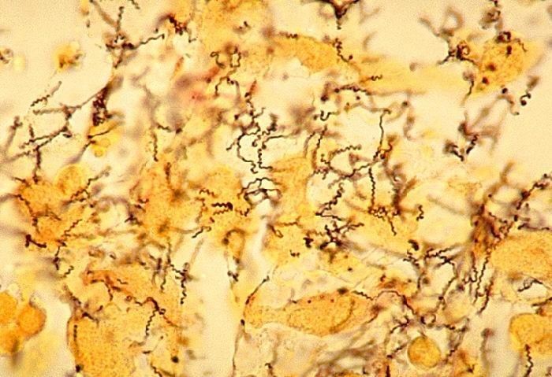
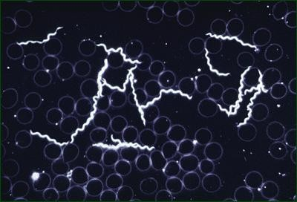
Treponema pallidum
Physiology
-Strictly human pathogen
-Slow replication (time of replication
= 30 hrs)
-Too thin to be visible in light microscope ( darkfield, fluorescence)
-Do not survive well outside of host
-Not cultivable
Treponema pallidum
Darkfield Microscopy of
Treponema pallidum

Slide 8
Syphilis
Transmission
  sexual contact, genital
  congenital in utero or during birth
  transfussion of blood
Not highly contagious (~30% chance of acquiring disease after single exposure to infected partner) , but transmission rate dependent upon stage of disease
Long incubation period during which time host is non-infectious
Chronic infection
slowly progressive

Slide 9
Primary lesion –chancre
(painless)
(10 to 60 days)
  area of ulceration/inflammation
shedding of spirochetes
Secondary (2-10 weeks later)
  systemic spread
  disseminated mucocutaneous rash
  highly contagious
Tertiary
  rare
  skin,
(several years later)
central nervous system
delayed hypersensitivity
few organisms
* control by immune response
12

Slide 10
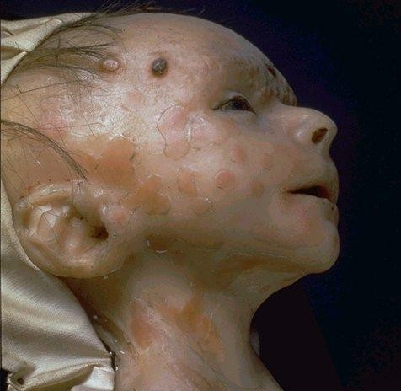
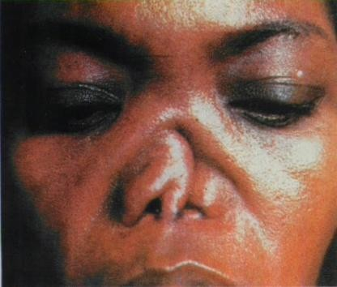
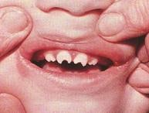
Congenital Syphilis
Congenital syphilis results from transplacental infection
T. pallidum septicemia in the developing fetus and
widespread dissemination
Abortion, neonatal mortality, and late mental or physical problems resulting from scars from the active disease and progression of the active disease state
Neonatal death Bone deformities Blindness Deafness
Deformed faces
Dental deformities,saddle nose
Skin rashes

Slide 11

Diagnosis -Treponema pallidum
Not culturable
Dark field microscopy
  actively motile organisms
(brightly lit against dark backdrop, light shines at an angle, reflected from thin organisms, enters objective)
Fluorescence microscopy
  antibody staining
Serology
for Secondary and Tertiary Syphilis
Screening method Specific diagnosis
Abs to cardiolipin (self antigen)
Abs to treponemal antigen

Slide 12
Diagnosis of Syphilis
Evaluation based on three factors:
  Clinical findings.
  Demonstration of spirochetes in clinical specimen.
  Present of antibodies in blood or cerebrospinal fluid.
More than one test should be performed.
No serological test can distinguish between other treponemal infections.

Slide 13
Treatment
Penicillin remains drug of choice
WHO monitors treatment recommendations
7-10 days continuously for early stage
At least 21 days continuously beyond the early stage
G PNC for congenital and late, TTC, ERY, Chloramphenicol (CMP), etc.
Prevention and control
Vaccine not available,
Prevention with barrier methods (e.g., condoms)
Prophylactic treatment of contacts identified through epidemiological tracing

