Slide 1
Chlamydia & Rickettsia

Slide 2
Chlamydia
Family: Chamydiaceae
Genus: Chlamydia
Species:
C. trachomatis
C. pneumonia
C. psittaci
Species | Disease
C. trachomatis 2 biovars, non LGV LGV | Trachoma, NGU, MPC, PID, conjunctivitis, Infant pneumonia, LGVLymphogranuloma venereum
C. pneumoniae | Pharyngitis, bronchitis, pneumonia
C. psittaci | Psittacosis

Slide 3
General Genus Characteristics
Small, round-to-oval organisms, vary in size
Cell envelope consists of 2 lipid bilayers w/ associated cell wall
Outer membrane similar to Gram-negative bacteria but no PG & no muramic acid
Possess ribosomes and synthesize their own proteins
Obligate INTRACELLULAR bacterial parasite
Infect columnar epithelial cells, survive by replication that results in the death of the cell
Unique developmental cycle (life cycle)
Two forms in the life cycle:
  Elementary body (EB)
  Reticulate body (RB)

Slide 4
Development (Life) Cycle
Occurs inside cytoplasmic vacuoles of host cell
2 forms: Elementary body & Reticulate body
Elementary Body (EB): extracellular and infectious; tiny, condensed, inert structure that can survive extracellular cell-to-cell passage; initiates infection
Reticulate Body (RB): intracellular and non-infectious
(inclusion body)
EB → RB → EB, etc. CYLCE

Slide 5
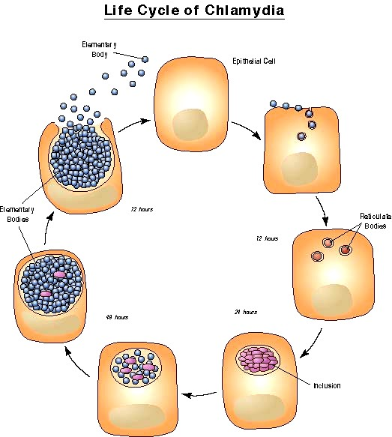
Pathology
Source: California STD/HIV Prevention Training Center

Slide 6
Development (Life) Cycle (reference)
EB enters susceptible host cell by receptor-mediated phagocytosis
chlamydial cell membrane proteins directing attachment to host cell glycolipid or glycopolysaccharide receptors
EB, when present w/in phagosomes, prevent formation of phagolysosomes (i.e., prevent fusion of phagosome and lysosome) Protection from enzymatic destruction
EB ∆’s into larger structure = RB (8 hr. time lapse)
NOT infectious, replicating form, metabolically active, survives only
intracellularly
RB’s divide by binary fission to fill & enlarge the vacuole, forming
inclusion body
After 48 hours, RB multiplication ceases; RB ∆’s into smaller, infectious
EB’s--NOT able to multiply
EB’s released from host cell by cytolysis, resulting in cell death Released EB’s enter a new host cell and the cycle is repeated

Slide 7
Clinical Syndromes Caused by C. trachomatis
Clinical Manifestations
Local Infection | Complication | Sequelae
Conjunctivitis Urethritis Proctitis | Epididymitis Reiter’s syndrome (rare) | Infertility (rare) Chronic arthritis (rare)
Conjunctivitis Urethritis Cervicitis Proctitis | Endometritis Salpingitis Perihepatitis Reiter’s syndrome (rare) | Infertility Ectopic pregnancy Chronic pelvic pain Chronic arthritis (rare)
Conjunctivitis Pneumonitis Pharyngitis Rhinitis | Chronic lung disease? | Rare, if any
Men
Women
Infants

Slide 8
Chlamydia trachomatis
Etiological agent for non-gonoccocal urethritis (NGU) , STD
Causative agent for range of genitourinary & ocular (eye) infections
1. Non-gonnococcal Urethritis (NGU)
♂: urethra = locus of infection
♀: may present w/ cervicitis (sign of early infection) +/or urethritis often asymptomatic, but communicable
Contiguous spread may involve epididymis in men, and uterine tubes &
surrounding tiss. in women, leading to PID- Pelvic Inflammatory Disease
Asymptomatic or untreated ♂ cases → chlamydia ascends reproductive tract to epididymis → potential sterility
Asymptomatic or untreated ♀ cases → scarring of uterus & uterine tubes
(chlamydia ascends reproductive tract) → sterility
Symptomatic cases: similar to infections caused by N. gonorrhoea, but incubation is longer (2-3 wks) and discharge is mucoid w/ fewer pus cells

Slide 9
C. Trachoma: ocular infection
Chronic contagious form of keratoconjunctivitis Leading cause of blindness in underdeveloped countries;
tremendous inflammation – can’t see eye
Transmitted by personal contact (eye epithelium)
  Eye-to-eye via droplets
  Contaminated surfaces touched by hands & conveyed to eyes
  Flies
Inflammatory response permanent opacities of cornea distortion of eyelids
conjunctival follicles undergo tissue necrosis 2° bacterial infection of the eye (opportunistic bacteria) → leads to blindness

Slide 10
3. Lymphogranuloma Venereum (LGV): genital infection Transmitted by sexual contact; follows genital inoculation Characterized by transient papules on external genitalia
  months later => painful swelling of inguinal & perirectal lymph nodes dt/ invasion of lymphatic & circulatory systems
Adenopathy (lymph node swelling) often accompanied by
constitutional symptoms
Inguinal buboes develop
    Large & painful lymph nodes in inguinal area
    Lymph nodes suppurate
    Chronic inflammation & fibrosis → extensive ulceration and blockage of regional lymphatic drainage.

Slide 11
Laboratory Diagnosis
Cell culture = Gold Standard – observation of inclusion bodies (Reticulate Bodies), or the vacuoles, filled w/ Chlamydia in cells scrapped from infected tissues
Serological Tests:
  Enzyme immunoassay
  Fluorescent Ab
Direct Immunofluorescence Format Ab (DFA): appearance of “apple-green” EB’s under microscope
PCR amplification DNA/RNA

Slide 12
Treatment & Prevention
Antibiotic therapy: Erythromycin base or ethylsuccinate 50 mg/kg/day orally divided into 4 doses daily for 14 days
azithromycin, 阿奇霉素interfering with bacteria ability to
make proteins
No vaccine; No acquired immunity
Treat 2°bacterial infection in trachoma
Proper face hygiene & sanitation – most effective in
preventing eyes infection.

Slide 13
Chlamydia psittaci
Etiological agent of Psittacosis or Ornithosis
  Zoonitic disease
  Transmitted to humans by inhalation of dust contaminated w/ respiratory secretions or feces of infected BIRDS, esp. parrots
  Affects Lower Respiratory Tract: acute onset of fever, hacking dry cough, flu-like sx’s
  Possible enlargement of liver & spleen
  Occupational disease (DVM’s, animal handlers) - pneumonia

Slide 14
Chlamydia pneumoniae
Respiratory pathogen that causes pharyngitis, followed by laryngitis, bronchitis, sinusitis, interstial pneumonia/pneumonitis
Significant cause of community-acquired respiratory infection; worldwide distribution
Person-to-person transmission usu. thru aerosolized respiratory droplets (sneezing)
Responsible for adult-onset asthma
Antibiotic therapies are available

Slide 15
Rickettsia

Slide 16
Rickettsia, Orientia, Ehrlichia Anaplasma and Coxiella Biology
Separate unrelated genera
Gram-negative bacteria, small, pleomorphic coccobacilli
– stain poorly with Gram stain (Giemsa)
Small obligate intracellular microbes (once considered to be viruses )
  grown in embryonated eggs or tissue culture
  cultivation is costly and hazardous
- aerosol transmission easily occur
“Reservoirs - animals, insects and humans
Arthropod vectors (except Coxiella)

Slide 17
Disease | Organism | Vector | Reservoir
Rocky Mountain spotted fever | R. rickettsii | Tick | Ticks, rodents
Ehrlichiosis | E. chaffeensis E ewingii | Tick Tick | Deer Deer
Anaplasmosis | A. phagocytophlium | Tick | Small mammals
Rickettsialpox | R. akari | Mite | Mites, rodents
Scrub typhus | O. tsutsugamushi | Mite | Mites, rodents
Epidemic typhus | R. prowazekii | Louse | Humans, squirrel fleas, flying squirrels
Murine typhus | R. typhi | Flea | Rodents
Q fever | C. burnetii | None | Cattle, sheep,
(ticks in animals) goats, cats
50

Slide 18
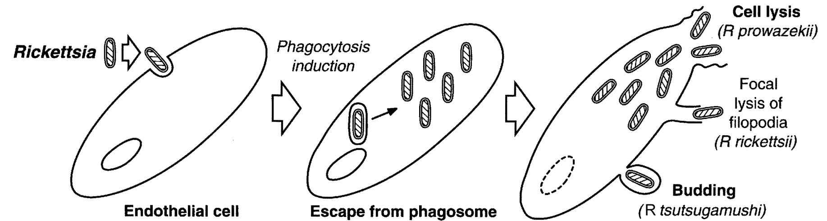
Replication of Rickettsia and Orientia
Infect endothelial in small blood vessels
  Induced phagocytosis
Lysis of phagosome and entry into cytoplasm
  Phospholipase
Replication
Release

Slide 19
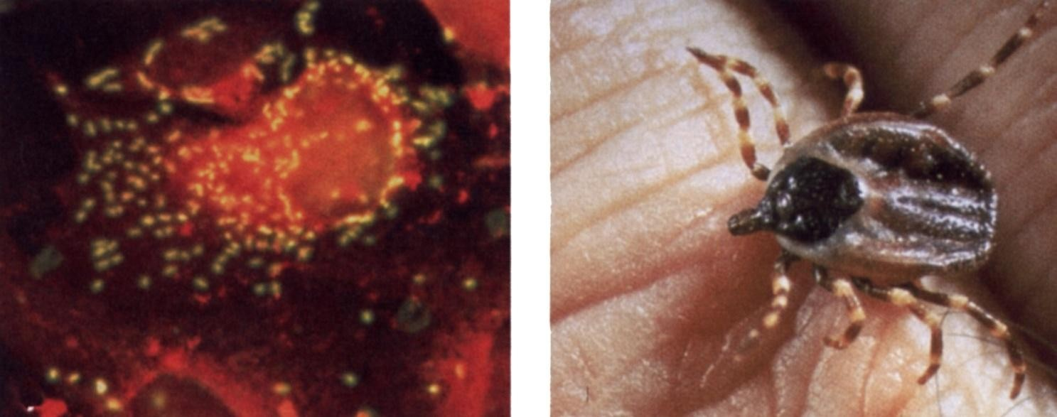
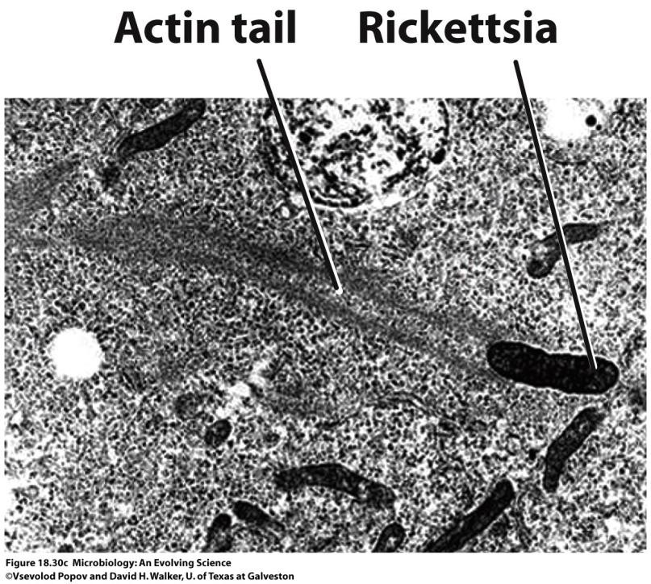
Rickettsia rickettsii
Rocky Mountain spotted fever
Vector - Tick
Fluorescent Ab staining
From: G. Wistreich, Microbiology Perspectives, Prentice Hall

Slide 20
Rocky Mountain Spotted Fever -R. Rickettsii
Vector - Ixodid (hard) tick via saliva
  Prolonged exposure to tick is necessary
Reservoirs - ticks (transovarian passage) and rodents
  humans are accidentally infected (most common from April – September)
Incubation period - 2 to 12 days
Abrupt onset fever, chills, headache and myalgia
Rash appears 2 -3 days later in most (90%) patients
  Begins on hands and feet and spreads to trunk (centripetal spread)
  Palms and soles common
  Maculopapular but can become petechial or
hemorrhagic

Slide 21
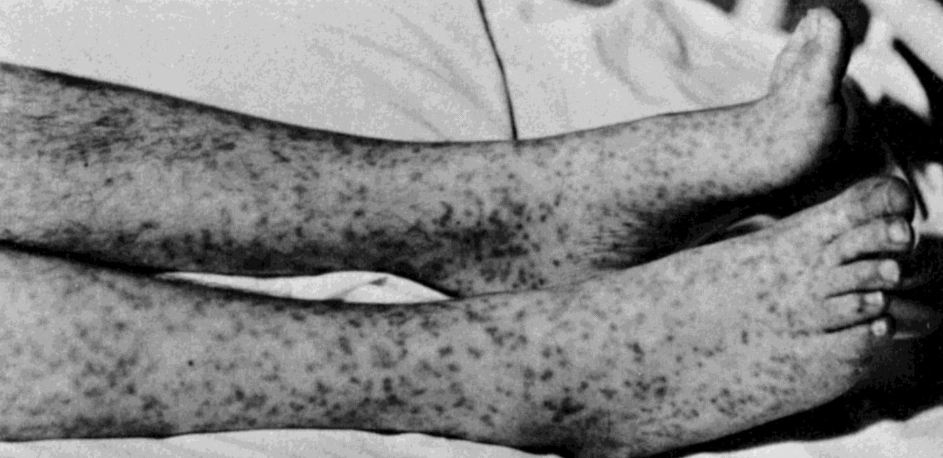
Complications from widespread vasculitis
  Gastrointestinal, respiratory, seizures, coma, renal failure
  Most common when rash does not appear
Mortality in untreated cases - 20%
Rash of Rocky Mountain Spotted Fever

Slide 22
Laboratory Diagnosis - R. rickettsii
Initial diagnosis - clinical grounds
Fluorescent Ab test for Ag in punch biopsy - reference labs
PCR based tests - reference labs
Serology
  Indirect fluorescent Ab test for Ab
  Latex agglutination test for Ab

Slide 23
Treatment, Prevention and Control
R. rickettsii
Tetracycline and chloramphenicol
– Prompt treatment reduces morbidity and mortality
No vaccine
Prevention of tick bites (protective clothing, insect
repellents)
Prompt removal of ticks
Can’t control the reservoir

Slide 24







