Slide 1
Government Accounting
Dr. Shilpa Vardia

Slide 2
Characteristics of Government Accounting
1. Accounting Code

Slide 3
Characteristics of Government Accounting
Accounting Year

Slide 4
Characteristics of Government Accounting
Responsibility Fixation

Slide 5
Characteristics of Government Accounting
Public Sector Commercial Enterprises

Slide 6
Characteristics of Government Accounting
Public Sector Commercial Enterprises

Slide 7
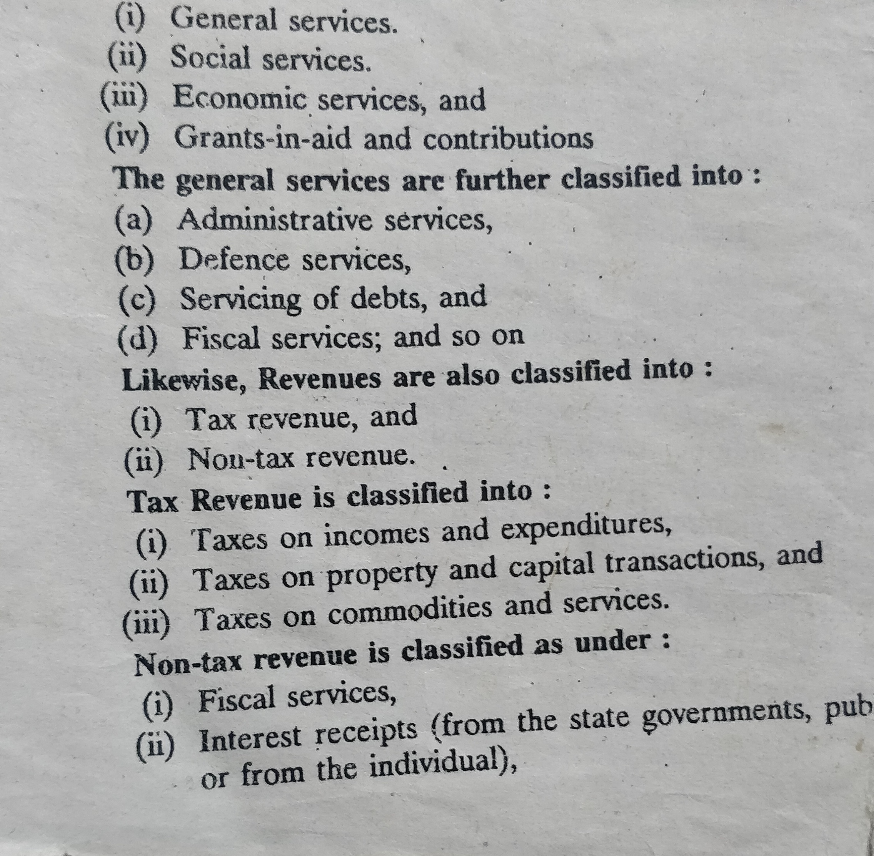
Characteristics of Government Accounting
Income and Expenditure Classification

Slide 8
Characteristics of Government Accounting
Maintaining Internal Accounts

Slide 9
Combined Accounts

Slide 10
Characteristics of Government Accounting
Structure/ Classification of Accounts
Consolidated Funds
Contingency Funds
Public Funds

Slide 11
Characteristics of Government Accounting
Appropriation

Slide 12
Characteristics of Government Accounting
DISBURSEMENT OF GRANTS

Slide 13
Characteristics of Government Accounting
SUPPLEMENTARY BUDGET

Slide 14
Characteristics of Government Accounting
FINANCIAL CONTROL AND AUDIT

Slide 15
Characteristics of Government Accounting
Statutory Control

Slide 16
Characteristics of Government Accounting
Coding of Accounting Head

Slide 17
Characteristics of Government Accounting
Appropriation

Slide 18
Characteristics of Government Accounting
Disbursement of Grants

Slide 19
Characteristics of Government Accounting
Budget

Slide 20
Characteristics of Government Accounting
Supplementary Budget

Slide 21
Characteristics of Government Accounting
Financial Control and Audit

Slide 22
Characteristics of Government Accounting
Statutory Control

Slide 23
Characteristics of Government Accounting
Coding of Accounting Head
0 &1 for Revenue
2 & 3 for Expenditure
4 & 5 Capital Expenditure
6 & 7 Credit and Advance
8 Casual Fund

Slide 24
Characteristics of Government Accounting
Charged Vs Voted

Slide 25
System of Financial Administration in India
Public Accounts Classification
Consolidated Funds
Contingency Funds
Public Accounts
Debt and Deposit Division
Remittance Division

Slide 26
Treasuries
Treasuries Rules
Account with the Reserve Bank

