Slide 1

TRANSFER PRICING

Slide 2
Content
Introduction
Objectives of Transfer Pricing
Methods of Transfer Pricing
  Cost Based Transfer Pricing
  Market Based Transfer Pricing
  Negotiated Transfer Pricing
Advantages and Disadvantages 5.Conclusion

Slide 3

INTRODUCTION

Slide 4

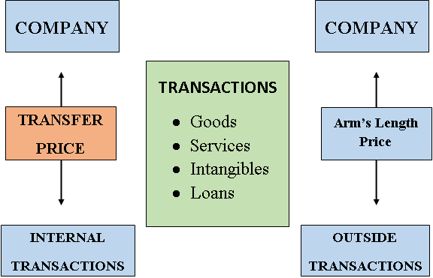
A Transfer Price is the price at which divisions of a company transfer recourses with each other.

Slide 5
Transfer pricing relates to
The price that one segment of an organization charges for a product or service supplied to another segment of the same organization is known as transfer price.
Transfer price is the price at which goods or services are transferred between affiliated entities with an organization.

Slide 6
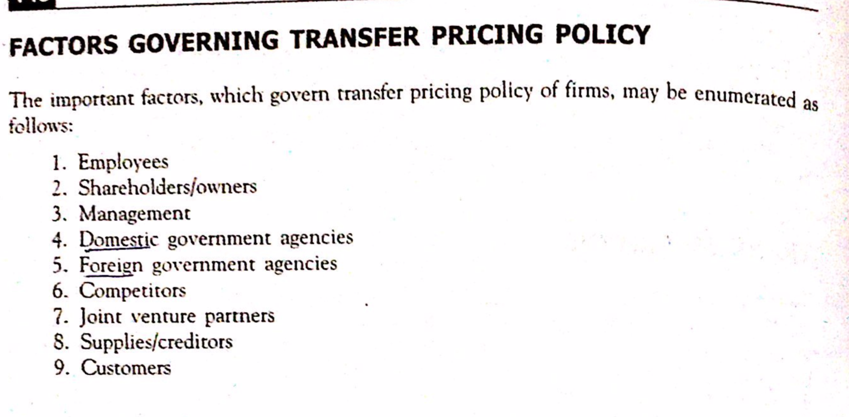

Slide 7
Types of Internal Transactions
A transfer pricing arrangement can be between,
Between Inter-Company Departments
Parent Company and Subsidiary
Between two Subsidiaries of the Parent Company

Slide 8


Internal Transaction can happen,
Local context
Global context

Slide 9

OBJECTIVES OF TRANSFER PRICING

Slide 10

Minimizing tax liability
Helps to maintain divisional autonomy
As a method of performance measurement & reward.

Slide 11
Methods of Transfer Pricing
Cost Based Transfer Pricing
Market Based Transfer Pricing
Negotiated Transfer Pricing

Slide 12
To provide information for decision making.
To optimise allocation of financial resources.
To Enhancing a company’s competitive position and improve its relations with foreign governments.

Slide 13
COST BASED TRANSFER PRICING

Slide 14
Different forms of cost based transfer pricing,
Variable cost
Actual full cost
full cost plus profit margin
Standard full cost

Slide 15
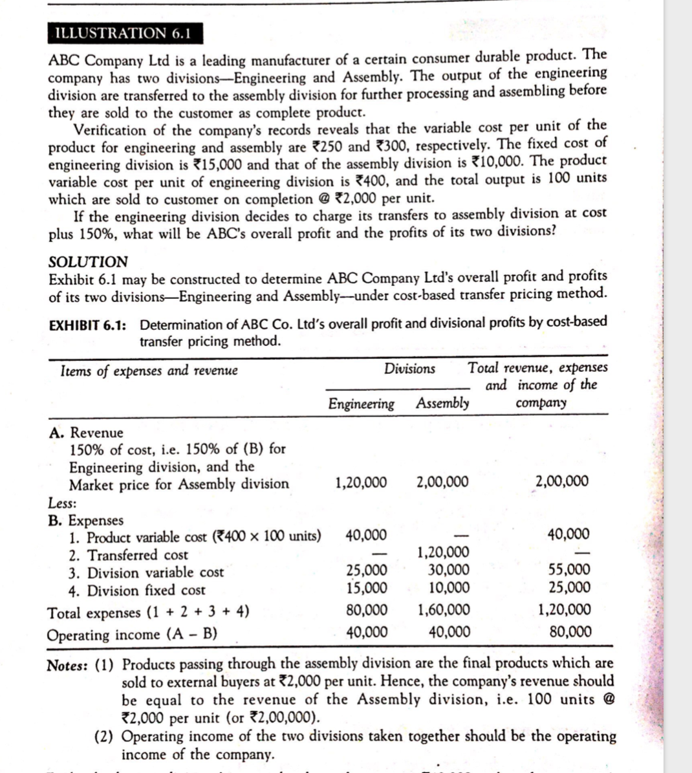

Slide 16
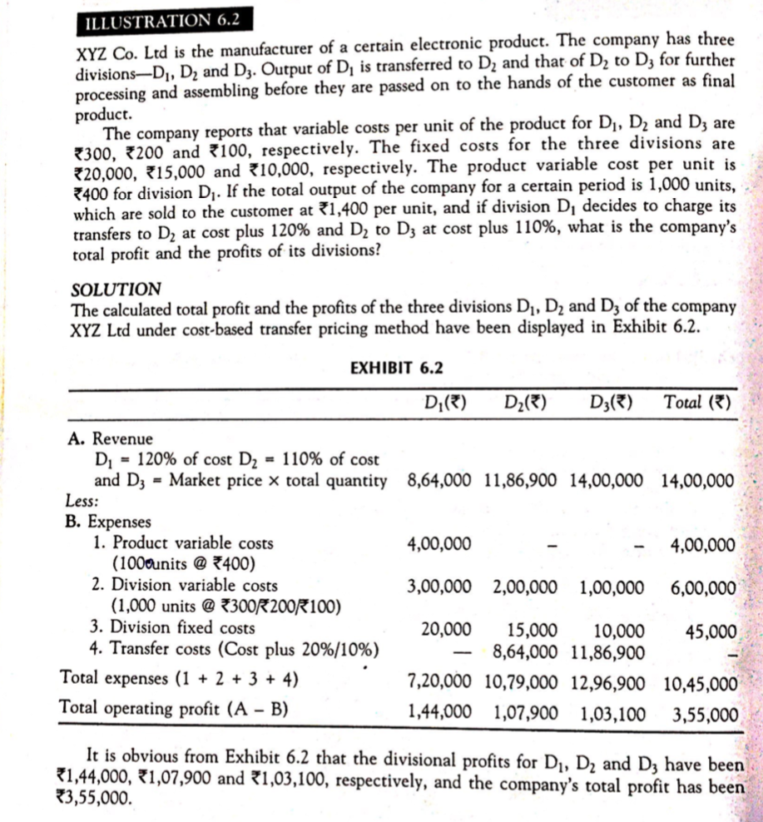

Slide 17
MARKET BASED TRANSFER PRICING

Slide 18
What is Market Based Transfer Pricing
When the outside market for the good is well defined, competitive and stable, firms often use the market price as an upper bound for the transfer price.

Slide 19
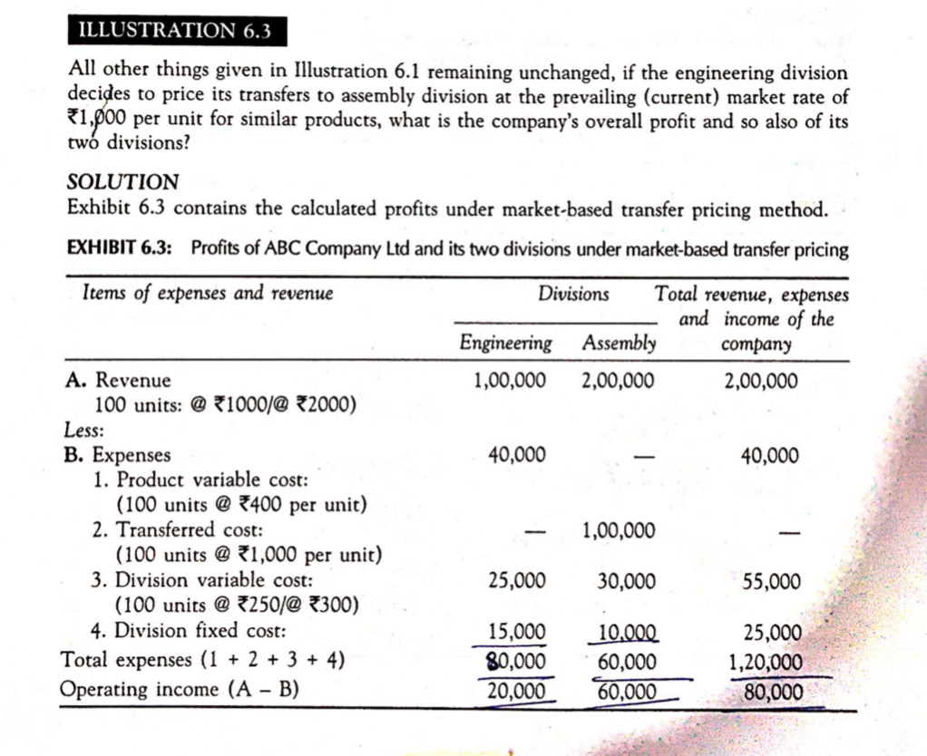

Slide 20
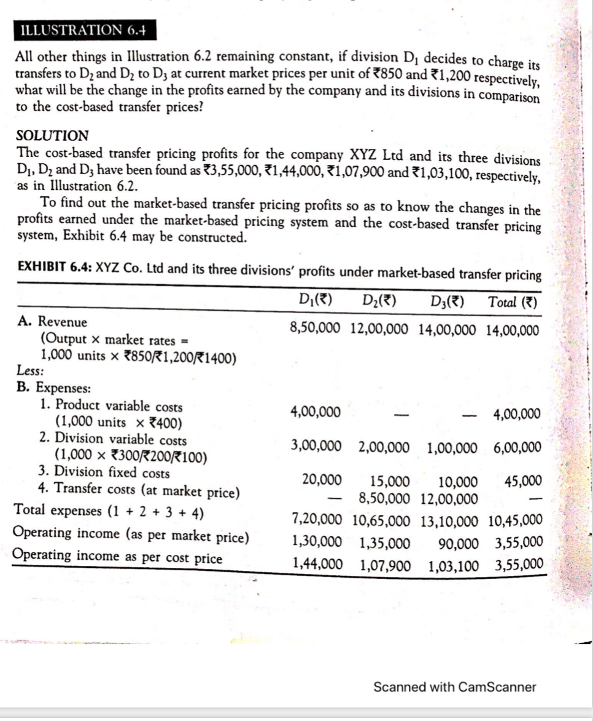

Slide 21
Advantages of Market Based Transfer Pricing Method
Managers motivation increases because they have more control over assets
Top managers are not distracted by routine
Forces selling division to be competitive with market conditions
Decisions are better and timelier because of the manager’s proximity to local conditions

Slide 22
NEGOTIATE TRANSFER PRICING

Slide 23
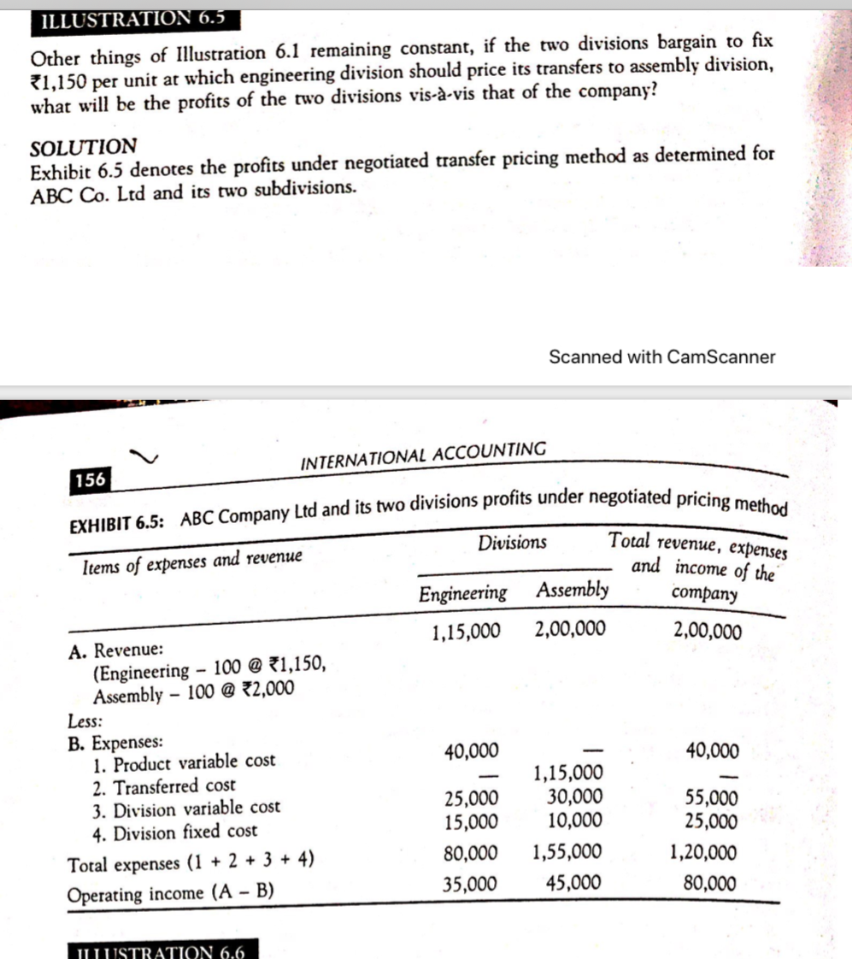

Slide 24
Negotiated Transfer Pricing can be defined as the price set by negotiation between the buying and selling divisions.
The negotiated transfer prices,
- Seller’s perspective:
Transfer price > Variable cost + opportunity cost
- Purchaser’s perspective:
Transfer price < Cost of buying from outside
suppliers

Slide 25
Benefits of Negotiate Transfer Pricing
Not need of active market for a particular good.
Full autonomy to buy and sell.
Managers are fully informed.
Time saving method.
Motivational factor

Slide 26
Drawbacks of Negotiate Transfer Pricing
The parties does not have equal bargaining power
Risk for disharmony with opportunity costs.
Conflicts on transfer prices between divisions

Slide 27
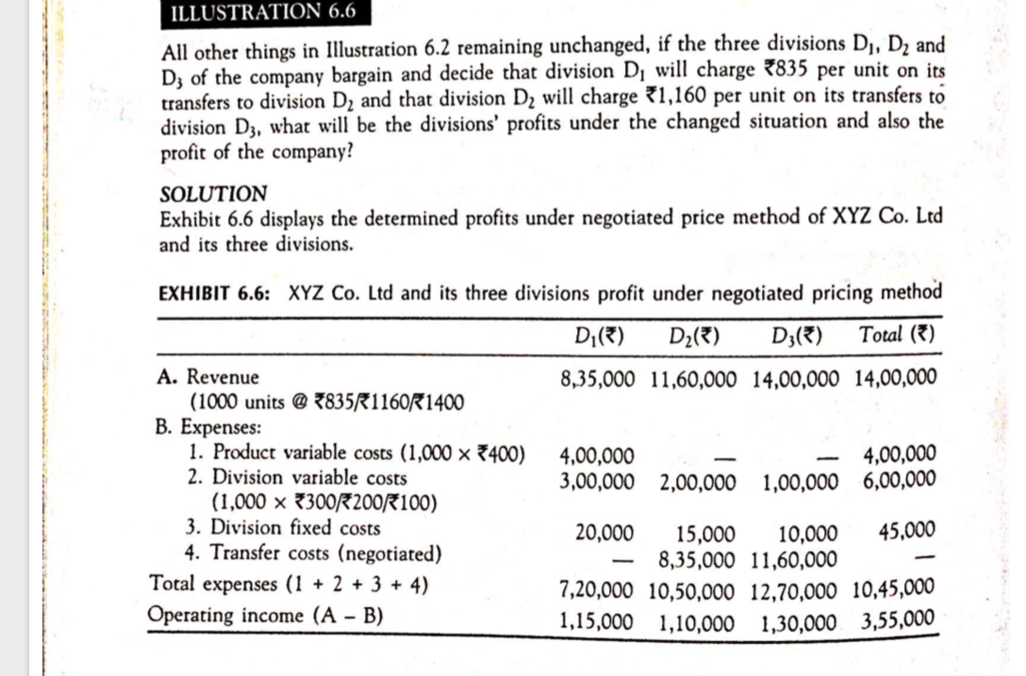

Slide 28
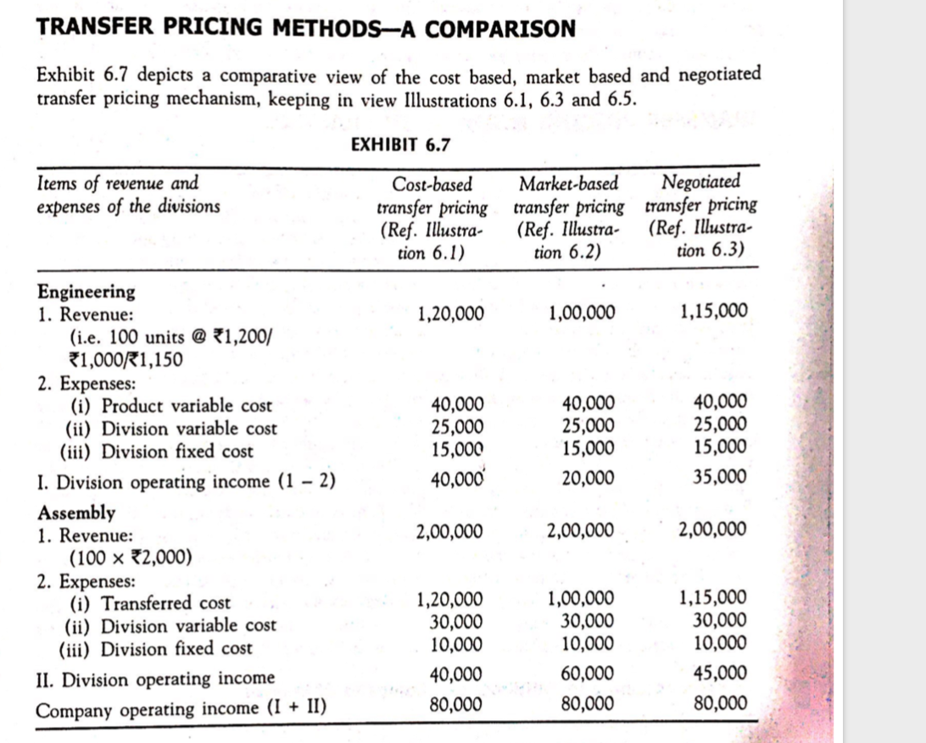

Slide 29
ADVANTAGES
& DISADVANTAGES

Slide 30
Advantages
Allows the company to generate profit figures for each division in separate manner.
The sales, pricing and the production departments can be coordinated through this method
Helps in resource allocation

Slide 31

Performance evaluation of each department becomes easy
Decisions become better and more timely
Managers’ motivation increases
Reducing income taxes

Slide 32
Disadvantages
Disagreement among organizational divisional managers
Additional costs, time and manpower will be required
Transfer prices do not work equally
Cause dysfunctional behavior
Highly complicated
Difficult to estimate the right amount of pricing policy

Slide 33
Mechanism to reduce transfer pricing disputes
Competent authority procedures
Advanced pricing agreements (APA)

Slide 34
Transfer Pricing for Intangibles and Services

