Slide 1
MARKETING MANAGEMENT
UNIT –IV
MARKET Segmentation

Slide 16
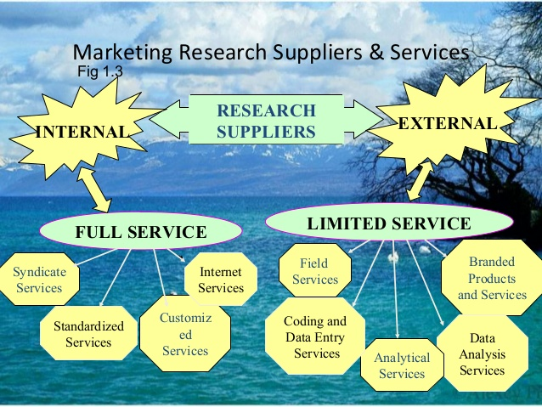

Slide 18
THANK YOU

