Slide 1
MODELS OF CONSUMER BEHAVIOR
Prof (Dr) B. L. Verma
Professor, Department of Business Administration
UCCMS, MLSU, UDAIPUR

Slide 19
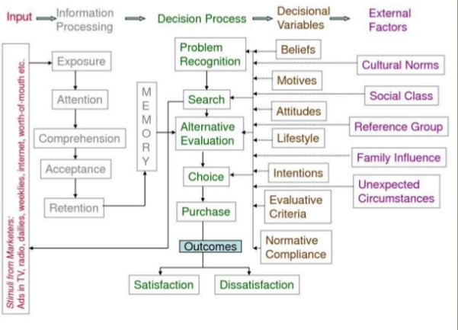

Slide 23
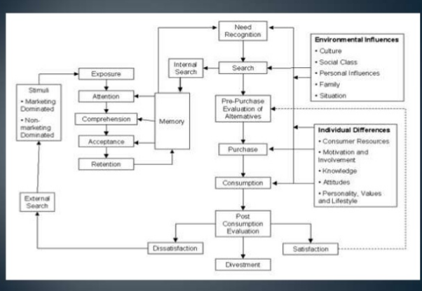

Slide 24
THANKS

