Slide 1
CONSUMER BUYING DECISION PROCESS
Prof (Dr) B. L. Verma
Professor, Department of Business Administration
UCCMS, MLSU, UDAIPUR

Slide 5
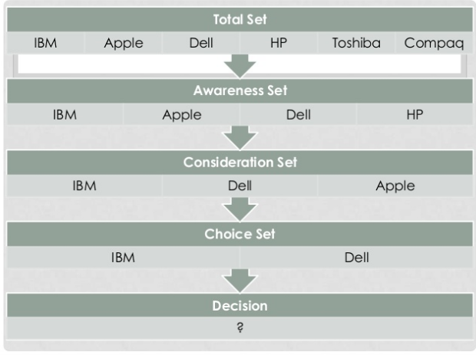

Slide 12
THANKS

