Slide 1
Difference between Domestic Marketing and International Marketing

Slide 2
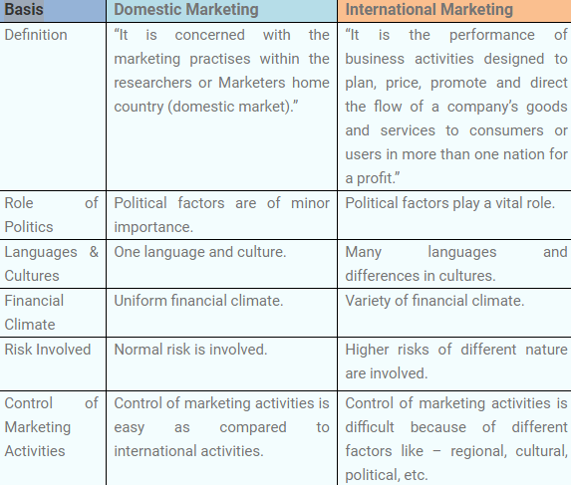

Slide 3
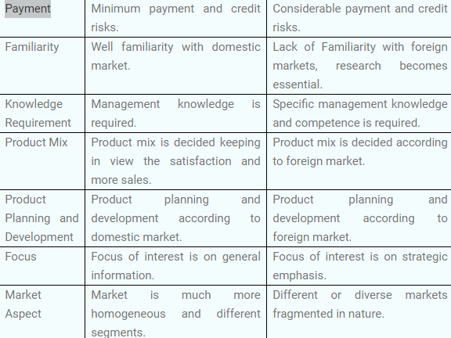

Slide 4
Definition of Domestic Marketing
Domestic Marketing refers to the marketing activities employed on a national scale. Marketing strategies were undertaken to cater customers of a small area, generally within the local limits of a country. It serves and influences the customers of a specific country only.
Domestic Marketing enjoys a number of privileges like easy to access data, fewer communication barriers, deep knowledge about consumer demand, preferences and taste, knowledge about market trends, less competition, one set of economic, social & political issues, etc. However, due to the limited market size, the growth is also limited.

Slide 5
Definition of International Marketing
International Marketing is when the marketing practices are adopted to cater the global market. Normally, the companies start their business in the home country, after achieving the success they proceed their business to another level and become a transnational company, where they seek to enter in the market of several countries. So, the company must be known about the rules and regulations of that country.
International marketing enjoys no boundaries, keeping the focus on the worldwide customers. However, some disadvantages are also associated with it, like the challenges it faces on the path of expansion and globalization. Some of which are socio-cultural differences, changes in foreign currency, language barriers, differences in buying habits of customers, setting and international price for the product and so on

Slide 6
DIFFERENCES IN POINTS_________________
In domestic marketing, there is less government influence as compared to the international marketing because the company has to deal with rules and regulations of numerous countries.
The activities of production, promotion, advertising, distribution, selling and customer satisfaction within one’s own country is known as Domestic marketing. International marketing is when the marketing activities are undertaken at the international level.

Slide 7
In domestic marketing, business operations are done in one country only. On the other hand, in international marketing, the business operations conducted in multiple countries.
In international marketing, there is an advantage that the business organization can have access to the latest technology of several countries which is absent in case domestic countries

Slide 8
The risk involved and challenges in case of international marketing are very high due to some factors like socio-cultural differences, exchange rates, setting an international price for the product and so on. The risk factor and challenges are comparatively less in the case of domestic marketing.
International marketing requires huge capital investment, but domestic marketing requires less investment for acquiring resources

Slide 9
In domestic marketing, the executives face less problem while dealing with the people because of similar nature. However, in the case of international marketing, it is quite difficult to deal with customers of different tastes, habits, preferences, segments, etc.
International marketing seeks deep research on the foreign market due to lack of familiarity, which is just opposite in the case of domestic marketing, where a small survey will prove helpful to know the market conditions.

Slide 10
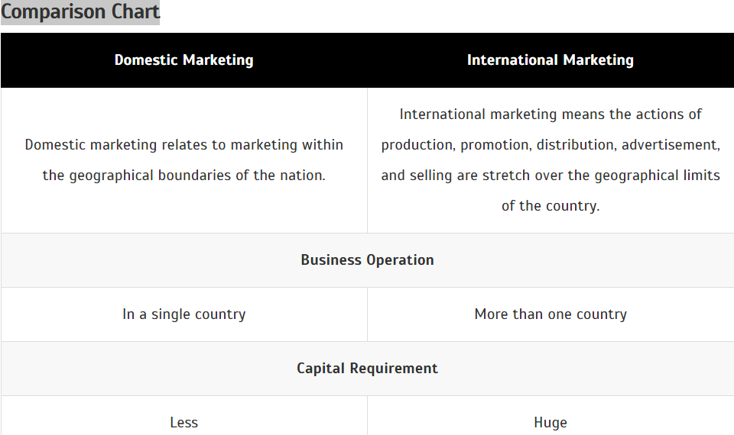

Slide 11
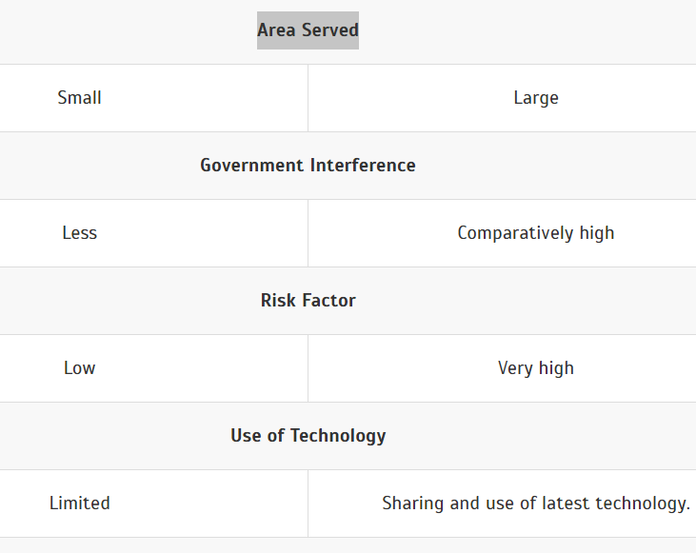

Slide 12
Thanks

