Slide 1
Difference between Market Information System v/s Market Research
Prof (Dr) B.L.Verma
Professor
Department of business administration
UCCMS,MLSU, UDAIPUR

Slide 2
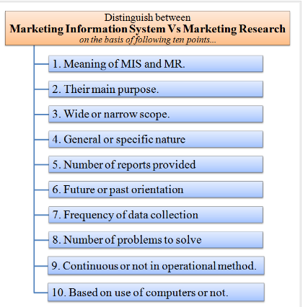

Slide 3
Difference between MIS vs MR is based on the following ten points:

Slide 4
Meaning of MIS and MR.
Their basic or main purpose.
Wide or narrow scope.
General or specific nature.
Number of reports provided.
Future or past orientation.
Frequency of data collection.
Number of problems to solve.
Continuous or non-continuous operational method.
Based on use of computers or not.
Now let's distinguish MIS and Marketing Research (MR) on above points

Slide 5
Meaning :
MIS means to collect, analyze and supply relevant marketing information to the marketing managers. The marketing managers use this information for taking effective marketing decisions. It is a permanent and continuous process.
Marketing Research (MR) is a systematic process of collecting and analyzing information to solve a specific marketing problem.
Purpose :
The main purpose of MIS is to provide relevant information to marketing managers and enable them to make effective marketing decisions.
However, the main purpose of Marketing Research (MR) is to solve a specific marketing problem.

Slide 6
Scope :
The scope of MIS is wide. Marketing Research (MR) is one of its component. It is not only used to solve problems but also helps to prevent problems in the future.
The scope of Marketing Research (MR) is narrow. It is one small part of MIS. It solves a specific present marketing problem.
Nature :
MIS is more nonspecific or general in nature. It can solve many types of marketing problems.
Marketing Research (MR) is more specific or particular in nature. At one time, it can only solve a single type of marketing problem

Slide 7
Reports :
MIS gives four types of reports namely, plan-reports, periodic-reports, triggered-reports and demand reports.
Marketing Research (MR) provides only one report called as ‘MR Report.’
Orientation :
Orientation of MIS is more future-oriented when compared to MR.
However, the orientation of Marketing Research (MR) is more past and present one when compared to MIS. It concentrates more on earlier and latest information. It uses this information to solve a current marketing problem

Slide 8
Problems :
MIS deals with and attempts to solve many different marketing problems at one time. For this, it collects, stores, analyze and supply relevant market information to the marketing managers.
Marketing Research (MR) only deals with a single marketing problem at one time. It doesn't solve multiple marketing problems simultaneously.
Data :
In MIS, the data is collected more frequently, usually almost daily. This is a must for every company.
In Marketing Research (MR), the data is not collected as frequently as MIS. It is collected on a required basis

Slide 9
Operation :
MIS is a permanent and continuous system. Here, the inflow of market information never stops. Data is constantly collected and stored for further analysis. It is properly analyzed, studied and well-organized before supplying to the marketing managers. MIS has a starting but no ending point.
Marketing Research (MR) is not a continuous system. Here, data is collected only when a company faces a specific marketing problem. It has a starting and ending point

Slide 10
Computers :
MIS is heavily based on the use of computers. Here, computing technologies are widely used to ease and facilitate data collection, its storage, analysis, retrieval and supply of relevant information to marketing managers of the company.
Unlike MIS, Marketing Research (MR) hardly makes use of computers. It uses computers only for analyzing some information and is not entirely based on computing technologies.

Slide 11
What Should Marketers Investigate Using Marketing Information?
An easy—and truthful—answer to this question is “everything.” There is no aspect of marketing to which information and research do not apply. Every marketing concept and every element involved in the marketing management process can be subjected to a great deal of careful marketing research and inquiry. Some important questions include:
Who is the customer?
What problems is the customer trying to solve with a given purchase?
What does s/he desire in the way of satisfaction?
How does the customer get information about available choices?
Where does s/he choose to purchase?
Why does s/he buy, or not buy?
When does s/he purchase?
How does s/he go about seeking satisfaction in the market?

