Slide 1
Managerial Economics
Sarika Singh
FMS MLSU Udaipur

Slide 2
What is Economics
What is Business economics ?
What kind of issues does it deal with?
How can it help us make better decisions, in business or elsewhere?
Nature and Scope of Managerial economics

Slide 3
What Is economics?
Economics is a study of human activity both at individual and National level.
Any activity involved in efforts aimed at earning money and spending this money to satisfy our wants such as food, Clothing, shelter, and others are called “Economic activities”.

Slide 4


Slide 5
In eighteenth century Adam Smith, the Father of Economics, defined economics as the study of nature and uses of national wealth’.

Slide 6
Microeconomics
➢ The study of an individual consumer or a firm is called microeconomics.
➢ Microeconomics deals with behavior and problems of single individual and of micro organization.
➢ It is concerned with the application of the concepts such as price theory, Law of Demand and theories of market structure and so on.

Slide 7
Macroeconomics
➢ The study of ‘aggregate’ or total level of economic activity in a country is called macroeconomics.
➢ It studies the flow of economics resources or factors of production (such as land, labor, capital, organization and technology) from the resource owner to the business firms and then from the business firms to the households.
➢ It is concerned with the level of employment in the economy.
➢ It discusses aggregate consumption, aggregate investment, price level, and payment, theories of employment, and so on.

Slide 8
Managerial/Business Economics
Managerial Economics is the integration of economic theory with business practice for the purpose of facilitating decision making and forward planning

Slide 9




Slide 10
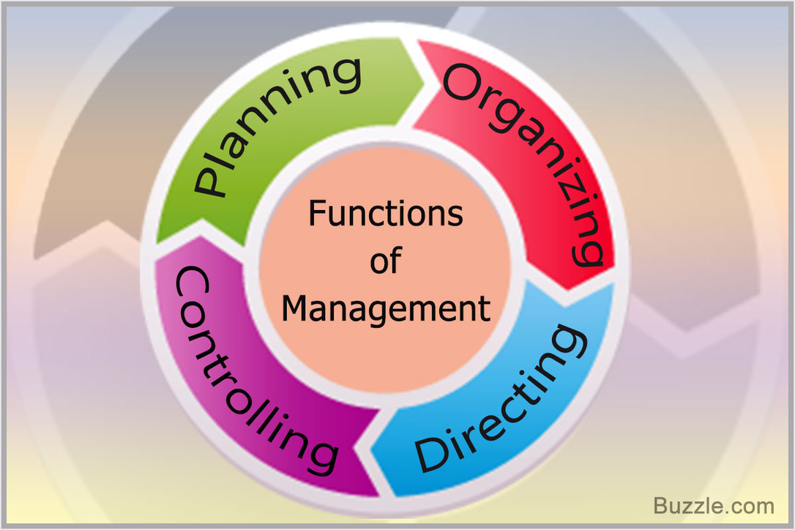
Functions of management

Slide 11


Slide 12


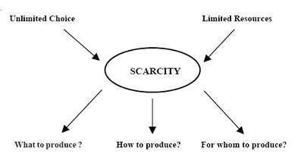
Economics is a social science, which studies human behaviour in relation to optimizing allocation of available resources to achieve the given ends.
Prof. Evan J Douglas, ‘Managerial economics’ is concerned with the application of economic principles and methodologies to the decision making process within the firm or organisation under the conditions of uncertainty”

Slide 13

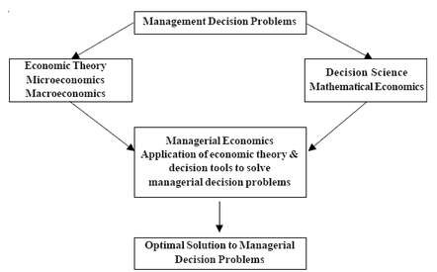

Slide 14
It involves an application of Economic theory – especially, micro economic analysis to practical problem solving in real business life. It is essentially applied micro economics.
It is a science as well as art facilitating better managerial discipline..
It is concerned with firm’s behaviour in optimum allocation of resources. It provides tools to help in identifying the best course among the alternatives and competing activities in any productive sector whether private or public.

Slide 15


1. Demand Analysis and Forecasting
2. Cost Analysis
3. Production and Supply Analysis
4. Pricing Decisions, Policies and Practices
5. Profit Management, and
6. Capital Management

Slide 16




· The basic tools of demand analysis i.e.; Demand, Demand curve, Determinants, Demand Distinctions and Demand Forecasting etc.

Slide 17


· Cost concepts, cost-output relationships, Economies and Diseconomies of scale and cost control..

Slide 18
· Economies and Diseconomies of scale Supply analysis Supply schedule, curves and function, Law of supply and its limitations, Elasticity of supply and Factors influencing supply.

Slide 19


· Pricing is a very important area of Managerial Economics. In fact, price is the genesis of the revenue of a firm and as such the success of a business firm largely depends on the correctness of the price decisions taken by it.
The important aspects dealt with under this area are: Price Determination in various Market Forms, Pricing Methods, Differential Pricing, Product-line Pricing and Price Forecasting.

Slide 20


· Business firms are generally organised for the purpose of making profits and, in the long run, profits provide the chief measure of success. In this connection, an important point worth considering is the element of uncertainty existing about profits because of variations in costs and revenues which, in turn, are caused by factors both internal and external to the firm. If knowledge about the future were perfect, profit analysis would have been a very easy task.

Slide 21


· It deals with Cost of capital, Rate of Return and Selection of projects..

Slide 22


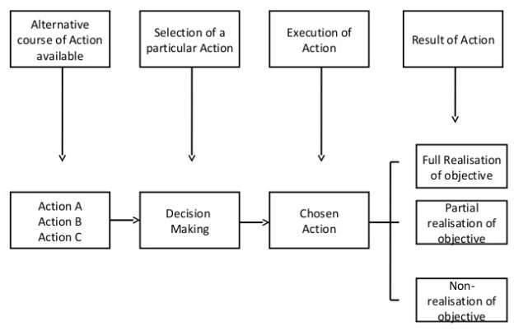

Slide 23
Incremental Principle
Equi-marginal Principle
Opportunity Cost Principle
Time Perspective Principle
Discounting Principle

Slide 24


This principle states that a decision is said to be rational and sound if given the firm’s objective of profit maximization, it leads to increase in profit, which is in either of two scenarios-
If total revenue increases more than total cost
If total revenue declines less than total cost

Slide 25




The laws of equi-marginal utility states that a consumer will reach the stage of equilibrium when the marginal utilities of various commodities he consumes are equal.
According to the modern economists, this law has been formulated in form of law of proportional marginal utility. It states that the consumer will spend his money-income on different goods in such a way that the marginal utility of each good is proportional to its price

Slide 26
Opportunity cost is one of the most important and fundamental concepts in the whole of economics. Given that we have said that economics could be described as a science of choice, we have to look at what sacrifices we make when we have to make a choice. That is what opportunity cost is all about.
Sacrifice of Alternatives
Opportunity cost is the minimum price that would be necessary to retain a factor-service in it’s given use. It is also defined as the cost of sacrificed alternatives

Slide 27
According to this principle, a manger should give due emphasis, both to short-term and long-term impact of his decisions, giving apt significance to the different time periods before reaching any decision
Time periods
Short-run refers to a time period in which some factors are fixed while others are variable. The production can be increased by increasing the quantity of variable factors
long-run is a time period in which all factors of production can become variable. Entry and exit of seller firms can take place easily

Slide 28


According to this principle, if a decision affects costs and revenues in long-run, all those costs and revenues must be discounted to present values before valid comparison of alternatives is possible
Discounting
Discounting can be defined as a process used to transform future rupees into an equivalent number of present rupees.
This is essential because a rupee worth of money at a future date is not worth a rupee today. Money actually has time value. For instance, Rs.100 invested today at 10% interest is equivalent to Rs.110 next year.

Slide 29

He studies the economic patterns at macro- level and analysis it’s significance to the specific firm he is working in.
He has to consistently examine the probabilities of transforming an ever- changing economic environment into profitable business avenues.
He assists the business planning process of a firm.
He also carries cost-benefit analysis.

Slide 30
He assists the management in the decisions pertaining to internal functioning of a firm such as changes in price, investment plans, type of goods /services to be produced, inputs to be used, techniques of production to be employed, expansion/ contraction of firm, allocation of capital, location of new plants, quantity of output to be produced, replacement of plant equipment, sales forecasting, inventory forecasting, etc.
In addition, a managerial economist has to analyze changes in macro- economic indicators such as national income, population, business cycles, and their possible effect on the firm’s functioning.

Slide 31
He is also involved in advicing the management on public relations, foreign exchange, and trade. He guides the firm on the likely impact of changes in monetary and fiscal policy on the firm’s functioning.
He also makes an economic analysis of the firms in competition. He has to collect economic data and examine all crucial information about the environment in which the firm operates.
The most significant function of a managerial economist is to conduct a detailed research on industrial market.

Slide 32
In order to perform all these roles, a managerial economist has to conduct an elaborate statistical analysis.
He must be vigilant and must have ability to cope up with the pressures.
He also provides management with economic information such as tax rates, competitor’s price and product, etc. They give their valuable advice to government authorities as well.
At times, a managerial economist has to prepare speeches for top management.

