Slide 1
Cost Analysis
Mrs Sarika Singh
FMS MLSU Udaipur

Slide 2
Cost analysis assumes a great significance in all major business decisions because the term ‘cost’ has different meaning under different settings and is subject to varying interpretations.

Slide 3
The analysis of cost is an important factor in almost all business analysis and business decision making like
The weak points in the production management.
Minimizing the cost.
Finding the optimum level of output.
Determining price and dealers; margins.
Estimating or projecting the cost of operation.

Slide 4
COST CONCEPT & TYPES
OPPORTUNITY COST –
Opportunity cost of a product is value of the next best alternative forgone (that is not chosen).
It can also defined as the revenue forgone for not making the best alternative use.
The concept of opportunity cost is useful for manager in decision making.

Slide 5
ECONOMIC COST
This cost includes explicit and implicit cost both. In other words, economic cost includes both recorded and unrecorded cost.
EXPLICIT COST is the actual money expenditure on inputs or payments made to the outsiders for hiring the factor services.
Example – wages paid to employees, payment for raw materials etc.

Slide 6
IMPLICIT COST is the cost of self supplied factors .
Example- Interest on own capital ,Rent of own land etc.
The sum of explicit cost and implicit cost is the total cost of production of a commodity.

Slide 7
ACCOUNTING COST
Accounting cost is the cost based upon accounting records in the book of accounts.
They are recorded in the book of accounts when they are actually incurred . Its based on Accrual concept.
Accounting costs are explicit cost and must be paid.

Slide 8
PRIVATE COST & SOCIAL COST
Private costs are those which are actually incurred by a firm on the purchase of goods and services from the market. For a firm, all actual costs both explicit and Implicit are private costs.
Social Costs refers to the total cost borne by the society due to production of a commodity

Slide 9
Incremental and Sunk Costs
Incremental costs are closely related to marginal costs, incremental costs refers to the total additional cost associated with the expand in output.
Sunk Costs are those which cannot be altered, increased or decreased by varying the rate of output.

Slide 10
Short Run and long run costs
Short run costs are costs that vary with variation in output. Short run costs are the same as variable costs
Long run costs are costs that are incurred on fixed assets like plant, machinery, etc

Slide 11
DIRECT AND INDIRECT COST
Direct cost are the costs that have direct relationship with a unit of operation. This includes items such as software, equipment, labor and raw materials.
Indirect cost are those cost whose cost can’t be easily traced to a product such as electricity , stationary and other office expenses.

Slide 12
TOTAL COST
Total cost is the actual money spends to produce a particular quantity of output.
It is the summation of fixed and variable costs
TC = TFC+ TVC
TFC(Total Fixed Cost):
Total fixed costs, i.e the cost of plant, building, equipment etc. remain fixed with a change in output.
TVC(Total Variable Cost):
The total variable cost i.e the cost of labour, raw material etc varies with the variation in output.

Slide 13
AVERAGE COST
Average cost is the total cost of producing per unit of commodity. It can be found out as follows
AC= AFC +AVC
AC= Total cost/no.of units produced
AFC (Average fixed Cost)-
Fixed cost of producing per unit of the commodity.
AFC= total fixed cost / no. of units produced.
AVC (Average Variable Cost)
Variable cost of producing per unit of the commodity.
AVC= total fixed cost / no. of units produced.

Slide 14
MARGINAL COST
Marginal cost is the additional to total cost when one more unit of output is produced .
It can be arrived by dividing the change in total cost by the change in total output.
MC =
⎛ ΔTC ⎞
⎜ _{ΔQ} ⎟
⎝ ⎠

Slide 15
Cost-output Relationship

Slide 16
Cost-output Relationship
Cost-output relationship has 2 aspects:
Cost-output relationship in the short run,
Cost-output relationship in the long run
The SHORT RUN is a period which doesn’t permit alterations in the fixed equipment (machinery , building etc.) & in the size of the org.
The LONG RUN is a period in which there is sufficient time to alter the equipment (machinery, building, land etc.) & the size of the org. output can be increased without any limits being placed by the fixed factors of production

Slide 17
Cost-output Relationship In The Short Run

Slide 18
SHORT RUN COSTS
Average Fixed Cost
Average Variable Cost
Average Total cost

Slide 19



Total, average & marginal cost
TC) = TFC + TVC, rise as output rises
Total cost (TC) = TFC + TVC, rise as output rises
Average cost (AC) = TC/output
3. Marginal cost (MC) = change in TC as a result of changing output by one unit
Fixed cost & variable cost
Total fixed cost (TFC) = cost of using fixed factors = cost that does not change when output is changed, e.g.
Total variable cost (TVC) = cost of using variable factors = cost that changes when

Slide 20
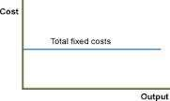
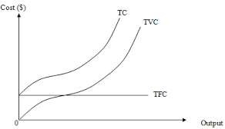
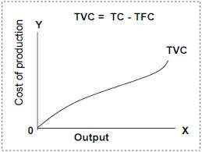

Slide 21
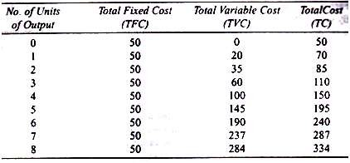

Slide 22
Average Fixed Cost and Output
The greater the output, the lower the fixed cost per unit, i.e. the average fixed cost.
Total fixed costs remain the same & do not change with a change in output.
Average Fixed Cost and Output
The greater the output, the lower the fixed cost per unit, i.e. the average fixed cost.
Total fixed costs remain the same & do not change with a change in output.

Slide 23
Average Total cost and output
Average total cost, also known as average costs, would decline first & then rise upwards.
Average cost consists of average fixed cost plus average variable cost.
Average fixed cost continues to fall with an increase in output while avg. variable cost first declines & then rises.
So , as Avg. variable cost declines the Avg. total cost will also decline. But after a point the Avg. variable cost will rise.
When the rise in AVC is more than the drop in Avg.

Slide 24
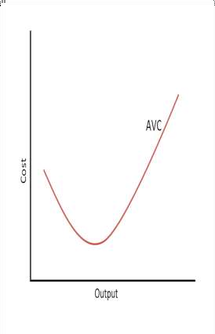
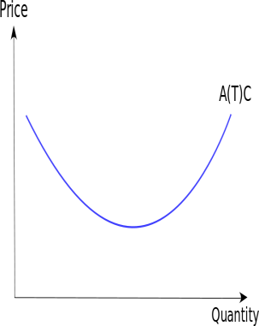
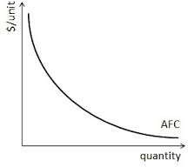
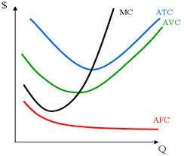
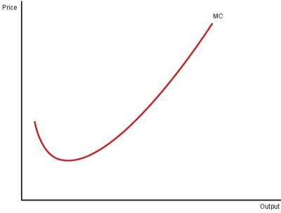

Slide 25
RELATIONSHIP BETWEEN MARGINAL AND AVERGAE COST
The marginal costs and average costs are related.
When marginal cost exceeds average cost, average cost must be rising.
When marginal cost is less than average cost, average cost must be falling.
The position of marginal cost relative to average total cost tells us whether average total cost is rising or falling.

Slide 26
Relationship between Marginal Cost and Average cost
If MC>ATC, then ATC is rising
If MC>MVC , then AVC is rising
If MC< ATC, then ATC is falling
If MC<AVC, then AVC is falling
If MC=AVC and MC=ATC, then AVC and ATC are at there minimum points

Slide 27
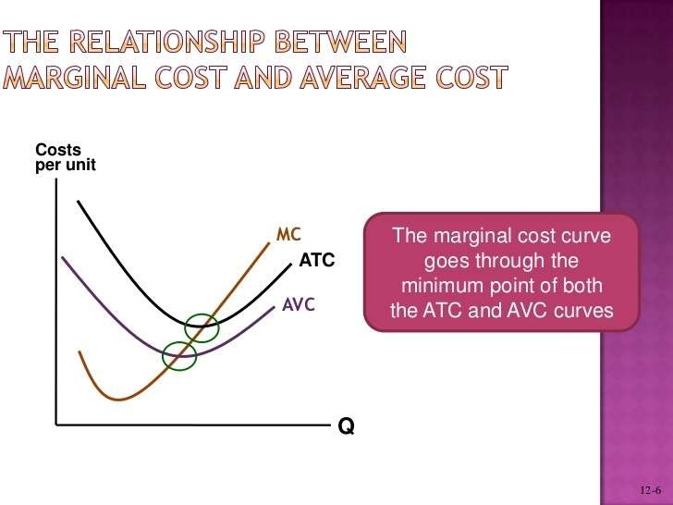

Slide 28
Long Run Costs

Slide 29
Long Run Costs
They are costs over a long period of time.
They permit for enough change in all factors of production.
Thus firms can produce more.
Supply of a commodity is adjusted to its demand.

Slide 30
Long Run Cost Curve
All costs are variable in the long run.
There are only average variable cost in long run, since all factors are variable.
It is also called as planning curve or envelope or scale curve.

Slide 31
Production Rules for the Long Run
If selling price > ATC (or TR > TC):
Continue to produce.
Maximize profit by producing where MR = MC.
If selling price < ATC (or TR < TC):
There will be a continual loss.
Sell the fixed assets to eliminate fixed costs.
Reinvest money is a more profitable alternative.

Slide 32
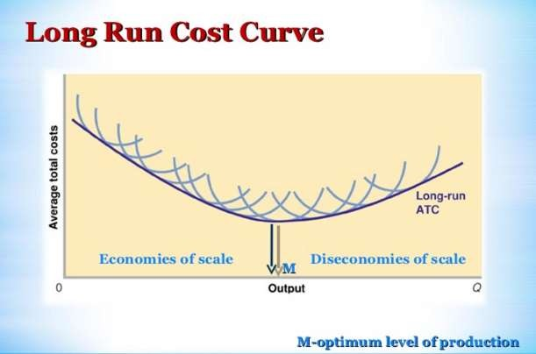

Slide 33
Determinants of Costs

Slide 34
Factors determining the cost are
Size of plant: There is an inverse relationship between size of plant and cost. As size of plant increases, cost falls and vice versa.
Level of Output: There is a direct relationship between output level and cost. More the level of output, more is the cost ( i. e., total cost) and vice Versa.
Price of Inputs: There is a relationship between price of inputs and cost. As the price of inputs rises, cost ruses and vice versa.

Slide 35
State of technology: More modern and upgraded the technology implies lesser cost and vice versa.
Management and administrative efficiency: Efficiency and cost are inversely related. More the efficiency in management and administration better will be the product and less will be the cost. Cost will case of inefficiencies in management and administration.

Slide 36
Break-Even Analysis

Slide 37
Break-even analysis
Break-even analysis or what is also known as profit contribution analysis is an important analytical technique used to study the relationship between the total costs (TC), Total revenue (TR) and total profits and losses over the whole range of stipulated output.
The breakeven analysis is a technique of having a preview of profit prospects and a tool of profit planning. It integrates the cost and revenue estimates to ascertain the profits and losses associated with different levels of output.

Slide 38
To illustrate the break-even analysis under linear cost and revenue conditions, let us assume linear cost and linear revenue functions are given as follows.
Cost function: TC = 100 + 10 Q………..eq. (1) Revenue function: TR = 15 Q……..……eq. (2)
The cost function given in eq. (1) =>
firm’s TFC (total fixed cost) = 100 and its variable cost varies at a constant rate of 10 per unit in response to increase in output. The revenue function given in fig.
implies that price for the firm’s product is given in the market at 15 per unit of sale.

Slide 39


Break-even Analysis : Linear Function
y
700
600
500
400
TR
Operating profit
Cost and revenue
TC
Operating
Loss
TVC
B
300
200
100
TFC
x
0
10
20
30
output
40

Slide 40
The line TFC shows the total fixed cost at 100 for a certain level of output.
The line TVC shows the variable cost rising with a slope.
The line TC has been obtained by plotting the TC function.
The line TR shows the total revenue.
The line TR & TC lines intersect at point B
At point B, Q = 20 ;firm’s total cost =total revenue
At Q=20, TC breaks-even with TR. Point B, therefore the break-even point and Q= 20 is break-even output.

Slide 41
Below this level of output, TC exceeds TR.
Vertical difference TC-TR known as operating loss.
Beyond Q=20, TR>TC and TR-TC is known as operating profit.
It may be noted that a firm producing a commodity under cost and revenue conditions given in above eq. (1) & (2).
Must produce at least 20 units to make its total cost and total revenue break-even.
At break-even point, TR = TC

Slide 42
Break–even analysis under non-linear function

Slide 43

Break–even analysis under non-linear function
y
TC
B₂
TR
Total cost and revenue
B₁
F
TFC
x
0
Q₁
Q₂
Output per time unit

Slide 44
TFC line shows the fixed cost at OF and the vertical distance between TC and TFC measures the total variable cost (TVC).
The curve TR shows the total revenue at different output & price.
The vertical distance between the TR and TC measure profit/loss.
TR & TC curves intersect at two points, B1 & B2, where TR = TC.
OQ1 corresponding to break-even point B1 and OQ2 corresponding to break-even point B2 ;TR > TC.
Profitable range lies between OQ1 and OQ2 units of output.

