Slide 1
Profit maximization Model
Mrs Sarika Singh
FMS MLSU Udaipur

Slide 2
Introduction
Profit is the making of gain in business activity for the benefit of the owners of the business.
Generally Profits are the primary measure of the success of any business.
Profit maximization is the short run or long run process by which a firm determines the price and output level that returns the greatest profit.
Profit maximization refers to the sales level where profits are highest. You might assume that the higher the sales level, the higher the profits - but that is not always true!

Slide 3
Definition
A process that companies undergo to determine the best output and price levels in order to maximize its return. The company will usually adjust influential factors such as production costs, sale price, and output levels as a way of reaching its profit goal.

Slide 4
There are two main profit maximization methods:
1.Marginal Cost-Marginal Revenue Method
2 Total Cost-Total Revenue Method

Slide 5
Important Terms
Profit is defined as total revenue minus total cost.
Profit = TR – TC
Profit: The money left over once you pay all of your bills out of funds that come in from your customers. So for example, if you sell 5 necklaces for $5 each, and the cost to purchase the necklaces is
$3, you will have revenues (customer monies in) of 5 necklaces * $5 each = $25, and costs of 5 necklaces * $3 each = $15. Your profit will be $25 revenue - $15 cost = $10 remaining.
TR: This stands for ‘Total Revenue’. Total revenue simply means the total amount of money that the firm receives from sales of its product or other sources or the total amount of money the firm collects in sales.
TC: This stands for ‘Total Cost’. Its the cost of all factors of
production.

Slide 6
Important Terms
MC: This stands for 'marginal cost,' which means the per-unit cost of your item. Marginal cost is the additional cost incurred in producing one more unit of output.
MR: This stands for 'marginal revenue,' which means the per-unit selling price of your item. Marginal revenue is the additional revenue earned by selling one more unit of a product.

Slide 7

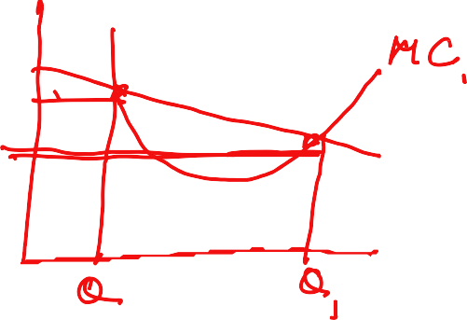
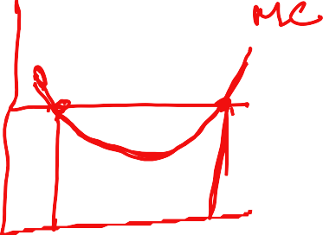


Profit Maximization
To maximize economic profits, the firm should choose the output for which
Marginal Revenue is equal to Marginal Cost
ie., MR = MC
riExii

Slide 8
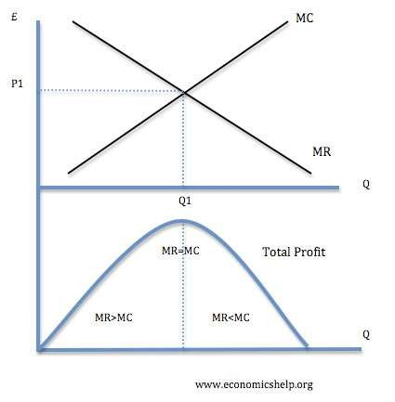



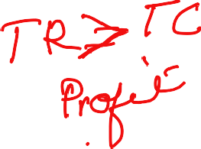








Diagram of Profit Maximization
TRA ^{TC}
I
TRIA ^{TC}
profit
TR
TC
BED
TACT
G loss
A firm can maximize profits if it produces at an output where Marginal revenue (MR) = Marginal cost (MC)

Slide 9
Reasons For Aiming At Reasonable Profit
Preventing Entry Of Competitors
Projecting A Favorable Public Image
Restraining A Trade Union Demand
Maintaining Customer Goodwill

