Slide 1
Oligo poly
Mrs Sarika Singh
FMS MLSU Udaipur

Slide 2
Meaning
Derived from Greek word: “oligos” (few) “pollien” (to sell)
An oligopoly is a market form in which a market or industry dominated by a small numbers of sellers.
OR
Oligopoly is a situation where a few large firms compete against each other and there is an element of interdependence in decision making of these firms.

Slide 3
Characteristics
Few Sellers
Homogeneous or differentiated product - homogenous (like in perfect competition: petrol, cement, steel and aluminum), or differentiated (like in monopolistic competition: cars, motorbikes, televisions, washing machines, and soft drinks)
Entry is possible but difficult.

Slide 4
Characteristics
Interdependence - no player can take a decision without considering the action of rivals
Uncertainity
Indeterminateness

Slide 5
Collusive
Non - Collusive
Firms might decide to collude together and not compete with each other.
Firms behave as single monopoly.
They aim at maximizing their collective profit instead of individual profit
Eg: Cartel formation and
Price leadership.
Firms compete with each
other.
Firms behave independently.
Aims at maximizing their
own profit.
Eg: Price Rigidity (Kinked demand curve.)

Slide 6
Price rigidity (Kink demand curve)
Two Basic assumptions:
If a firm decreases price, others will also do the same - So the firm initially faces a highly elastic demand curve. A price reduction will give some gains to the firm initially, but due to similar reaction by rivals, this increase in demand will not be sustained.
If a firm increases its price, others will not follow – So the firm will lose large number of its customers to rivals due to substitution effect.

Slide 7
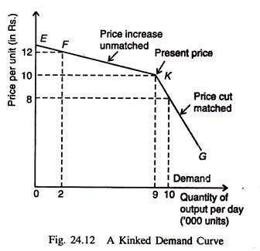
The demand curve is more elastic above the kink and less elastic below the kink.
If the firm decreases its price from Rs.10 to Rs.8, the price is matched by the other firms hence the curve slopes downward from K-G.
If the firm increases its price from Rs.10 to Rs.12, the price is not matched by the other firms hence the curve slopes upward from K-F.
Kink is at point K.

Slide 8
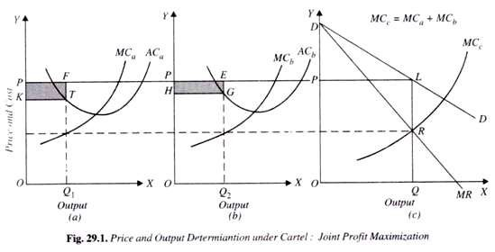
Cartel Formation
MCa = A’s marginal cost MCb = B’s marginal cost
In cartel,ΣMC = industry marginal cost;
OQ is the profit maximizing output because at this output level MR=ΣMC.
OP = price at which both firms can sell their output.
At MC=MR; OQ1 = output of A, OQ2 = output of firm B.
OQ=OQ1 + OQ2; OQ1 > OQ2.

Slide 9
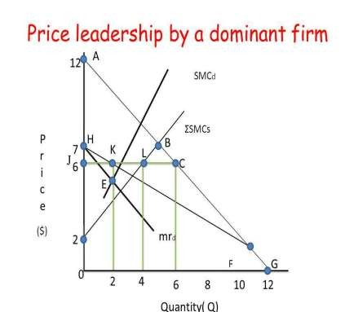
Price Leadership
The setting of prices in a market by a dominant company, which is followed by others in the same market.
  The leader firm will set the price based
on this equilibrium (SMCs = MRd) at point E.
  The price is Rs.6 at which the leader and the followers will sell their output.
  The followers will produce upto the point where ΣSMCs = Price i.e point L.
  The total output will be 6, of which 4 will be sold by the followers and 20 by the leader charging Rs.6, the price set by the leader.

Slide 10
Conclusion
An oligopoly may end up looking more like a monopoly or competitive market depending on the number of firms.
No certainty as to how firms will compete in oligopoly.
It depends on the objectives of the firm, the market’s n contestability and nature of the product.
Thus, oligopoly has emerged as the most prevalent market form in the industrialized world.

