Slide 1
Monopolistic Competition
Mrs Sarika Singh
FMS MLSU Udaipur

Slide 2
What Is Monopolistic Competition?
Monopolistic competition is a market where:
A large number of firms.
Each firm produces a differentiated product.
Firms compete on product quality, price, and marketing.
Firms are free to enter and exit the industry.

Slide 3
What Is Monopolistic Competition?
Large Number of Firms
The presence of a large number of firms in the market implies:
Each firm has only a small market share and therefore has limited market power to influence the price of its product.
Each firm is sensitive to the average market price, but no firm pays attention to the actions of the other, and no one firm’s actions directly affect the actions of other firms.
Collusion, or conspiring to fix prices, is impossible.

Slide 4
What Is Monopolistic Competition?
Product Differentiation
Firms in monopolistic competition practice product differentiation, which means that each firm makes a product that is slightly different from the products of competing firms.

Slide 5
What Is Monopolistic Competition?
Competing on Quality, Price, and Marketing
Product differentiation enables firms to compete in three areas: quality, price, and marketing.
Quality includes design, reliability, and service.
Because firms produce differentiated products, each firm has a downward-sloping demand curve for its own product.
But there is a tradeoff between price and quality.
Differentiated products must be marketed using advertising and packaging.

Slide 6
What Is Monopolistic Competition?
Entry and Exit
There are no barriers to entry in monopolistic competition, so firms cannot earn an economic profit in the long run.

Slide 7
Price and Output in Monopolistic Competition
The Firm’s Short-Run Output and Price Decision
A firm that has decided the quality of its product and its marketing program produces the profit-maximizing quantity at which its marginal revenue equals its marginal cost (MR = MC).
Price is set at the highest price the firm can charge for the profit-maximizing quantity.
The price is determined from the demand curve for the firm’s product.

Slide 8
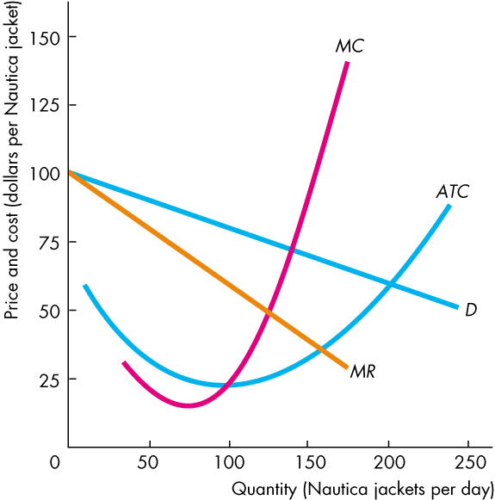
Price and Output in Monopolistic Competition
Figure shows a short-run equilibrium for a firm in monopolistic competition.
It operates much like a single-price monopoly.

Slide 9
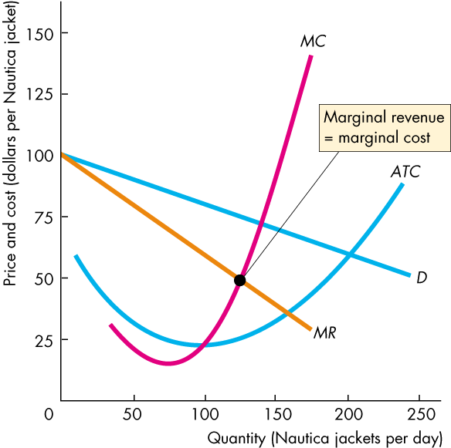
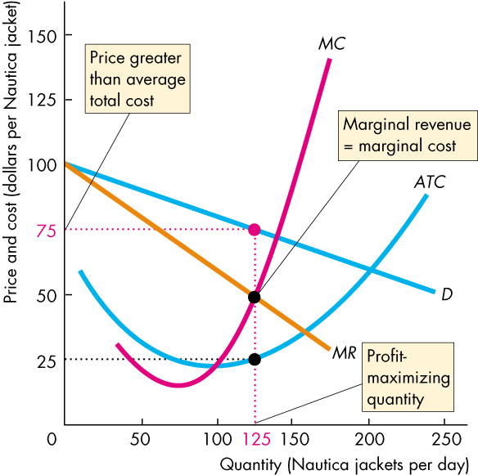
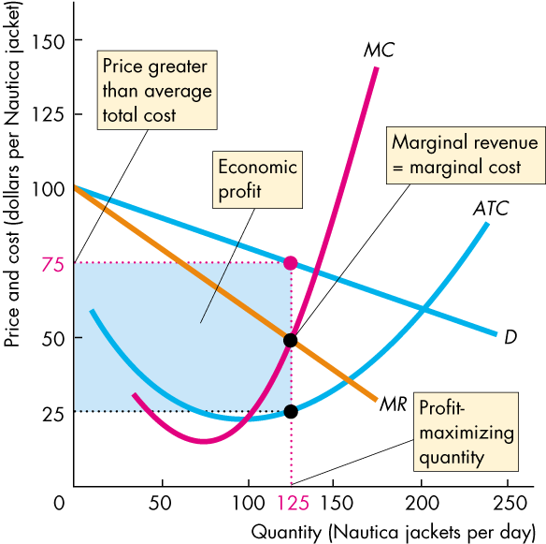
Price and Output in Monopolistic Competition
The firm produces the quantity at which marginal revenue equals marginal cost
and sells that quantity for the highest possible price.
It makes an economic profit (as in this example) when P > ATC.

Slide 10
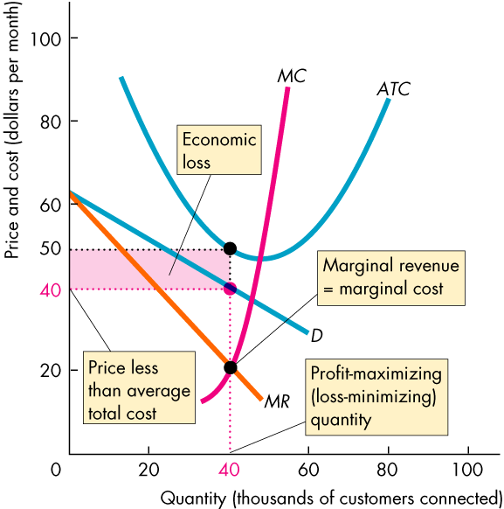
Price and Output in Monopolistic Competition
Profit Maximizing Might be Loss Minimizing
A firm might incur an economic loss in the short run.
Here is an example.
In this case, P < ATC.

Slide 11
Price and Output in Monopolistic Competition
Long Run: Zero Economic Profit
In the long run, economic profit induces entry.
And entry continues as long as firms in the industry make an economic profit—as long as (P > ATC).
In the long run, a firm in monopolistic competition maximizes its profit by producing the quantity at which its marginal revenue equals its marginal cost, MR = MC.

Slide 12
Price and Output in Monopolistic Competition
As firms enter the industry, each existing firm loses some of its market share. The demand for its product decreases and the demand curve for its product shifts leftward.
The decrease in demand decreases the quantity at which MR = MC and lowers the maximum price that the firm can charge to sell this quantity.
Price and quantity fall with firm entry until P = ATC and firms earn zero economic profit.

Slide 13
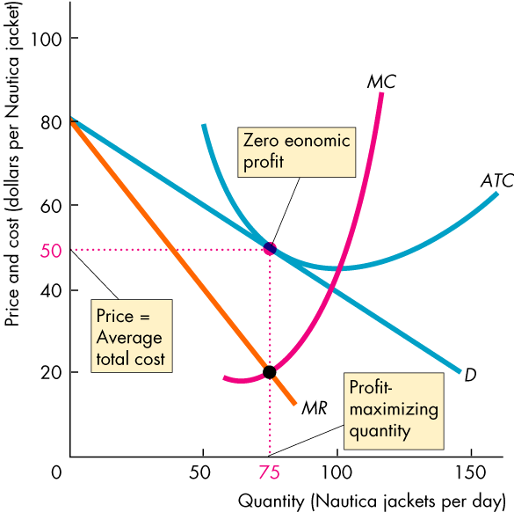
Price and Output in Long run Monopolistic Competition
Figure shows a firm in monopolistic competition in long-run equilibrium.
If firms incur an economic loss, firms exit to achieve the long-run equilibrium.

Slide 15
Price and Output in Monopolistic Competition
Monopolistic Competition and Perfect Competition
Two key differences between monopolistic competition and perfect competition are:
Excess capacity
Markup
A firm has excess capacity if it produces less than the quantity at which ATC is a minimum.
A firm’s markup is the amount by which its price exceeds its marginal cost.

Slide 16
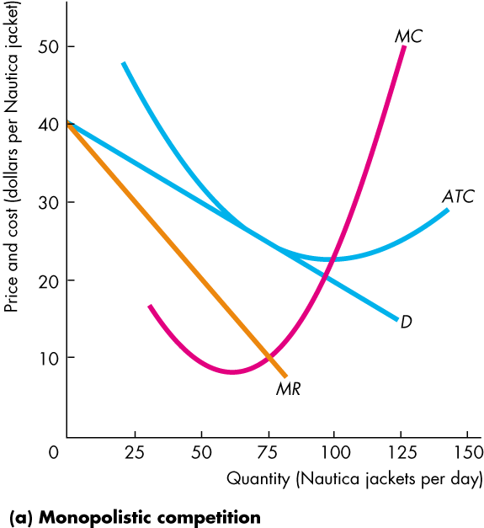
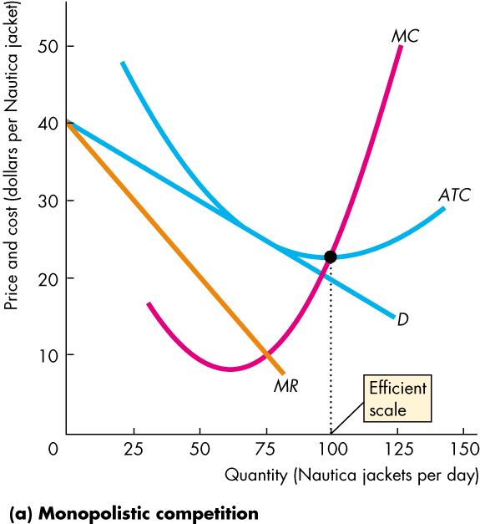
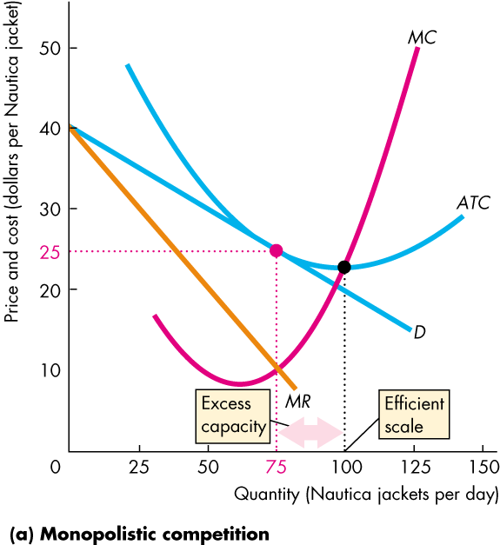
Price and Output in Monopolistic Competition
Excess Capacity
Firms in monopolistic competition operate with excess capacity in long-run equilibrium.
The downward-sloping demand curve for their products drives this result.

Slide 17
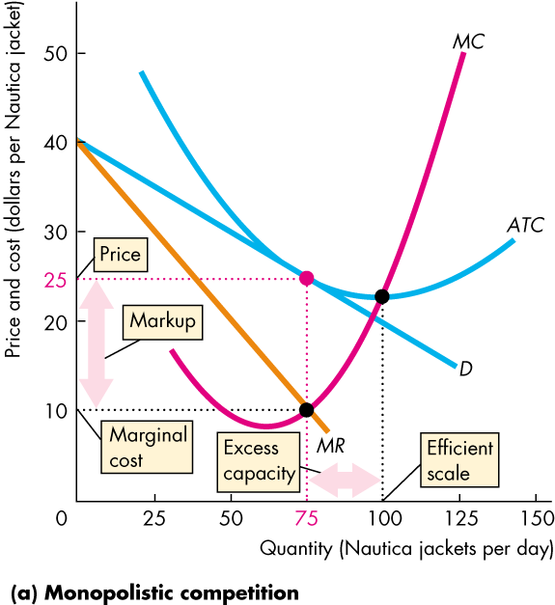
Price and Output in Monopolistic Competition
Markup
Firms in monopolistic competition operate with positive mark up.
Again, the downward-sloping demand curve for their products drives this result.

Slide 18
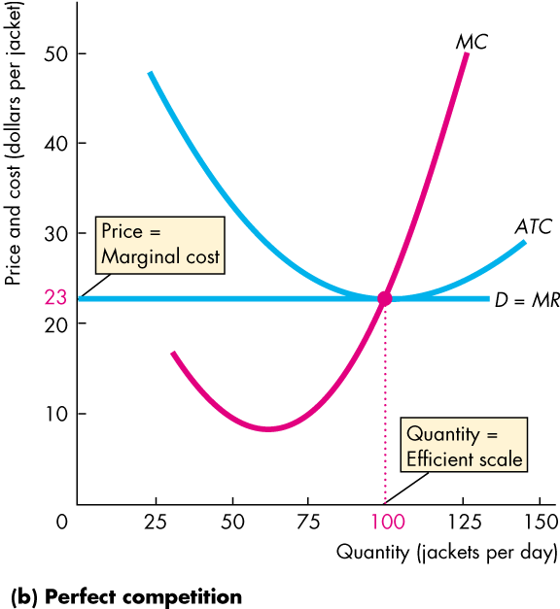
Price and Output in Monopolistic Competition
In contrast, firms in perfect competition have no excess capacity and no markup.
The perfectly elastic demand curve for their products drives this result.

