Slide 1
Perceptual mapping

Slide 2
It is a diagrammatic technique used by marketers that attempts to visually display the perceptions of customers or potential customers
The positioning of a brand is influenced by customer perceptions rather than those of businesses.
It utilizes customer input to understand their brand, product, or service from the customer’s perspective.
Other names are market mapping or positional mapping
Perceptual mapping is usually two dimensional but it can be multi-dimensional as well.

Slide 3
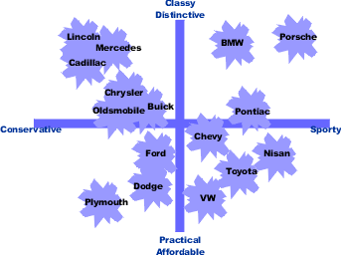
Example of perceptual map with two dimensions:

Slide 4
The perceptual map displayed on the previous slide shows that consumer perceptions of various automobiles on the two dimensions of sportiness/conservative and classy/affordable. According to the sample collected from consumers it was found that Porsche was the sportiest and classiest of the cars They felt Plymouth was most practical and conservative.
Cars that are positioned close to each other are seen as similar on the relevant dimensions by the consumer. For example, consumers see Buick, Chrysler, and Oldsmobile as similar. They are close competitors and form a competitive grouping. A company considering the introduction of a new model will look for an area on the map free from competitors.
Blank spaces on the perceptual map are the opportunities that can be grabbed by the companies in order to improve its competitive position

Slide 6
All these are website development companies and the perceptual map is two-dimensional.
Now that we have a concrete visual representation, we can see how WordPress.com is doing well among these two attributes as compared to its competitors
We can see that Wix.com has the highest total engagement on social media and highest time on site among its competitors. We can also see that Weebly.com has the lowest total engagement on social media and lowest time on site.

Slide 7
Example of multi- dimensional perceptual map

Slide 8
Multidimensional perceptual map shows the positioning of multiple brands relative to the attributes. It may look a little bit confusing but it is usually a far more effective approach to understand the overall market.
For example: perceptual map shown in the previous slide shows the various attributed associated with the numerous soft drinks such as Fanta, Pepsi, Mt. Dew, water, Sprite, Coke Zero, etc.
Through this map we can figure out the perceptions of customers towards these brands such as Mt. Dew and Sprite are tangy, Pepsi Next is modem, Pepsi is sweet , Water is clear and so on.

Slide 9
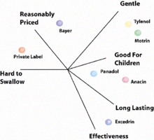
Example of perceptual map with multi- dimensions

Slide 10
Multidimensional perceptual maps are built with more dimensions visualized as profile charts in small map regions, and then items are mapped to the regions by their similarity to the vectors that represent the region.
The perceptual map displayed on the previous slide shows that there are various dimensions on the basis of which customers perceptions are found such as reasonably priced, gentle, hard to swallow, effectiveness and good for children. It is through this map the marketers can found what are perceptions of customers such as customers perceive Bayer as reasonably priced and gentle.

Slide 11
Advantages of perceptual mapping
It enables companies to better understand their customers.
It also allows businesses to see what consumers think of other brands, particularly their competitors.
Regular uses of the maps can help track preferences, and see changes as they happen.
It can help define market segments, showing clusters of businesses differentiated by key aspects.
It can also help in identifying gaps in a market where a new product or service could be introduced.
It can also be used to help keep track of how a new product, such as a recently introduced smartphone, is being viewed in a specific market.

Slide 12
Limitations of perceptual mapping
It requires lot of time and efforts in order to gather data through surveys, polls, etc.
Results may not always be reliable because of miscommunication and lack of knowledge.
Perceptual maps are not beneficial for high-involvement purchase decisions.
They are less helpful for corporate brand images as compared to individual brands.
There is a difference between the perception of the brands benefits and the realities.
It is an expensive method

