Slide 1
Marketing communications- source, message and media effects

Slide 2
INTRODUCTION
To be a manager is to be a communicator – the two are inextricably linked. A great manager needs to communicate upwards, sideways and with his/her team all the time. Employees have a stake in the business, so it is essential that they are kept fully informed regularly so that their views and opinions are sought.
Communication is any process in which people share information, ideas, and feelings. It involves not only the spoken and written word, but also body language. Communication is two - way process that is delivering and receiving information both is important. Communication process is complete only when the receiver of the message understands the message in the same way as intended by the sender.

Slide 3
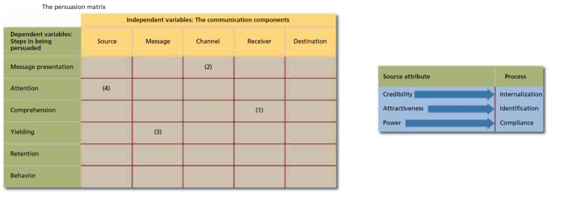
To develop an effective advertising and promotional campaign, a firm must select the right spokesperson to deliver a compelling message through appropriate channels or media. Source, message, and channel factors are controllable elements in the communications model. The persuasion matrix helps marketers see how each controllable element interacts with the consumer’s response process.

Slide 4
1.Receiver/comprehension: Can the receiver comprehend the ad? Marketers must know their target market to make their messages clear and understandable. A less educated person may have more difficulty interpreting a complicated message. Jargon may be unfamiliar to some receivers. The more marketers know about the target market, the more they see which words, symbols, and expressions their customers understand.
2. Channel/presentation: Which media will increase presentation? A top-rated, prime-time TV program is seen by nearly 12 million households each week. TV Guide and Reader’s Digest reach nearly 12 million homes with each issue. But the important point is how well they reach the marketer’s target audience. CNN’s financial show Lou Dobbs Money line reaches only around a million viewers each weekday evening, but its audience consists mostly of upscale businesspeople who are prime prospects for expensive cars, financial services, and business-related products.

Slide 5
3. Message/yielding: What type of message will create favorable attitudes or feelings? Marketers generally try to create agreeable messages that lead to positive feelings toward the product or service. Humorous messages often put consumers in a good mood and evoke positive feelings that may become associated with the brand being advertised. Music adds emotion that makes consumers more receptive to the message. Many advertisers use explicit sexual appeals designed to arouse consumers or suggest they can enhance their attractiveness to the opposite sex. Some marketers compare their brands to the competition.
4. Source/attention: Who will be effective in getting consumers’ attention? The large number of ads we are bombarded with every day makes it difficult for advertisers to break through the clutter. Marketers deal with this problem by using sources who will attract the target audience’s attention—actors, athletes, rock stars, or attractive models.

Slide 6
SOURCE FACTORS
Source means the person involved in communicating a marketing message, either directly or indirectly.
A direct source is a spokesperson who delivers a message and/or demonstrates a product or service. An indirect source doesn’t actually deliver the message but draws attention to enhance the appearance of the ad.
There are 3 source factors:
Source creditability
Source attractiveness
Source power

Slide 7
Source Credibility : Credibility is the extent to which the recipient sees the source as having relevant knowledge, skill, or experience and trusts the source to give unbiased, objective information. There are two important dimensions to credibility, expertise and trustworthiness. Because attitudes and opinions developed through an internalization process become part of the individual’s belief system, marketers want to use communicators with high credibility.
Use of Expertise : Spokespeople are often chosen because of their knowledge, experience, and expertise in a particular product or service area. Endorsements from individuals or groups recognized as experts, such as doctors or dentists, are also common in advertising.
Use of trustworthiness : While expertise is important, the target audience must also find the source believable. Finding celebrities or other figures with a trustworthy image is often difficult. Hence, advertisers use various techniques to increase the perception that their sources are trustworthy.

Slide 8
Example of source creditability

Slide 9
Source Attractiveness: A source characteristic frequently used by advertisers is attractiveness, which encompasses similarity, familiarity, and likability. Similarity is a supposed resemblance between the source and the receiver of the message, while familiarity refers to knowledge of the source through exposure. Likability is an affection for the source as a result of physical appearance, behavior, or other personal traits.
Use of similarity : Companies select salespeople whose characteristics match well with their customers. Global marketers often hire foreign nationals as salespeople so customers can relate more easily to them.
Use of Likability : Advertisers recognize the value of using spokespeople who are admired: TV and movie stars, athletes, musicians, and other popular public figures. They think celebrities have stopping power. That is, they draw attention to advertising messages in a very cluttered media environment.

Slide 11
Source Power :A source has power when he or she can actually administer rewards and punishments to the receiver. As a result of this power, the source may be able to induce another person(s) to respond to the request or position he or she is advocating. The source must be perceived as being able to administer positive or negative sanctions to the receiver (perceived control) and the receiver must think the source cares about whether or not the receiver conforms (perceived concern). The receiver’s estimate of the source’s ability to observe conformity is also important (perceived scrutiny). Power as a source characteristic is very difficult to apply in an on personal influence situation such as advertising. An indirect way of using power is by using an individual with an authoritative personality as a spokesperson.

Slide 13
MESSAGE FACTORS
Way of presentation of communication is very important to determine their effectiveness. It consists of two parts:
a) Message structure
b) Message appeal

Slide 14
a) Message structure - it includes:
Order of Presentation: A basic consideration in the design of a persuasive message is the arguments’ order of presentation. Presenting the strongest arguments at the beginning of the message assumes a primacy effect is prating, whereby information presented first is most effective. Putting the strong points at the end assumes a recency effect, whereby the last arguments presented are most persuasive. The order of presentation can be critical when a long, detailed message with many arguments is being presented. Most effective sales presentations open and close with strong selling points and bury weaker arguments in the middle. For short communications ,such as a 15- or 30-second TV or radio commercial, the order may be less critical. However, many product and service messages are received by consumers with low involvement and minimal interest. Thus, an advertiser may want to present the brand name and key selling points early in the message and repeat them at the end to enhance recall and retention.
For example: Reliance network ad

Slide 15
2) Conclusion Drawing: Marketing communicators must decide whether their messages should explicitly draw a firm conclusion or allow receivers to draw their own conclusions. Does the marketer want the message to trigger immediate action or a more long-term effect? If immediate action is an objective, the message should draw a definite conclusion. This is a common strategy in political advertising, particularly for ads run close to Election Day. When immediate impact is not the objective and repeated exposure will give the audience members opportunities to draw their Own conclusions, an open-ended message may be used. Many advertisers believe that letting customers draw their own conclusions reinforces the points being made in the message.
For example: in the next slide example of soya milk is given
Another example is of Melody “ Melody itni chocolaty kyon hai, Melody khao khud jaan jao”

Slide 17
3) Message Sidedness:
One-sided message mentions only positive attributes or benefits. One-sided messages are most effective when the target audience already holds a favorable opinion about the topic.
For example: Rin, Liril, Reliance, Airtel
A Two-sided message presents both good and bad points. Two-sided messages are more effective when the target audience holds an opposing opinion or is highly educated. Two-sided messages may enhance the credibility of the source.
For example, W. K. Buckley Limited has become one of the leading brands of cough syrup in Canada by using a blunt two sided slogan, “Buckley’s Mixture. It tastes awful. And it works (see in next slide). Refutational two sided messages are in which the communicator presents both sides of an issue and then refutes the opposing viewpoint. For e.g. The Almond Board of California used an ad to refute nutritional concerns about almonds regarding their fat content.

Slide 19
b) Message appeal
The choice of appeal is one of the most important and tedious work for marketers. It is designed according to logical and other important factor. There are following type of appeals followed by the marketers.
Comparative appeal
Fear appeal
Humor appeal

Slide 20
Comparative appeal
when the advertiser directly or indirectly uses the name of competitors for comparing the advertisement.

Slide 21
2) Fear appeal
companies sometimes use feal appeal in order to erase the feal of the consumers

Slide 22
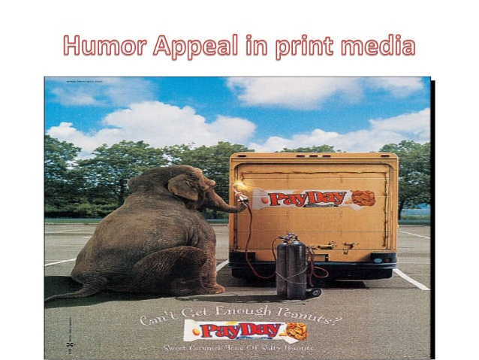
3) Humor appeal
marketers sometimes use such kind of appeal in order to attract the customers.

Slide 23
CHANNEL/ MEDIA FACTORS:
While a variety of methods are available to transmit marketing communications, they can be classified into two broad categories, personal and non-personal media. There are a number of basic differences between personal and non-personal communications channels. Information received from personal influence channels is generally more persuasive than information received via the mass media. It includes:
Difference in information processing
Effects of context and environment
Clutter

Slide 24
Difference in Information Processing: Self-paced print media make it easier for the message recipient to process a long, complex message. Advertisers often use print ads when they want to present a detailed message with a lot of information. Broadcast media are more effective for transmitting shorter messages or, in the case of TV, presenting pictorial information along with words.
Effects of Context and Environment: Interpretation of an advertising message can be influenced by the context or environment in which the ad appears. A qualitative media effect is the influence the medium has on a message. The image of the media vehicle can affect reactions to the message. For example, an ad for a high-quality men’s clothing line might have more of an impact in a fashion magazine like GQ than in Sports Afield.

Slide 25
Clutter: Another aspect of the media environment, which is important to advertisers, is the problem of clutter, which has been defined as the amount of advertising in a medium. Clutter is of increasing concern to advertisers since there are so many messages in various media competing for the consumer’s attention. Half of the average magazine’s pages contain ads and in some publications the ratio of ads to editorial content is even higher. Clutter is of increasing concern to advertisers since there are so many messages in various media competing for the consumer’s attention. Clutter has become a major concern among television advertisers as a result of increases in non-program time and the trend toward shorter commercials. Advertisers and agencies want the networks to commit to a minimum amount of program time and then manage the non-program portion however they see fit.

Slide 26
COMMUNICATION PROCESS DIAGRAM

Slide 27
IMPORTANCE OF MARKETING COMMUNICATION
It is very important to have a communication flow between the firm and the consumer. In the absence of a direct face-to-face contact with the consumer, the marketer has to make provisions for developing a communication flow between them and their customers.
The Traditional view, the marketer’s held, was that they can enter into a communication with their consumer through the development of a ‘promotion mix’, which includes personal selling, advertising, sales promotion and publicity. However, in the existing competitive scenario, firms have realized that in order to woo and win over consumers, they have to develop a multi dimensional flow of communication network between them on one hand and with the consumers on the other side.
While the organization performs its role as an effective communicator, the firm is also a sender of market message and also a receiver of the market response.

