Slide 1
In store stimuli

Slide 2
In store stimuli are promotional techniques employed to increases unplanned or subconsciously planned purchases of products.
Manufacturers and retailers spends large sum of money on advertising and in-store promotion in the hope of increasing sales of their merchandise through impulsive buying.
in-store stimuli is very important in todays time because fierce competition has always been a hallmark of the retail industry. In recent years, it has become even tougher, as innovative new entrants have upset the status quo and existing retailers have become more efficient. Hence, in order to survive and grow in this competitive environment; it is essential to adopt various in-store stimuli techniques.

Slide 3
In-store stimuli techniques
on-shelf positions
price-off promotions
samples
point-of-purchase displays
coupons
in-store demonstrations

Slide 4
On shelf positions
it is a key to attract the customers and grow the sales of the stores.
Although a retailer might have agreed to put the item in his/her store; that doesn't mean you get prime real estate. Most consumers believe that the middle shelf - or the shelf closest to their eye level - is the best placement for products in a store as compared to top or bottom.
Knowing that shelf positioning can have real impact on product sales, it's critical for you to go into negotiations with a retailer and fight for the best shelf space.

Slide 5
Price – off promotions
Price - off promotion examples are all around us. Big price-offs may be as old as the trade industry, but it’s an evergreen method of increasing sales volume. We all wait for the summer/winter clearance sale to finally buy items we’ve spotted but couldn’t afford to buy during the season. There are sales promotion ideas for boosting in – store stimuli.
Price cuts are convenient for both customers and retailers. It offers the possibility to buy more for less and it allows retailers to clear their stocks and sell huge volumes while keeping the money flowing and the business going.

Slide 6
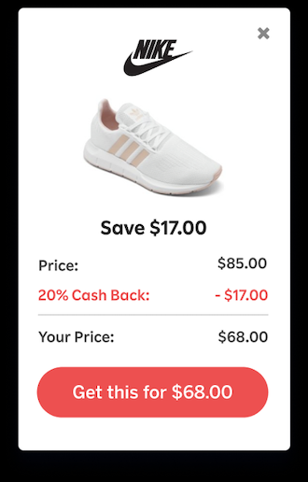

Slide 7
Samples
Many consumers may pass your product on the shelves, mulling over all the reasons they would like to try it. However, many shoppers, particularly those in the stores, try to stay within a spending budget. Purchasing a product that leads to regret is seen as a waste of money.
Thus, by having the opportunity to sample the product or see it demonstrated, they mitigate the risk of trying a new brand.
This is called by experts bringing your product into a consumer’s “consideration set”.
Sampling is the test-run than can end up a home-run for the manufacturer.

Slide 8
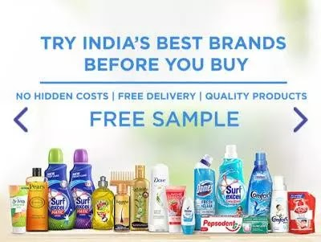

Slide 9
Point of purchase displays
The phrase “point of purchase” may conjure images of wherever customers go to make their purchase and hand over payment.
Placing small, inexpensive, and relevant items on the counter can boost sales. So can using displays of these items to create an area where customers can queue while waiting to check out.
This point of purchase marketing technique works for a few reasons:
Customers have already made a decision to buy something, making them more likely to buy an additional product if it does not significantly add to the total price of their purchase.
“Add-on” type items that are highly relevant to your customers can trigger impulsive purchases or serve as reminders for customers. Sephora, for example, keeps their travel- and sample-sized products in these displays, which are easy for customers to justify as something they genuinely need to stock up on.

Slide 10
You can turn a shopping nuisance — a long check-out line and wait time; into an extended shopping experience for your customers. Your display can keep them engaged and interested as they wait, which maintains their decision to buy a product and reduces the chances they’ll walk out empty-handed simply because they saw a long line at the register.
Point of purchase marketing does include your cash register and checkout counter, but you’re not limited to just these areas in your store. You can get creative with strategies in places like:
Various places throughout your sales floor
Directly on specific displays or sections of products
Customer’s smartphones that they use as they browse

Slide 11
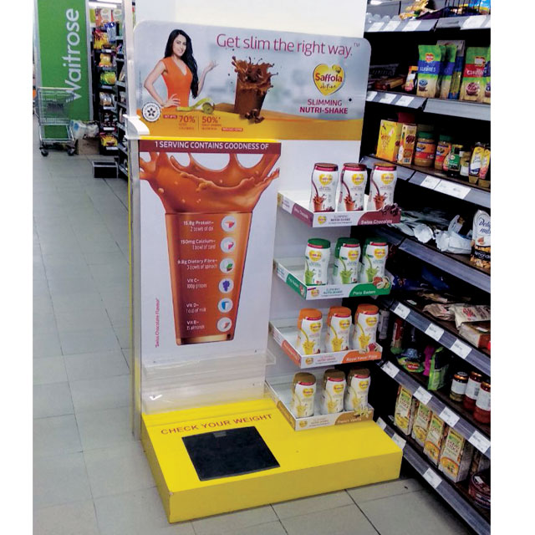
Example of Saffola (Slimming Nutri – Shake)

Slide 12
Coupons
You can offer vouchers and coupons via email, your website, or print materials such as product packaging, catalogs, and so on. They are a great way to thank your current customers and to encourage them to continue doing business with you.
One way to really get people excited about their next purchase with you is to offer a mystery coupon. Not only is it interactive but it also makes customers feel as if they’re playing a game and getting more than just a run-of-the-mill discount.

Slide 13
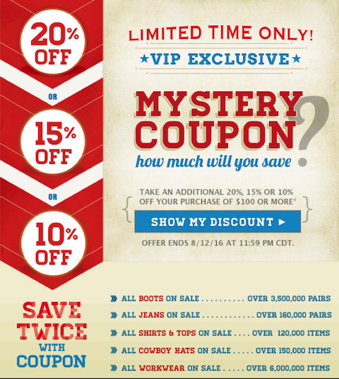

Slide 14
In-store demonstrations
In-store product demonstrations offer a real-time opportunity for stores to directly showcase, demonstrate, and promote items to encourage immediate sales. These demos allow sales representatives and experts to connect directly with the customer at a critical point in the sales funnel. The greater the connection, the higher the conversion.
Customers today want to have confidence in the products they’re purchasing, and physical product demonstrations are the best way to gain consumers trust, while reducing the perceived risk associated with investing in something new.

Slide 15
