Slide 1
Store image and loyalty

Slide 2
Store image
It can be defined as “a store defined in customers’ mind partly based on functional attributes and partly based on psychological attributes.” Functional attributes are assortment of commodities, layout, location, price value relation, and service that consumers can objectively compare with other stores. Psychological attributes are attractiveness and luxuriousness that represent special attributes of that store. Store image also includes its characteristic attributes which makes customer feel the store different from others.
Store image is basically complex of meanings and relation that make consumers distinguish the store from others.

Slide 3
Importance of store image
If designed properly it can accelerate the buying pattern of consumers
Gives the competitive advantage
It also helps in distinguishing one store from other
Store image attributes such as price level are used to forecast marketing performance as a business success measure.
It helps in increasing the loyalty and long term relationship with customers
It is responsible for store performances
Helps in attracting customers

Slide 4
How to improve store image
Shoppers responds to music psychologically and behaviorally. Thus, presence of pleasant music will contribute in improving the store image.
Well-designed lighting systems can bring an added dimension to an interior, guide the customer's eyes to key sales points, create an atmosphere of excitement.
It can also be improved by providing a logical store layout and sufficient signage
Store personnel contribute to entertaining store experiences. Hence, by employing talented store personnel; store image can be improved.

Slide 5
Store image dimensions
There are basically 8 store image dimensions and those are:
Atmosphere ( store interior, store atmosphere)
Convenience ( transportation, location, parking, shopping ease, store hours)
Facilities ( store layout, store appearance, convenience of facilities, fitting room and fixtures)
Institutional ( clientele, store reputation )
Merchandise ( assortment, style, price, quality )
Promotion ( advertising, displays, sales incentives )
Sales Personnel ( interaction, appearance )
Service ( after sales service, payment option, in-store service, delivery options)

Slide 6
Role of store image in impulsive buying
Customers come to store not only to purchase merchandise but also to share their experiences. If store image is designed properly there are possibilities that customers make unplanned purchases; which is very common now-a-days. Apart from unplanned purchases; if the store image is designed properly, consumers can make repetitive purchases. Moreover, if the store image is designed properly; there is high possibility that the customers of competitors shift to our store because of better experiences. Hence, store image play a very crucial role in impulsive buying of the customers.

Slide 7
Store loyalty
It mean when a buyer prefers and therefore systemically goes to the same store to make purchases.
It is very important for stores to achieve store loyalty because it ultimately leads to increase in profitability and increased retention of customers.
Store loyalty and store image are closely related. Both are directly related such as if there is improvement in the store image then there will also be improvement in store loyalty and vice versa.
It is difficult to achieve store loyalty. Hence, in order to achieve store loyalty it is essential for stores to adopt various strategies to improve store loyalty. These strategies are discussed in the next few slides.

Slide 8
Strategies to improve store loyalty
Engage : engage the customer at every point of a sales cycle. That means from the moment they walk in the door to the moment they leave, regardless of a purchase; they will feel appreciated. This feeling of appreciation doesn’t guarantee that they’ll make a purchase, but it makes it more likely than if you had ignored them.
Stay in touch : keeping in touch with your customers is very essential to nurture your long-term relationship. Stores can keep in touch with the customers through SMS, mails, coupons, etc.
Reward loyalty : Loyalty programs are all the rage and very often are expected by customers. But as much as they might be anticipated, customers do appreciate them and are more likely to frequent a business if they know it will benefit them in the long run.

Slide 9
Build a community : Community is an extension of advocacy, and it’s the perfect place to make people loyal to your brand. Since the majority of people shop online, you should build an online community. Once you know your audience’s expectations, create an online group and bring those people together. Make them the first ones to hear about your brand’s novelties and offers.
Tear down the walls with social media : A great example of social media engagement is Wendy’s Twitter profile. Whenever someone mentions them, they’ll get back with a witty reply, making anyone want to engage in a conversation with them.

Slide 10
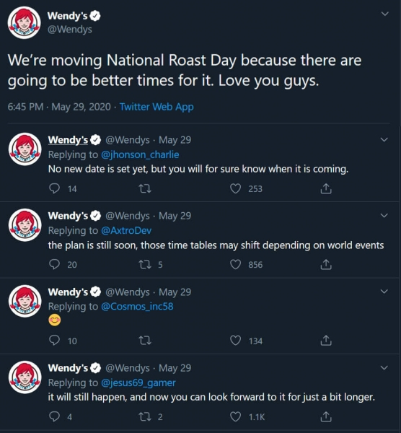

Slide 11
Submit your Fevicol ad Idea & stand a chance to get it made & win –
1. iPhone 11 (3 winners)
2. Rs. 5000 Amazon voucher (10 winners)
All you have to do is –
1. Tag @StuckByFevicol
2. Use #MyFevicolAd with your entry
Contest ends on 27th December ‘19!
Another example of engage (that is a video) is given in the next slide
Example of engage:

Slide 12


