Slide 1
Writing for Enquiries

Slide 2
Introduction
Letter of enquiry describes what the writer wants and why. The more unusual the request the more convincing the reason needs to be.
The letter written for the purpose of knowing about the quality, quantity and price if the goods and the conditions of the business are known as enquiry letters.
It is the foundation of business relationships.

Slide 3
Types of Enquiries
Solicited Enquiry: An enquiry made in response to the seller’s advertisement and publicity.
Unsolicited Enquiry: An enquiry made on buyers own initiative.
Routine Enquiry: An enquiry made by an old buyer in the usual course of business.

Slide 4
Contents
Subject Heading
First Paragraph
Second Paragraph
Final Paragraph

Slide 5
Subject Heading
This should inform the reader that this is an enquiry or request e.g.
Enquiry about textbooks
Request for brochures
Query about website

Slide 6
First Paragraph
This should tell the reader what you want
The introduction serves as the executors summary for the letter of enquiry and includes the name of your organization , the amount needed or requested and a description of the project.The Qualification of the aproject staff, a brief description of evaluate methodology and a time table are also included here.

Slide 7
Second Paragraph
This paragraph tells the reader why you are contacting his or her organization, and gives further details of the enquiry.

Slide 8
Examples for Second Paragraph
I saw your advertisement in HT daily on 23 October 2020
Your company was recommended to me by Mr. XYZ of KT logistics.

Slide 9
Final Paragraph
This paragraph should contain a polite expression or an expression of thanks to the reader. The degree of politeness depends on how unusual or difficult your request is.

Slide 10
Final Paragraph
Possible language includes
Thanks
I look forward to hearing from you.
I am looking forward to hear from you.
Thank you for your assistance.
I appreciate that this is an unusual request, but I would be very grateful for any help you provide.
If you think that reader might have further questions, you can suggest that he or she contact you.

Slide 11
Guidelines
State your purpose
List your questions or requested actions.
Offer something in return to encourage action.
Follow up with a thank you note, e-mail or phone call to the person who helped you with your request.

Slide 12
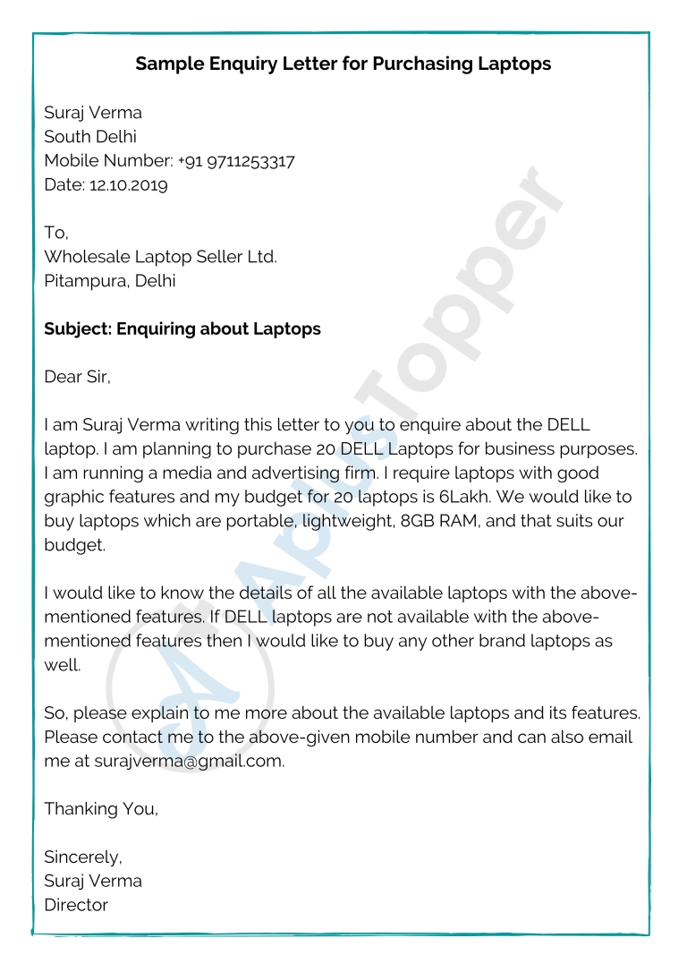
Sample Letter

Slide 13
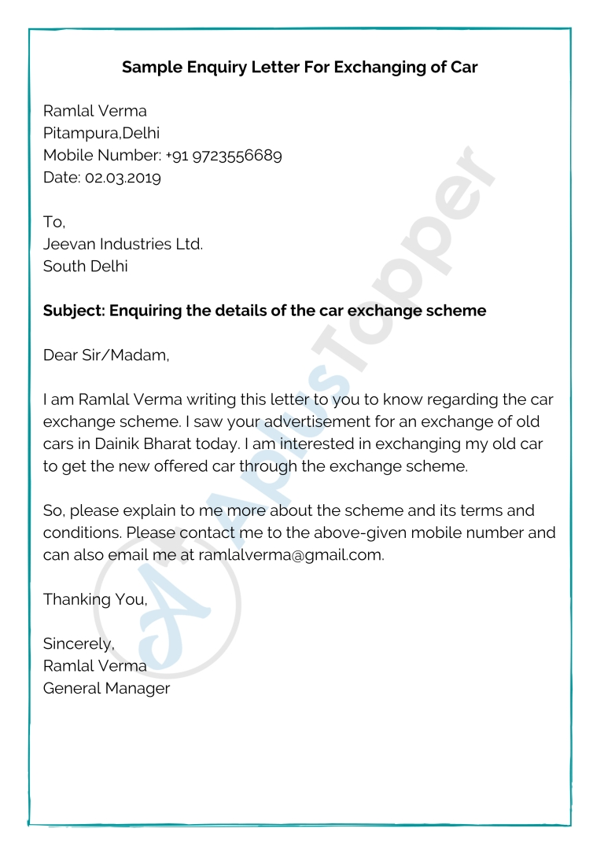
Sample Letter 2

Slide 14


