Slide 1
FACULTY OF MANAGEMENT STUDIES
Managerial Skill Development
Submitted To :
PROF. MEERA MATHUR
Submitted By:
HIMANSHI BAGRECHA
SEJAL CHAWAT
SHREYA POKHARNA
NIKHIL SINGH
SIDDESH MEHTA
Preeti Kannan Iyer

Slide 2
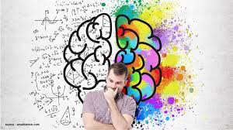
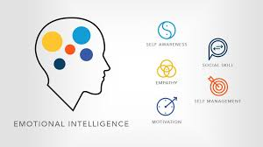
Emotional intelligence

Slide 3
Contents
Introduction
Characteristics
Benefits
Components
Test on EI
Importance
Applications
Difference between EI and AI
Conclusion

Slide 4
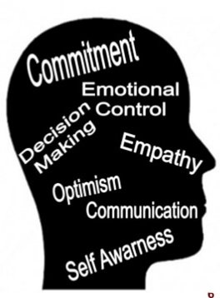
Emotional Intelligence
Emotional intelligence (EI), is the capability of individuals to recognize their own emotions and those of others, discern between different feelings and label them appropriately, use emotional information to guide thinking and behavior, and manage and/or adjust emotions to adapt to environments or achieve one's goal(s).

Slide 5
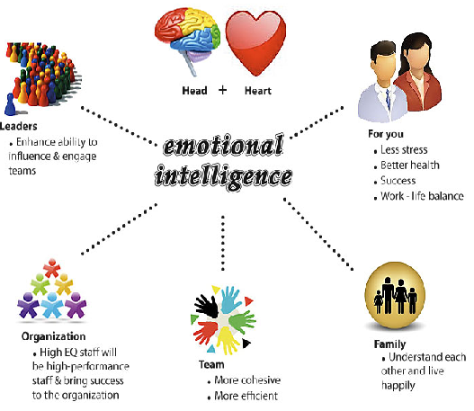

Slide 6
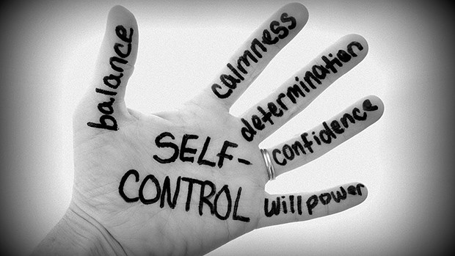
Characteristics of EI
Self control
passion
Self motivation
Determination

Slide 7
Benefits
Emotional Intelligence
Better team work
Deal with change
Handle tough conversations
Essential people skill
Strong leader
Communication

Slide 8
Components of EI
Emotional intelligence
Self-awareness
Self-regulation
Motivation
Empathy
Social skills

Slide 9
Test on emotional intelligence

Slide 10
IMPORTANCE OF EI
Emotional intelligence
Physical health
Success
Relationships
Mental well-being
Leadership
Conflict resolution

Slide 11
Applications of EI
Applications of EI in organizations
Leadership & professional development
Selection & performance profiles
Development & strengthening of teams
Interactions and agreements with customers & suppliers
Development & strengthening of culture & climate
Improvement of process

Slide 12
Difference between EQ and IQ
IQ | EQ
Helps you get in the door | Helps you succeed in job
Measure of ability to learn or understand | Measure of ability to use your emotions and logical skills
Trying to convince someone by facts | Trying to convince someone by reasoning
Book smart | Heart smart
Gets you through school, college & job | Gets you through life
Learn, understand and Implement knowledge, logical reasoning and abstract thinking. | Recognize, control and express one’s own emotions and access other’s emotions.

Slide 14
Meaning
Measures
Ability
Acquisition
Ensures
Recognises

Slide 16
Thank You

