Slide 1

EMOTIONS :
EMOTIONAL EMPATHY
AND
EMOTIONAL INTELLIGENCE

Slide 2
INTRODUCTION
1. Emotional Empathy : Emotional empathy, also called affective empathy or primitive empathy, is the subjective state resulting from emotional contagion. It is our automatic drive to respond appropriately to another’s emotions. This kind of empathy happens automatically, and often unconsciously
2. Emotional Intelligence : Emotional intelligence refers to the ability to identify and manage one’s own emotions, as well as the emotions of others

Slide 3
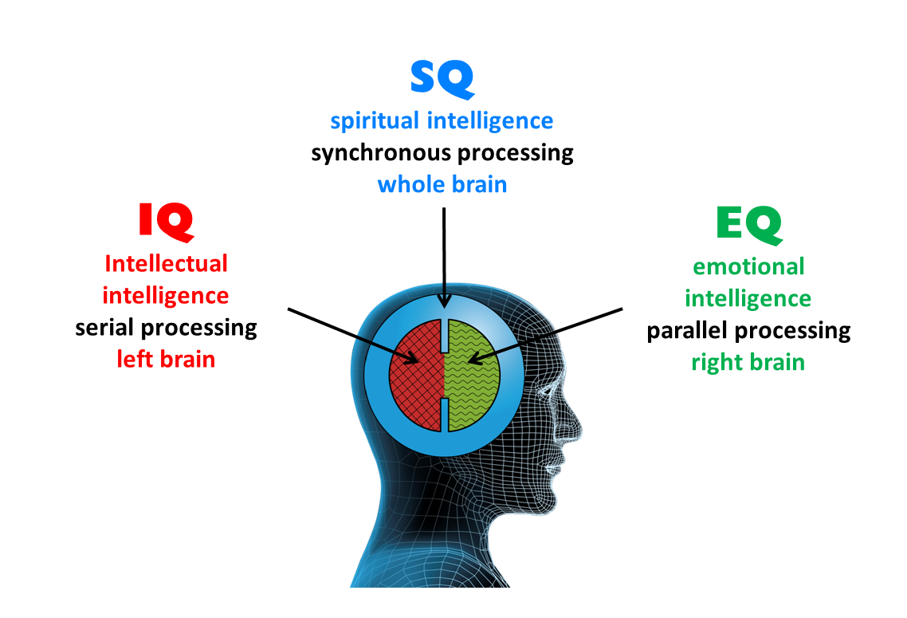
WHY IS EQ IMPORTANT ?
EQ is the pattern of how people’s biases in their thinking leads them to think one thing or choice is better than another, as well as their clarity in differentiating within those biases to exercise clear and sound judgement.

Slide 4

EMOTIONAL INTELLIGENCE IN LEADERSHIP
Self-awareness
Slow down
Keep a journal

Slide 5
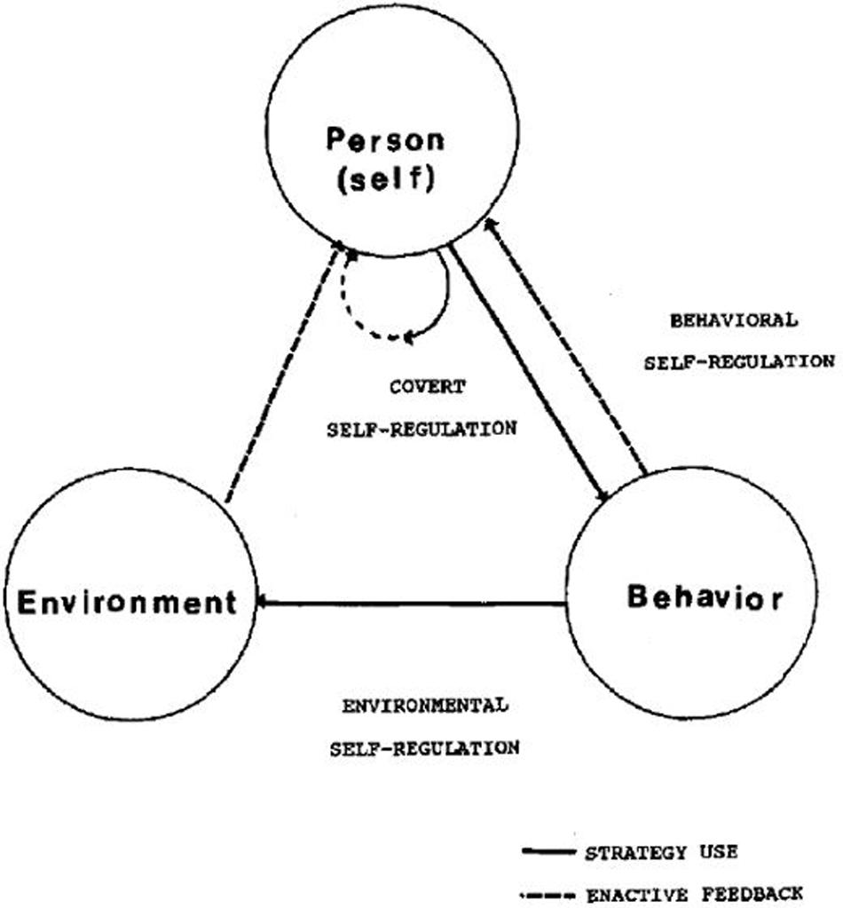
2. Self-regulation
Practice being calm
Know your values
Hold yourself accountable

Slide 6

3. Motivation
Re-examine why you're doing your job
Know where you stand
Be hopeful and find something good

Slide 7
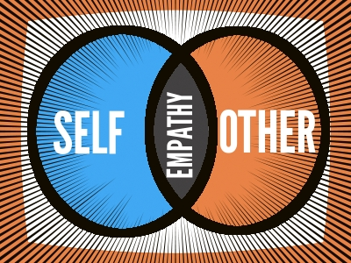
4. Empathy
Put yourself in someone else's position
Pay attention to body language
Respond to feelings

Slide 8


Slide 9

5. Social Skills
Learn conflict resolution
Improve your communication skills
Learn how to praise others

Slide 10


