Slide 1
FACULTY OF MANAGEMENT STUDIES
Managerial Skill Development
Submitted To :
PROF. MEERA MATHUR
Submitted By:
HIMANSHI BAGRECHA
SEJAL CHAWAT
SHREYA POKHARNA
NIKHIL SINGH
SIDDESH MEHTA
PREETI KANNAN IYER

Slide 2
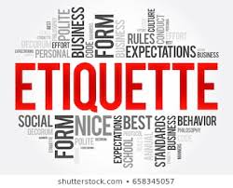
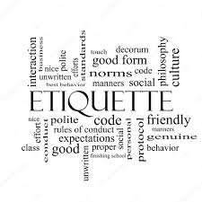
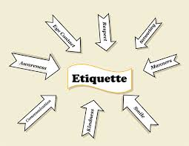
Etiquettes

Slide 3
Contents
Introduction
Importance of etiquettes
Types of etiquettes
Etiquettes in different cultures
Conclusion

Slide 4
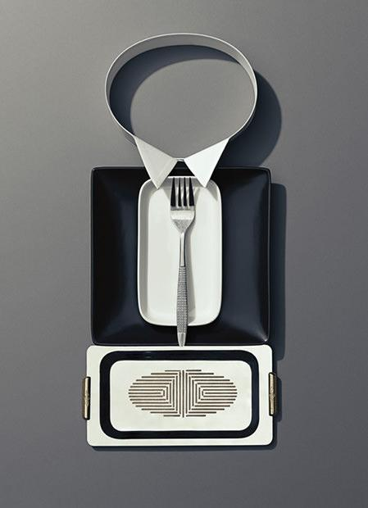
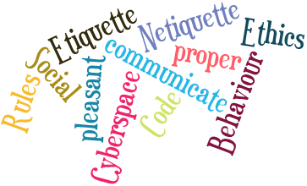
What is Etiquette?
Etiquette is a code of behavior that delineates expectations for social behavior according to contemporary conventional norms within a society, social class, or group.

Slide 5
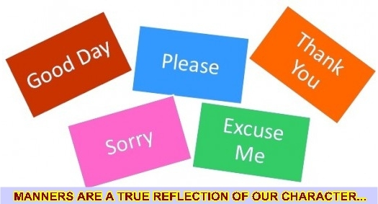
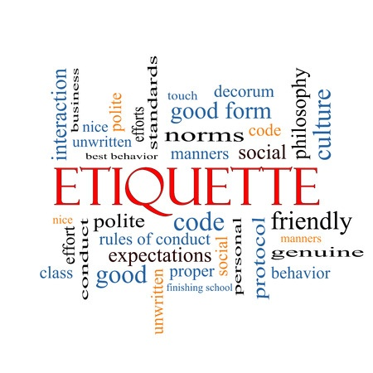
Manners vs. Etiquette
Manners Etiquette
• polite behaviour that reflect • a code of conduct based
an attitude of consideration, on social acceptance and
kindness and respect for efficiency.
others
In summary, Etiquette is the set of rules, Manners are the actions. It is good manners to follow the proper etiquette for any situation.

Slide 6
Importance of etiquettes
Provides personal security
Protects the feelings of others
Makes communication clearer
Makes good first impression
Enhance your status at work

Slide 7
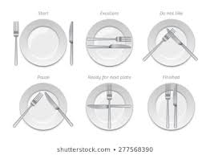
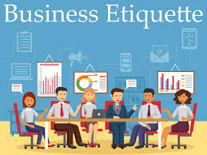
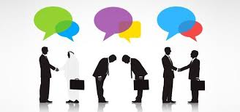
Types of etiquettes

Slide 8
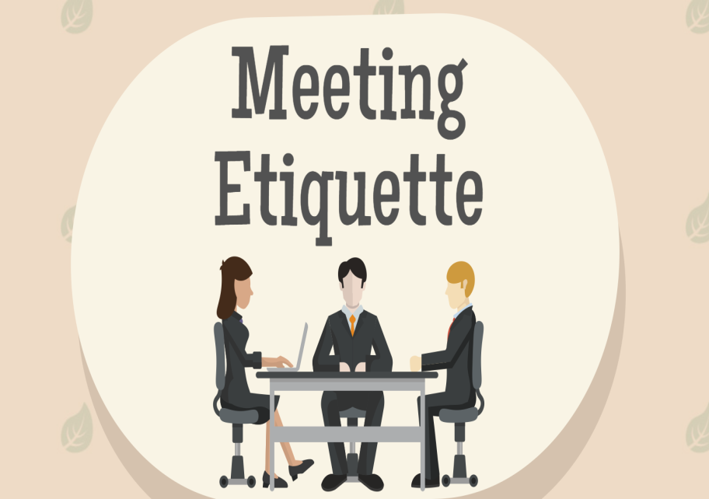
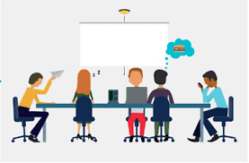
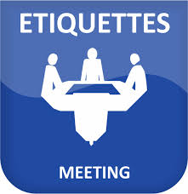
Meeting Etiquettes
Here are some strategies for maintaining proper meeting etiquettes
Be on time
Have strong agenda
Keep cell phone on silent
Be a good listener and active participant
Avoid nervous habits

Slide 9
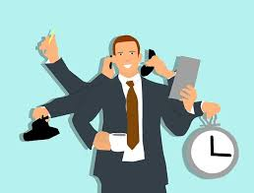
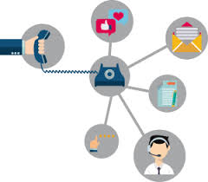
Telephone Etiquettes
Here are some strategies for maintaining proper telephone etiquettes
Voice has to be pleasant
Don’t call at odd hours
Use proper language
Don’t take too long to pick up call
Speak clearly

Slide 10
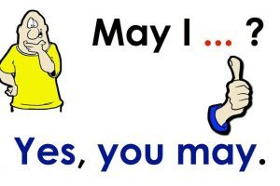
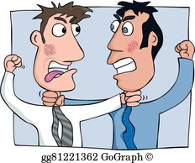
Corporate Etiquette
Never peep in other’s cubical
Stay away from nasty politics
Reach office on time
Always ask for permission
Never criticize or make fun of your colleague

Slide 11
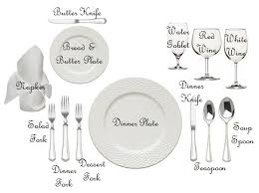
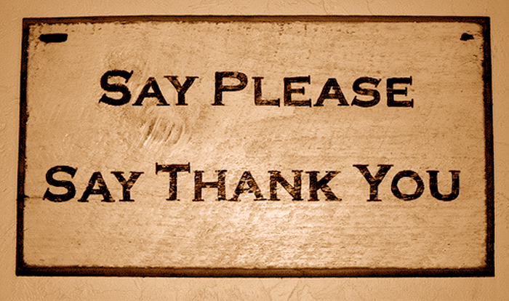
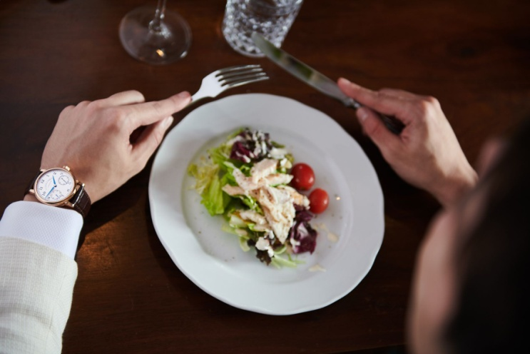
Dining Etiquette
Elbows off the table
Placement of napkin
Know which utensils to use
Remember BMW
Always say please and thank you to wait staff

Slide 12
Social Etiquettes
Greet properly
Speak slowly and clearly
Don’t smoke, chew gum or tobacco
Smile and make eye contact
Give a firm handshake
Always be punctual

Slide 13
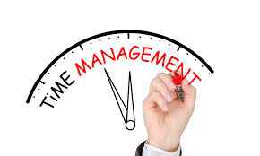
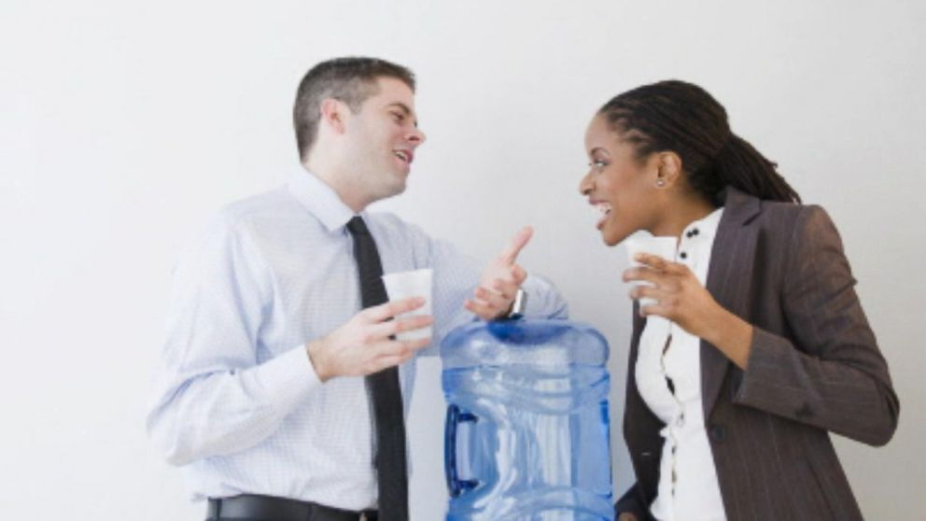
Business Etiquette
Arrive on time.
Dress appropriately for work.
Avoid gossips.
Watch your body language.
Introduce yourself & others.

Slide 14
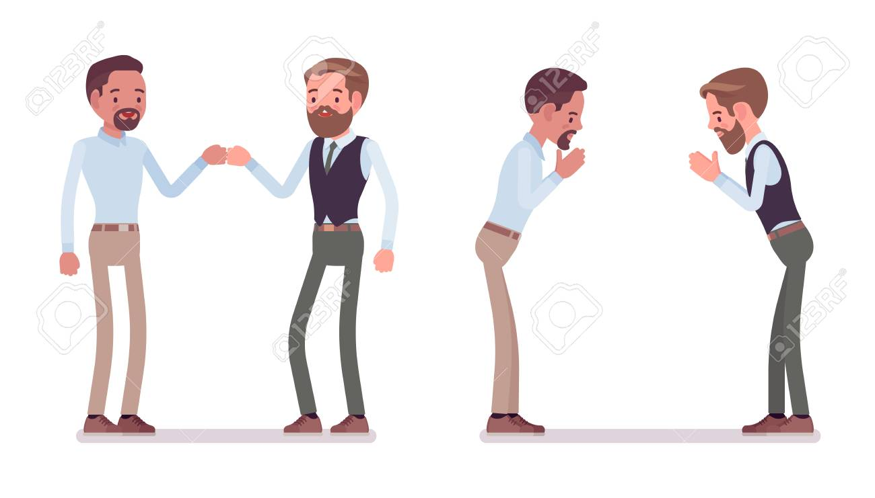
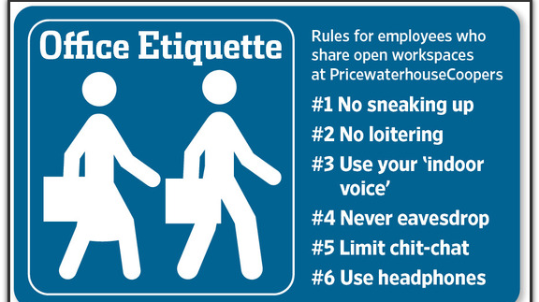
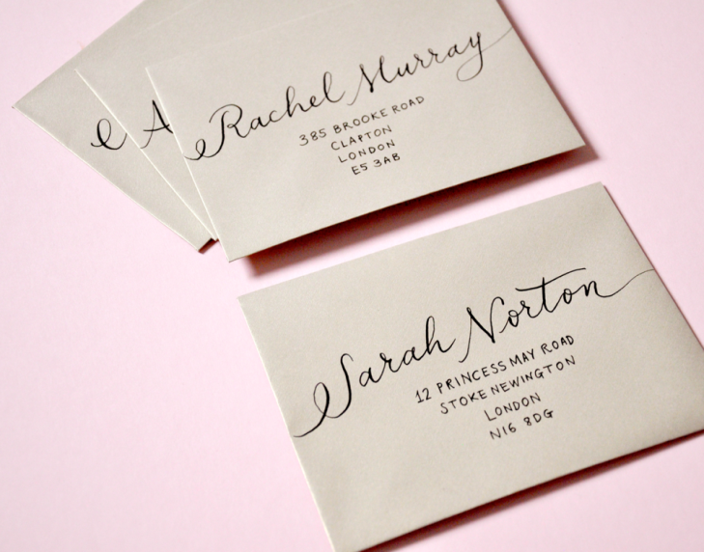
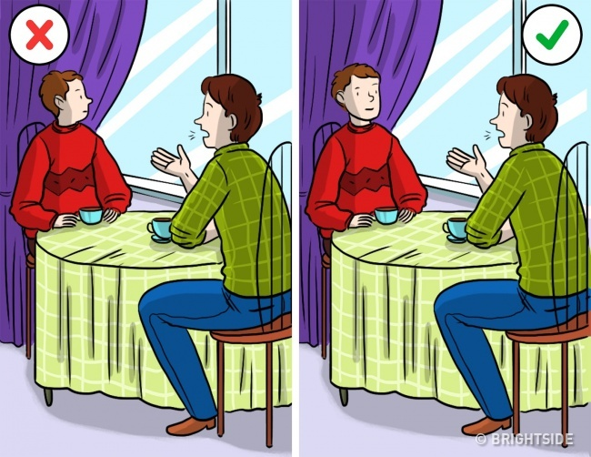
CROSS CULTURE BUSINESS ETIQUETTES

Slide 15
CONCLUSION
Solicit feedback
Non – verbal communication matters
Give respect to everyone
Punctuality is key
Etiquette transforms a man into a gentlemen

Slide 16
Thank You

