Slide 1
FACULTY OF MANAGEMENT STUDIES UDAIPUR
Submitted by
Abhishek Babel (1)
Harshil Pagaria (11)
Ishani Shrimal (16)
Pragati Lohar (31)
Vatsal Gandhi (57)
Yashasvi Dhakar (60)
Managerial Skill Development
Submitted to
Prof. Meera Mathur

Slide 6
Types of corporate culture

Slide 14
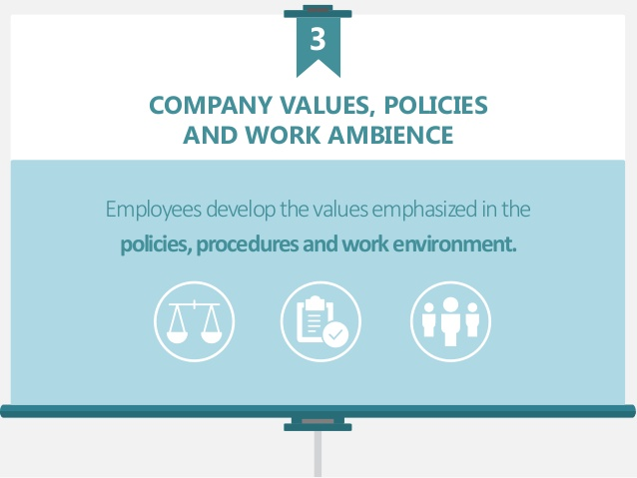

Slide 18
IMPORTANCE AND NEED Of Healthy CORPORATE CULTURE.
Employees retention
Reputation
Increases Productivity
Improves Quality
Create a healthy working environment.
Guides employees in terms of acceptable Behavior and attitude.

Slide 31
Thank you!!

