Slide 1
FACULTY OF MANAGEMENT STUDIES
MBA CMAT 2019-2021
Subject: Managrerial Skills Development
Topic: dressing for interview Do’s and Don’ts For men and women
Presented to: Dr Meera Mathur
Presented by:
Manish Kalal
Nikhil Vaishnav
Rajat
Sanjay
Siddharth Dashora
Somil suhalka

Slide 2
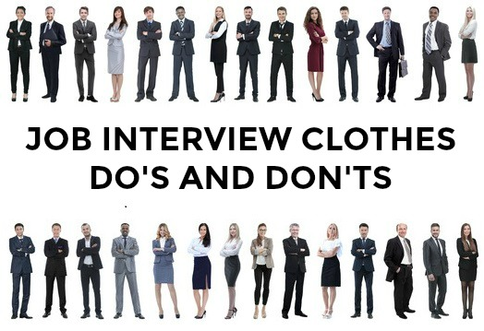

Slide 3
The way you dress for an interview gives potential employers their first impression of how you present yourself professionally. Even if you look great on paper, if you don’t dress appropriately for an interview, you give the impression that you lack respect for yourself and those you are meeting with.

Slide 4
Your outward appearance in an interview is an employer's first glimpse of your judgment skills. If you’re applying for a high-level professional job in an industry in which wearing tailored suits are the norm, showing up in anything else can indicate that you don’t know what’s expected or that you don’t care and you're flouting the standards.
judgment

Slide 5
Professionalism
Dressing appropriately for work isn’t simply a matter of looking professional; it’s also an indication that you recognize that norms and standards exist because they are expectations that need to be followed. Even if you believe that you should be judged on your talent and ability and not on your appearance, dressing appropriately for the situation shows that you have respect for your employer and clients, and you are willing to follow the directives in the workplace.

Slide 6
Confidence
Dressing professionally can give you a boost of confidence, putting you in a work frame of mind. It’s even recommended that you dress in work attire for telephone interviews, simply because it puts you in a difference mindset than if you are interviewing in your bathrobe or a pair of shorts. When you look your best, it has the potential to bring out your best performance.

Slide 7
Respect
Dressing in the right attire for an interview shows that you’re serious about the job, respectful of the interviewer's time, and are genuinely interested in the position. It also demonstrates an understanding of the corporate culture, and showcases you as someone who would fit easily into the workplace dynamic.
A large part of dressing to impress in an interview is in learning about the company in advance of the interview and getting a feel for how people outfit themselves.

Slide 8
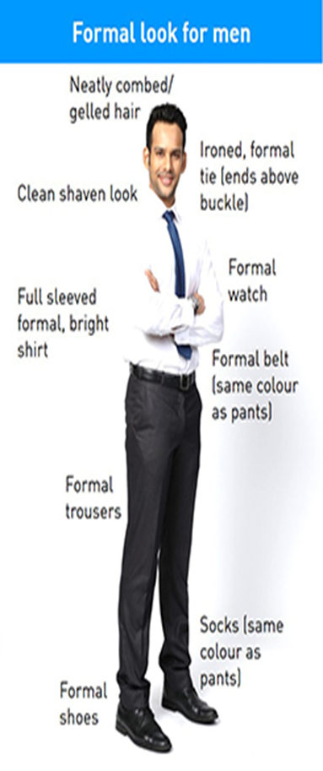

Slide 9
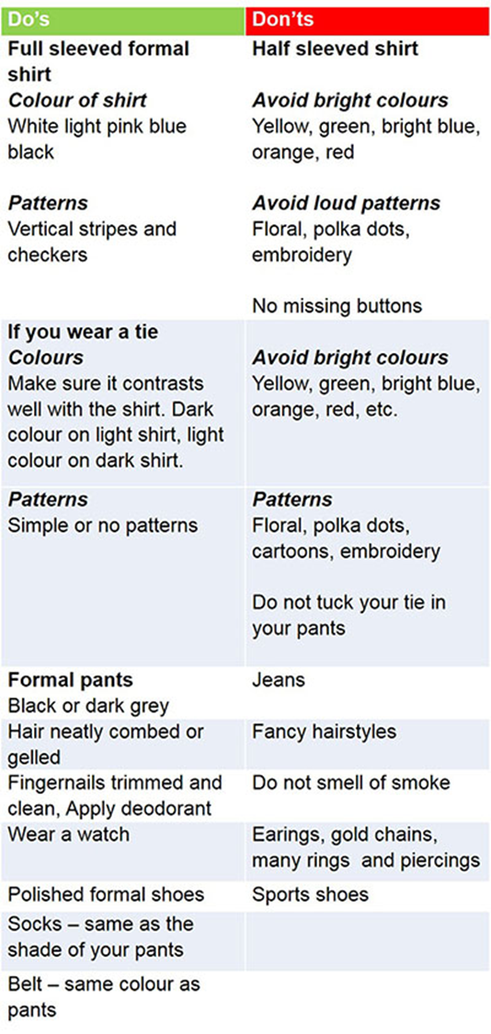

Slide 10
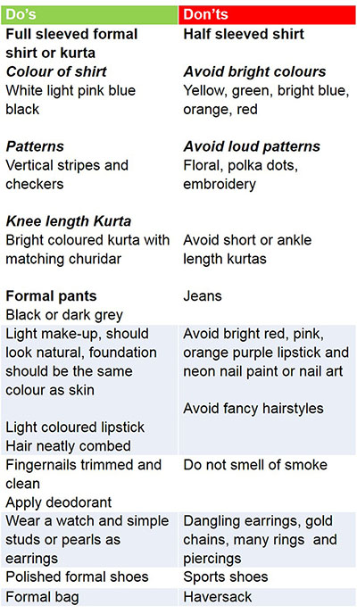
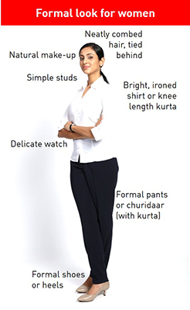

Slide 11
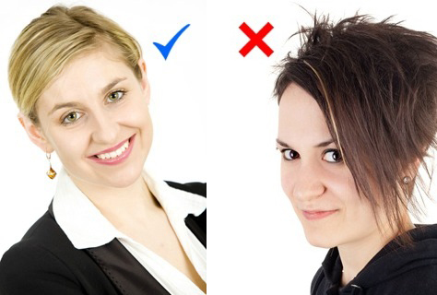
What are appropriate job interview clothes?
Your hair and make-up
Your hair should be neatly combed and styled. Avoid a style that allows you to fiddle with your hair - this makes you appear nervous and unsure.
Keep you hair off your face. You don't want to be constantly flicking your hair out of the way during the interview.
Sunglasses pushed up into your hair is a definite no! It looks messy and unprofessional.
Wear understated makeup in natural tones.
Overdone eye shadow, heavy eyeliner and brightly-colored lipstick make you appear frivolous and unprofessional.
Ensure your nails are clean and manicured and only wear neutral polish.
Unless the job is in a very informal environment men should have a traditional haircut and shave before the interview. A clean shave makes the right impression. If you really want to retain your facial hair make sure it is neatly trimmed.

Slide 12
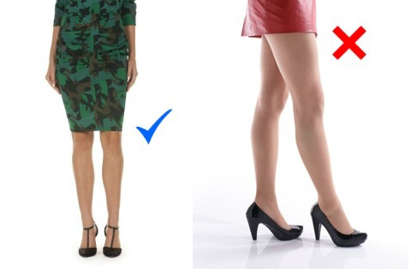
Job interview clothes - keep it professional
Your hemline should fall just above or on your knee.
Short and split skirts are difficult to sit comfortably in - you have to continually tug your skirt down during the interview.
Job interview clothes should fit properly and not be too tight.
Low neck-lines, transparent fabric and bra straps on display should be avoided.
Men should avoid wearing baggy interview clothes. Sweats and clothes that are too big create an impression of untidiness.
Pants pulled down around your hips look unprofessional. Advice on what men should wear to an interview.

Slide 13
Your shoes
Wear closed, medium to low-heeled shoes such as a pair of black pumps.
You should be able to walk comfortably in your shoes and appear confident and at ease.
Very high-heeled shoes are unsuitable.
Avoid brightly colored and trendy shoes - you are not there to make a fashion statement.
Invest in a pair of smart business-wear shoes. You will get a lot of wear out of a pair of black or dark brown shoes. Make sure your shoes are clean and well shined. Scruffy and scuffed shoes ruin the smartest job interview clothes.

Slide 14
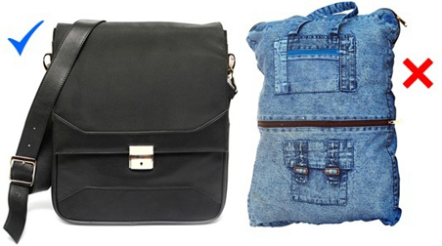
Carry a smart bag
Carry a small briefcase or similar bag in place of a purse to your job interview. This provides an easy way of carrying a tablet or laptop, if you need to take one with you to the interview, as well as all your documents.
If you feel you need a purse, a small structured one is preferable to a large floppy bag. Avoid canvas, denim and straw, these look very unprofessional.
Your accessories
Wear understated jewelry. Ostentatious, in-your-face jewelry is a big distraction and gives the impression of flashiness.
For men a classic watch and one simple ring per hand are acceptable. Avoid necklaces and bracelets.
Big, dangling earrings and jangling bracelets are particularly distracting on women candidates as they bounce about as you talk and move your hands.
Anklets can make your feet a focal point. You want the interviewer to concentrate on your face and what you have to say.

Slide 15
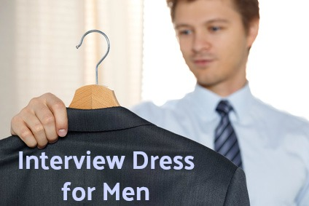
Select your clothes the day before
Take time to prepare beforehand and select your interview clothes carefully. Pay attention to detail. All interview clothes should be clean, tidy and neatly pressed. Check for dangling threads, hems starting to come undone, stains etc.
If you are having to travel any distance to your job interview consider how wrinkled your clothes may look after a couple of hours traveling. Select job interview clothes that do not crease easily.

Slide 16
Thank you 🙏

