Slide 1

Sustainable
Development
Prerna bhati

Slide 2

OUTLINE
Introduction
What is Development?
Sustainable Development
Views of Sustainable Development
Concept of Sustainable Development
Evolution of SD Concept:
The pillars of sustainable development
Changing Perspective of SD
Approaches of Sustainable Development
Sustainability principles
Multiple Crises and Sustainable Development
Conclusion.

Slide 3

1.1 The term “sustainable development” first came to prominence in the world Conservation Strategy (WCS) in 1980.
  It achieved a new status with the publication of two significant reports by Brundtalnd on: North and South: a programme for survival and common crisis (1985) and
  Our Common Future (1983) and has gained even greater attention since the United Nations Conference on Environment and Development (UNCED) held in Rio de Jenerio in June 1992.

Slide 4




Generally Development is the gradual growth of a situation that becomes more advanced and strong than previous one.
Development is intended to bring a positive change for human being and its surroundings. Development may take place by bringing about a change in policy, projects and legislation.
Development is a unfolding of human potentials for meaningful participation in economic, social, political and cultural process and institutions, so that people can improve their conditions.

Slide 5




Sustainable development is development that meets the needs of the present without compromising the ability of future generations to meet their own needs.
Gro Harlem Brundtland first introduced the concept of sustainable development in 1987. He was then the Prime Minister of Norway and chairman of the World Commission on Environment and Development.

Slide 6


Improvement of lifestyles and well-being
Preserving natural resources and ecosystems
Sustainable
Development

Slide 7
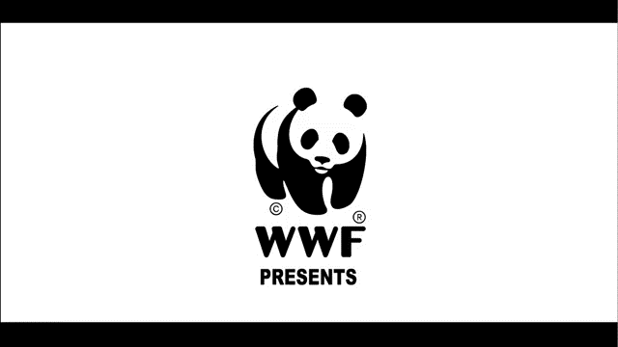

Slide 8


Evolution of SD Concept:
Rio to Johannesburg
The landmark event in the evolution of the concept of sustainable development had been the 1972
Stockholm Conference on the Human Environment convened by the United Nations, the report of the
World Commission on Environment and Development (WCED),
  Our Common Future and the 1992 United Nations
Conference on Environment and Development (UNCED) or Rio Earth Summit as it is commonly
referred to. The many activities between successive landmark events sought to build on the outcome of the previous event, to clarify issues, and to provide inputs into the preparatory process of the following events.

Slide 9
The UN established the Commission on Sustainable Development (CSD) in December 1992 to ensure an effective follow-up of UNCED and to monitor and report on the implementation of the Earth Summit
agreements at the local, national, regional, and international levels
A (Rio+5) Special Session of the General Assembly, held ion June 1997, adopted a comprehensive programe for further implementation of Agenda 21 as well as the work programe of the CSD for 1997-
2002.
The Kyoto Protocol adopted in December 1997 and the Conferences of the Parties (COPs), held over the years, have made some advances
relating to clarification of various aspects of financing and
implementing sustainable development globally.

Slide 10

Aim
Maximizing the probability of achieving sustainable development.
Minimizing the chances of environmental degradation.

Slide 11


Four Major
components
The climatic change.
Nutrient cycles.
Hydrological cycle.
Bio-diversity.

Slide 12


Example of Sustainable
Development
SOLAR ENERGY The greatest advantages of solar energy are that it is completely free and is available in a limitless supply. Both of these factors provide a huge benefit to consumers and help reduce pollution. Replacing non-renewable energy with this type of energy is both environmentally and financially effective.
Wind Energy is another readily available Wind energy source. Harnessing is the power of wind energy necessitates the use of windmills; however,

Slide 13
due to construction cost and finding a suitable location, this kind of energy is meant to service more than just the individual. Wind energy can supplement or even replace the cost of grid power, and therefore may be a good investment and remains a great example of sustainable development.
Crop Rotation
This farming practice is beneficial in several ways, most notably because it is is chemical-free. Crop rotation has been proven to maximize the growth potential of land, while also preventing disease and insects in the soil. Not only can this form of development benefit commercial farmers, but it can also aid those who garden at home.

Slide 14
Efficient Water Fixtures . According to the EPA, it takes a lot of energy to produce and transport water and to process waste water, and since less than one percent of the Earth’s available water supply is fresh water, it is important that sustainable water use is employed at the individual and societal level.
Green Space According to the UW-Madison Department of Urban and Regional Planning, advantages of green spaces include, “helping regulate air quality and climate … reducing
energy consumption by countering the warming effects of paved surfaces … recharging groundwater supplies and protecting lakes and streams from polluted runoff

Slide 15




Pillars for Sustainable Development

Slide 16



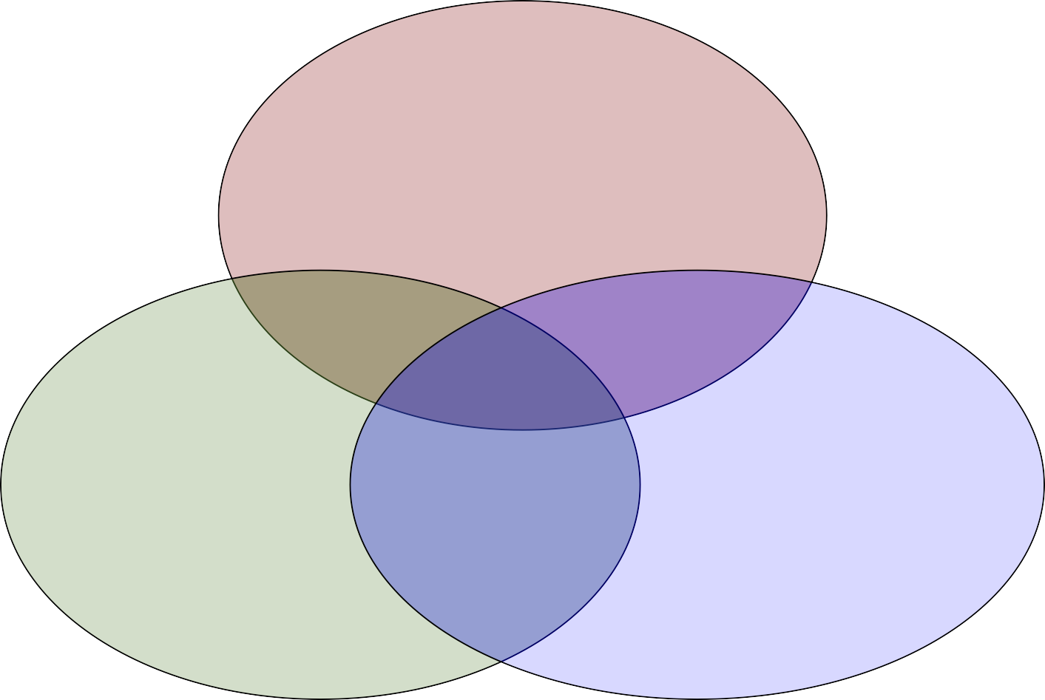

Interdependent and Mutually
Reinforcing Pillars of Sustainable
Development
Social Development
Environ- mental Protection
Economic Develop-
ment
16
United Nations 2005 World Summit Outcome Document

Slide 17

A Fourth Pillar
“…cultural diversity is as necessary for humankind as biodiversity is for nature.” Sustainable development
cannot be understood “simply in terms of economic growth, but also as a means to achieve a more satisfactory intellectual, emotional, moral and
spiritual existence”.
Universal Declaration on Cultural Diversity (UNESCO, 2001)

Slide 18


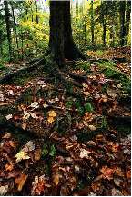
Culture: how human beings make
sense of the world
how people think, learn and solve problems, what they value and respect, what attracts and delights them, what offends them and their sense of what is appropriate
the soil in which the tree of identity has its roots
manifests itself in human relations,
systems of organization, technology,
arts, politics, economics, community life - all the things that humans do.

Slide 19

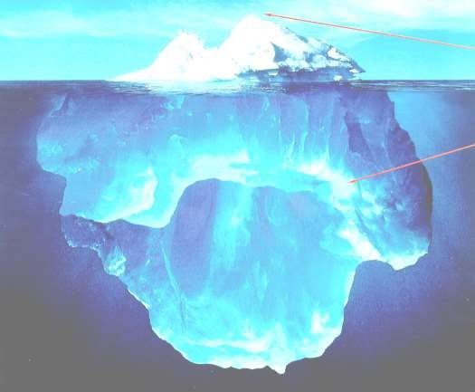
A Metaphor for Culture
_{Laws} Language Folklore
Artifacts and Behaviour
Visible Culture
Primary Culture
Music
Customs Food
Beliefs and
Values
highly patterned implicit rules of behavior hidden cultural grammar
Assumptions

Slide 20

Primary Level Culture
There is an underlying, hidden level of culture that is highly patterned – a set of unspoken, implicit rules of behavior and thought that controls everything we do. This hidden cultural grammar defines the way in which people view the world, determines their values, and establishes the basic tempo and rhythms of life. Most of us are either totally unaware or else only peripherally aware of this. I call these hidden paradigms primary level culture. (E.T. Hall)
20

Slide 21


Other Metaphors for Culture
The collective programming of the mind
which distinguishes the members of one
group from another - the software of the mind
The eyes through which we see the world
21

Slide 22


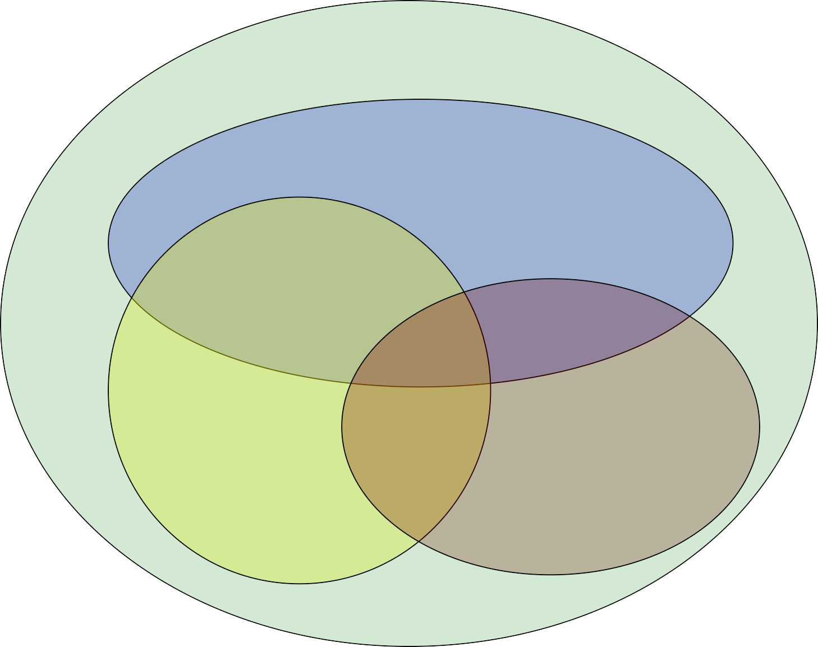
Putting it All
Together
Environmental Protection
Economic Develop-
ment
Cultural Diversity
Social
Develop-
ment
22

Slide 23


What are the desired outcomes
of sustainable development?
Clean water & air
Safety from poverty
Fertile soil & good food
A livelihood & a healthy economy
An optimum population size
& disease
Social contact & a sense of community
Work, rest & celebration
Opportunities to learn
Halting global warming
23

Slide 24



CIDA’s Framework identifies
key features for the “pillars” of sustainable development:
Environmental sustainability
Economic development
Social development
Cultural diversity

Slide 25
Environmental Protection
Ecosystem integrity
  Biological diversity
Managed population size
25

Slide 26
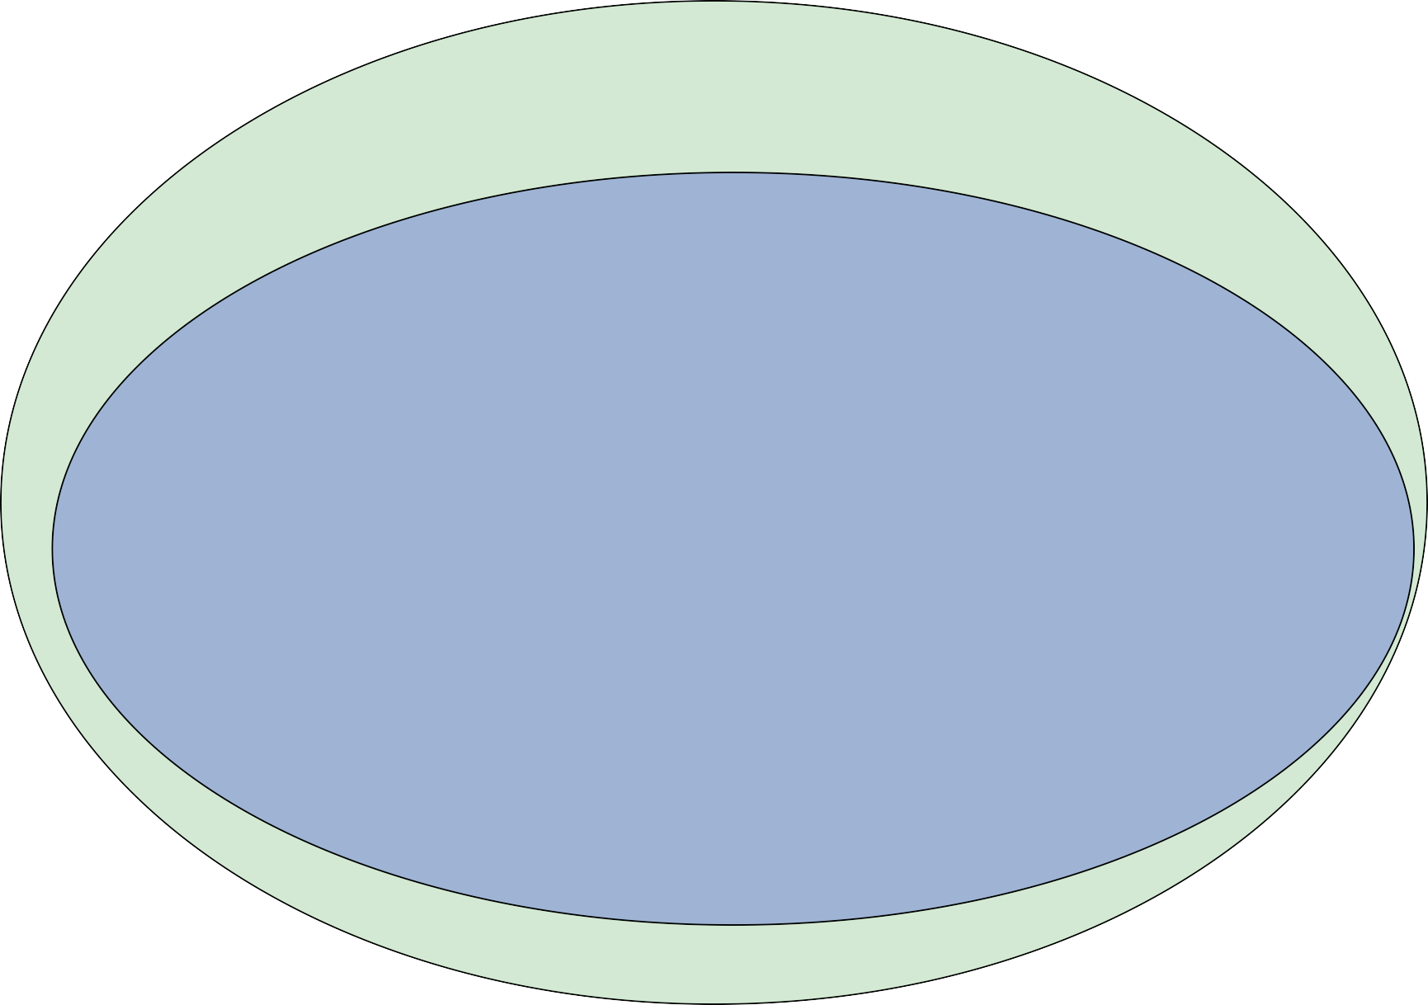
Environmental Protection
Economic Development Appropriate economic policies Efficient resource allocation More equitable access to
resources Increasing the productive capacity of the poor
26

Slide 27
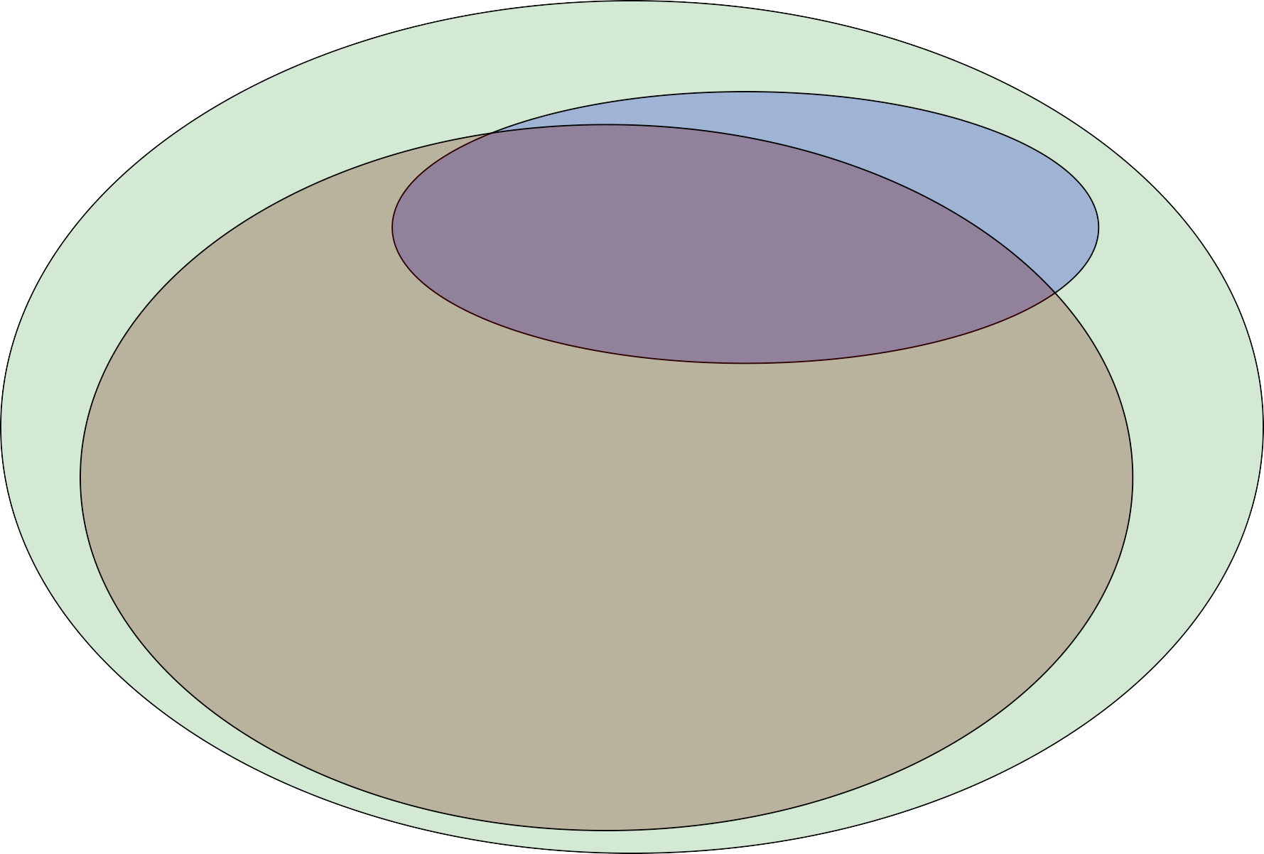
Environmental Protection
Economic Development
Social Development
Improved income distribution Gender equity
Investing in basic health & education
Emphasizing participation of the beneficiaries
27

Slide 28
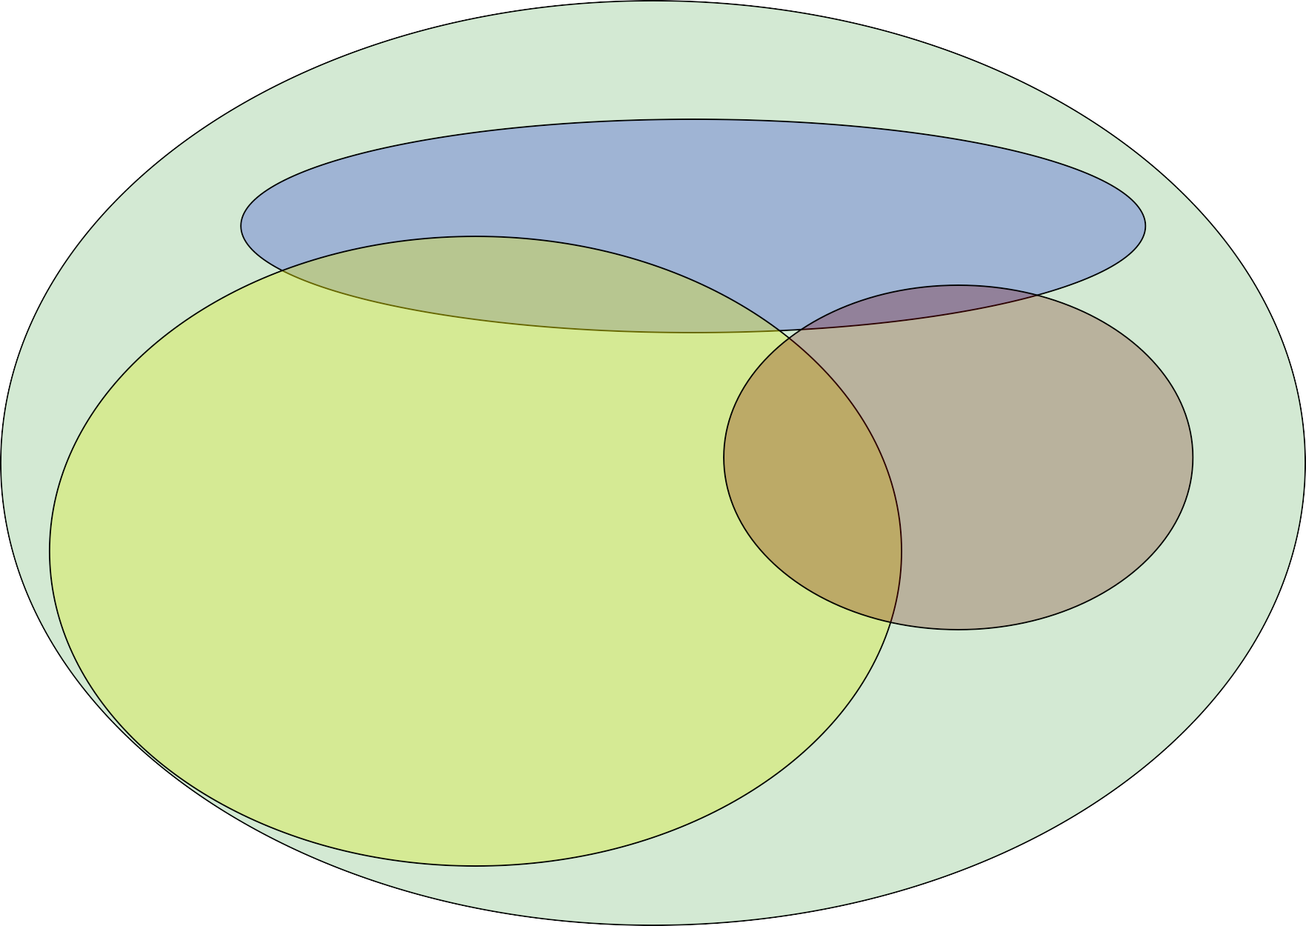
Economic Development
Environmental Protection
Cultural Diversity Sensitivity to cultural factors Recognition of values conducive to development
Social Development
28

Slide 29
The principles of a sustainable society are
Respect and care for the community of life.
Improve the quality of human life.
Conserve the Earth's vitality and diversity.
Minimize the depletion of non-renewable resources.
Keep within the Earth's carrying capacity.
Change attitudes and practices.
Enable communities to care for their own environments.
Provide a national framework for integrating development and conservation.
Create a global alliance.

Slide 30

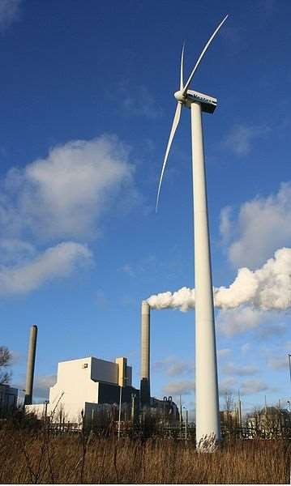
Sustainability principles
Reduce dependence upon fossil fuel,underground metals, and minerals
Reduce dependence upon synthetic chemicals and other unnatural substances
Reduce encroachment
upon nature
Meet human needs fairly & efficiently.
➢
➢
➢
Old and new approaches to human use of the atmosphere

Slide 31


Sustainability issues are to be
analyzed at various levels
Global level - Ozone depletion;
  Climate change; and
  Air pollution
Regional, National or Area-level
Water pollution -Water depletion - Deforestation- Fisheries depletion - Biodiversity- Desertification and Erosion.
-Local level - a plot, a farm or a village
Soil losses - Loss of soil quality (chemical or physical) - Loss of farm income

Slide 32
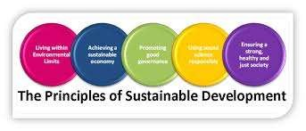

Slide 33


WHAT IS OUR GOAL IN
SUSTAINABLE DEVELOPMENT
Sustainable development requires the active
involvement of all stakeholders : government,
NGOs, private sectors, but also civil society. It is not just politicians, or policy makers who decide what SD should be like.

Slide 34

OUR GOAL
You have to remind policy makers to make decision to protect your future : you can remind them that you want better jobs, cleaner cities, more equitable resources distribution, and above all, a guarantee that your future is secure, full of opportunity, a pleasant world to live in and a healthy planet.

Slide 35

PROBLEMS
Where poverty and population pressure “intersect”
Human and their environment suffer.a

Slide 36


What is Needed to Achieve the
sustainable development ?
Eco Friendly
Present generation should aware for needs of presence and future generation.
And also ensure the productive assets available to future
generation are not.
Such technologies need to be developed and implemented which help to conserve resources,
Prevent unnecessary pollution and help restore the environment wherever appropriate.

Slide 37

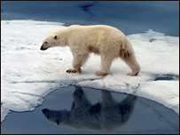
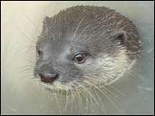
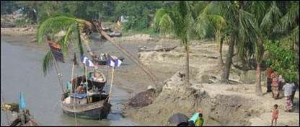
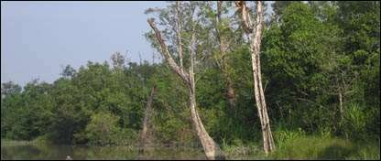
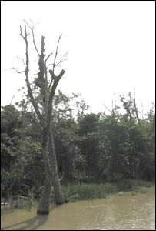
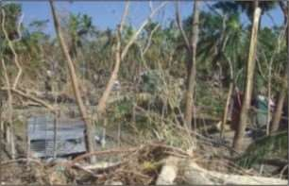
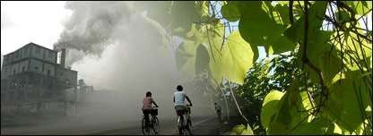
Symptoms of Crisis
Some examples of the impact of climate change on earth

Slide 38

SUJESTIONS
We need to spread social awareness to bring massive change in social attitude.
Action must be taken against the backdrop of serious inequities and their impact on the environment.
Environment mistakes of the past need not to be repeated, as past patterns of degradation are not inevitable.

Slide 39
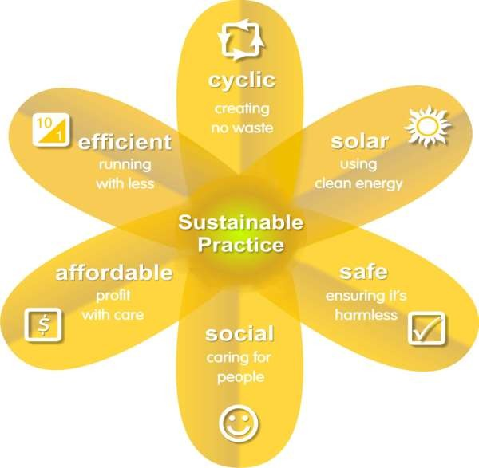
There are many always of communicating what sustainable practice is…
However what is most important is to understand the connectedness of each of these areas.

Slide 40
THANK YOU….

