Slide 1

Prerna bhati

Slide 2
IN THE PRESENTATION
Understanding of WTO
WTO in beginning and Fact file of WTO
Why WTO and functions and principle of WTO
Structure of WTO
Role of WTO
Relevance of WTO
TRIPs, TRIMs of WTO
Agreements done under WTO guidance
Role of WTO in developing countries
Current issues of WTO

Slide 3
WORLD TRADE ORGANIZATION
Intergovernmental organisation international trade
which regulates the
Officially commenced on 1st Jan 1995 under the Marrakesh Agreement
Signed by 123 nations in 1994
WTO had replaced GATT (General agreement on tariffs and trade)
They deal with: agriculture, textiles and clothing, banking, telecommunications, government purchases, industrial standards and product safety, food sanitation regulations, intellectual property and much more.

Slide 4
WTO: THE BEGINNINGS
The World Trade Organization (WTO) came into being on January 1st 1995.
It extended GATT in two major ways. First GATT became only one of the three major trade agreements that went into the WTO
Second the WTO was put on a much sounder institutional footing than GATT

Slide 5
FACT FILE OF WTO
Location - Geneva, Switzerland
Established - 1 January 1995
Created by - Uruguay Round negotiations (1986-94)
Membership - 162 countries since 30 November 2015
Head - Roberto Azevêdo (Director-General)
Secretariat staff - 625

Slide 6























WHY WTO?
To arrange the implementation, administration and operations of trade agreements
Settlement of disputes
Trade relations in issues deal with under the agreements.
To provide a framework for implementing of the results arising out
of the deliberations which taken place at ministerial conference level.
To manage effectively and efficiency the trade policy review
mechanism (TRIM).
To create more together relationship with all nations in respect of global economic

Slide 7
FUNCTIONS OF WTO
Administering WTO trade agreements
Forum for trade negotiations
Handling trade disputes
Monitoring national trade policies
Technical assistance and training for developing countries
Cooperation with other international organizations

Slide 8











PRINCIPLES OF WTO
The basic principles of the WTO (according to the WTO):
Trade Without Discrimination
  Most Favoured Nation (MFN): treating other people equally
  National treatment: Treating foreigners and locals equally
Freer trade: gradually, through negotiation
Predictability: through binding and transparency
Promoting fair competition
Encouraging development and economic reform.

Slide 9
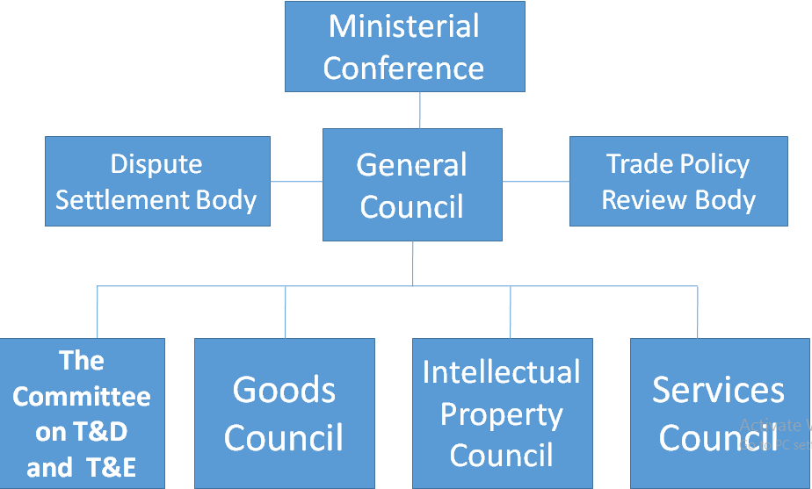
STRUCTURE OF WTO

Slide 10































ROLE OF WTO
The main goal of WTO is to help the trading industry to become smooth, fair, free and predictable. It was organized to become the administrator of multilateral trade and business agreements between its member nations. It supports all occurring negotiations for latest agreements for trade. WTO also tries to resolve trade disputes between member nations.
Multi-lateral agreements are always made between several countries in the past. Because of this, such agreements become very difficult to negotiate but are so powerful and influential once all the parties agree and sign the multi-lateral agreement. WTO acts as the administrator. If there are unfair trade practices or dumping and there is complain filed, the staff of WTO are expected to investigate and check if there are violations based on the multi-lateral agreements.

Slide 11
TRIMS, AND TRIPS OF WTO
1) Agreement on Trade-Related Investment Measures (TRIMs)
TRIMs refers to certain conditions or restrictions imposed by a
governments in respect of foreign investment in the country
The agreement on TRIMs provides that no contracting party shall apply any TRIM which is inconsistent with the WTO Articles.
2) Agreement on Trade-Related Aspects of Intellectual Property
Rights (TRIPS)
The Agreement on Trade Related Aspects of Intellectual Property Rights (TRIPS) is an international agreement administered by the World Trade Organization (WTO) that sets down minimum standards for many forms of intellectual property (IP) regulation as applied to nationals of other WTO Members

Slide 12
TRIPS contains requirements that nations' laws must meet
for copyright rights, including the rights of
performers, broadcasting including
producers of sound recordings and organizations; geographical indications,
appellations of origin; industrial designs; integrated circuit layout-designs; patents; monopolies for the developers of new plant varieties; trademarks; trade dress; and undisclosed or confidential information.
Specifies enforcement procedures, remedies, and dispute
resolution procedures.

Slide 13
THE RELEVANCE OF WTO
The system helps promote peace.
The system allows disputes to be handled constructively.
A system based on rules rather than power makes life easier for
all.
Freer trade cuts the cost of living.
It gives consumers more choice and a broader range of qualities to choose from.
Trade raises incomes.
Trade stimulates economic growth and that can be good news for employment.
The basic principles make the system economically more efficient, and they cut costs.

Slide 14
THE AGREEMENTS
The WTO is ‘rules-based’; its rules are negotiated agreements
Overview: a navigational guide
Plurilateral agreement
Further changes on the horizon, the Doha Agenda.
Some of the agreements of WTO:
-Tariffs: more bindings and closer to zero
-The Agriculture Agreement: new rules and commitments
-Textiles: back in the mainstream
-Intellectual property: protection and enforcement

Slide 15
The agreement covers five broad issues:
How basic principles of the trading system international intellectual property agreements applied
and other should be
How to give adequate protection to intellectual property rights
How countries should enforce those rights adequately in their
own territories
How to settle disputes on intellectual property between members of the WTO
Special transitional arrangements during the period when the new system is being introduced

Slide 16
RECENT ISSUES
Twenty-four participants from around the world are attending a two- month Advanced Trade Policy Course (ATPC) from 18 January to 11 March 2016
Lamy calls for addressing macro-economic imbalances through cooperation
Transparency mechanism for preferential trade arrangements set for
approval
Market access for LDCs (Least Developing Countries)
Trade agreements between developing countries
Trade policy reviews: ensuring transparency
TRIPS Agreement aimed at facilitating medicines in poor countries.
access to essential

Slide 17
CONCLUSION
It is the place where the member country comes and talks together and shares their grievance in order to resolve their problem related to International trade.
The countries make their decisions through various councils and committees, whose membership consists of all WTO members.
The system helps promote peace, by handling Dispute of member countries. It provides free trade which cuts the costs of living and provides more choice of products and qualities and stimulates economic growth.

Slide 18
The WTO agreements cover goods, services and intellectual property. They spell out the principles of liberalization, and the permitted exceptions. They include individual countries’ commitments to lower customs tariffs and other trade barriers, and to open and keep open services markets. They set procedures for settling disputes. They prescribe special treatment for developing countries. They require governments to make their trade policies transparent
WTO deals with the special needs of developing countries as two thirds of the WTO members are developing countries and they play an increasingly important and active role in the WTO because of their numbers, because they are becoming more important in the global economy, and because they increasingly look to trade as a vital tool in their development efforts.

Slide 19


