Slide 1
Utility Analysis
Sarika Singh
FMS MLSU Udaipur

Slide 2
I. Introduction to Utility analysis
Meaning of Utility - The power of a commodity that satisfy the wants of consumer - want satisfying power
  Introduced by Jermy Bentham
  Measurement ‘Utils’
  Subjective entity

Slide 3
II. Cardinal Utility approach and Ordinal Utility l approach
Utility Analysis
Cardinal Utility analysis
Ordinal Utility Analysis
Alfred Marshal
can be measured
‘Utils’
Law of Diminishing Marginal Utility
Law of Equi-marginal Utility
Mashellian Analysis
J. R. Hicks & R.G.D. Allen
Cannot be measured but compared as rank
Indifference Curve analysis

Slide 4
and its assumptions
III.
Meaning of Ordinal Utility analysis
Meaning of Ordinal Utility analysis
Ordinal means- Can be compare with each other- 1St , 2nd , 3rd etc.
Ordinal Utility analysis - Utility can compare but can not be measure.
Popularized by J.R. Hicks and R.G.D. Allen
Used the tool named Indifference Curve
Known as Indifference curve approach of utility analysis

Slide 5
III.
Assumption of Cardinal Utility Analysis or Indifference Curve approach
Consumer is rational or Rationality :
Consumer’s Objective is maximization of utility, subject to Price and consumption expenditure
Utility is ordinal:
Utility cannot be measured cardinally. It can be expressed ordinally can rank according to the satisfaction or utility of each basket.
Consistence in choice :
if the consumer prefers combinations of A of good to the combinations B of goods, he then remains consistent in his choice.
If A > B, then never become B > A

Slide 6
III.
Assumption of Cardinal Utility Analysis or Indifference Curve approach
Consumer’s Preference is Transitive:
A is preferred over combination B is preferred over C, then combination A is preferred over combination A is preferred over C.
If A > B and B > C, then A > C
Diminishing Marginal Substitution of goods:
In the Indifference Curve analysis, the principle of Diminishing Marginal Rate of Substitution is assumed. That is Convexity of Indifference curve or Negative slop of indifference
Dependent Utility:
TU = f( q1 + q2 + q3 + . . . . . .+ qn)
A Large bundle of goods preferred to small bundle

Slide 7
IV. Meaning of Indifference Curve
The Indifference curve was invented by F Y Edgeworth
An Indifference curve is the locus point of all those combination of two commodity that yield same level of satisfaction or utility to the consume

Slide 8
IV. Meaning of Indifference Curve
An Indifference curve is the locus point of all those combination of two commodity that yield same level of satisfaction or utility to the consumer
Various Combinations: |  |  | Utility
Combination | Unit of Rice | Unit of Wheat
a) | 16 kg of Rice | 2 kg of Wheat | 100u
b) | 12 kg of Rice | 5 kg of Wheat | 100u
c) | 11 kg of Rice | 7 kg of Wheat | 100u
d) | 10 kg of Rice | 10 kg of Wheat | 100u
e) | 9 kg of Rice | 15 kg of Wheat | 100u

Slide 9
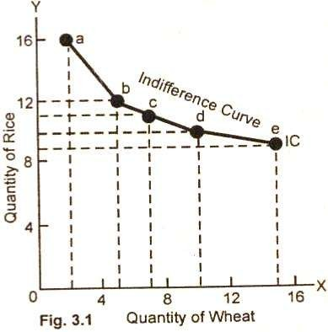
IV. Meaning of Indifference Curve
Various Combinations: |  |  | Utility
 | Unit of Rice | Unit of Wheat
a | 16 | 2 | 100u
b | 12 | 5 | 100u
c | 11 | 7 | 100u
d | 10 | 10 | 100u
e | 9 | 15 | 100u
An Indifference curve is the locus point of all those combination of two commodity that yield same level of satisfaction or utility to the consumer

Slide 10
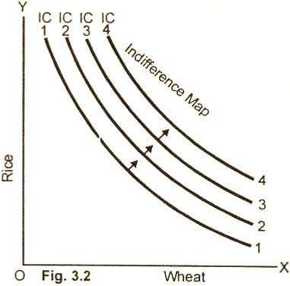
An Indifference Map
A graph showing a whole set of indifference curves is called an indifference map. An indifference map, in other words, is comprised of a set of indifference curves. Each successive curve further from the original curve indicates a higher level of total satisfaction.

Slide 11

VI. Marginal Rate of Substitution of goods – MRS xy
The concept of Marginal Rate Substitution (MRS) was introduced by Dr. J.R. Hicks and Prof. R.G.D. Allen to take the place of the concept of diminishing marginal utility.
The slop of indifference curve is known as Marginal Rate of Substitution MRS
The rate or ratio at which goods X and Y are to be exchanged is known as the
marginal rate of substitution (MRS).
“The marginal rate of substitution of X for Y measures the number of units of Y that must be scarified for one unit of X gained so as to maintain a constant level of
satisfaction”.
MRS xy = Change in good X / Changes in good Y
- MRS xy =

Slide 12

VI. Marginal Rate of Substitution of goods – MRS xy
MRS : “The marginal rate of substitution of X for Y measures the number of units of Y
that must be scarified for unit of X gained so as to maintain a constant level of satisfaction”.
MRS xy = Change in good X / Changes in good Y
- MRS xy =
Combination | Apple X | Mango Y | Utility | Ratio | MRS
A | 1 | 15 | 100 | - | -
B | 2 | 10 | 100 | 5:1 | 5
C | 3 | 6 | 100 | 4:1 | 4
D | 4 | 3 | 100 | 3:1 | 3
E | 5 | 1 | 100 | 2:1 | 2

Slide 13
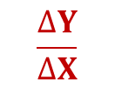
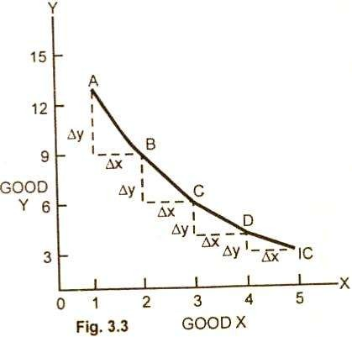
VI. Marginal Rate of Substitution of goods – MRS xy
MRS : “The marginal rate of substitution of X for Y measures the number of units of Y
that must be scarified for one unit of X gained so as to maintain a constant level of satisfaction”.
MRS xy = Change in good Y / Changes in good X - MRS xy =

Slide 14
VI. Marginal Rate of Substitution of goods – MRS xy
MRS : “The marginal rate of substitution of X for Y measures the number of units of Y
that must be scarified for unit of X gained so as to maintain a constant level of satisfaction”.
MRS xy = Change in good X / Changes in good Y
- MRS xy =
Combination | Apple X | Mango Y | Ratio | MRS
A | 2 | 30
B | 4 | 20
C | 6 | 12
D | 8 | 6
E | 10 | 2

Slide 15
VI. Marginal Rate of Substitution of goods – MRS xy
MRS : “The marginal rate of substitution of X for Y measures the number of units of Y
that must be scarified for unit of X gained so as to maintain a constant level of satisfaction”.
MRS xy = Change in good X / Changes in good Y
- MRS xy =
Combination | Apple X | Mango Y | Ratio | MRS
A | 2 | 30 | - | -
B | 4 | 20 | 10:2 | 5
C | 6 | 12 | 8:2 | 4
D | 8 | 6 | 6:2 | 3
E | 10 | 2 | 4:2 | 2

Slide 16
VII. Principles of Diminishing Marginal Rate of Substitution of goods – MRS xy
This behaviour showing falling MRS of good X for good Y and yet to remain at the same level of satisfaction is known as Diminishing Marginal Rate of Substitution.
Combination | Apple X | Mango Y | MRS
A | 1 | 15 | -
B | 2 | 10 | 5
C | 3 | 6 | 4
D | 4 | 3 | 3
E | 5 | 1 | 2

Slide 17
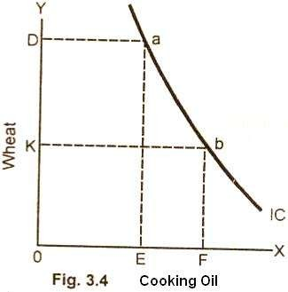
V. Properties/Characteristics of Indifference Curve
(1) Indifference Curves are Negatively Sloped:
It slopes downward because as the consumer increases the consumption of X commodity, he has to give up certain units of Y commodity in order to maintain the same level of satisfaction.

Slide 18
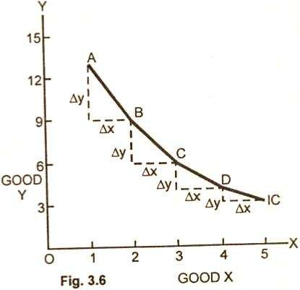
V. Properties/Characteristics of Indifference Curve
(2) Indifference Curve are Convex to the Origin:
the consumer substitutes commodity X for commodity Y, the marginal rate of substitution diminishes of X for Y along an indifference curve.
Principle of Diminishing Marginal Rate of Substitution

Slide 19
V. Properties/Characteristics of Indifference Curve
(3) Higher Indifference Curve Represents Higher Level
A higher indifference curve that lies above and to the right of another indifference curve represents a higher level of satisfaction and combination on a lower indifference curve yields a lower satisfaction.

Slide 20
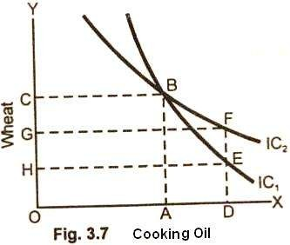
V. Properties/Characteristics of Indifference Curve
(4) Indifference Curve Cannot Intersect Each Other:
Given the definition of indifference curve and the assumptions behind it, the indifference curves cannot intersect each other. It is because at the point of tangency, the higher curve will give as much as of the two commodities as is given by the lower indifference curve.

Slide 21
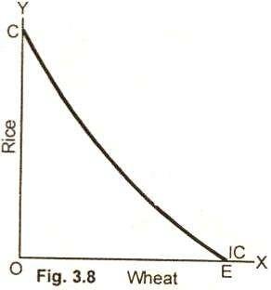
V. Properties/Characteristics of Indifference Curve
(5) Indifference Curves do not Touch the Horizontal or Vertical Axis:
One of the basic assumptions of indifference curves is that the consumer purchases combinations of different commodities. He is not supposed to purchase only one commodity.

Slide 22

VIII. Price Line or Budget Line
A budget line or price line represents the various combinations of two goods which can be purchased with a given money income and assumed prices of goods".
Income (Y)= 60 , Price of Biscuit (Px) = 6, Price of Coffee(Py) = 12
Market Basket | Biscuit Qx | Coffee Qy
A | 10 | 0
B | 8
C | 6
D | 4
E | 2
F | 0 | 5
Price Line or Budget Line

Slide 23
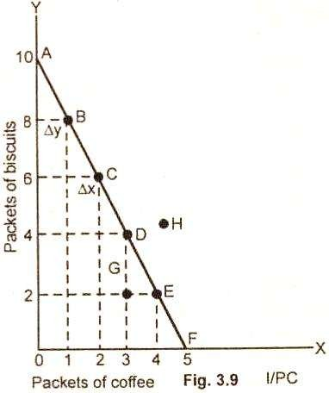

VIII. Price Line or Budget Line
A budget line or price line represents the various combinations of two goods which can be purchased with a given money income and assumed prices of goods".
Income (Y)= 60 , Price of Biscuit (Px) = 6, Price of Coffee(Py) = 12
Combination | Biscuit | Coffee
A | 10 | 0
B | 8 | 1
C | 6 | 2
D | 4 | 3
E | 2 | 4
F | 0 | 5

Slide 24

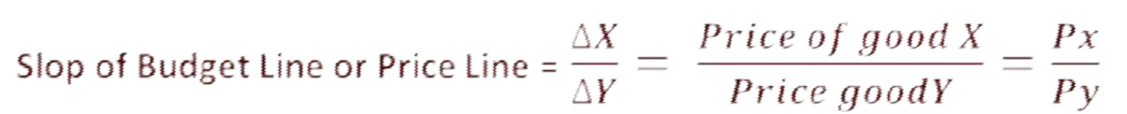
IX. Slop of Price Line or Budget Line
The slope of the budget line indicates how many packets of biscuits a purchaser must give up to buy one more packet of coffee. For example, the slope at point B on the budget line is ∆Y / ∆X

Slide 25
X. Changes or Shift in Price Line or Budget Line
The price line is determined by the income of the consumer and the prices of goods in the market. If there is a change in the income of the consumer or in the prices of goods, the price line shifts in response to a exchange in these two factors.
(i) Income changes: When there is change in the income of the consumer, the prices of goods remaining the same, the price line shifts from the original position. It shifts upward or to the right hand side in a parallel position with the rise in income.
(ii) Price changes. If there is a change in the price of one good, the income of the consumer and price of other good is held constant. When there is a fall in the price of one good say commodity A, the consumer purchases more of that good than before. A price change causes the budget line to rotate

Slide 26
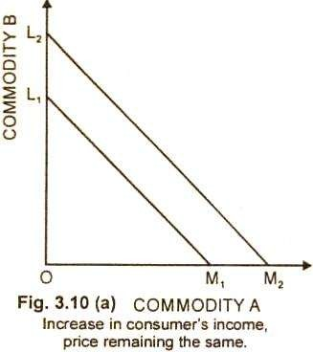
X. Changes or Shift in Price Line or Budget Line
(i) Income changes: When there is change in the income of the consumer, the prices of goods remaining the same, the price line shifts from the original position. It shifts upward or to the right hand side in a parallel position with the rise in income.
Rise in income.
A fall in Income?????

Slide 27
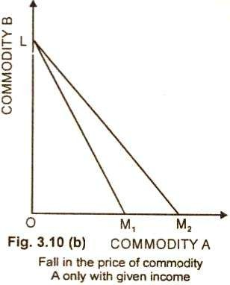
X. Changes or Shift in Price Line or Budget Line
(ii) Price changes. If there is a change in the price of one good, the income of the consumer and price of other good is held constant. When there is a fall in the price of one good say commodity A, the consumer purchases more of that good than before. A price change causes the budget line to rotate
What will happen to Price Line
Price of commodity B fall?
Price of Commodity B Rice ?
Price of commodity A rice ?

