Slide 1
Elasticity of Demand
Mrs Sarika Singh
Faculty of Management Studies
MLSU Udaipur

Slide 2
Definition Of Price Elasticity Of Demand
The change in the quantity demanded of a product due to a change in its price is known as Price elasticity of demand. Thus, the sensitiveness or responsiveness of demand to change in price is as called elasticity of demand

Slide 3
Kinds Of Price Elasticity Of Demand
Perfectly elastic demand
Relatively elastic demand
Elasticity of demand equal to utility
Relatively inelastic demand
Perfectly inelastic demand

Slide 4
Perfectly elastic demand
y
When the demand for a product changes
–increases or decreases even when there is no change in price, it is known as perfect elastic
^{x} demand.
P R
Perfectly elastic
demand curve
I C E
D
D
0

Slide 5
Relatively elastic demand
y
When the proportionate change in demand is more than the proportionate changes in price, it is known as relatively elastic demand.
P R I C E
Relatively elastic
demand curve
D
D
0
demand
x

Slide 6
Elasticity of demand equal to utility
When the proportionate change in
y
P R I C E
D
demand is equal to proportionate changes in price, it is known as unitary elastic demand
Elasticity of demand equal to utility curve
D
0
x
demand

Slide 7
Relatively inelastic demand
Y
When the proportionate change in demand is less than the proportionate changes in price, it is known as relatively inelastic demand
D
Relatively inelastic
demand curve
P R I C E
D
O
X
demand

Slide 8
Perfectly inelastic demand
Y
D
When a change in price, howsover large, change no changes in quality demand, it is known as perfectly inelastic demand
P R I C E
Perfectly inelastic demand curve
0
D
X
demand

Slide 9
ALL KINDS OF DEMAND CAN BE SHOWN IN ONE DIAGRAM AS FOLLOW
Y
WHERE
D1) Perfectly elastic demand
D1 D2)Relatively elastic demand
P
R I C E
D
D2
D3)Elasticity of demand equal to utility
D4)Relatively inelastic
D3
D4
0
D5
DEMAND
X
demand
D5)Perfectly inelastic demand

Slide 10
Measurement Of Price Elasticity Of Demand
There are main methods like
Percentage method or proportionate method
Total outlay method or total revenue method
Geometric method or point method
Arc elasticity of demand

Slide 11
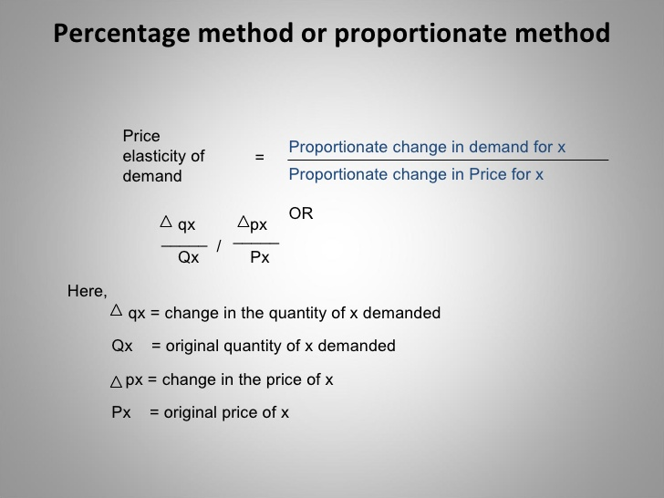
1.Percentage Method

Slide 12
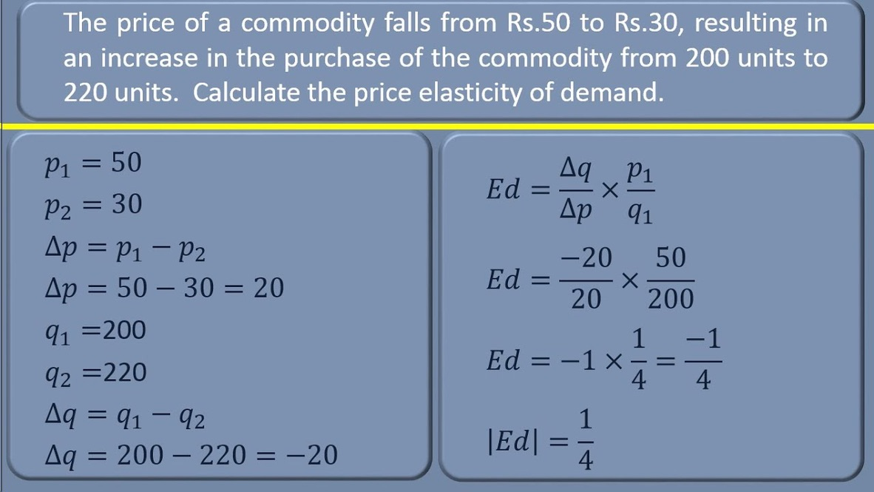

Slide 13
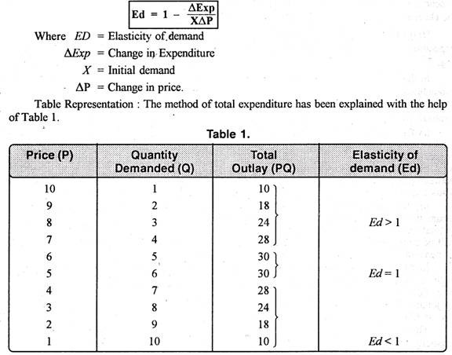
2.Total Expenditure method
In this method ,Price elasticity is measured by comparing the total expenditure of the consumer(TR or total sales from the seller’s point of view)before and after variations in the price

Slide 14
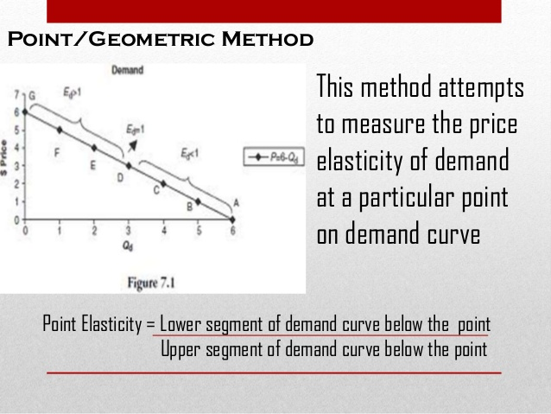
3.Point Method

Slide 15
Factors Affecting Price Elasticity Of Demand

Slide 16
Factors Affecting Price Elasticity Of Demand
Nature of the Commodity
Availability of Substitutes
Variety of uses of commodity
Postponement
Influence of habits
Proportion of Income spent on a commodity
Range of prices

Slide 17
Factors Affecting Price Elasticity Of Demand
Income Groups
Elements of time
Pattern of income distribution

Slide 18
Practical Importance of the Concept of Price Elasticity Of
Demand

Slide 19
Practical Importance of the Concept of Price Elasticity Of Demand
The concept is helpful in taking Business Decisions
Importance of the concept in formatting Tax Policy of the government
For determining the rewards of the Factors of Production
To determine the Terms of Trades Between the Two Countries

Slide 20
Practical Importance of the Concept of Price Elasticity Of Demand
Determination of Rates of Foreign Exchange
For Nationalization of Certain Industries
In economic Analysis ,the concept of price elasticity of demand helps in explaining the irony of poverty in the midst of plenty.

Slide 21
Income Elasticity Of Demand

Slide 22
Income Elasticity of Demand
Income elasticity of Demand (Ey) expresses the responsiveness of a consumer”s demand for any good to the change in his Income
It is defined as ratio of percentage change in the quantity demanded of a commodity to the percentage change in income

Slide 23
Types Of Income Elasticity Of Demand
Positive Income elasticity of demand
Negative Income elasticity of demand
Zero Income elasticity of demand

Slide 24
Positive Income elasticity of demand
Y
D
P A
D
Income
B S
Quantity Demanded
O
X

Slide 25
Positive Income elasticity of demand
Income Elasticity Equal to Unity or One e g Comforts
Income Elasticity Greater Than Unity Or One e g luxuries
Income Elasticity Less Than Unity or One eg necessities

Slide 26
Negative Income elasticity of demand
Price
P
A
Total Revenue
B S
Quantity Demanded (000s)
Eg –Inferior Goods

Slide 27
Zero Income elasticity of demand
Y
D
Income
O
X
D
Quantity Demanded

Slide 28
Measurement Of Income Elasticity Of Demand
Proportionate change in Demand
Income Elasticity Of Demand =
Proportionate change in Income
i.e.
Income Elasticity Of Demand =
∆q ∆ y
+
Q Y

Slide 29
Measurement Of Income Elasticity Of Demand
Here , ∆q = Change in the quantity demanded.
Q = Original quantity demanded.
∆y = Change in income.
Y = Original income.
For e.g. ,when Income of the consumer = 2,500/- , he purchases 20 units of X, when income = 3,000/- he purchases 25 units of X

Slide 30
Measurement Of Income Elasticity Of Demand
Thus
Income Elasticity of Demand
∆q ∆ y
=
+
Q
Y
= (5/20) + (500/2500)
= 1.5
therefore here the IED is 1.5 which is more than one.

Slide 31
Factors Affecting Income Of Demand
Income Itself Only.
Price Of the Commodity

Slide 32
Importance Of the Concept of Income Elasticity Of Demand
In production planning and management
In forecasting demand when change in consumers income is expected
In classifying goods as normal and inferior
In expansion and contraction of the firm by the figure of income elasticity of demand
Markets situations could be studied with the help of IED

Slide 33
Cross Elasticity of Demand
Cross elasticity of demand express a relationship between the change in the demand for a given product in response to a change in the price of some other product
E.g. if the X tea demand reduces tremendously than it effect could be seen in demand of sugar and milk.

Slide 34
Types of Cross Elasticity of Demand
Cross Elasticity of Demand Equal to Unity or One
Cross Elasticity of Demand Greater than Unity or one
Cross Elasticity of demand less than unity or one

Slide 35
Measurement Cross Elasticity of Demand
Proportionate change in Demand
for product X
Cross Elasticity of Demand =
Proportionate change in Price of product Y
i.e.
∆qx
∆p y
Cross Elasticity of Demand =
+
Qx
Py

Slide 36
Cross Elasticity of Demand For Substitutes
D
Y
Price of Y
D
O
X
Demand for Y

Slide 37
Cross Elasticity of Demand For Complementary Products
D
Y
Price of Y
D
O
X
Demand for Y

Slide 38
Cross Elasticity of Demand For Neutral
Products
D
Y
Price of Y
O
X
Demand for Y

Slide 39
Importance of Cross Elasticity Of Demand
The concept is of very great importance in changing the price of the products having substitutes and complementary goods .
In demand forecasting
Helps in measuring interdependence of price of commodity .
Multiproduct firms use these concept to measure the effect of change in price of one product on the demand of their other product

Slide 40
Advertising Elasticity of Demand
Advertising elasticity of demand is the measure of the rate of change in demand due to change in advertising expenditure
The amount of change in demand of goods due to advertisement is known as Advertisement Elasticity of Demand .

Slide 41
Advertising Elasticity of Demand
Proportionate change in Demand
for product
Advertising Elasticity of Demand =
Proportionate change in Advertising expenditure
i.e.
∆qx
∆a
Advertising Elasticity of Demand =
÷
Q
A

Slide 42
Relationship Between Advertising
Expenditure and Sales
S
Y
Sales
S
X
O
Advertising Expenditure

Slide 43
Factors Affecting Advertising Elasticity Of Demand
The stage of the Product’s Market
Development .
Reaction of market Rival Firms.
Cumulative Effect of Past Advertisement.
Influence of Other Factors.

Slide 44
Importance of the Advertising Elasticity Of Demand in Business Decisions
It is useful in competitive industries.
Though advertisement shifts the demand curve to right path but it also increases the fixed cost of the firm.

