Slide 1
UNIT II
PERSONNEL FUNCTION
PART II
JOB ANALYSIS

Slide 12
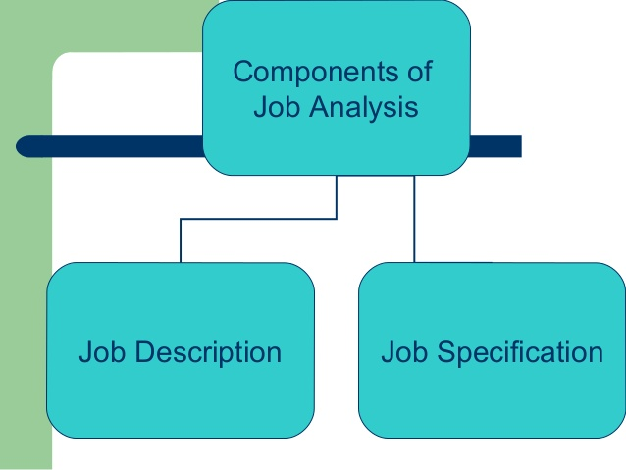

Slide 33
THANK YOU

