Slide 1
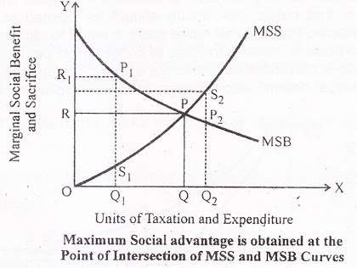
Point of Maximum Social Advantage
Social advantage is maximised at the point where marginal social sacrifice cuts the marginal social benefits curve.This is at the point P. At this point, the marginal disutility or social sacrifice is equal to the marginal utility or social benefit. Beyond this point, the marginal disutility or social sacrifice will be higher, and the marginal utility or social benefit will be lower.

Slide 2

Assumptions of the Principle
All taxes result in sacrifice and all public expenditures lead to benefits.
Public revenue consist of only taxes and no other sources of income to the government.
The government has no surplus or deficit budget but only balanced budget.
Public expenditure is subject to diminishing marginal social benefit and taxes are subject to increasing marginal social sacrifice.

Slide 3


Limitations of the Principle
Difficult to measure marginal utility and disutility.
Difficult to assess the capacity of the people.
Difficult to know about likings and dislikings of the people.

Slide 4

Conclusion
The Principle of Maximum Social Advantage states that public finance leads to economic welfare when public expenditure & taxation are carried out up to that point where the benefits derived from the MU (Marginal Utility) of expenditure is equal to (=) the Marginal Disutility or the sacrifice imposed by taxation.

