Slide 1
Consolidated Accounts for Holding Companies Part I

Slide 2
Dr. Asha Sharma
Assistant Professor
Department of Accountancy and Statistics
University College of Commerce & Management Studies
Mohanlal Sukhadia University, Udaipur
E-mail: drashasharma.sharma07@gmail.com

Slide 3
HOLDING & SUBSIDARY COMPANY

Slide 4
HOLDING COMPANY
When a company acquires majority or more than 50% shares in the ownership capital or in the position to influence or control the management, is called a holding company
.

Slide 6
Relation between
Holding
Subsidiary
Who purchase more than 50%

Slide 7
A “Holding company” is a corporation that owns enough voting stock in one or more other companies to exercise control over them. A corporation that exists solely for this purpose is called a pure holding company.

Slide 8
What is subsidiary company?
If company A holds more than 50% Shares of company B then;
Company A is a holding company Company B is a subsidiary company
Example: Coal India is a holding company. Bharat Coking ltd, Mahanadi Coal Fields ltd are its subsidiary companies.

Slide 9
A subsidiary company, subsidiary, or sister company is a company that is completely or partly owned and partly or wholly controlled by another company that owns more than subsidiary can be liability company

Slide 11
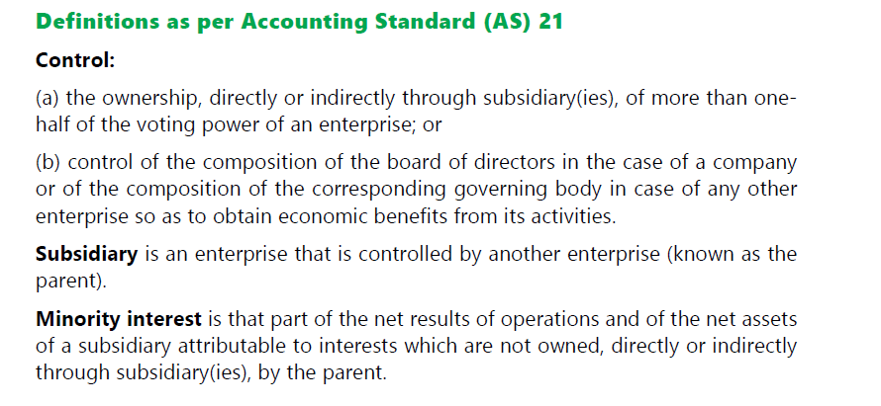

Slide 12
In the United States, Berkshire Hathaway is the largest
publicly traded holding company
The company wholly owns GEICO, BNSF, Lubrizol, Dairy Queen, Fruit of the Loom, Helzberg Diamonds and Net Jets, owns half of Heinz, owns an undisclosed percentage of Mars, Incorporated and has significant minority holdings in American Express, The Coca-Cola Company, Wells Fargo, and IBM.

Slide 14
Advantages
Holding companies can take risks through subsidiaries, and limit this risk to the subsidiary alone rather than placing the parent company on the line
The holding company also benefits from the subsidiary's goodwill and reputation, while being sheltered from risks faced by the subsidiary in the case of legal issues, tax liabilities and lawsuits.
When raising capital a larger holding company has more diversity of assets than an individual company, which makes raising capital easier.

Slide 15
Advantages
The holding company generally produces no products or services and is simply a vehicle for owning shares of other companies.
Easy to give up the control
Taking benefits of monopoly status
Foreign Capital: The holding company may also attract the foreign capital for the expansion of a business.
The holding company eliminates competition due to centralized control over the subsidiary companies, so it earns maximum profit.

Slide 16
Disadvantages
Problem of Monopoly:
Unequal Distribution of Wealth:
Costly Management:
Minority Interest Ignored:
Misuse of Funds:

Slide 17
Top Holding companies - GLOBAL

Slide 18
Holding companies in INDIA

Slide 19
Advantages
The holding company provides the subsidiary company with buying power, research and development funds, marketing money and know-how, employees, technical expertise and other features which otherwise it could not afford or accomplish alone.
The parent can provide the monetary means and capability to jump start new companies and products.
Ability to offset profits and losses of one part of a business with another

Slide 20
Disadvantages
A major disadvantage of being a subsidiary of a large organization is the limited freedom in management
Decision making can become time consuming as issues often must go through various chains of command within the parent bureaucracy before any action can be taken
Legal paperwork involved with creating a subsidiary can be lengthy and expensive
Control also becomes an issue when a subsidiary is partially owned by another outside organization

Slide 21
Types of Holding Company
PARENT COMPANY
OFFSPRINGS COMPANY
Ultimate Company

Slide 22
PARANT COMPANY (Companies bearing the TATA label)

Slide 23
Subsidiaries without the TATA Label

Slide 24
(OFF SPRING COMPANY)

Slide 25
ULTIMATE COMPANY

