Slide 1
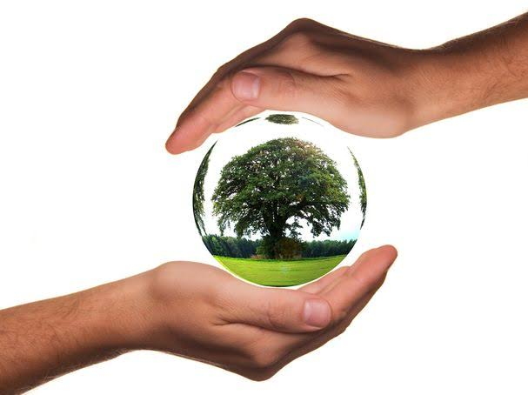
FACULTY OF MANAGEMENT STUDIES
ENVIRONMENTAL MANAGEMENT
CMAT 1st SEMESTER(2020-22)
Dr. Prerna Bhati Ma’am

Slide 2
UNIT 1
PRERNA BHATI

Slide 3
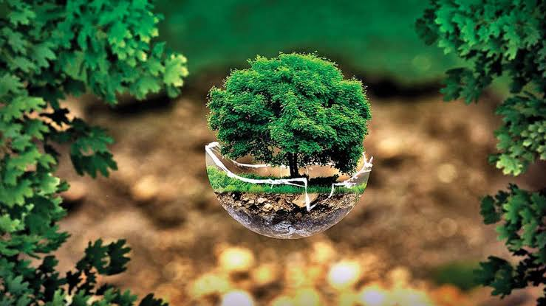
TOPIC:-
Implications of Human Population Growth and Limits to Growth

Slide 4
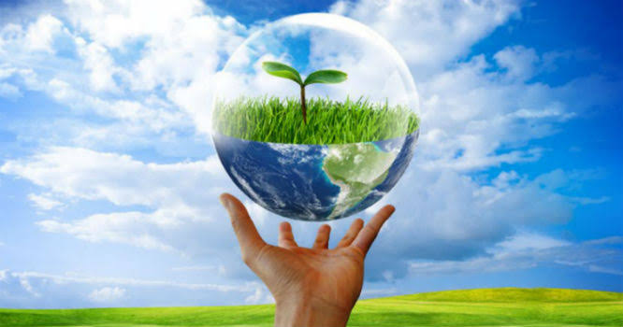
Introduction
“If the world is to save any part of its resources for the future, it must reduce not only consumption but the number of consumers.”
The current population of India contributes to 17% of the global population. All these people are unevenly distributed across 3.28 million square kilometers of our geographical area.
Population is rising at an alarming rate in India making overpopulation an urgent and important issue. Indians are ignoring the soon to explode overpopulation bomb.
Overall human impact due to excess population on the environment is causing overconsumption, excessive pollution and proliferation of technology has pushed the planet into a new geological epoch.
Limits to Growth refers to the limits of the ecosystem to absorb wastes and replenish raw materials in order to sustain the economy.

Slide 5
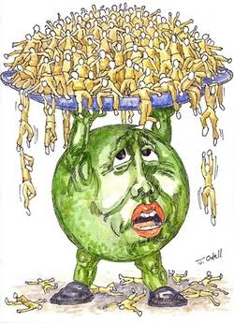
Implications of Human Population Growth
The interplay between population growth, resource depletion/environmental damage has been debated much.
The fact is that both population growth and unsustainable development are a cause of concern especially in developing countries.
It is known that population growth and economic development are affecting the environment.
The increasing population is exerting an ill impact on the growth of the society with an increasing depletion of the natural and manmade resources.
Population growth is causing climate change and affecting existence of human beings and other creatures on the planet.

Slide 6


Sustainability
India’s population is increasing manifold. But the question is, have we devised developmental programs that are in accordance with this increase?
If not, population factor alone would have significant contribution towards degradation of environment and resource depletion. More people mean more pressure on resources, more consumption of energy, more production of wastes including greenhouse gases- all having adverse effects on environment.
Sustainable Development is about protecting environment. Sustainability should, therefore, reflect equity, environmental concerns and social responsibilities vis-à-vis population regardless of time or location.

Slide 7
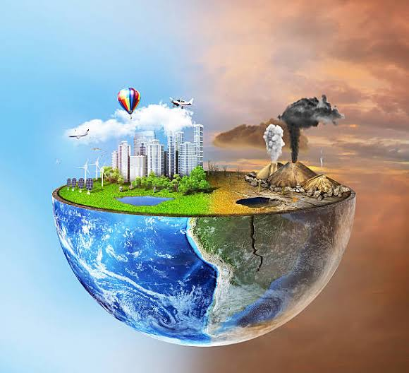
Effects of Population Growth on Environment
Loss of Biodiversity: Extracting more minerals and hunting more animals has led to increasing ecological imbalance.
Deforestation: Demand for more food and more wood products has led to reduced ability of trees to capture CO₂ which is associated with loss of habitat and extinction of various species.
Increasing pollution levels: Overuse of coal, oil and natural gas is producing serious effects on environment. Environment pollution leads to global warming, melting of glaciers, climate changes and rise in sea level.
Land Degradation: Intensive farming and excessive use of pesticides has led to over-exploitation of land in the form of soil erosion, water logging and salination.

Slide 8
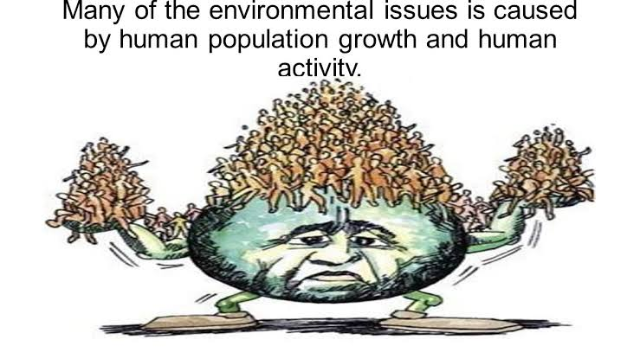

Slide 9
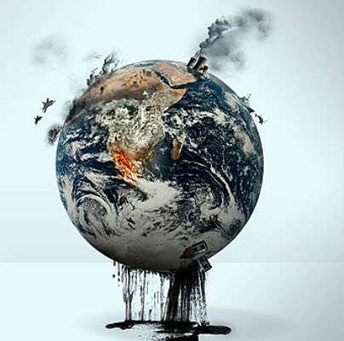
LIMITS TO GROWTH
BUT
EARTH IS
DEFINITELY
FINITE
UNIVERSE
MAYBE
INFINITE

Slide 10
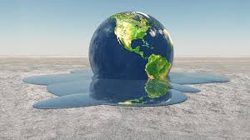
  It is a fact that we will not be able to 'manage" the environmental crisis unless people change their attitude, consumption patterns, manufacturing and marketing practices and get into technological world that is less intensive in its use of materials and energy
  It is also a fact that improvements in efficiency alone will not be enough. The economics till recently are following a policy that a growth as an infinite variable. The world now is desperately trying to keep pace with the environmental problems it has been creating as a result of above policy.
  They are not mindful of what is called "earth's carrying capacity concept”.

Slide 11

  Following this concept further, one can argue there is considerable scope for dematerialization and de-energisation without a decrease in living standards. But this will not happen unless it is promoted through changes in the fiscal system which supports appropriate technological improvements Also, it will not happen if principle of sufficiency is ignored. We have to set a level of sufficiency, i.e. this much and not beyond it.
  The nations of the world would then have almost unlimited environmental space in the foreseeable future to use alternate source of energy for their economic growth. Therefore, the world needs an international mechanism that not only provides incentives to all nations to live within their entitled amounts but also helps to promote rapid transition to a non-carbon energy economy.

Slide 12

  EXAMPLE OF LIMITS TO GROWTH:
  LOCUSTS ATTACK
  https://youtu.be/tBrUN3PGZaI

Slide 13

Limits to growth
LIMITS TO GROWTH
“One of the strangest assumptions of present day mental models is the idea that world of moderation must be a world of strict, centralized government control. For a sustainable economy, that kind of control is not possible, desirable or necessary. ”
- Donella H. Meadows

Slide 14
Running towards efficiency, ignoring the issue of sufficiency.
Goal of efficiency will be easy for developing countries , because financial assistance for resources and technology is easily available to achieve the goal.
Dilemma of sufficiency :- Limit to growth – will not be easy because the population who are constantly being fed the dream that everything is sufficient and they all will get whatever they want and on their extent.
What do you think how we can aware population about the capacity and finite resources of nature??
The idea of sufficiency may become saleable only if there is a global agreement that all population will strive towards a common convergence point on a per capita basis. In other words, sufficiency will be possible only if , the world is prepared to reach an international agreement on limits to growth and to say, that we have fixed our level of greed and now not more than that.
If sufficiency principles adopted by all the nations of the world ,can definitely us to move towards greater sustainability within a globalised economy.

Slide 15

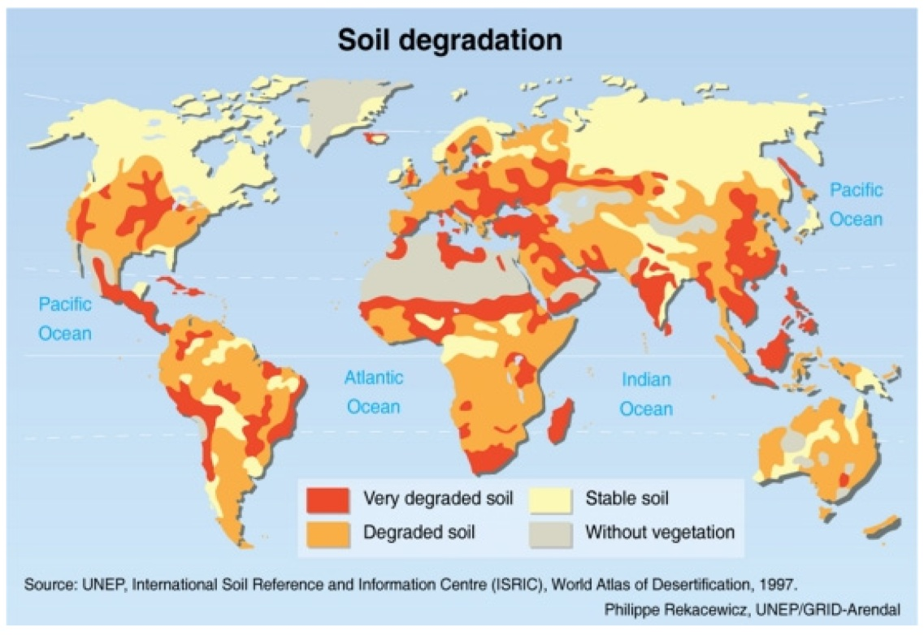
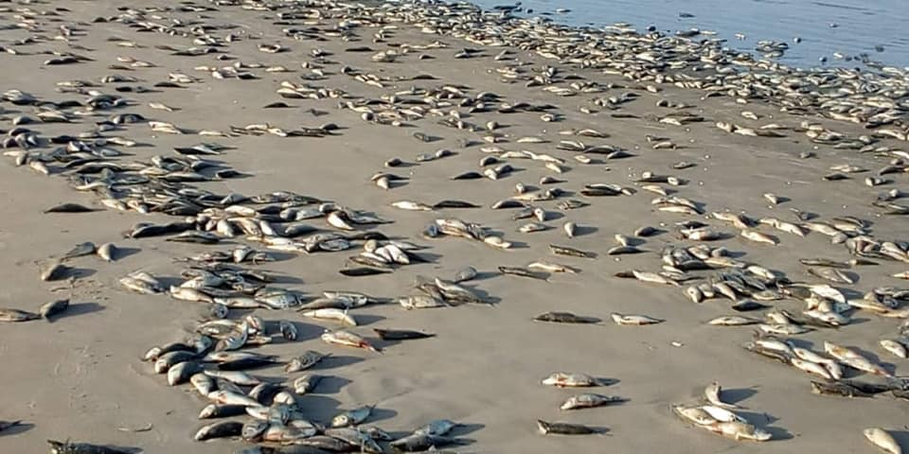
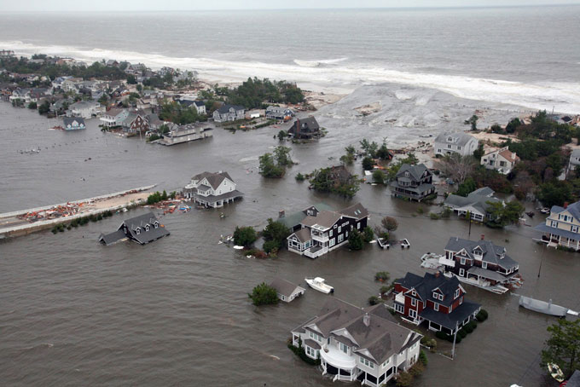
38 percent, or nearly 1.4 billion acres, of currently used agricultural land has been degraded.
54 nations experienced downfall in gdp during 1990-2001
75 percent of the world’s oceanic fisheries were fished at or beyond capacity and the species may have been pushed to biological extinction.
Sea level has risen 10–20 cm since 1900. Most non-polar glaciers are retreating, and the extent and thickness of Arctic sea ice is decreasing in summer.

Slide 16
Convergence Point
It has to be a system that talks about equitable entitlements or property rights to provide economic incentives to those use this environment in sustainable manner and disincentive to those who use it in unsustainable manner.
Within a globalised economy, those who consume more than their fair share of world’s environmental space would thus have to pay for the extra space they want to use to those who do not consume their full share.
In this way world will begin to ‘Value the unvalued commons’.

Slide 17
In the case of global warming problem, the answer would be in establishing equitable entitlements to the common space and carbon emissions trading mechanism which helps to penalise those who want to consume more than their entitlements and reward to those who do not use the full share of their entitlements.
This is convergence on per capita basis.

Slide 18
LIMITS TO GROWTH
There is a difference between an ecology of means and an ecology of ends:
For example: In the last 20 years fuel efficiency of cars has grown enormously, nevertheless, the problem of cars is far from being solved because while efficiency grew, the number of cars and the power of cars also grew.
An ecology of means has to be accompanied by an ecology of ends, the efficiency revolution will remain counterproductive if it is not accompanied by sufficiency revolution.
Issue of sufficiency and issue of efficiency:
The goal of efficiency will be easy for government of developing countries to accept especially if industrialised countries are prepared to provide financial assistance and technology transfer to achieve the goal…….whereas,
The issue of sufficiency will be possible only if , one day, the world is prepared to reach an international agreement on limits to growth and to say, that we have fixed our level of greed and no more.

Slide 19
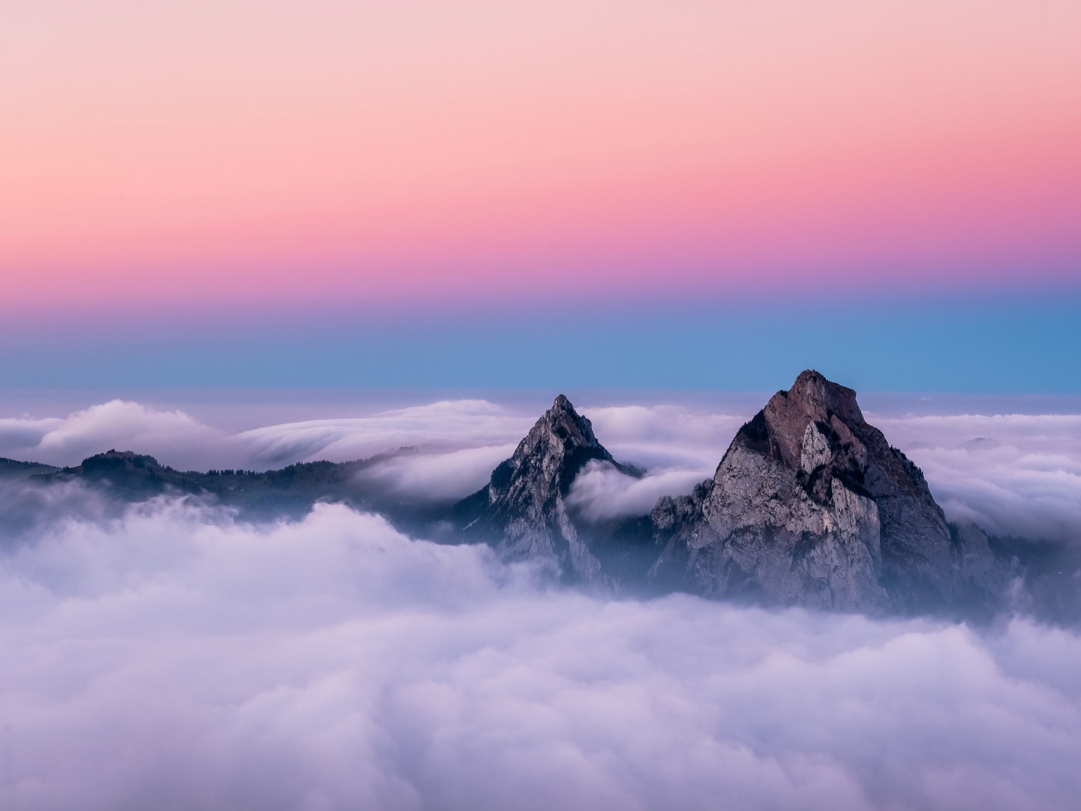
Economic and political policies towards sufficiency principles if adopted by all the nations of the world, can definitely help them to move towards greater sustainability within a globalized economy.
The global distribution of wealth and oppurtunities is extremely skewed.
The richest 20 percent of the worlds population controls more than 80 percent
of the world gross product and uses nearly 60 percent of world commercial
energy.

Slide 20
There is a considerable scope for demateriliastion and de-energisation without a decrease in living standards.
Nothing is as irrational as running with high speed and with utmost efficiency but in the wrong direction.
The Principle of sufficiency must be followed by people.
Within a globalised economy , those who consume more than
Their fair share of the worlds enviournmental space would thus have to pay for the extra space they want to use to those who do not consume their full share.
In this way the world will begin to value the unvalued commons.

Slide 21
An ecology of means has to be accompanied by an ecology of ends.
The idea of sufficiency may become saleable only if there is a global agreement that all societies will strive towards a common convergence point on a per capita basis.

Slide 22
EXAMPLE-1
Extinction of Coral Reefs due to Increasing Human Population

Slide 23
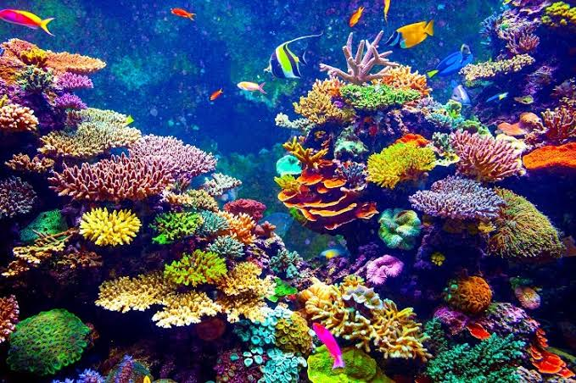
CORAL REEFS
A coral reef is an underwater ecosystem characterized by reef- building corals. Reefs are formed of colonies of coral polyps held together by calcium carbonate.
Coral reefs are large underwater structures composed of the skeletons of colonial marine invertebrates called coral. The coral species that build reefs are known as ‘hard corals’ because they extract calcium carbonate from seawater to create a hard, durable exoskeleton that protects their soft, sac-like bodies.
Coral reefs are found in more than 100 countries around the world. Most reefs are located between the Tropics of Cancer and Capricorn, in the Pacific Ocean, the Indian Ocean, the Caribbean Sea, the Red Sea, and the Persian Gulf.
The biggest coral reefs are found in the clear, shallow waters of the tropics and subtropics. The largest of these coral reef systems, the Great Barrier Reef in Australia, is more than 1,500 miles long (2,400 kilometers ).
There are hundreds of different species of coral reefs. Coral have a dazzling array of shapes and colours, from round, folded brain corals (named for their resemblance to a human brain) to tall, elegant sea whips and sea fans that look like intricate, vibrantly coloured trees or plants.

Slide 24
SIGNIFICANCE OF CORAL REEFS IN ENVIRONMENT
Reefs play an important role in protecting the shoreline from storms and surge water. Barrier reefs, such as Florida’s, were named for the way they reduce waves and buffer the shores.
As the foundation for complex food webs, coral reefs support an incredible diversity of fish. Algae, soft coral, sponges and invertebrates create the base of this web. From small herbivorous fish to large predatory fish, all find food and protection on the reef.
Along side reef fish is an equally diverse array of marine crustaceans, reptiles and mammals. Everything from lobsters and octopus to sea turtles and dolphins depend on the reef for food, habitat and protection.
Most corals and sponges are filter feeders, which means that they consume particulate matter suspended in the water column.
Coral reefs often form the backbone of local economies. Tourists coming to dive need not only dive boats and guides, but also restaurants, hotels and commercial and entertainment facilities. In many cases, tourism associated with reefs has expanded to transform the entire economy of a region.

Slide 25
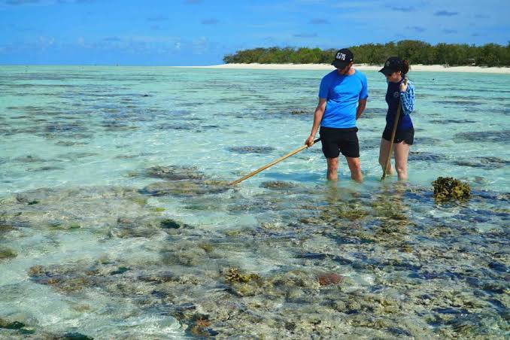
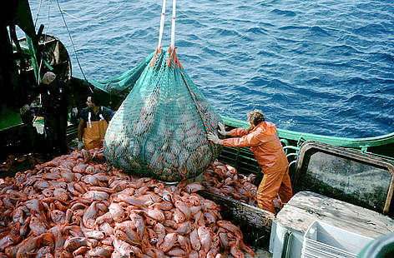

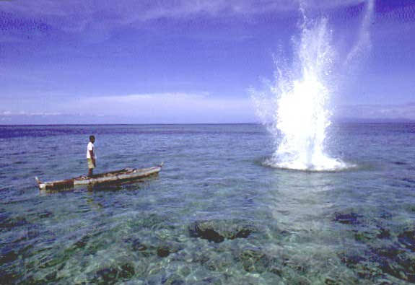
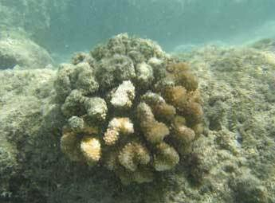
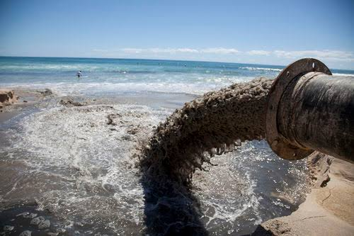
Overfishing
Coral souvenir
Reef walking
Different Impact of human population
Sedimentation due to construction
Sewage
Blast fishing

Slide 26
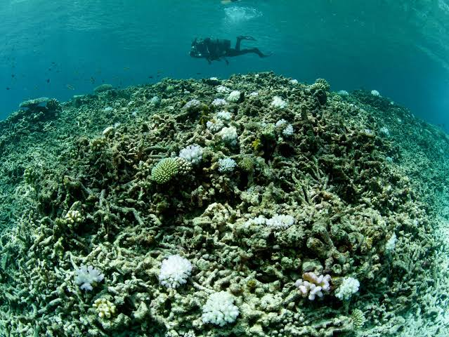
Impact of humans on coral reefs:
Damaging activities include coral mining, pollution (organic and non-organic), overfishing, fishing, the digging of canals and access into islands and bays. Other dangers include disease, destructive fishing practices and warming oceans.
In 2008, a study estimated that 19% of the existing area of coral reefs has already been lost, and that 17% is likely to be lost over the subsequent 10–20 years.Only 46% of the world's reefs could be regarded as in good health and about 60% of the world's reefs may be at risk due to destructive human activities.
The threat to the health of reefs is particularly strong in Southeast Asia, where 80% of reefs are endangered. By the 2030s, 90% of reefs are expected to be at risk from both human activities and climate change by 2050, it is predicted that all coral reefs will be in danger.

Slide 27

EXAMPLE-2

Slide 28
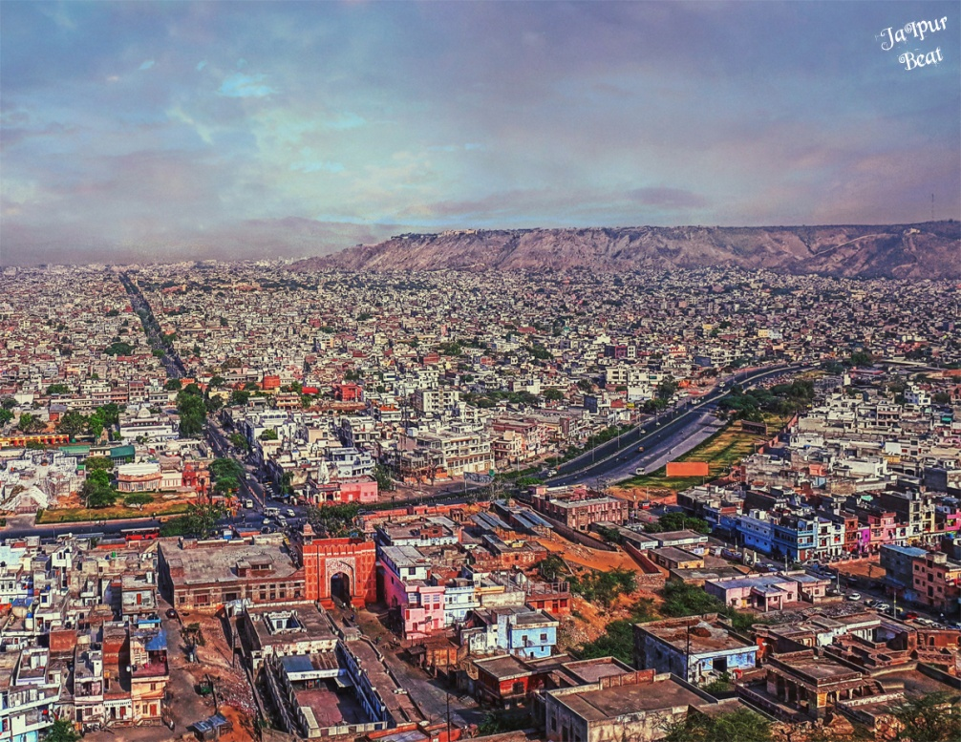
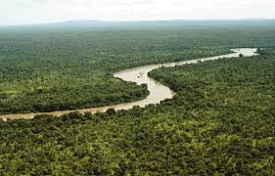
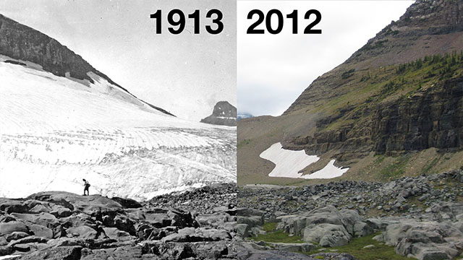
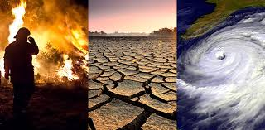
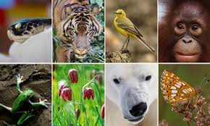
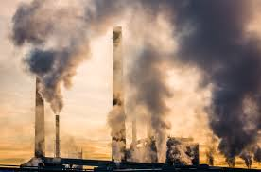

Slide 29
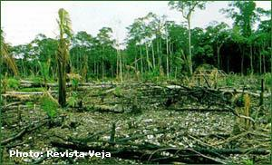
Destruction of Amazon Rainforest
Since 1978 about one million square kilometers of Amazon rainforest have been destroyed. Vast areas of rainforest were felled for cattle pasture and soy farms, drowned for dams, dug up for minerals, and bulldozed for towns and colonization projects.
How increased human population affected Amazon Rainforest?
Deforestation in the Amazon was primarily the product of subsistence farmers who cut down trees to produce crops for their families and local consumption driven by industrial activities and large-scale agriculture, makes the Air Drier and promotes Soil Erosion.
By the 2000s more than three-quarters of forest clearing in the Amazon was for cattle-ranching.
With more food being produced, more people survive, leading to population increase.

Slide 30
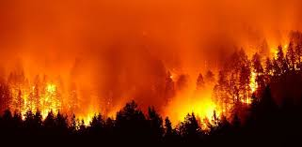
Amazon Fire
“The Amazon is burning—and humans are likely to blame”(CNN)
.
At least 125,000 hectares (310,000 acres) — the equivalent to 172,000 soccer fields — were cleared of forest earlier in 2019, and then burned in August, the report showed.
Human-driven deforestation of the Amazon is used to clear land for agriculture, livestock, and mining, and for its lumber.
Man-made fires in the Amazon also tend to elevate their smoke into the higher atmosphere due to the more intense burn of the dry biomass.
Further evidence of the fires being caused by human activity is due to their clustering near roads and existing agricultural areas rather than remote parts of the forest.

Slide 31
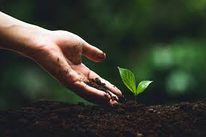

CONCLUSION
“The human population can no longer be allowed to grow in the same old uncontrolled way. If we do not take charge of our population size, then nature will do it for us”
The world population is growing by approximately 74 million people per year. We have consumed more resources in the last 50 years than the whole of humanity before us.
We humans have spread across every continent and created huge changes to landscapes, ecosystems, atmosphere everything, due to increased demand for food, water and arable land.
The pressure of increased human population can’t be reduced but can be controlled in order to protect the environment and for maintaining the balance of earth’s natural cycle.
“The Earth will not continue to offer its harvest, except with faithful stewardship. We cannot say we love the land and then take steps to destroy it for use by future generations.”
—John Paul II

Slide 32
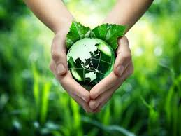
“As I see it, humanity needs to reduce its impact on the Earth urgently and there are three ways to achieve this: we can stop consuming so many resources, we can change our technology and we can reduce the growth of our population.”
-Sir David Attenborough
( naturalist and broadcaster)
THANK YOU

