Slide 1
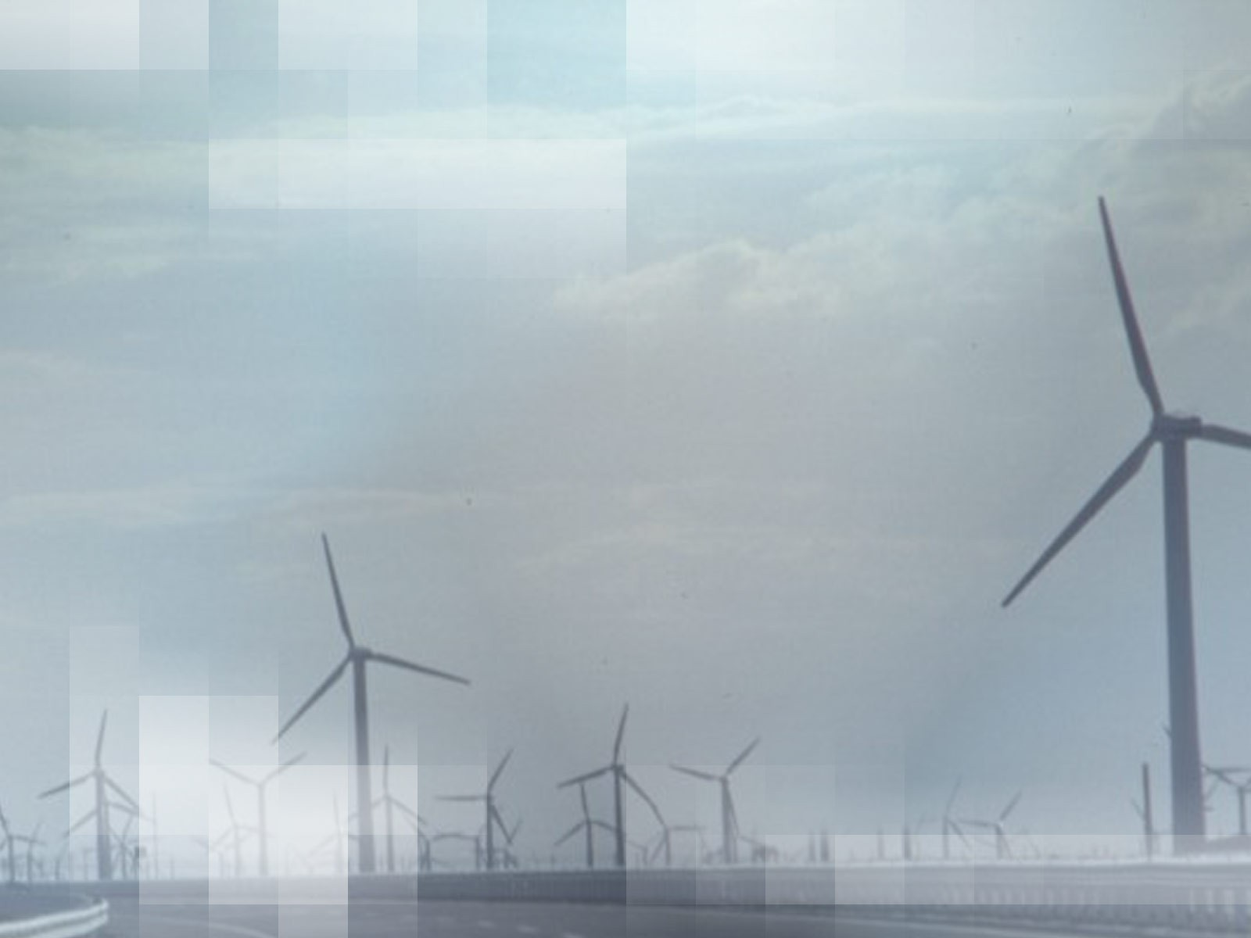
Basic Scheme and Application of Energy Conservation

Slide 2
ENERGY
Energy can neither be created nor it can be destroyed. It can only be converted from one form to another.
For example :
In a room heater, electrical energy is converted to thermal energy.
Turbine converts mechanical energy stored in steam to electrical energy.

Slide 3
TYPES OF ENERGY
➢Energy can be broadly divided into two categories-
Renewable energy
Non-renewable energy

Slide 4
RENEWABLE ENERGY
➢ Renewable energy can be generated continuously practically without decay of source.
➢ Example :
•
•
•
•
•
•
Solar Wind
Geothermal Hydro Biomass Tidal

Slide 5

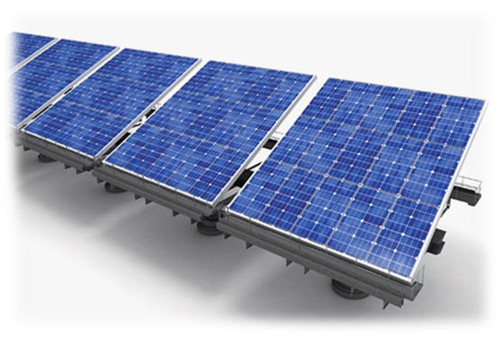
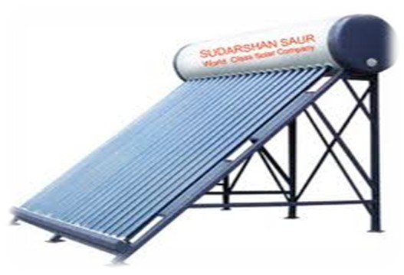
SOLAR ENERGY
➢
Solar Energy can be converted into electrical energy by using solar panels.
➢ Solar powered electrical generation depands on heat engines and photovoltaic's.
➢ Examples :
SOLAR CELLS
•
•
•
Solar cooker Solar heater Solar cells
➢ Advantages :
SOLAR HEATER
•
•
Solar energy doesn’t produce Carbon dioxide. It have minimal impact on environment.
➢ Disadvantages :
It is not constant, it depends on weather conditions, time and location.

Slide 6

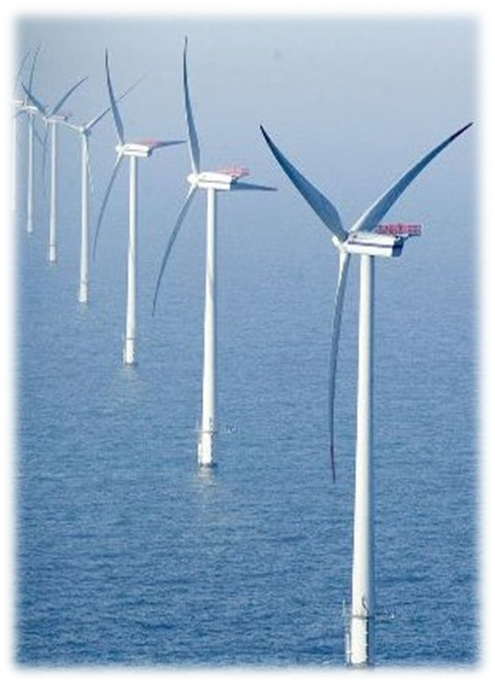
WIND ENERGY
Wind energy generated by wind turbines is mainly used to generate electricity.
India is world's fifth largest producer of electricity generation in this area.
Advantages :
Wind turbines (often called windmills) do not release emissions that pollute the air or water.
➢ Disadvantages :
Installation and maintenance cost is very high.
Only few places are there in world where wind blow continuously throughout the year.
WIND TURBINES

Slide 7
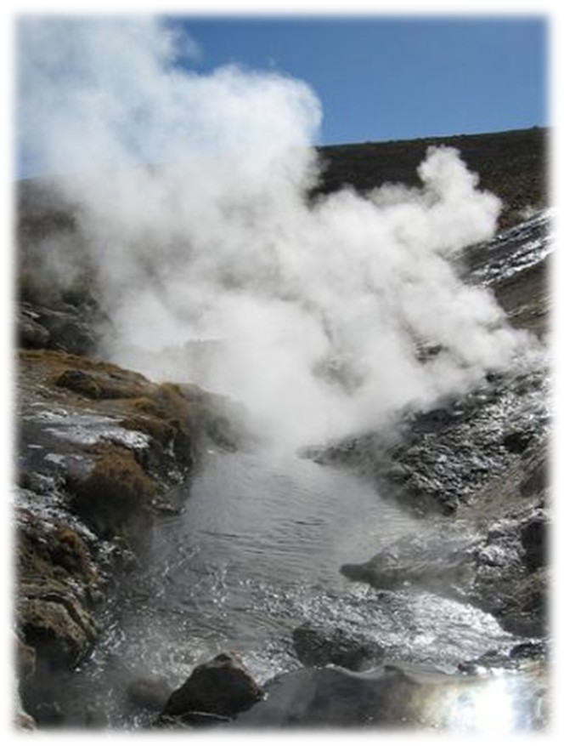
GEOTHERMAL ENERGY
Geothermal energy is heat from within the Earth. We can recover this heat as steam or hot water and use it to heat buildings or generate electricity.
Examples :
HOT SPRINGS
•
•
•
Hot springs Fumaroles (smoke) Geysers
➢ Advantages :
Carbon dioxide emission levels are very low. They release less than 1% of the carbon dioxide.
➢ Disadvantages :
•
•
Installation cost is very high.
Release various kind of harmful gases.

Slide 8
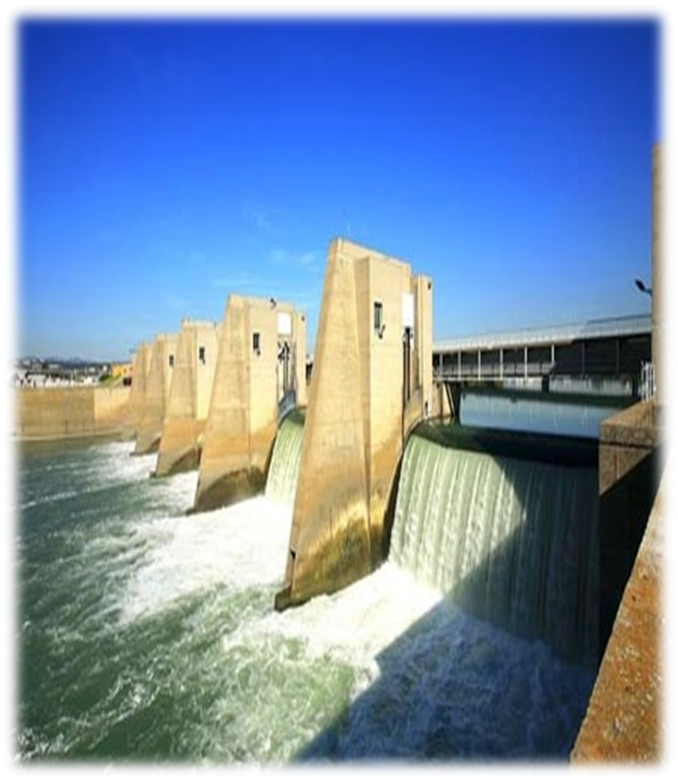
HYDRO ENERGY
➢
Hydro energy is generally generated from running water
using various mechanical methods.
➢ Examples:
Hydroelectric Dam
•
•
•
Dams
Tidal Barrages
Ocean Thermal Energy Conversion (OTEC) system
➢ Advantages :
Produces very less amount of carbon dioxide.
It is also being used to control flood and for irrigation purposes.
➢ Disadvantages:
Natural environment is destroyed.

Slide 9
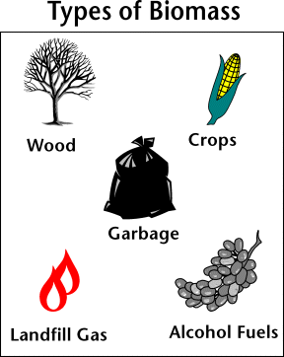
BIOMASS ENERGY
➢
Biomass is organic material made from plants and animals waste. (microorganisms).
When it is burned, the chemical energy in biomass is released as heat .
Examples :
•
•
•
Methanol (from animal waste) Ethanol
Biodiesel(liquid biomass)
➢ Advantages :
Equipment (biogas plant) installation cost is less.
Helps in garbage reduction.
➢ Disadvantages :
Releases high amount of sulphurous gases.

Slide 10
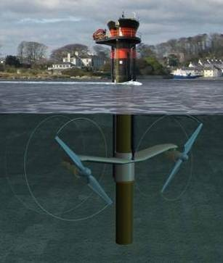
TIDAL ENERGY
➢The energy contained in ocean waves can potentially provide an unlimited source of renewable energy.
➢Ocean waves are created by the interaction of wind with the surface of the sea.
➢Advantages :
It doesn't produce greenhouse gases and its life is very long.
It’s efficiency is around 80%.It doesn’t require any kind of fuel to run.
➢Disadvantages :
Sea-Gen tidal turbine, installed in Strangford
Cost of construction of tidal power plant is high.
Lough, County Down, Northern Ireland, (image courtesy of Marine Current Turbines (MCT))

Slide 11
NON-RENEWABLE ENERGY
➢Non renewable energy can’t be generated again and again form the same source.
➢ Examples:
Petroleum products ( kerosene, petrol, diesel, etc )
Coal
Uranium

Slide 12
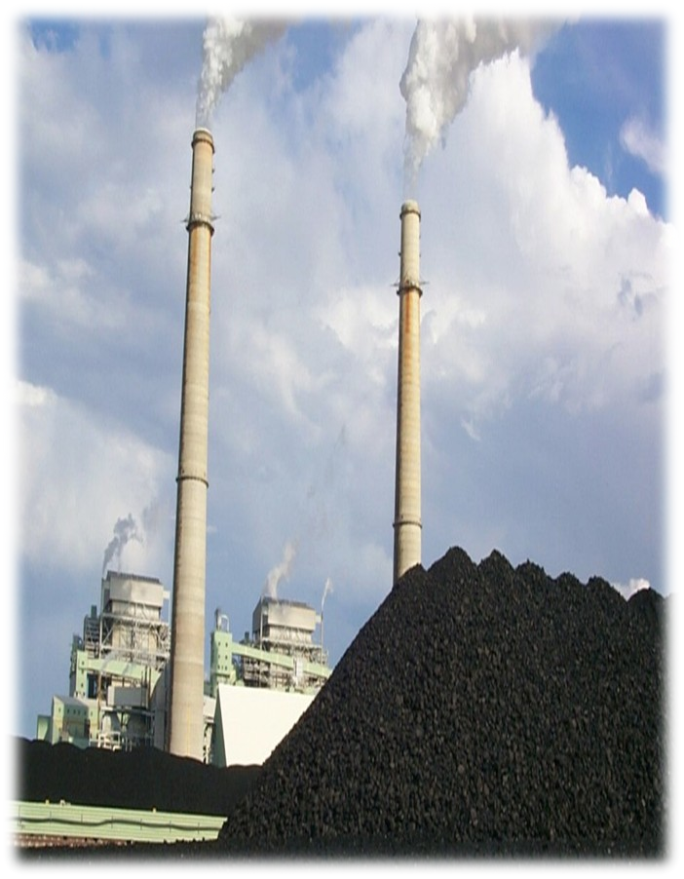
COAL
Coal is a combustible black or brownish-black sedimentary rock composed mostly of carbon and hydrocarbons.
For millions of years, a layer of dead plants at the bottom of the swamps was covered by layers of water and dirt, trapping the energy of the dead plants.
The heat and pressure from the top layers helped the plant remains turn into what we today call coal .
➢ Disadvantages :
Responsible for 57% of carbon dioxide in the air.
Coal

Slide 13
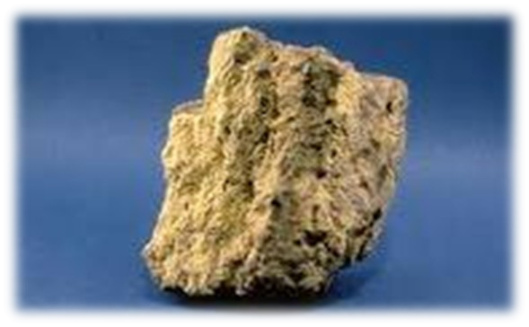
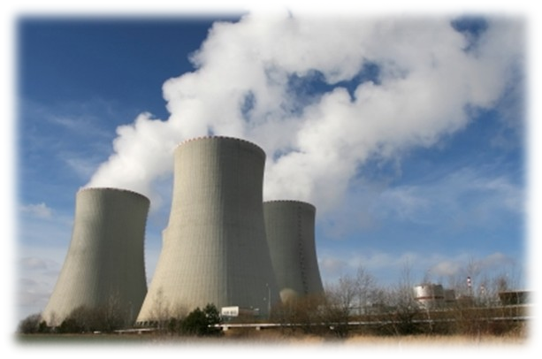
URANIUM
Nuclear energy is energy in the nucleus (core) of an uranium-235 atom. Atoms are tiny particles that make up every object in the universe.
It can be released from atoms in two ways: nuclear fusion and nuclear fission.
Advantages :
Even a small amount can release enough energy to light-up thousand of energy for months. (1 kg uranium-235 corresponds to 2.7 million kg coal equivalent.)
uranium
➢ Disadvantages :
After using it in nuclear reactor then also it radioactive substances is very dangerous for human . Eg : carbonyl accident and fukushima plant accident.
Nuclear plant

Slide 14
DIFFERENCE BETWEEN RENEWABLE AND NON-RENEWABLE SOURCE OF ENERGY
➢RENEWABLE SOURCE
➢NON-RENEWABLE SOURCE
•
Definition : Renewable energy can be generated continuously practically without decay of source.
•
Definition : Non-renewable can’t be generated continuously without decay of source.
•
Responsible for 3-4% of carbon dioxide in environment.
•
Responsible for 91-94% of carbon dioxide in environment.
Main reason behind “global warming”.
•
Not a reason behind “global warming”.
•

Slide 15
ENERGY CONSERVATION
Energy conservation refers to efforts made to reduce energy consumption.
Energy conservation can be achieved through increased efficient energy use or reduced consumption from non- renewable energy sources.
Energy conservation is often the most economical solution to energy shortages.

Slide 16
WHY TO CONSERVE ?
We have limited fuels available on earth.
Our demand for energy is increasing day-by-day.
It is possible that someday, most of fuels will be exhausted , and we will have to switch to alternate energy.

Slide 17
ENERGY CONSERVATION IN ‘INDIA’
In India , government has passed “ energy conservation bill, 2001 ” for better utilization of energy and conservation of the same.
By this act, it is mandatory for energy intensive sectors to get their “energy audit ” conducted by energy auditor.
Bureau of energy efficiency : this body keeps watch on energy consumption patterns, develops norm for appliances etc.
Star ratings : BEE has also initiated “star rating system” for electrical appliances e.g. - CFL’S , geysers, refrigerator, etc.

Slide 18
DATA RELATED TO ENERGY CONSUMPTION IN ‘INDIA’
About 70% of India's energy generation capacity is from fossil fuels, with coal accounting for 40% of India's total energy
consumption followed by crude oil and natural gas at 24% and 6% respectively.
By 2030, India's dependence on energy imports is expected to exceed 53% of the country's total energy consumption. In 2009- 10, the country imported 159.26 million tonnes of crude oil which amount to 80% of its domestic crude oil consumption .
In India 31% of the country's total imports are oil imports.

Slide 19
What we can do ?
Always switch off light and fans while going out of room.
We should not open fridge frequently.
While going to purchase new products eg. Geysers, television, CFL, etc. insist for ratings ranging from 4-5 .
Increase everyone's understanding of the benefits of energy efficiency.

Slide 20
What we can do ?
RECYCLE waste materials into new products to prevent waste of potentially useful materials.
REPLACE old light bulbs with energy saving fluorescent bulbs. They may cost more, but will save you much more in the long run.

Slide 21
RECYCLING IS AN EXCELLENT WAY OF SAVING ENERGY AND CONSERVING THE ENVIRONMENT.
Do you know that:
1 recycled tin would save enough energy to power a television for 3 hours.
1 recycled glass bottle would save enough energy to power a computer for 25 minutes.
1 recycled plastic bottle would save enough energy to power a 60-watt light bulb for 3 hours.
70% less energy is required to recycle paper compared with
making it from raw materials.

Slide 22


Slide 23
THREE R’s
➢ The slogan reduce, reuse, recycle is widely used to raise awareness against the use of non-renewable source of energy.
Reduce consumption
Reuse manufactured products
Recycle raw materials

Slide 24
SAVE ENERGY, SAVE EARTH

