Slide 1
Accounts for Banking Companies
Part I

Slide 2
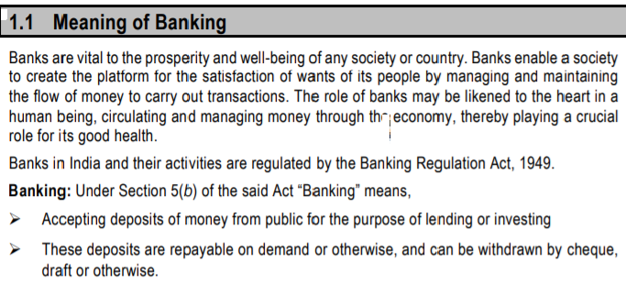
Restriction on Business of Banking Company

Slide 3
1.2 MEANING OF BANKING COMPANY
According to Sec. 5 of the Banking Regulation Act, 1949, a banking company means the accepting, for the purpose of lending or investment, of deposits of money from the public, repayable on demand or otherwise and withdrawn by Cheque, Draft, Order or otherwise. In short, a banking company means and includes any company which carries on the business or which transacts the business of banking in India.

Slide 4
1.3 PRINCIPAL PROVISIONS OF BANKING REGULATION ACT
Section 8 to 34

Slide 5
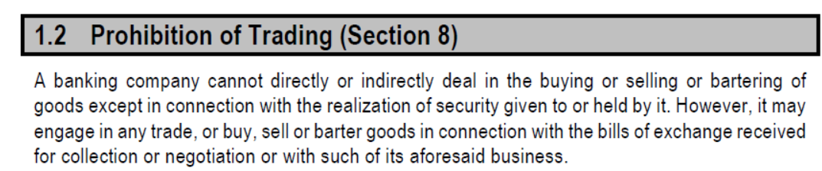
Prohibition of Trading Section 8

Slide 6
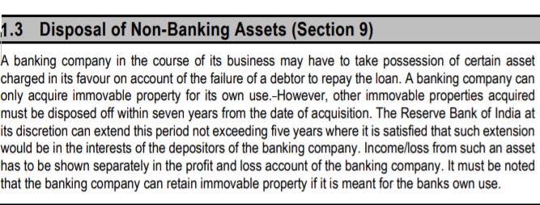
Disposal of Non Banking Assets Section 9

Slide 7
Management (Sec. 10):
Sec. 10(a) states that not less than 51% of the total number of members of the Board of Directors of a banking company shall consist of persons who have special knowledge or practical experience in one or more of the following fields: (a) Accountancy; (b) Agriculture and Rural Economy; (c) Banking; (d) Co-operation; (e) Economics; (f) Finance; (g) Law and (h) Small-scale Industry

Slide 8
Minimum Capital Reserves (Sec. 11):
Sec.11 of the Banking Regulation Act, 1949, provides that no banking company shall commence or carry on business in India, unless it has minimum paid-up capital and reserve of such aggregate value as noted below

Slide 9
(a) Foreign Banking Companies
In case of banking company incorporated outside India, its paid-up capital and reserve shall not be less than ` 1 lakh in respect of its principal place of business plus ` 15 lakhs and, if it has a place of business in Mumbai or Kolkata or in both, ` 20 lakhs.

Slide 10
(b) Indian Banking Companies:
In case of an Indian banking company, the sum of its paid-up capital and reserves shall not be less than the amount stated below: (i) If it has places of business in more than one State, ` 5 lakhs, and if any such place of business is in Mumbai or Kolkata or in both, ` 1 lakh in respect of its principal place of business plus ` 10 lakhs.

Slide 11
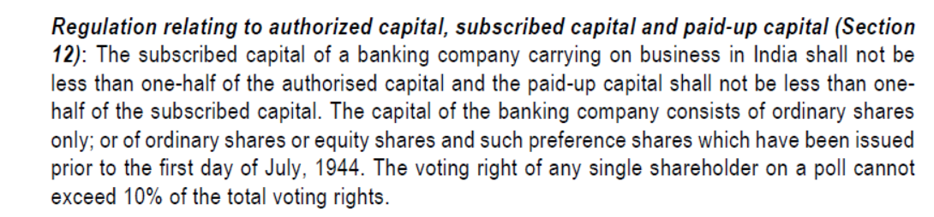
Regulation relating to Capital
Section 12

Slide 12
Payment of Commission, Brokerage etc. (Sec. 13):
According to Sec. 13, a banking company is not permitted to pay directly or indirectly by way of commission, brokerage, discount or remuneration on issues of its shares in excess of 2½ of the paid-up value of such shares.

Slide 13
Payment of Dividend (Sec. 15):
According to Sec. 15, no banking company shall pay any dividend on its shares until all its capital expense (including preliminary expenses, organization expenses, share selling commission, brokerage, amount of losses incurred and other items of expenditure not represented by tangible assets) have been completely written off.

Slide 14
Reserve Fund/Statutory Reserve
(Sec. 17)
According to Sec. 17, every banking company incorporated in India shall, before declaring a dividend, transfer a sum equal to 20% of the net profits of each year (as disclosed by its Profit and Loss Account) to a reserve fund. The Central Government may, however, on the recommendation of RBI, exempt it from this requirement for a specified period.

Slide 15
Sec 17 cont.
The exemption is granted if its existing reserve fund together with Share Premium Account is not less than its paid-up capital. If it appropriates any sum from the reserve fund or the share premium account, it shall, within 12 days from the date of such appropriation, report the fact to the Reserve Bank, explaining the circumstances relating to such appropriation

Slide 16
Cash Reserve (Sec. 18):
Under Sec. 18, every banking company (not being a Scheduled Bank) shall, if Indian, maintain in India, by way of a cash reserve in cash, with itself or in current account with the Reserve Bank or the State Bank of India or any other bank notified by the Central Government in this behalf, a sum equal to at least 3% of its time and demand liabilities in India.

Slide 17
(Sec. 18 cont.)
The Reserve Bank has the power to regulate the percentage also between 3% and 15% (in case of Scheduled Banks). Besides the above, they are to maintain a minimum of 25% of its total time and demand liabilities in cash, gold or unencumbered approved securities. But every banking company’s asset in India should not be less than 75% of its time and demand liabilities in India at the close of last Friday of every quarter.

Slide 18
Liquidity Norms (Sec. 24)
According to Sec. 24 of the Act, banking companies must maintain sufficient liquid assets in the normal course of business. The section states that every banking company has to maintain in cash, gold or unencumbered approved securities, an amount not less than 20% of its demand and time liabilities in India. This percentage may be changed by the RBI from time to time according to economic circumstances of the country. This is in addition to the average daily balance maintained by a bank.

Slide 19
Accounts and Audit (Secs. 29 to 34A):
The above Sections of the Banking Regulation Act deal with the accounts at audit. Every banking company, incorporated in India, at the end of financial year expiring a period of 12 months as the Central Government may by notification in the Official Gazette specified, must prepare a Balance Sheet and a Profit and Loss Account as on the last working day of that year or according to the Third Schedule or as circumstances permit.

Slide 20
Format of Balance Sheet of a Banking Co. Company
FORM OF CONSOLIDATED BALANCE SHEET OF A BANK AND ITS
SUBSIDIARIES ENGAGED IN FINANCIAL ACTIVITIES
Balance Sheet of ________________________ (here enter name of the banking group)
(000’s omitted)
Balance Sheetas on March 31 (Year)
 | Schedule | as on March 31 (Year) | as on March 31 (Year)
CAPITAL & LIABILITIES |  | (current year) | (previous year)
Capital | 1
Reserves & Surplus | 2
Minorities Interest 2A | 2A
Deposits | 3
Borrowings | 4
Sundry Payables
Other Liabilities and Provisions | 5
Total
ASSETS
Cash and Balances with Reserve Bank
of India
 | 6
Balances with banks and money at call
and short notice
 | 7
Investments | 8
Loans & Advances | 9
Sundry Receivables
Fixed Assets | 10
Other Assets | 11
Goodwill on Consolidation
Debit Balance of Profit and Loss A/C
Total
Contingent liabilities | 12
Bills for collection

Slide 21
Format of P & L Accounts of a Banking Co.
FORM OF CONSOLIDATED PROFIT & LOSS ACCOUNTS OF A BANK AND ITS
SUBSIDIARIES ENGAGED IN FINANCIAL ACTIVITIES
Profit & Loss Accounts________________________ (here enter name of the banking group)
(000’s omitted)
Profit & Loss Accounts for the year ended March 31 ___
 | Schedule | as on March 31 (Year) | as on March 31 (Year)
I. Income |  | (current year) | (previous year)
Interest and dividend earned1 | 13
Share of earnings in Associates
Other income
Total | 14
II. Expenditure
Interest expended | 15
Operating expenses | 16
Provisions and contingencies
Total
Consolidated Net profit/(loss) for the year before deducting Minorities' Interest
Less: Minorities' Interest
Consolidated profit/(loss) for the year attributable to the group
Add: Brought forward consolidated profit/(loss) attributable to the group
III. Appropriations
Transfer to statutory reserves
Transfer to other reserves
Transfer to Government/Proposed dividend
Balance carried over to consolidated balance sheet
Total
Earnings per Share

