Slide 1
Decision Support Systems

Slide 2
Decision Support Systems
Decision support systems (DSS)
Offer potential to assist in solving both semi-structured and unstructured problems

Slide 3
Decision Making as a Component of Problem Solving
Intelligence
Decision making
Design
Choice
Problem solving
Implementation
Monitoring

Slide 4
Problem Solving Factors
Multiple decision objectives
Increased alternatives
Increased competition
The need for creativity
Social and political actions
International aspects
Technology
Time compression

Slide 5
Characteristics of a DSS (1)
Handles large amounts of data from different sources
Provides report and presentation flexibility
Offers both textual and graphical orientation

Slide 6
Characteristics of a DSS (2)
Supports drill down analysis
Performs complex, sophisticated analysis and comparisons using advanced software packages
Supports optimization, satisficing, and heuristic approaches

Slide 7
Characteristics of a DSS (3)
Performs different types of analyses
“What-if” analysis
Makes hypothetical changes to problem and observes impact on the results
Simulation
Duplicates features of a real system
Goal-seeking analysis
Determines problem data required for a given result

Slide 8
Goal Seeking Example
You know the desired result
You want to know the required input(s)
Example:
Microsoft Excel’s “Goal Seek” and “Solver” functions

Slide 9
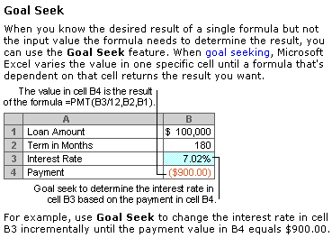
Excel
demo

Slide 10
Capabilities of a DSS (1)
Supports
Problem solving phases
Different decision frequencies
Merge with another company?
How many widgets should I order?
low
high
Frequency

Slide 11
Capabilities of a DSS (2)
Highly structured problems
Straightforward problems, requiring known facts and relationships.
Semi-structured or unstructured problems
Complex problems wherein relationships among data are not always clear, the data may be in a variety of formats, and are often difficult to manipulate or obtain

Slide 12
Decision Making Levels
Strategic
Tactical
Operational
Operational-level managers involved with daily decisions
Strategic-level managers involved with long-term decisions
High
Low
Decision Frequency

Slide 13
Integration of TPS, MIS, and DSS
In many organizations they are integrated through a common database
Separation of DSS transactions in the database from TPS and MIS transactions may be important for performance reasons

Slide 14
Web-Based Decision Support Systems
Web-based decision support systems
Decision support system software provides business intelligence through web browser clients that access databases either through the Internet or a corporate intranet

Slide 15
Components of a DSS
Model management software (MMS)
Coordinates the use of models in the DSS
Model base
Provides decision makers with access to a variety of models
Dialogue manager
Allows decision makers to easily access and manipulate the DSS

Slide 16
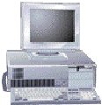
Database
Model base
DBMS
MMS
External databases
Access to the internet, networks, and other computer systems
External database access
Dialogue manager

Slide 17
Model Base
Model Base
Provides decision makers with access to a variety of models and assists them in decision making
Models
Financial models
Statistical analysis models
Graphical models
Project management models

Slide 18
Advantages and Disadvantages of Modeling
Advantages
Less expensive than custom approaches or real systems.
Faster to construct than real systems
Less risky than real systems
Provides learning experience (trial and error)
Future projections are possible
Can test assumptions
Disadvantages
Assumptions about reality may be incorrect
Accuracy of predications often unreliable
Requires abstract thinking

Slide 19
Group Decision Support System
Group Decision Support System (GDSS)
Contains most of the elements of DSS plus software to provide effective support in group decision-making settings

Slide 20
Databases
Model base
GDSS processor
GDSS software
External databases
Access to the internet and corporate intranet, networks, and other computer system
Dialogue manager
External database access
Users

Slide 21
Characteristics of a GDSS (1)
Special design
Ease of use
Flexibility
Decision-making support
Delphi approach (decision makers are geographically dispersed)
Brainstorming
Group consensus
Nominal group technique

Slide 22
Characteristics of a GDSS (2)
Anonymous input
Reduction of negative group behaviour
Parallel communication
Automated record keeping
Cost, control, complexity factors

Slide 23
Components of a GDSS and GDSS Software
Database
Model base
Dialogue manager
Communication capability
Special software (also called GroupWare)
E.g., Lotus Notes
people located around the world work on the same project, documents, and files, efficiently and at the same time

Slide 24
Decision Room
Decision Room
For decision makers located in the same geographic area or building
Use of computing devices, special software, networking capabilities, display equipment, and a session leader
Collect, coordinate, and feed back organized information to help a group make a decision
Combines face-to-face verbal interaction with technology-aided formalization

Slide 25
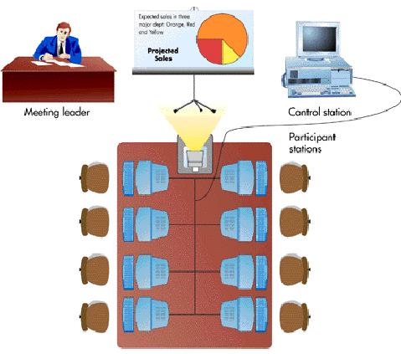

Slide 26
Wide Area Decision Network
Characteristics
Location of group members is distant
Decision frequency is high
Virtual workgroups
Groups of workers located around the world working on common problems via a GDSS

Slide 27
Executive Support System
Characteristics
A specialized DSS that includes all the hardware, software, data, procedures, and people used to assist senior-level executives within the organization
Board of directors
President
Function area vice presidents
Function area managers

Slide 28
Characteristics of ESSs
Tailored to individual executives
Easy to use
Drill down capabilities
Support the need for external data
Help with situations with high degree of uncertainty
Futures orientation (predictions, forecasting)
Linked with value-added business processes

Slide 29
Capabilities of an ESS
Support for
defining overall vision
strategic planning
strategic organizing and staffing
strategic control
crisis management

Slide 30
End of Chapter

