Slide 1
Business Model
A plan for the successful operation of a business, identifying sources of revenue, the intended customer base, products, and details of financing.
The way in which the company conducts its business to generate revenue.

Slide 2
Revenue Model
Direct sales
Subscription model
Transaction fee model
Advertising support model
Sponsorship model

Slide 3
Classification on the basis of relationships of transaction parties
B2C
B2B
C2C
C2B
B2G

Slide 4
B2C | Sells products or services directly to consumers
B2B | Sells products or services to other businesses or brings multiple buyers and sellers together in a central marketplace
B2G | Businesses selling to local, state, and federal agencies
C2C | Consumers sell directly to other consumers
C2B | Consumers fix price on their own, which businesses accept or decline

Slide 5
Relation between B2B and B2C
Raw material producer
Manufacturer
Distributor
Retailer
Consumer
B2B
B2C

Slide 6
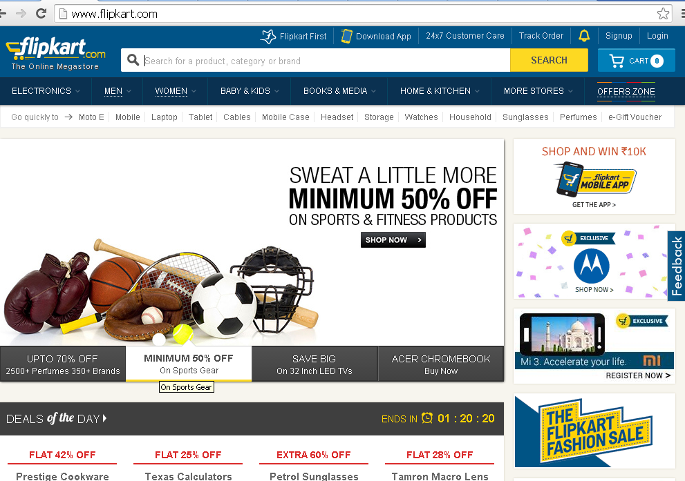

Slide 7
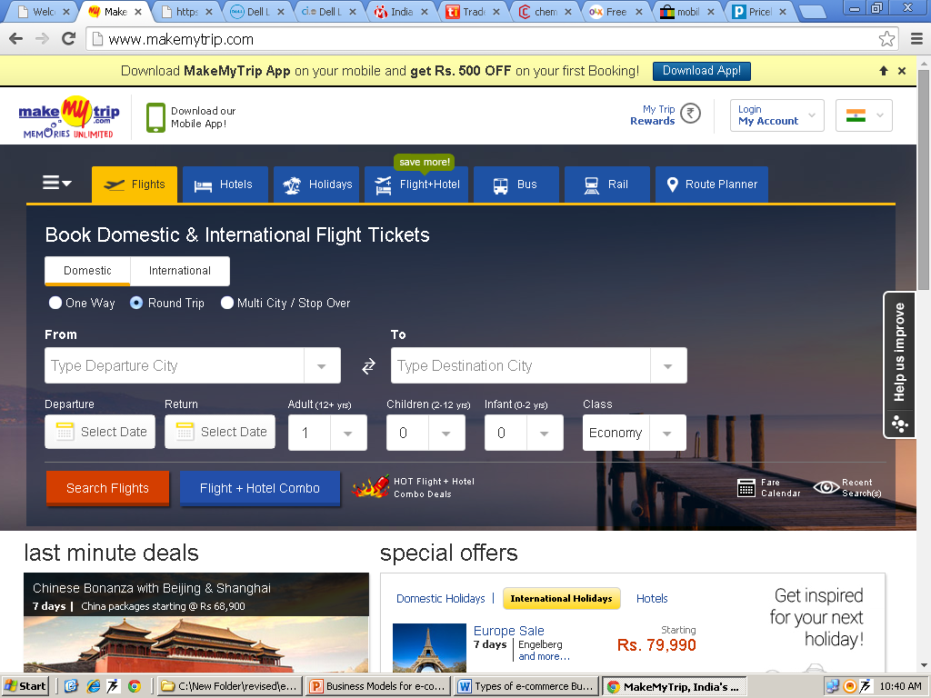

Slide 8
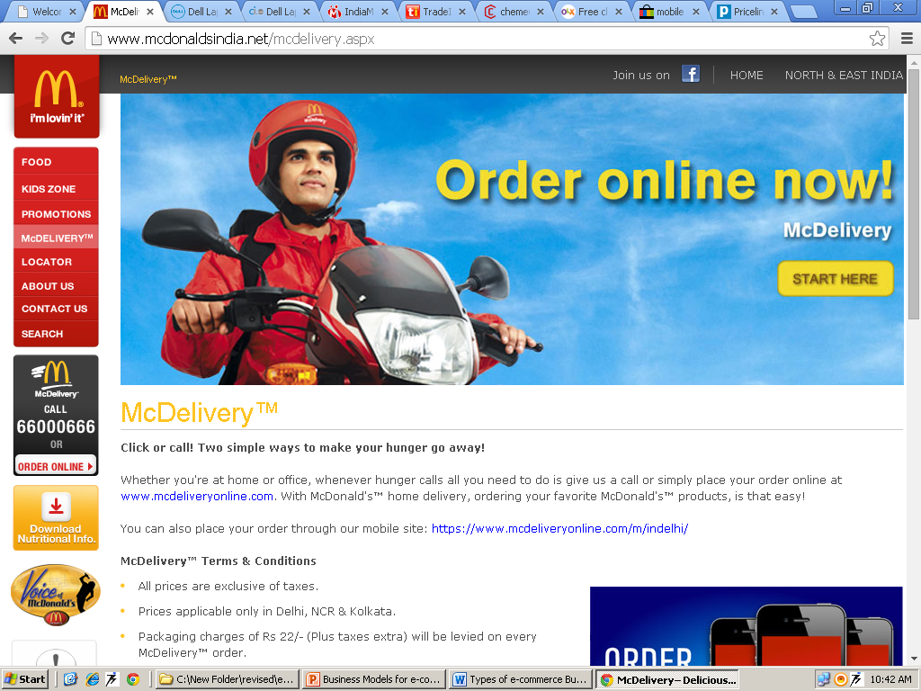

Slide 9
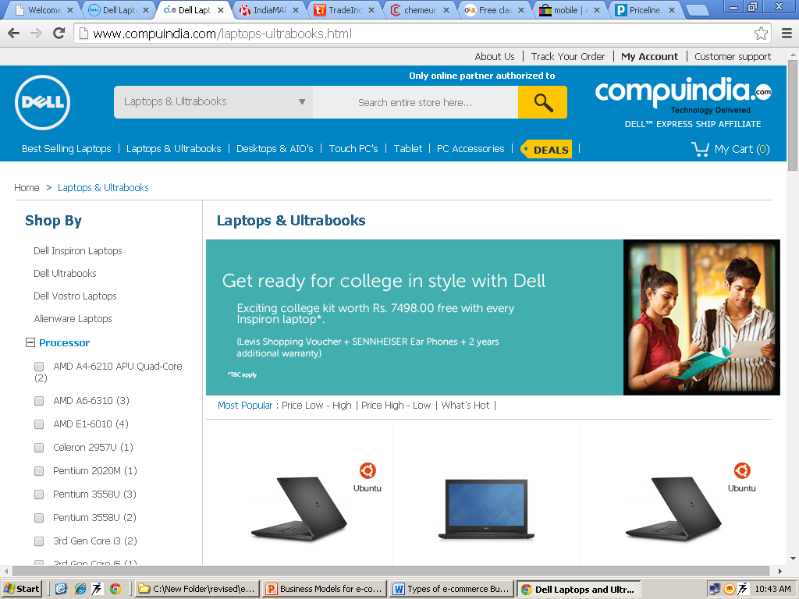

Slide 10
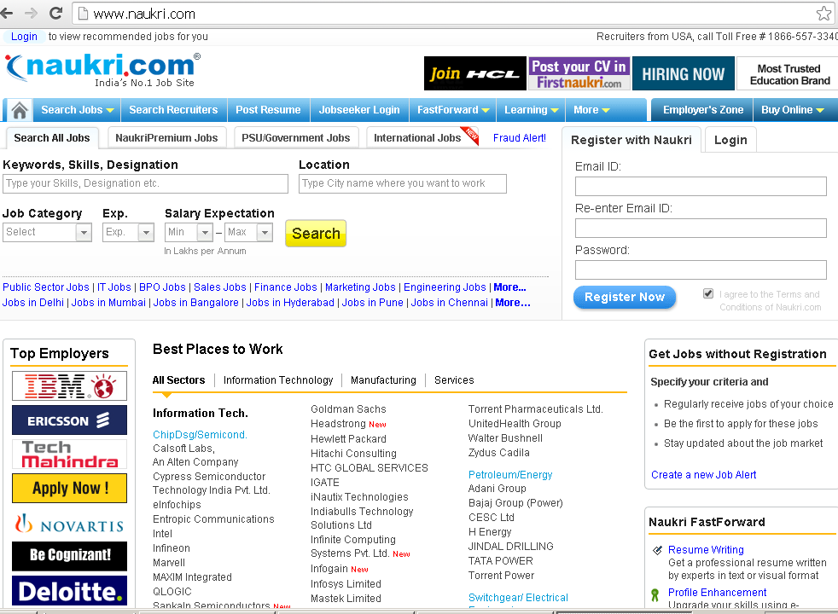

Slide 11
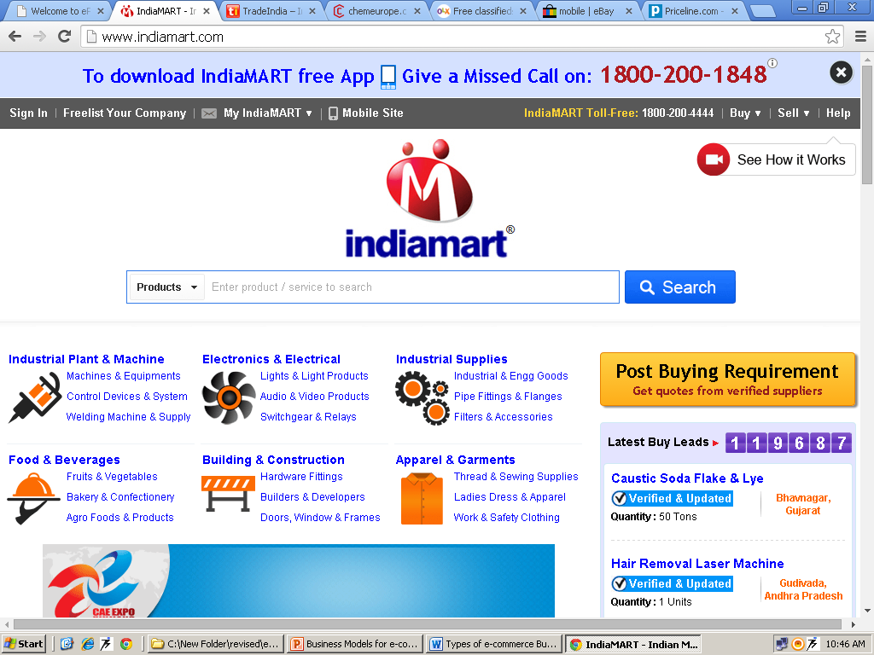

Slide 12
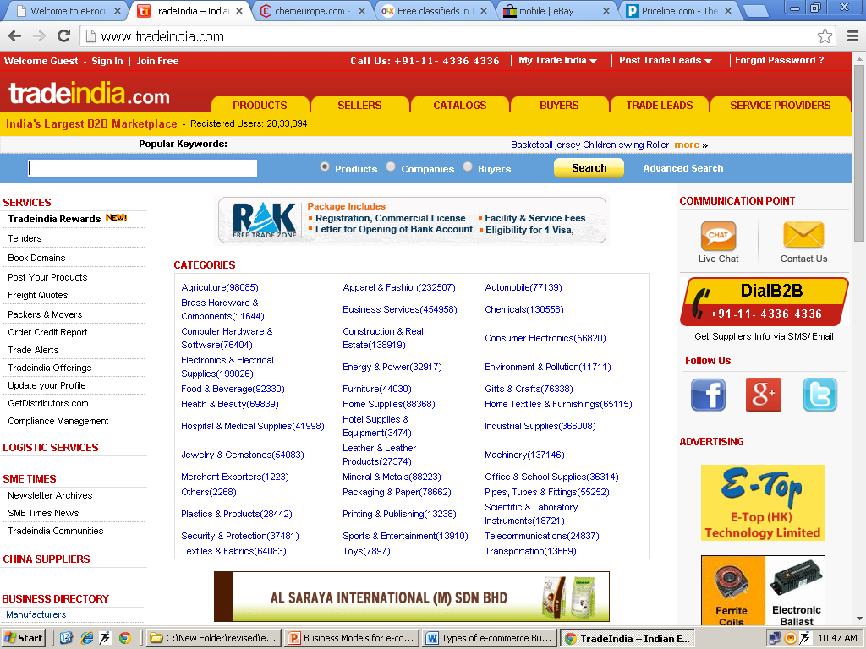

Slide 13
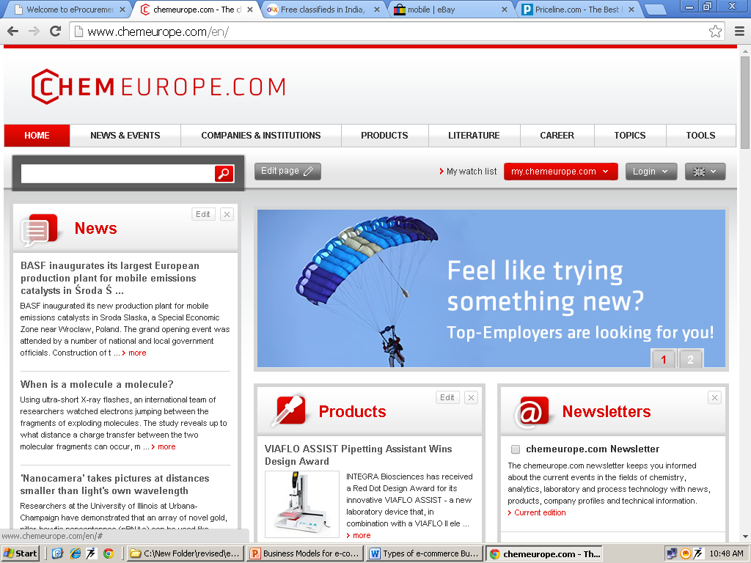

Slide 14
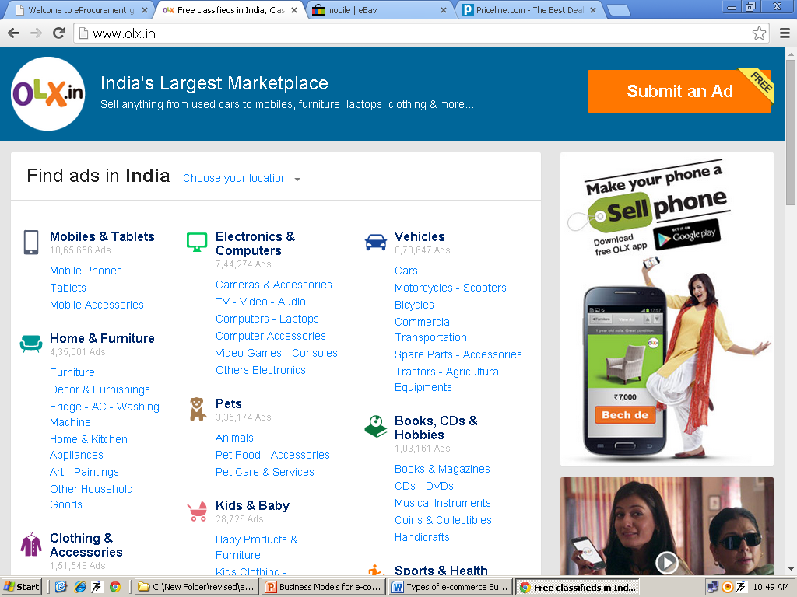

Slide 15
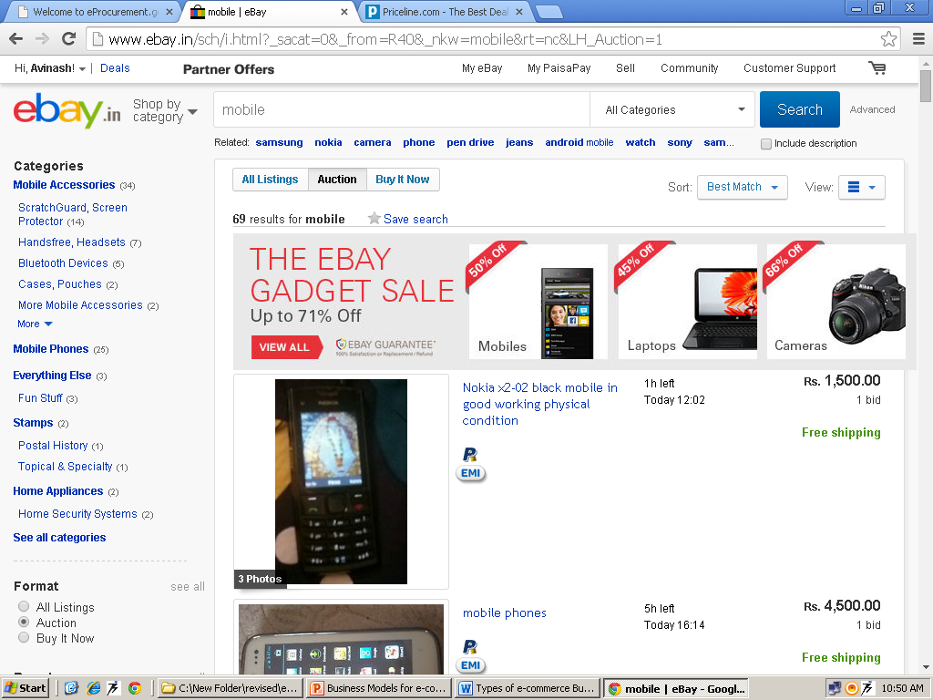

Slide 16
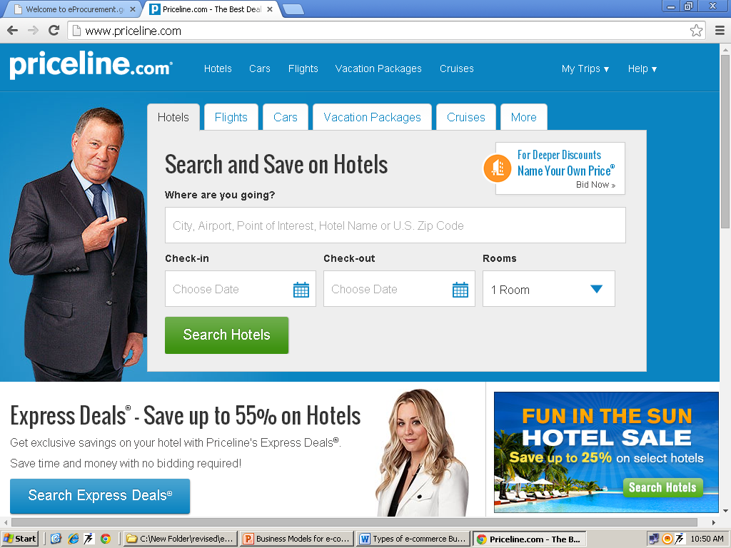

Slide 17
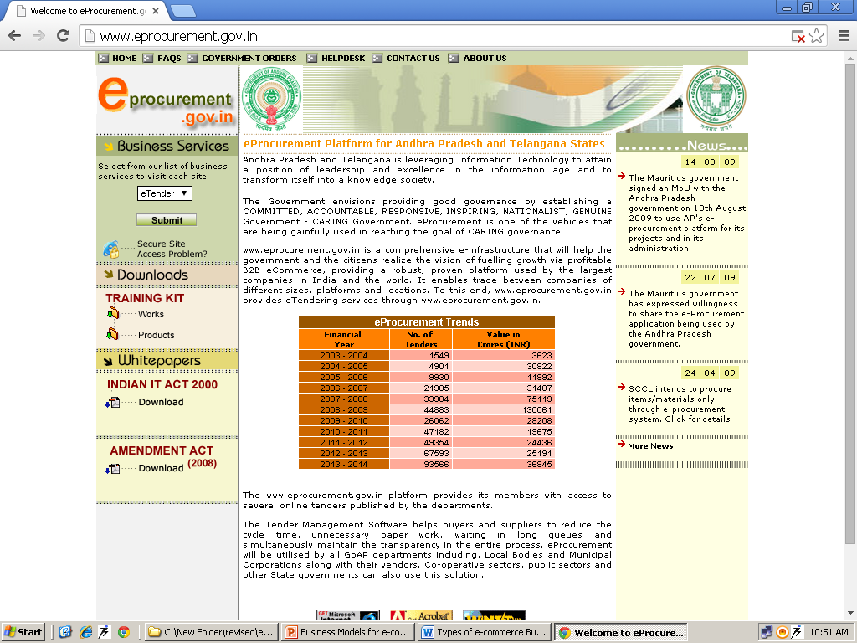

Slide 18
Types of Business Models on the basis of nature of transactions
Brokerage Model
Advertising Model
Buyer Aggregator Model
Merchant Model
Manufacturer Model
Affiliate Model
Community Model
Subscription Model
Utility Model
Infomediary Model

Slide 19
Brokerage Model
Brokers are market-makers: they bring buyers and sellers together and facilitate transactions.
Charges a fee or commission for each transaction it enables.
Includes:
Marketplace exchanges
Auction Brokers
Demand collection systems/Reverse Auction
Transaction Brokers
Search agent

Slide 20
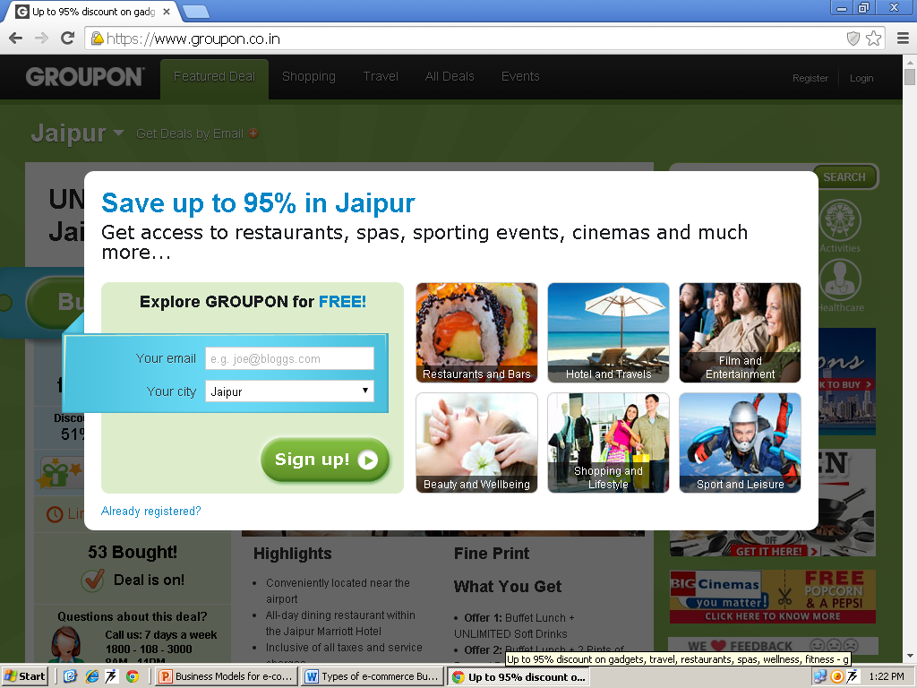
Buyer Aggregator Model
A site that pools the purchasing power of buyers who have a common goal of purchasing and receiving a discount on goods and services, and then connects those buyers with the sellers of those products and services.

Slide 21
Advertising Model
The broadcaster, in this case, a web site, provides content and services (like email, IM, blogs) mixed with advertising messages in the form of banner ads. Can be carried out in following ways:
Portals
Classifieds
User registration
Query based paid placement
Contextual / Behavioural advertising
Intromercials

Slide 22
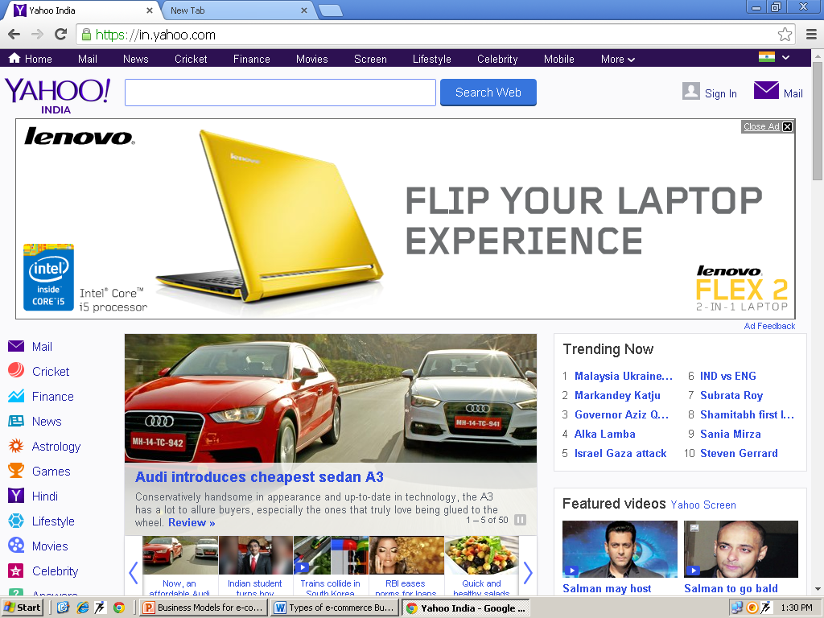

Slide 23
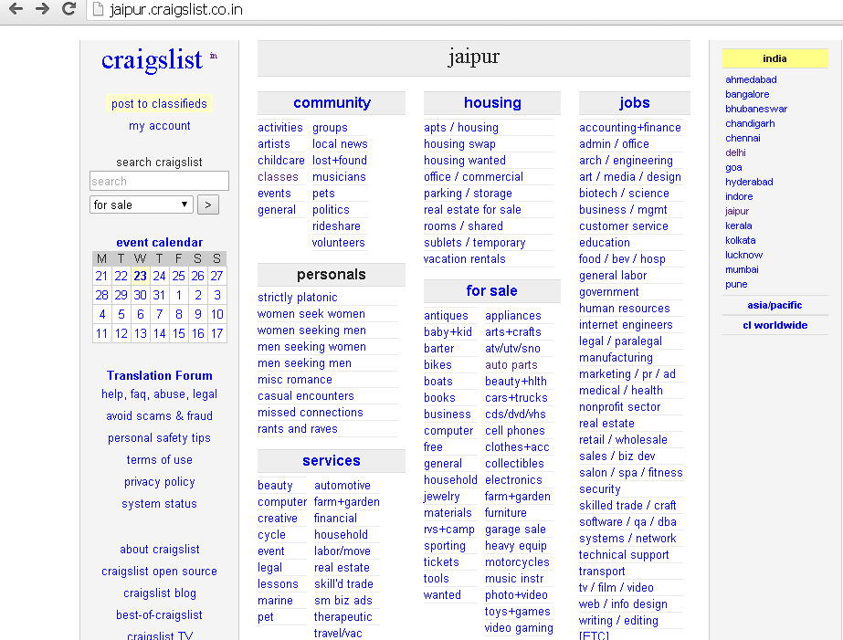

Slide 24
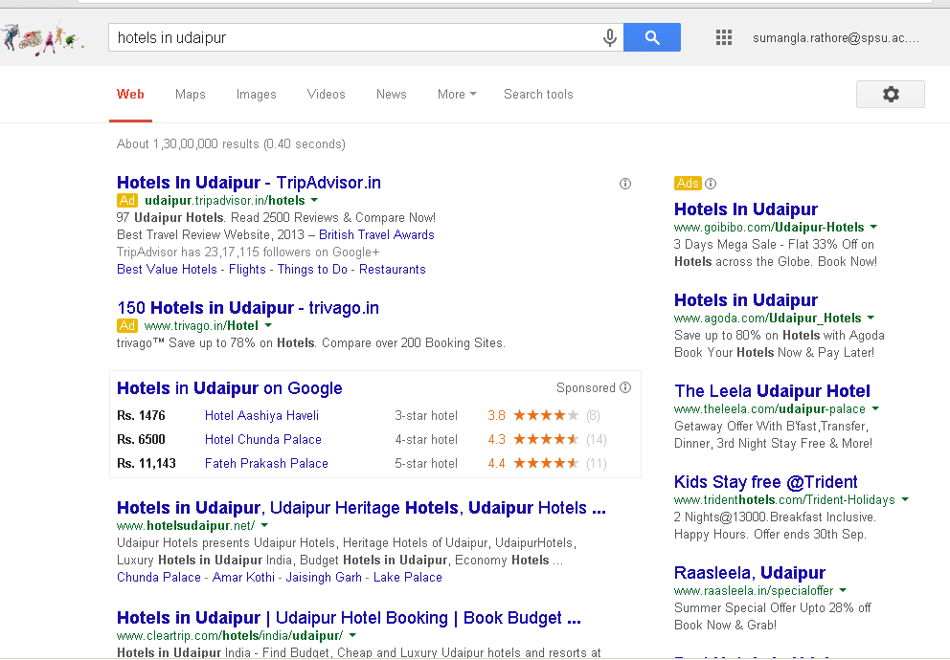

Slide 26
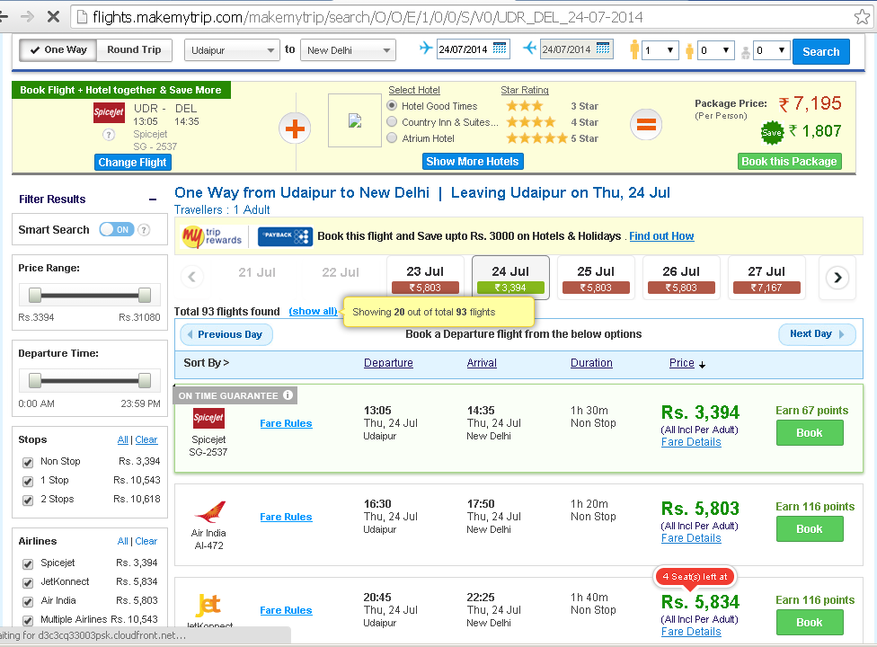
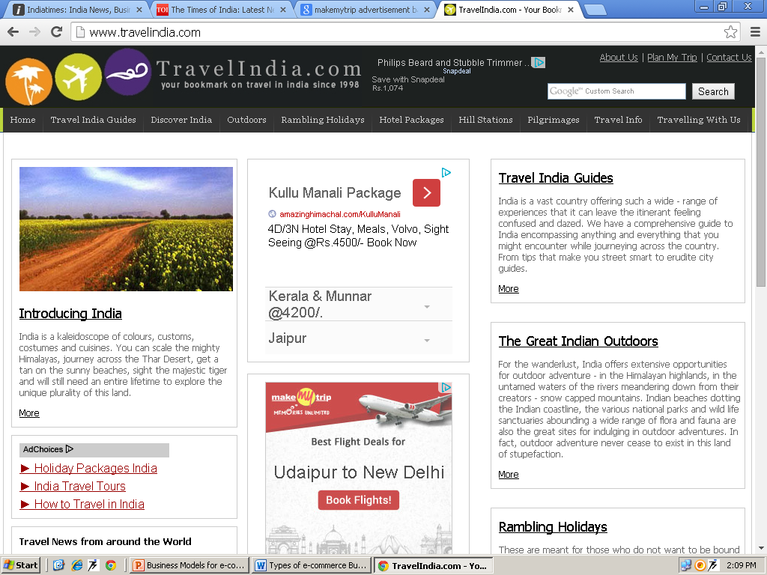

Slide 27
Infomediary Model
Infomediaries (information intermediaries) assist buyers and/or sellers understand a given market by independently collecting data about consumers and their consumption habits or producers and their products.

Slide 28
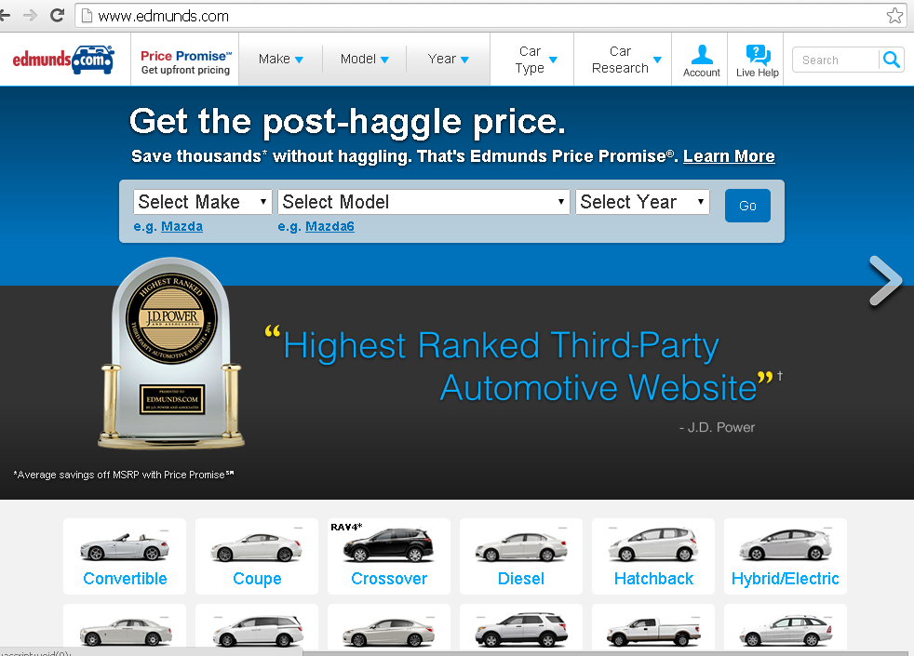

Slide 29
Merchant model
Wholesalers and retailers of goods and services. Sales may be made based on list prices or through auction.
Virtual Merchant
Catalog Merchant
Click and Mortar
Bit Vendor

Slide 30
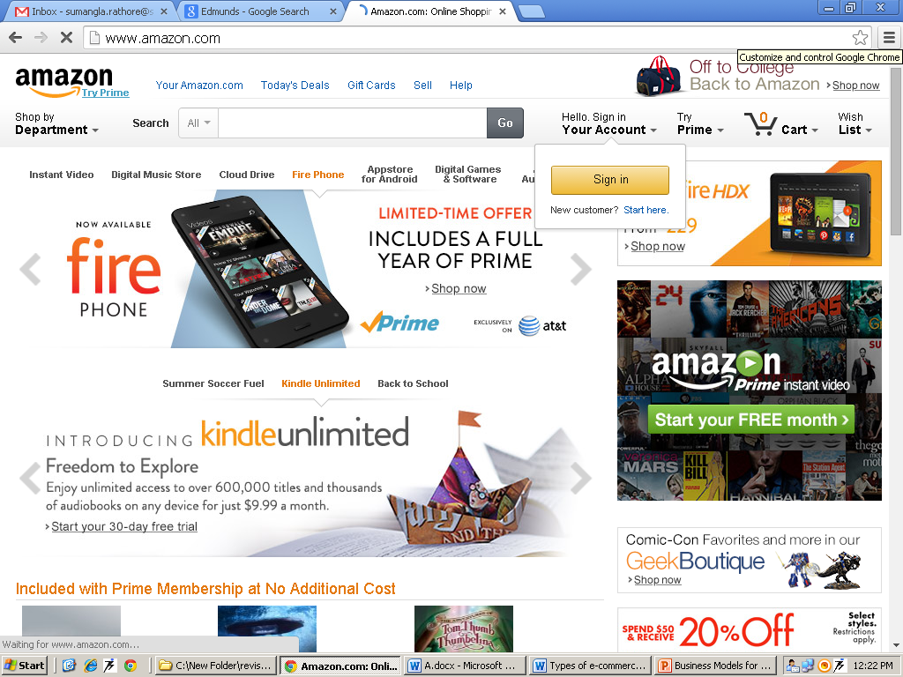

Slide 31
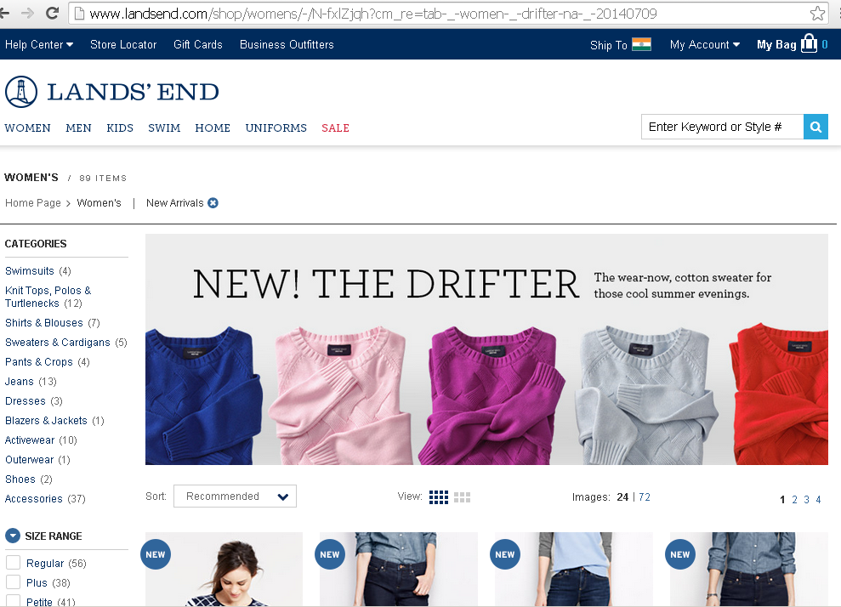

Slide 32
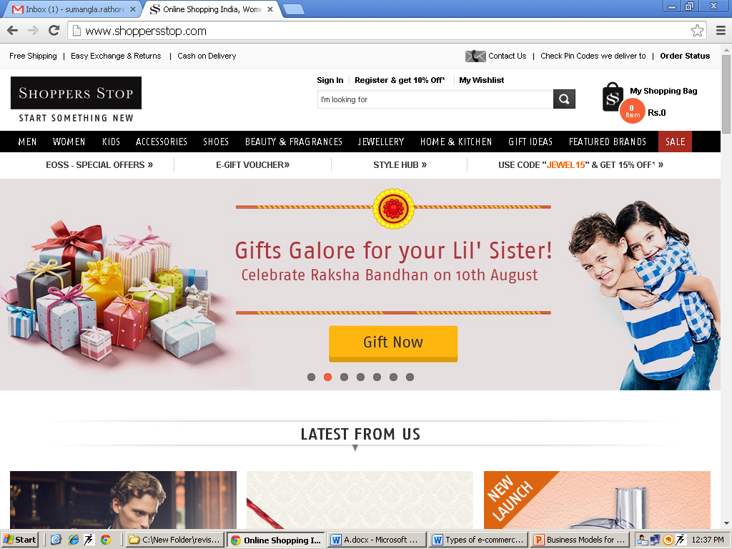

Slide 33
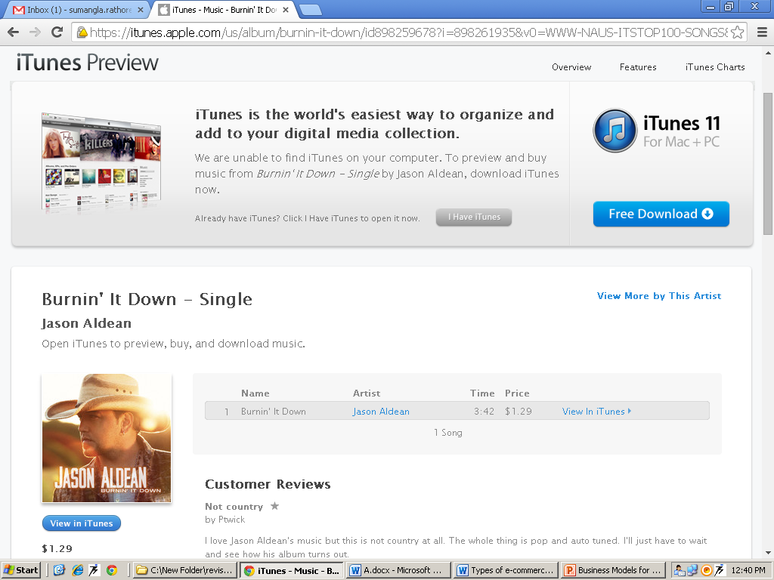

Slide 34
Manufacturer Model
a manufacturer (i.e., a company that creates a product or service) to reach buyers directly and thereby compress the distribution channel.
Dell.com

Slide 35
Affiliate model
Financial incentives offered to affiliated partner sites. The affiliates provide purchase-point click-through to the merchant. It is a pay-for-performance model.
Banner Exchange
Pay-per-click
Revenue Sharing

Slide 36
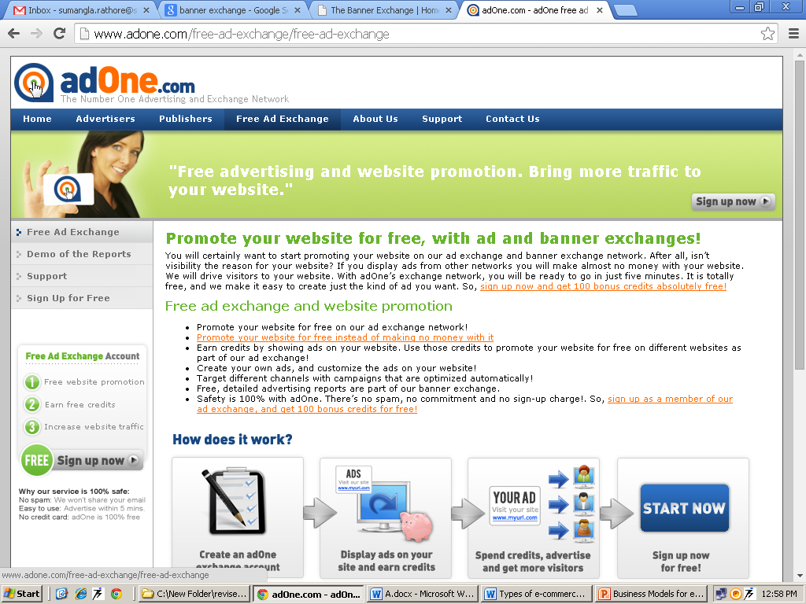

Slide 37
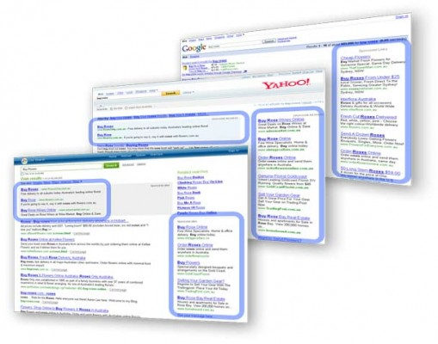
Pay-per-click
Internet marketing strategy, used to direct the internet traffic to websites, the advertisers then pay the host every time the advertisement is clicked on by users.

Slide 38
Community Model
Users have a high investment in both time and emotion. Revenue can be based on the sale of ancillary products and services or voluntary contributions; or revenue may be tied to contextual advertising and subscriptions for premium services.
Open Source
Open Content
Social Networking

Slide 39
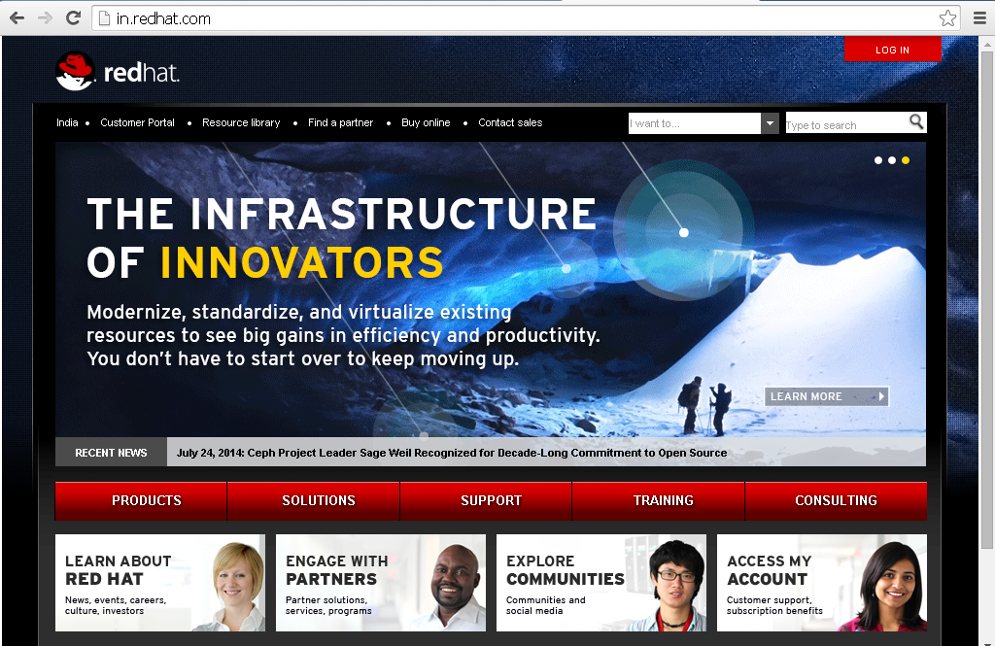
Open source

Slide 40
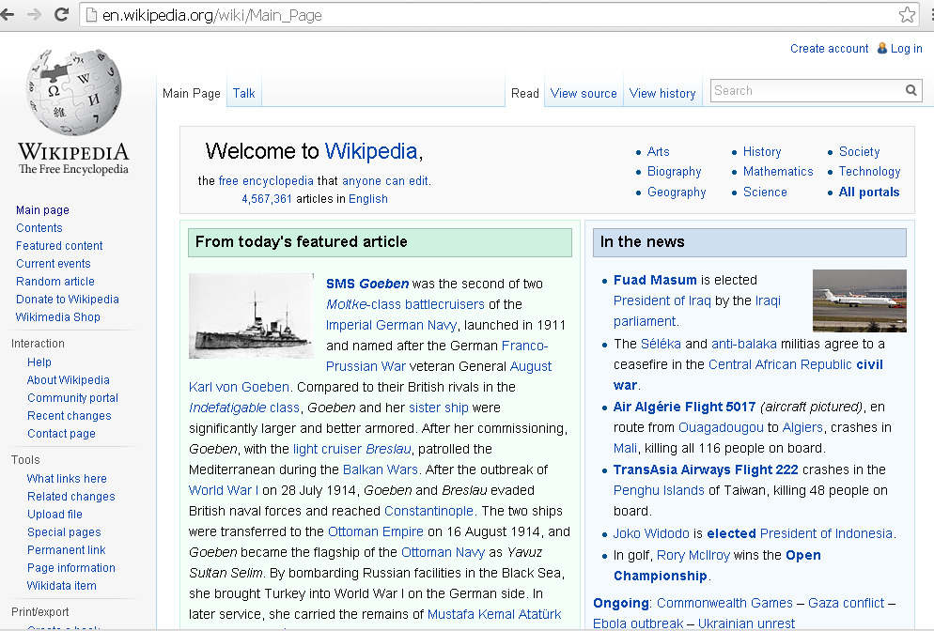
Open Content

Slide 42
Subscription Model
Users are charged a periodic -- daily, monthly or annual -- fee to subscribe to a service.
Subscription fees are incurred irrespective of actual usage rates.
Content Services
Person-to-person networking services
Trust services
Internet Service Providers

Slide 43
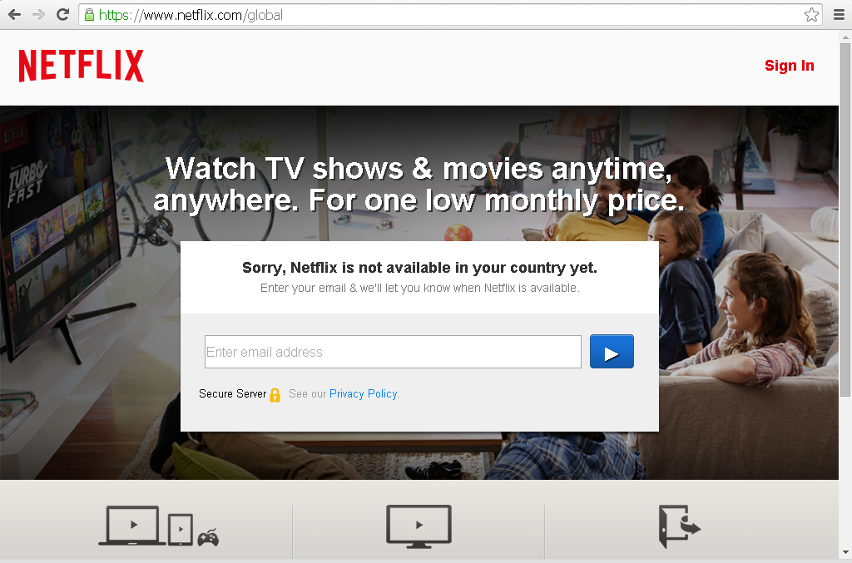

Slide 44
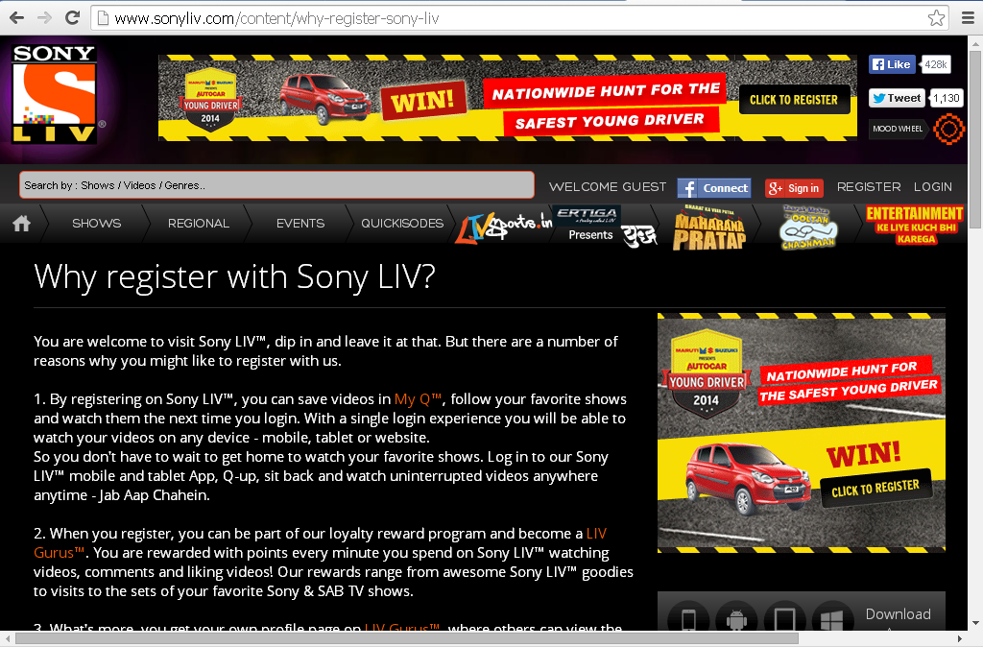

Slide 45
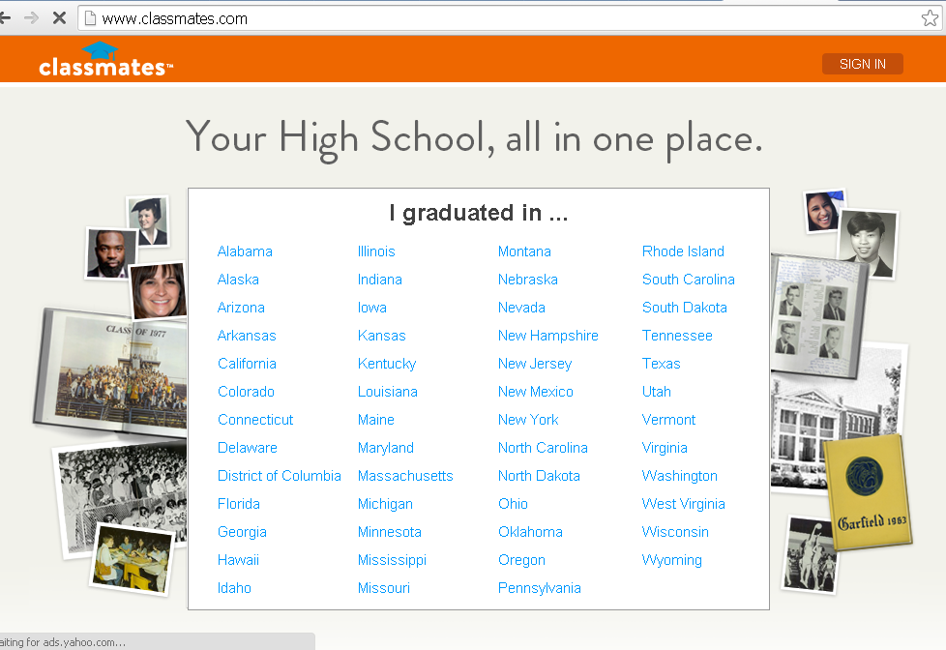

Slide 46
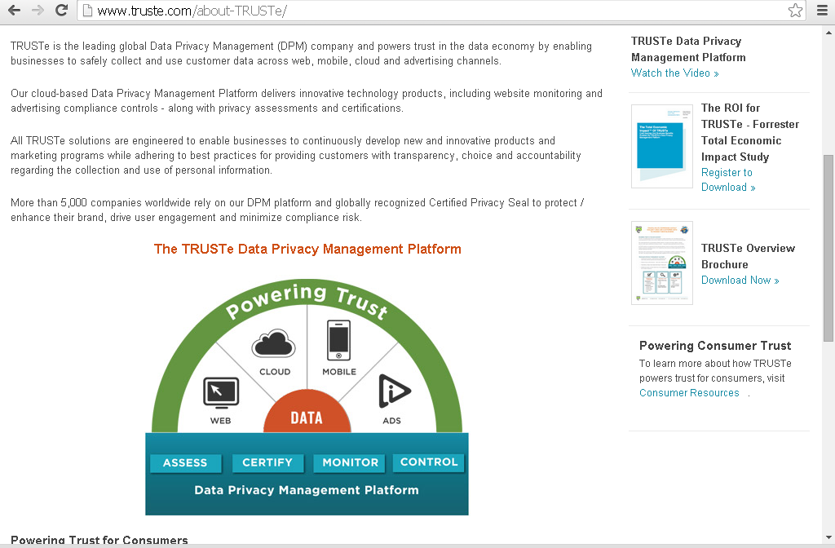

Slide 47
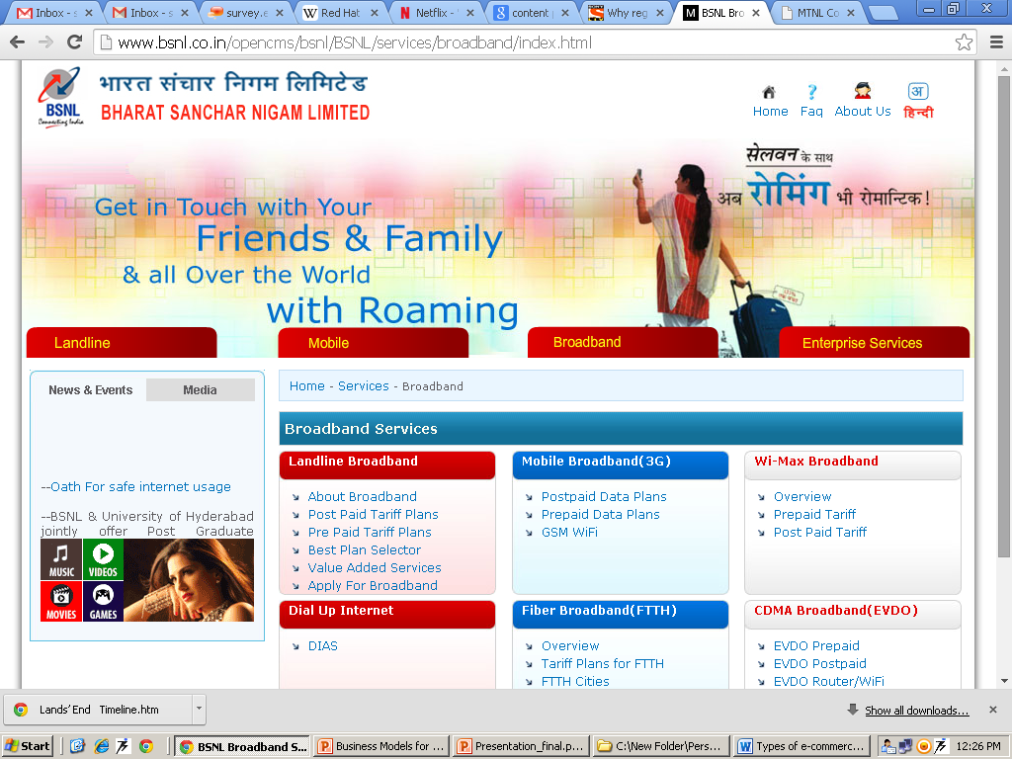

Slide 48
Utility Model
"on-demand" model is based on metering usage,
Metered Usage -- measures and bills users based on actual usage of a service.
Metered Subscriptions -- allows subscribers to purchase access to content in metered portions (e.g., numbers of pages viewed). or a "pay as you go" approach.

Slide 49
