Slide 1





Prerna bhati

Slide 2
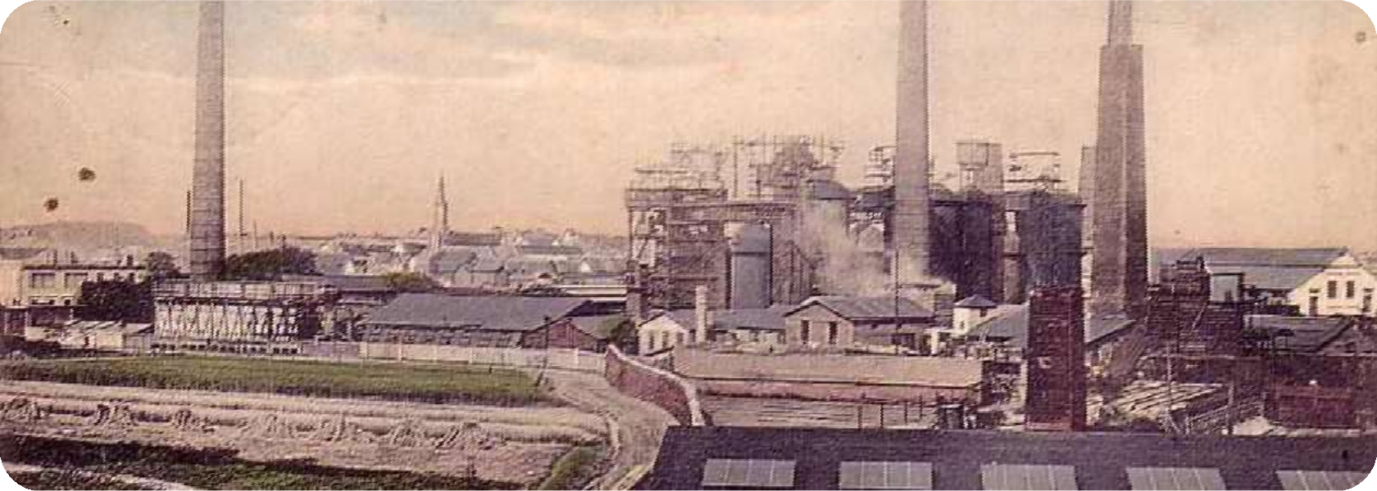

The Story So Far...
Globalization started blossoming in the 1890’s. By the end of the 19th century, trade was very free.

Slide 3
Globalization then began failing at the end of World War I, at the beginning of the 20th century.
Economic pressure pushed countries to
impose demand
trade barriers to divert away from imports and
national toward
domestically produced goods.

Slide 4
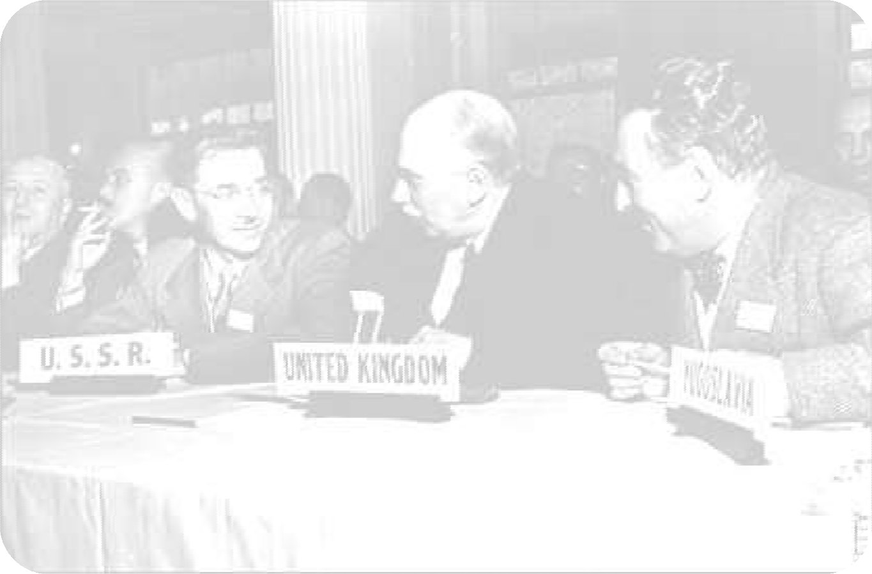
International Trade Organization (ITO)
A prospective organ proposed by the Bretton Woods Conference to establish rules and regulations for international trade
The ITO charter was agreed on at the UN Conference on Trade and Employment in March 1948, but was never ratified by the US Senate, thus never coming into existence

Slide 5
International Trade Organization (ITO)
Why was it not ratified?
UN members countries were then too anxious to begin trade liberalization
Much of its political support had evaporated
US State and Treasury Departments were busy with US reciprocal trade agreements with individual countries
The Cold War began, and the ITO became only of secondary interest to US politicians and bureaucrats

Slide 6

General agreement on tariffs and trade
A multilateral agreement regulating international trade.It was in effect from June 30, 1948, until January 1, 1995, when it was absorbed by the World Trade Organization (WTO).
Aims for substantial reduction of tariffs and other trade barriers, and the elimination of preferences, on a reciprocal and mutually advantageous basis
Negotiated during the UN Conference on Trade and Employment, and was the outcome of the failure of negotiating governments

Slide 7
Objective of GATT
The primary objectives of GATT was to expand international trade by liberalizing so as to bring about all round economic prosperity, the important objective are as follows as:-
Raising standards of living.
Ensuring growing demand.
full employment and large and steady
volume of real income and effective
Developing full use of resources of the world.
Expansion of production and international trade.

Slide 8
GATT has certain conventions and general principles governing international trade among countries that follows the GATT agreement:-
Any proposed change in the tariff or any type of commercial policy of a member country should not be undertaken without the consultation with the other parties to the agreement.
The countries that adhear to get work towards the reduction of tariff and other barriers to the international trade should be negotiated within the frame work of GATT.

Slide 9
#
For the realisation of the objective GATT adopted the
following:-
NON DISCRIMINATION- The principle of non-discrimination requires that no member country shall discriminate between in the conduct of international trade, to ensure non-discrimination the members of GATT to apply the principle of MFN(most favoured nation) status to all import and export duties. The GATT also permit to member to adopt step to counter dumping and export subsidies.
PROHIBITION OF QUANTITATIVE RESTRICTIONS- GATT seek to prohibit quantitative restrictions as far as possible and limit restrictions on trade to the less rigid tariffs, however certain exceptions to this prohibition are granted to countries, confronted with balance of payment difficulties and to the developing countries.
CONSULTATION- By providing a forum for continuing consultation, GATT has provided to resolve disagreements through consultation.

Slide 10
GATT: ROUNDS
The GATT system, albeit successful (due to highly pragmatic leadership), was imperfect, and so a series of rounds of laborious process of item-by-item tariff negotiations were held.

Slide 11
GENEVA
1
April 1947
Signing of GATT
45,000 tariff concessions affecting $10 billion of trade
₂ANNECY
April 1949
Around 5,000 counts of tariff reductions
TORQUAY
September 1950
Around 8,700 tariff concessions, cutting 1948 tariff levels by 25%
GATT was established as a governing world body
3

Slide 12
GENEVA II
4
January 1956
$2.5 billion in tariff reductions
Admission of Japan
5
DILLON
September 1960
$4.9 billion in tariff reduction
Creation of the European Economic Community (EEC)

Slide 13
KENNEDY
6
May 1964
Adoption of Part IV of the GATT– absolution from according reciprocity to developed countries
Reduction of $40 billion in tariffs
Adoption of an anti-dumping code
TOKYO
September 1973
Reduction of more than $300 billion in tariffs
Control of the proliferation of non-tariff barriers and voluntary export restrictions
7

Slide 14
Failing manufacturing industries sought protection from international competition.
There followed a series of Congressional initiatives that were basically protectionist.
The Reagan Administration sought to counter this protectionist trend by calling for a new round of global trade.

Slide 15
8
URUGUAY
September 1986
Extension into the areas of agricultural, textile and clothing, and service industries
Protection of intellectual property rights
Improved system of settling trade disputes
World Trade Organization (WTO) was established to rule on claims of treaty violation
GATT lives on as the foundation of the WTO. Although the 1947 agreement itself is technically defunct, its provisions were incorporated into the GATT 1994 agreement, designed to keep the trade agreements going while the WTO was being set up. The GATT 1994 is itself a component of the WTO Agreement.

Slide 16
GATT
GATT was provisional.
WTO
1) WTO is permanent.
1)
ad hoc and
WTO has members.
WTO does not permit this.
GATT has contracting parties.
GATT system allows existing domestic, legislation to continue even if it violated GATT agreement.
GATT was less powerful and dispute settlement mechanism was less efficient.
4) WTO is more powerful and dispute settlement mechanism was more efficient.

Slide 17
9
DOHA
November 2001
Current trade-negotiation round of the World Trade
Organization
Issues: Agriculture
Access to patented medicines Special and differential treatment Implementation issues

Slide 18
CONCLUSION
For 47 years, GATT reduced tariffs. This boosted world trade 8% a year during the 1950s and 1960s, faster than world economic growth.It was seen as such a success that many more countries wanted to join. By 1995,By increasing trade, GATT promoted world peace. Before GATT, from 1850 to 1949, the number of wars was ten times greater than after GATT, 1950 to 2000.GATT also promoted improved communication by providing incentives to smaller countries to learn English, the language of the world's largest consumer market. This adoption of a common language reduces misunderstanding. It also gives the less developed country a competitive advantage by giving them insight into the developed country's culture, marketing, and product needs.But low tariffs destroy some domestic industries, contributing to high unemployment in those sectors.GATT did not address any services like FDI,Globalized financial services in 80s.It reduced the rights of a nation to rule its own people. The agreement requires them to change domestic laws to gain the trade benefits.GATT do not have a dispute settlement body. For these reasons gradually GATT become an unsuccessful to achieve its objective for which in later period WTO is formed.

Slide 19



