Slide 1
FACULTY OF MANAGEMENT STUDIES
)
ENVIROMENTAL MANGEMENT
PATENTS
Dr. PRERNA BHATI

Slide 2
WHAT IS PATENT ?

Slide 3
PATENTS
A patent is a form of intellectual property that gives its owner the legal right to exclude others from making, using, or selling an invention for a limited period of years in exchange for publishing an enabling public disclosure of the invention. In most countries, patent rights fall under private law and the patent holder must sue someone infringing the patent in order to enforce his or her rights. In some industries patents are an essential form of competitive advantage; in others they are irrelevant.

Slide 4
THE WORD PATENT
The word patent originates from the Latin patere, which means "to lay open" (i.e., to make available for public inspection). It is a shortened version of the term letters patent, which was an open document or instrument issued by a monarch or government granting exclusive rights to a person, predating the modern patent system. Similar grants included land patents, which were land grants by early state governments in the US, and printing patents, a precursor of modern copyright.

Slide 5
MODERN USAGE
In modern usage, the term patent usually refers to the right granted to anyone who invents something new, useful and non-obvious. Some other types of intellectual property rights are also called patents in some jurisdictions: industrial design rights are called design patents in the US, plant breeders' rights are sometimes called plant patents, and utility models and Gebrauchsmuster are sometimes called petty patents or innovation patents.
The additional qualification utility patent is sometimes used (primarily in the US) to distinguish the primary meaning from these other types of patents. Particular species of patents for inventions include biological patents, business method patents, chemical patents and software patents.

Slide 6
HISTORY OF PATENTS
Although there is some evidence that some form of patent rights was recognized in Ancient Greece in the Greek city of Sybaris, the first statutory patent system is generally regarded to be the Venetian Patent Statute of 1474. Patents were systematically granted in Venice as of 1474, where they issued a decree by which new and inventive devices had to be communicated to the Republic in order to obtain legal protection against potential infringers. The period of protection was 10 years. As Venetians emigrated, they sought similar patent protection in their new homes. This led to the diffusion of patent systems to other countries.
WHEN WAS THE PATENT LAW INVNTED?
The first Patent Act of the U.S. Congress was passed on April 10, 1790, titled "An Act to promote the progress of useful Arts". The first patent under the Act was granted on July 31, 1790 to Samuel Hopkins for a method of producing potash (potassium carbonate).

Slide 7
WHEN DID PATENT START IN INDIA?
The history of Patent law in India starts from 1911 when the Indian Patents and Designs Act, 1911 was enacted. The present Patents Act, 1970 came into force in the year 1972, amending and consolidating the existing law relating to Patents in India. The Patents Act, 1970 was again amended by the Patents (Amendment) Act, 2005, wherein product patent was extended to all fields of technology including food, drugs, chemicals and micro organisms. After the amendment, the provisions relating to Exclusive Marketing Rights (EMRs) have been repealed, and a provision for enabling grant of compulsory license has been introduced. The provisions relating to pre-grant and post-grant opposition have been also introduced.
An invention relating to a product or a process that is new, involving inventive step and capable of industrial application can be patented in India. However, it must not fall into the category of inventions that are non-patentable as provided under Section 3 and 4 of the (Indian) Patents Act, 1970. In India, a patent application can be filed, either alone or jointly, by true and first inventor or his assignee.

Slide 8
Characteristics of Patent
Specifically, patented inventions must meet three characteristics: novel,
useful and not obvious.
• Novelty- Something new and non existent in prior act.
• Inventive step (Non Obvious)- An idea is non obvious if it would not be
discovered by one of ordinary skill in art when the idea was needed.
• Utility- Invention has a useful purpose and that it must actually perform its
intended purpose.
(Life Span-The life of a plant patent is 20 years from the date that
the patent application is filed with the USPTO.)

Slide 9
Objectives Of Patent
• To encourage inventor: If a person puts efforts and resources in invention something that
can be patented, he should have a provision that stops others from copying his work
without his permission. If it happens he would get motivated to research further.
• To protect Inventors’ interest: By protecting inventions the Law also protects the goodwill
and financial gains of the inventor. For e.g. if Patents are not provided anyone can copy
the formula of drugs and can sell it at cheaper rates. This will affect the goodwill of the
inventor in case the drug does not work, and the inventor will also lose his market that
will result in financial loss.
• Encourage Research and Development: If an inventor gets recognition for his work and at
the same time his work is protected also, he may get motivated for further research. This
will also motivate others to go in the field of research. All this will finally result in the
technical and financial growth of the society.
• To ensure Fair trade practices: By providing protection and monopoly rights the law
indirectly stimulates fair trade practices. If a businessman knows that he will be facing
legal action for copying others’ process or product, he may not try to do so. This will help
in controlling unfair competition.

Slide 10
Patent Application and Types of Patent
• Patent Application
• A patent application is a plea for the grant of a patent for the invention
described and claimed by the applicant. An application for this purpose
generally comprises of a description of the invention, added with official
forms and correspondence relevant to the application. Patent applications
are of several types, and each one of them caters to a unique purpose.
• Types of Patent
• The types of patent application are:
• Provisional Application
• Ordinary or Non-Provisional Application
• Convention Application
• PCT International Application

Slide 11
Provisional Application
• A provisional application, also known as a temporary application, is filed when
an invention is under experimentation and isn’t finalized. Moreover, it is a
preliminary application which is filed before the patent office for claiming
priority, as the Indian Patent Office follows the ‘First to File’ system (known
popularly as the First-Come-First-Served-Basis.
Ordinary or Non-Provisional Application
• This type of application is filed if the applicant doesn’t have any priority to
claim or if the application is not filed in pursuance of any preceding convention
application. It must be supported by a complete specification, the likes of
which must depict the invention in detail.

Slide 12
Convention Application
• A convention application is filed for claiming a priority date based on the
same or substantially similar application filed in any of the convention
countries. To avail a status of convention, an applicant is required to file an
application in the Indian Patent Office within a year from the date of the
initial filing of a similar application in the convention country.
PCT National Phase Application
• It is considered essential for an applicant to file a national phase
application in each of the country wherein protection is sought for. The
time-frame for filing the same is scheduled within 31 months from the
priority date or the international filing date, whichever is earlier. The timelimit could be enhanced through National Laws by each member country.

Slide 13
TYPES OF PATENTS
There are 4 types of patents:-
Utility Patents may be granted to anyome who invents a useful process,machine ,an article of manufacture. Example:- computer hardware,medications
Design Patent may be granted to anyone who invents a new ,original,and ornamental design for an article of manufacture.Example:- look of athletic shoe ,a bicycle helmet
Plant Patent may be granted to anyone who invents or discover and asexually reproduces any distinct and new variety of plants. Examples:- Hybrid tea roses

Slide 14
TYPES OF PATENTS
Reissue Patent A reissue patent is a patent issued by the U.S. Patent and Trademark Office (PTO) to correct a significant error in an already issued patent. A reissue patent may be issued for utility, design, or plant patents. A reissue patent does not change the term of the original patent. It only corrects the error in the original patent.

Slide 15
WHAT CAN BE PATENTED
An Invention must be:
A process or method (such as a new way to manufacture concrete)
A machine (something with moving parts or circuitry)
A manufactured article (such as a tool or another object that accomplishes a result with few or no moving parts, such as a pencil)
A new composition (such as a new pharmaceutical)
An asexually reproduced and new variety of plant
Must not be declared as non patentable under the PATENT ACT

Slide 16
WHAT CANNOT BE PATENTED
Any artistic creation
Mathematical methods
Business schemes
Anything against universal law

Slide 17
Patentable | Non-patentable
A new generator (the technical solution) | The mathematical formula for how the generator produces electricity
Use of the generator on a bicycle | A scheme for how to sell the generator
A method of manufacturing the generator

Slide 18
Procedure for obtaining patents in India
Step 1 – Writing and filling patent
application
The patent writing is a specialized skill and requires years of practice and knowledge of the patent law as well as the technical knowledge hence called techno-legal.
There are two ways to proceed about patent filling :
1. Provisional patent application
2. Complete patent application
1.Provisional patent application – It is a case used when you are in very early stage in the research and development for your invention. It gives you 12 months of time to file complete specification.
2.Complete patent application – The complete patent application includes
entire description of the invention, diagrams and claims.

Slide 19
Procedure for obtaining patents in India
Step 2 – Publication of the application
Application is published after 18 months from the filling date. To speed up this process, optionally an early publication request can be made if you do not wish to
wait till the expiry of 18 months from the date of filling for publishing your patent application.

Slide 20
Procedure for obtaining patents in India
Step 3 – Request for examination
The patent application is examined at patent office only after receiving request for examination that is RFE . Ideally the RFE is filled along with the application for the patent.
Upon receiving this request the controller gives your application to a patent
examiner who examines the patent application with different patentability
criteria.

Slide 21
Procedure for obtaining patents in India
Step 4 – Respond to objections in examination report
In this step majority of patent applicants will receive some kind of objections based on examination report here you need to
analyze the objection and respond to it.

Slide 22
Procedure for obtaining patents in India
Step 5 – Grant of patent
The Controller will grant the application upon satisfactory response by the applicant to overcome all of The objections raised in the FER.
On the grant of a patent, the application will be accorded a number, called serial number in the series of Numbers
accorded to patents under the Indian
Patents Act, 1970.

Slide 23
Sources of patent information
Technical information: Patents contain a wealth of technical information, which is often unavailable in journal articles and conference papers. Researchers who ignore the patent literature run a serious risk that they will miss important documents and waste time and money by duplicating previous research., Novelty or patentability of a new invention, i.e. whether it can be patented Freedom to operate or infringement: Before a company starts using a new process, staff should check whether it infringes another company’s patent.
Competitive intelligence: For example, by analyzing a rival company’s patent activity over several years, it’s possible to detect changes in its research direction.

Slide 24
Trademark
What is a trademark? A trademark is the right to use a specific name, word, phrase, symbol, logo, design, sound or color (or a combination of elements) to identify your products and distinguish them from other products. The name must be sufficiently unique—you can’t obtain trademark rights to a generic term like “computers” or “coffee.” A service mark is similar, but refers to the right to use a name to identify the source of services, and distinguish that source from other service providers. • How do you register a trademark? Common law usage of a name or logo begins as soon as you start using it in commerce (using the ™ symbol), but protection for common law marks is limited. In order to register a trademark, you must undertake a filing with the USPTO. Pricing is $375 per class for paper filings and $325 per class for electronic filings. Once your registration has been approved, you can begin using the ® symbol.

Slide 25
Copyright
What is a copyright? A copyright is a form of protection provided to authors of original works of authorship, including literary, dramatic, musical, artistic, and certain other intellectual works. Copyright protection is available both on published and unpublished works, including works transmitted online. You don’t need to register a copyright to have copyright protection. A copyright is secured automatically when the work is created. Using the copyright symbol © along with the year of first publication (or creation for unpublished works), and the author’s name signify the copyright. For example, © 2010 BizFilings. Copyright infringement can be avoided by showing that the work in question was created independently of the copyrighted work.

Slide 26
How do you register a copyright?
While copyright registration is not necessary, copyright law provides advantages to those who have filed a legal copyright. For example, in order to file a copyright infringement lawsuit in court, registration is necessary. • How do you search for copyrights already registered? There is not a way to perform a copyright search like there is patents and trademarks; however, in today’s world, doing a Google search for particular text or creations will, in many cases show if such a work already exists.

Slide 27
The Indian patent act
In india grant of patents is governed by the patent act 1970 and rules 1972 The patentee granted under the act are operative in the whole of india patent right various from country to country . In india the low which govern patent right is “ Indian Patent act 1970”.
Indian patent act grand exclusive right to the investor for his invention for limited period of time There are several authority helping investor in patent registration by providing them best well informed knowledge. In india patent registration can be failed individually or jointly

Slide 28
The Indian patent act
In case of deceased investor this can be done by his legal representative on behalf of him. All required document need to be filed along with the application form . Only after verification registration certificate is provided to the applicant . generally 20 years time has been generated to the patent holder but in case of the inventions related to manufacturing of food and drugs or medicine it is for seven years from the date of patent . There is a certain legal procedure which need to be followed in order to register.

Slide 29
Trademark act India
This Photo by Unknown Author is licensed under CC BY-SA
Indian trademark act provide protections to trademarks under the trade mark act 1999 it is a amandment of patent act 1970. According to trademark act 1999 section 2 (zb) “ a trademark can include a device, brand, heading , label , tickets, name, signature, word, letter, nmericle, shape of goods ,packaging or combination of colors or any such combination.

Slide 30
Copyright Act , 1957
This Photo by Unknown Author is licensed under CC BY
Frist copyright in india 1957 Now Indian coyright right 1957;w.e.f.1958 Further amendment in1983,1984,1992,1994,1999 adopted many English provisions, introduced new ideas and concepts.

Slide 31
Duration of copyright :
Copyright literary work , last of the authors lifeline plus 50 years from the end of the calendar year in which the authors dies 50 years of films and sound recordings 25 years for typographical arrangements of a published edition. Moral rights last for as long as copyright and can not be assigned An author may waive his/ her moral rights by signing an arrangement to that effect.

Slide 32
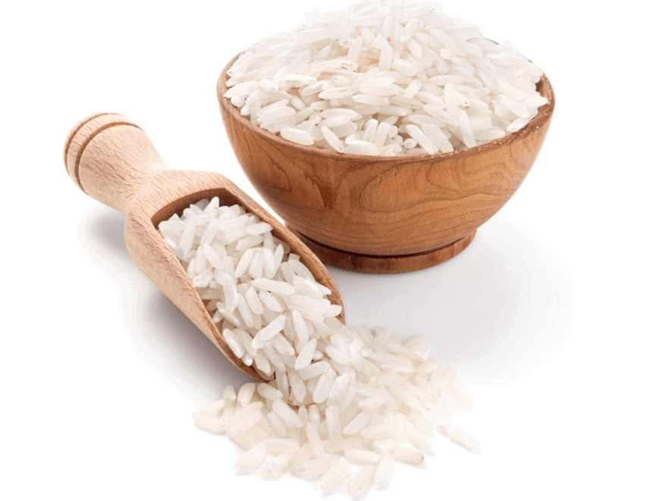
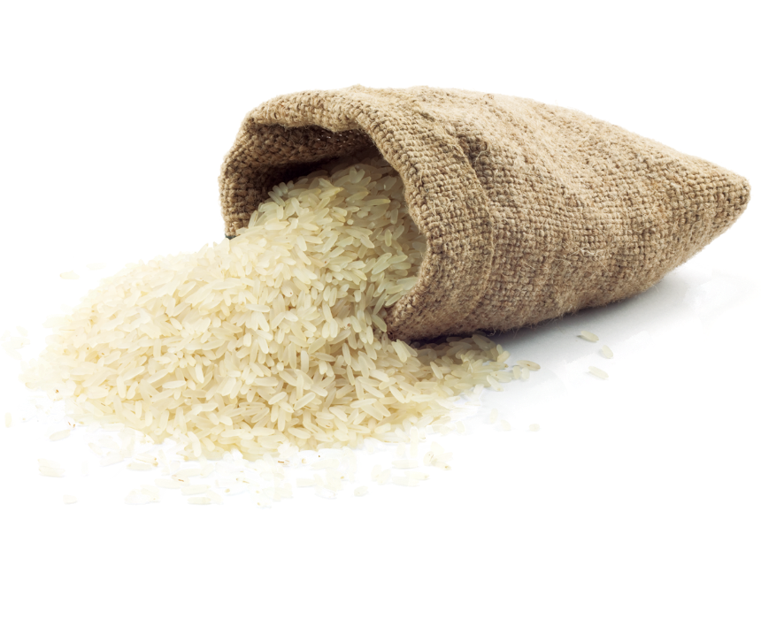
Basmati rice patent case
In 1997, when an American company RiceTec was granted a patent by the US patent office to call the aromatic rice grown outside India “Basmati”(the queen of fragrance)
India filed case as the basmati rice is geographical indication.
But RiceTec claimed that the Starch index(SI) of their product is different from Indian Basmati Rice.

Slide 33
Benefits to RiceTec
Brand Association
Reputation
Market share
Superior Features/characteristics
Confusing the customers into buying their product
Monopoly on Basmati Rice in US & Europe

Slide 34
Lose to Indian & Pakistan
Economic loses.
Global trade losses (Indian Basmati lost market of US & Europe).
(In 1996 India export 5 lac tonnes of Basmati only to Europe)
Both countries lose their global market share.
Total closedown on export of Pakistani Basmati Rice (i.e. Basmati 22)

Slide 35
THANK YOU

