Slide 1
FACULTY OF MANAGEMENT STUDIES (MLSU)
HUMAN RESOURCE TRAINING AND DEVELOPMENT
UNIT = 2
TOPIC : TRAINING NEED ASSESSMENT
BY : Ms TANUJA SINGHAL FOR : CMAT 3rd SEM

Slide 2
TRAINING NEED ASSESSMENT
A training need assessment is an assessment process that companies and other organization use to determine performance requirement and the knowledge , abilities and skills that their employees need to achieve the requirements.

Slide 3
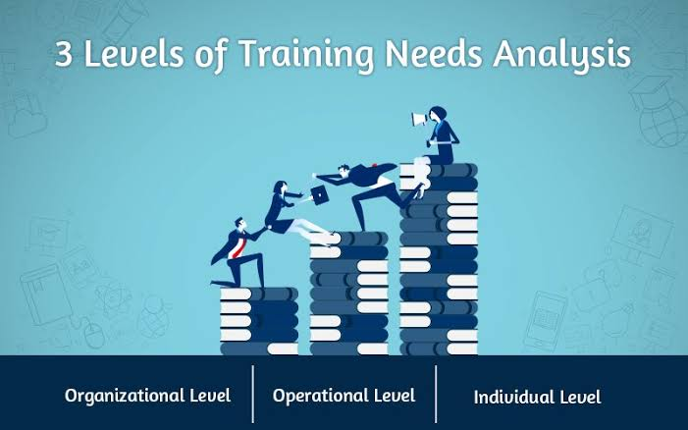
TRAINING NEED ASSESSMENT LEVELS

Slide 4
PROCESS OF TRAINING NEED ASSESSMENT
IDENTIFY PROBLEM NEEDS
DETERMINE DESIGN OF NEEDS ANALYSIS
COLLECT DATA
ANALYZE DATA
PROVIDE FEEDBACK

Slide 5
BENEFITS OF TNA
TNA helps training managers identify performance gaps and address these gaps with appropriate training intervention.
TNA act as a guide to decide what training is needed for whom, to achieve organizational objectives
TNA enables training managers develop training that is most relevant to the learning needs of particular group or department of employees .
TNA helps identify training objectives well in advance so that they can be the basis of evaluation training effectiveness .
TNA helps to allocate an organisation’s training budget effectively in the area where it can have the maximum impact.

