Slide 1
SUPPLY CHAIN MANAGEMENT
Dr. Niha Khan

Slide 2
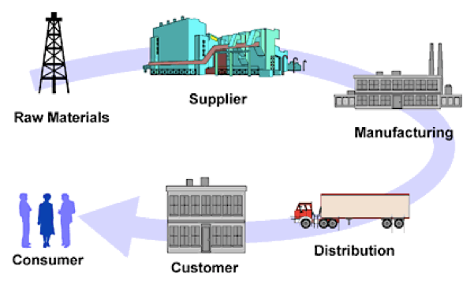
WHAT IS SCM?
¡○ “Supply Chain Management is the integration of key business processes from end user through original suppliers that
provides products, services, and information that add value for customers and other stakeholders.” – The Global Supply Chain Forum

Slide 3
SCM AND MARKETING
¡○ Supply chains are crucial functions that allow brands to translate customer demand into product fulfillment and market delivery.
¡○ As communication professionals, marketing promotes collaboration between buyers and suppliers, product
developers and common systems, customers and sales to
reduce lead time, streamline customer feedback, and improve sales forecasting.
¡○ Similar to manufacturing environments, marketing supply chains rely on the creation, production, warehousing, and
fulfillment of materials, as well as the collection of feedback for continuous refinement, all of which can be seamlessly
integrated into the larger supply chain.

Slide 4
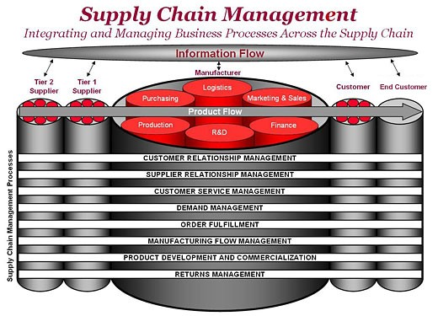
SCM PROCESSES
Source: Adapted from Douglas M. Lambert, Martha C. Cooper, and Janus D. Pagh, “Supply Chain Management: Implementation Issues and Research Opportunities,” The International Journal of Logistics Management, Vol. 9, No. 2 (1998), p. 2.

Slide 5




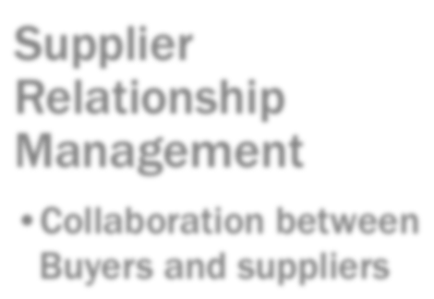
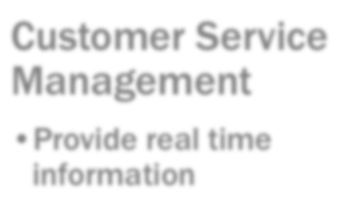








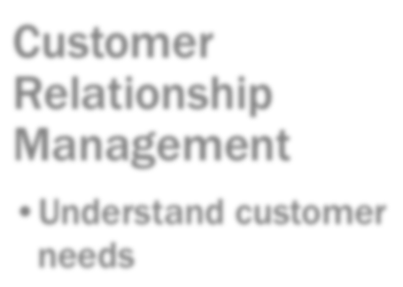
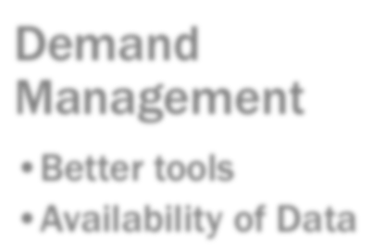






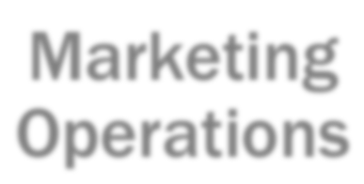
MO IN RELATION TO SCM
Supplier Relationship Management
Collaboration between Buyers and suppliers
Customer Service Management
Provide real time information
Customer Relationship Management
Understand customer needs
Demand Management
Better tools
Availability of Data
Marketing Operations

Slide 6





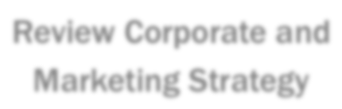



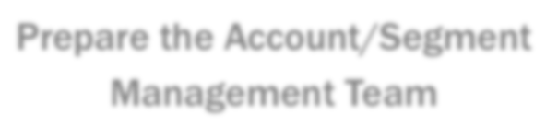







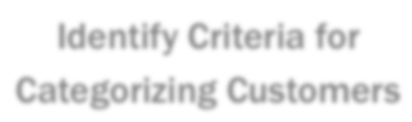





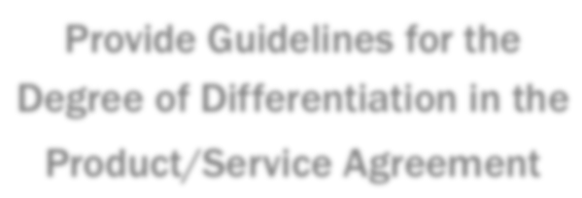

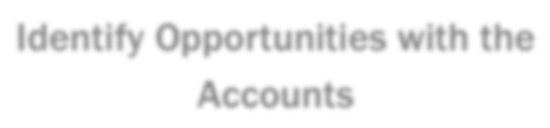
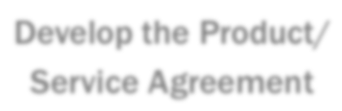


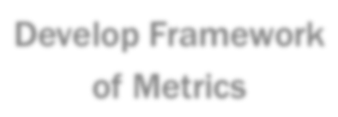

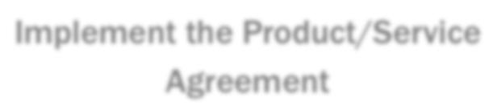


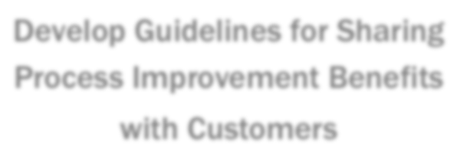

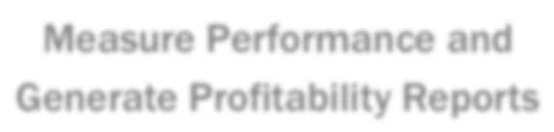
CUSTOMER RELATIONSHIP MANAGEMENT
Review Corporate and Marketing Strategy
Differentiate Customers
Prepare the Account/Segment Management Team
Identify Criteria for Categorizing Customers
Operational Sub-Processes
Strategic Sub-Processes
Internally Review the Accounts
Provide Guidelines for the Degree of Differentiation in the
Product/Service Agreement
Identify Opportunities with the Accounts
Develop the Product/ Service Agreement
Develop Framework of Metrics
Implement the Product/Service Agreement
Develop Guidelines for Sharing Process Improvement Benefits
with Customers
Measure Performance and Generate Profitability Reports

Slide 7



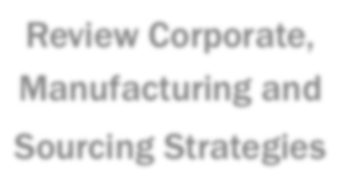



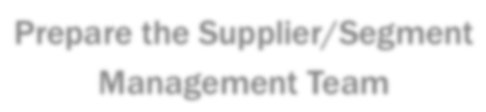




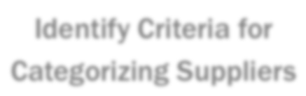


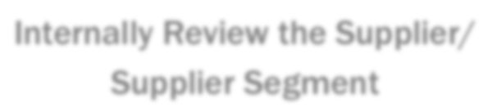



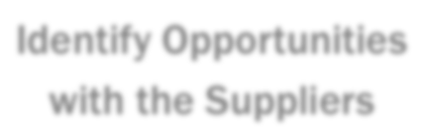
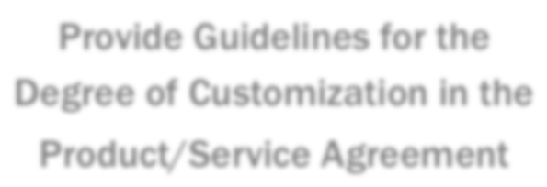
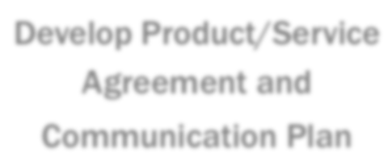



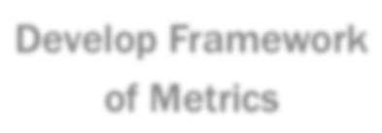


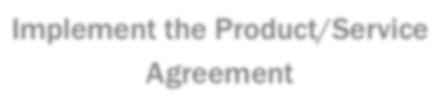

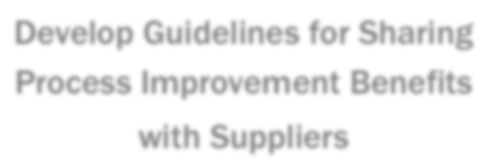
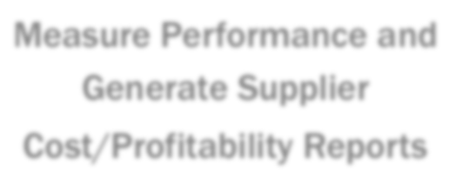


SUPPLIER RELATIONSHIP MANAGEMENT
Review Corporate, Manufacturing and
Sourcing Strategies
Differentiate Suppliers
Prepare the Supplier/Segment
Management Team
Identify Criteria for Categorizing Suppliers
Operational Sub-Processes
Strategic Sub-Processes
Internally Review the Supplier/
Supplier Segment
Provide Guidelines for the Degree of Customization in the
Product/Service Agreement
Identify Opportunities
with the Suppliers
Develop Product/Service
Agreement and
Communication Plan
Develop Framework of Metrics
Implement the Product/Service
Agreement
Develop Guidelines for Sharing Process Improvement Benefits
with Suppliers
Measure Performance and
Generate Supplier
Cost/Profitability Reports

Slide 8



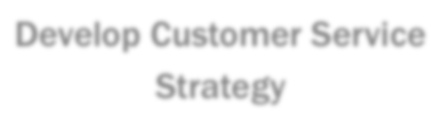












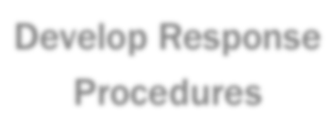
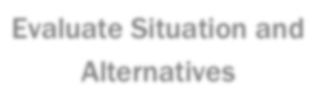


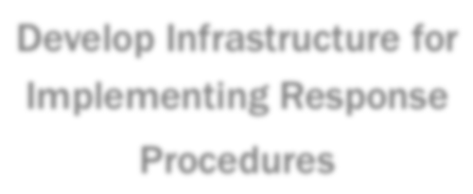





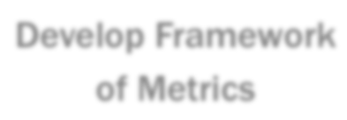

CUSTOMER SERVICE MANAGEMENT
Develop Customer Service Strategy
Recognize Event
Strategic Sub-Processes
Operational Sub-Processes
Develop Response Procedures
Evaluate Situation and Alternatives
Develop Infrastructure for Implementing Response Procedures
Implement Solution
Develop Framework of Metrics
Monitor and Report

Slide 9



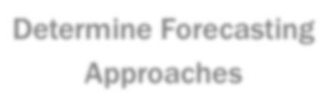

















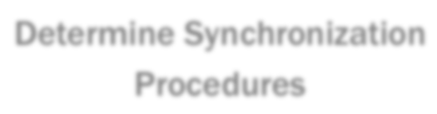




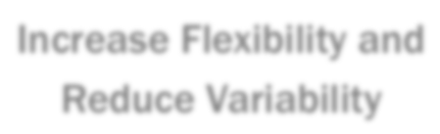
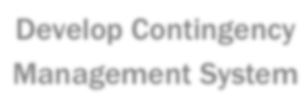




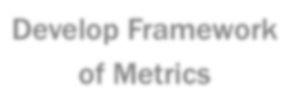

DEMAND MANAGEMENT
Determine Forecasting Approaches
Collect Data/Information
Plan Information Flow
Operational Sub-Processes
Forecast
Strategic Sub-Processes
Determine Synchronization Procedures
Synchronize
Develop Contingency Management System
Increase Flexibility and Reduce Variability
Develop Framework of Metrics
Measure Performance

Slide 10






















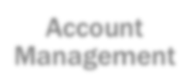
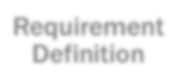
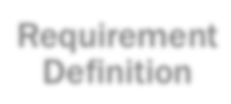
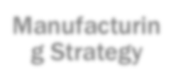
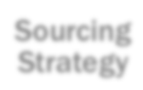
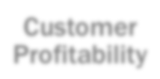






















MARKETING INTEGRATION
Marketing
Research & Development
Logistics
Production
Purchasing
Finance
Account Management
Requirement Definition
Requirement Definition
Manufacturin g Strategy
Sourcing Strategy
Customer Profitability
CRM
Account Administration
Technical Service
Performance Specification
Coordinated Execution
Priority Assessment
Cost to serve
CSM
Demand Planning
Process Requirements
Forecasting
Capability Planning
Sourcing
Trade-off Analysis
DM

Slide 11
REFERENCES
Gary Katz. (2016). Marketing Operations class presentation and notes.
Wikipedia. (2016). Marketing Operations. Retrieved from https://en.wikipedia.org/wiki/Marketing_operations
Wikipedia. (2016). Supply Chain Management. Retrieved from https://en.wikipedia.org/wiki/
Supply_chain_management#Importance
Steve Banker. ( 2009). Supply Chain and Marketing: A Growing Collaboration. Retrieved from
https://logisticsviewpoints.com/2009/07/29/supply-chain-and-
marketing-a-growing-collaboration/
Boundless. (2016). Influence on the Entire Supply Chain. Retrieved from
https://www.boundless.com/marketing/textbooks/boundless-
marketing-textbook/introduction-to-marketing-1/the-importance-of- marketing-22/influence-on-the-entire-supply-chain-127-7314/
Keely L. Croxton, Sebastián J. García-Dastugue, Douglas M. Lambert and Dale S. Rogers. ( n.d.). The Supply Chain Management Processes

