Slide 1



Dr. Niha Khan

Slide 2


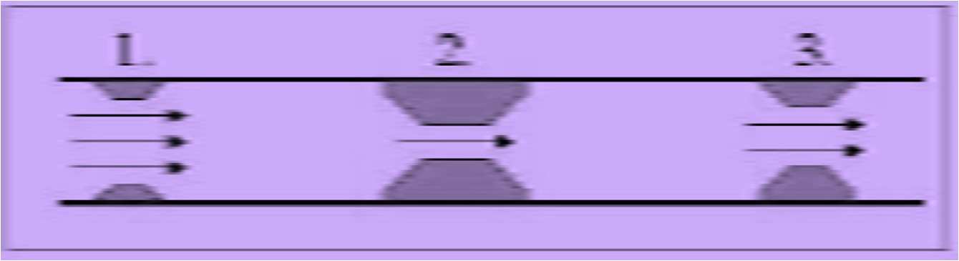
Bottleneck Operation
Bottleneck
operation:
An
operation
whose
of the
in a
capacity
sequence of is lower
operations than that
other operations

Slide 3

Capacity planning
Capacity is the maximum output rate of a production or service facility.
Capacity also includes
Equipment
Space
Employee skills
02/09/17
3

Slide 4
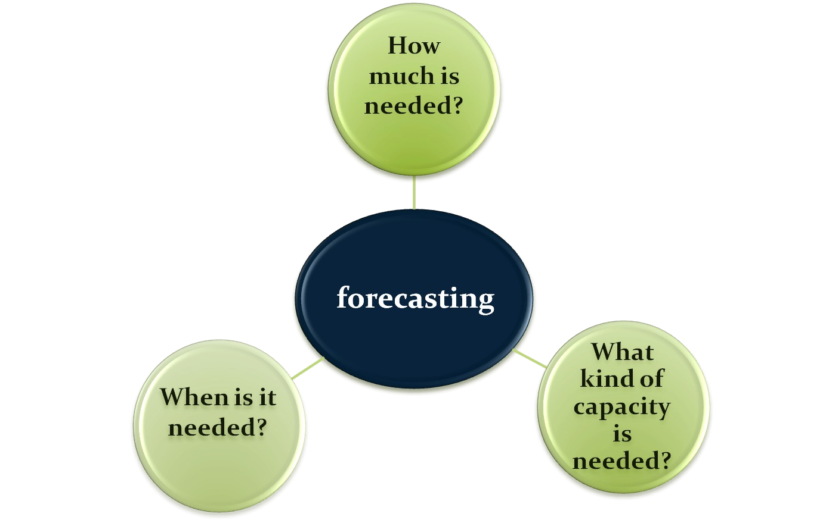
The basic questions in capacity planning

Slide 5
Capacity planning is the process of establishing the output rate that may be needed at a facility.
02/09/17
5

Slide 6
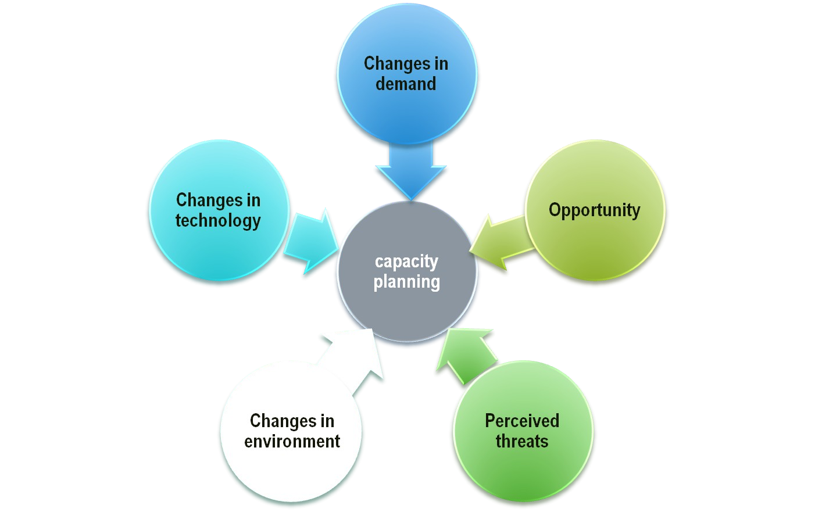
Reasons of capacity
planning

Slide 7
Importance of Capacity Decisions
Impacts ability to meet future demands
Affects operating costs
Major determinant of initial costs
Involves long-term commitment
Affects competitiveness
Affects ease of management
02/09/17
7

Slide 8
Measuring Capacity Examples
Type of Business | Input Measures of Capacity | Output Measures of Capacity
Car manufacturer | Labor hours | Cars per shift
Hospital | Available beds | Patients per month
Pizza parlor | Labor hours | Pizzas per day
Retail store | Floor space in | Revenue per foot
 | square feet
02/09/17
8

Slide 9
Capacity terminology
☑ Design capacity ( Max. Capacity )
is the maximum theoretical output of a system
Normally expressed as a rate
Under ideal conditions
☑ Effective capacity ( Best Operating Level )
is the capacity a firm expects to achieve given
current operating constraints
Often lower than design capacity
Under ideal conditions
Actual output ( Capacity Used )
is rate of output actually achieved
☑ Cannot exceed effective capacity.

Slide 10
Utilization and Efficiency
Utilization is the percent of design capacity achieved
Utilization = Actual Output/Design Capacity
Efficiency is the percent of effective capacity achieved
Efficiency = Actual Output/Effective Capacity
Both measures expressed as percentages

Slide 11
Calculating Capacity Utilization
Measures how much of the available capacity is actually being used:
Utilization = ^{actual output rate} (100%)
capacity
Measures effectiveness

Use either effective or design capacity in denominator
02/09/17
11

Slide 12


Efficiency/Utilization
Ex.
Design capacity = 50 trucks/day Effective capacity = 40 trucks/day Actual output = 36 units/day
 |  | Actual output | 36 units/day
Efficiency | = | = Effective capacity | = 90% 40 units/ day
Actual output
36 units/day
Utilization =
=
= 72%
Design capacity
50 units/day

Slide 13
Determinants of Effective Capacity
Facilities (size, location, layout, heating, lighting, ventilations)
Product and service factors (similarity of products)
Process factors (productivity, quality)
Human factors (training, skills, experience, motivations, absentation, turnover)
Policy factors (overtime system, no. of shifts)
Operational factors (scheduling problems, purchasing requirements, inventory shortages)
Supply chain factors (warehousing, transportation, distribution)
External factors (product standards, government agencies, pollution standard)

Slide 14

Calculating Processing Requirements
A dept. works 8- hour shift, 250 days/year
P | r | o | d | u | c | t | A D | n e | n m | u a | a n | l d | p | r | o p | S c e | t a e s r u | n d s i n n i t |  | a r d g t i m ( h r . ) | e | P | r | o n | c e | e s e d | s i n e d |  | g ( h | t r | i m . ) | e
# |  |  | 1 |  |  |  | 4 |  | 0 | 0 |  |  | 5 |  |  |  |  | . | 0 |  |  | 2 |  |  |  | , 0 | 0 | 0
# |  |  | 2 |  |  |  | 3 |  | 0 | 0 |  |  | 8 |  |  |  |  | . | 0 |  |  | 2 |  |  |  | , 4 | 0 | 0
# |  |  | 3 |  |  |  | 7 |  | 0 | 0 |  |  | 2 |  |  |  |  | . | 0 |  |  | 1 |  |  |  | , 4 | 0 | 0
 |  |  |  |  |  |  |  |  |  |  |  |  |  |  |  |  |  |  |  |  |  | 5 |  |  |  | , 8 | 0 | 0
annual capacity is 250* 8 = 2000 hours,
number of machines required = 5, 800 hours/ 2, 000 hours = 2. 90 machines
then we need three machines to handle the required volume

Slide 15
Capacity Planning Process
Forecast Demand
Develop
Alternative Plans
Quantitative
Factors (e.g., Cost)
Compute
Rated Capacity
Evaluate
Capacity Plans
Qualitative
Factors (e.g., Skills)
Compute
Needed Capacity
Select Best
Capacity Plan
Implement Best Plan

Slide 16
Planning Over a Time Horizon
Long-range planning
Intermediate- range planning
Add facilities
Add long lead time equipment
*
Subcontract Add equipment Add shifts
Add personnel
Build or use inventory
Short-range planning
Schedule jobs Schedule personnel Allocate machinery
*
Modify capacity
Use capacity
* Limited options exist
02/09/17
16

Slide 17
Economies of Scale
Economies of scale
If the output rate is less than the optimal level, increasing output rate results in decreasing average unit costs
Diseconomies of scale
If the output rate is more than the optimal level, increasing the output rate results in increasing average unit costs

Slide 18

Production units have an optimal rate of output for minimal cost.
Average cost per unit
Minimum average cost per unit
Minimum cost
0
Rate of output

Slide 19

Minimum cost & optimal operating rate are
functions of size of production unit.
Average cost per unit
Small
plant
Medium plant
Large plant
0
Output rate
5-19

Slide 20

02/09/17
20

Slide 21
Cost Volume Analysis:
Breakeven Analysis
Technique for evaluating process & equipment alternatives
Objective: Find the point at which total cost equals total revenue
Assumptions
Revenue & costs are related linearly to volume
All information is known with certainty
No time value of money

Slide 22
Break-Even Analysis
Fixed costs: costs that continue even if no units are produced: depreciation, taxes, debt, mortgage payments
Variable costs: costs that vary with the volume of units produced: labor, materials, portion of utilities
22

Slide 23
Breakeven Chart
Total revenue line
Breakeven point
Total cost = Total revenue
Profit
Total cost line
Cost in Dollars
Variable cost
Loss
Fixed cost
Volume (units/period)

Slide 24
Assumptions of Cost-Volume
Analysis
One product is involved
Everything produced can be sold
Variable cost per unit is the same regardless of volume
Fixed costs do not change with volume
Revenue per unit constant with volume
Revenue per unit exceeds variable cost per unit
5-24

Slide 25
Decision Theory
Helpful tool for financial comparison of alternatives under conditions of risk or uncertainty
Suited to capacity decisions
5-25

Slide 26

Small Box Office
ER 690,000
.3
200,000
Sign with Movie Co.
.6
Medium Box Office
1,000,000
ER 900,000
.1
Large Box Office
300,000
Small Box Office
ER 900,000
Sign with TV Network
.3
900,000
.6
Medium Box Office
900,000
^{.1} Large Box Office
900,000

Slide 27
Financial Analysis
Cash Flow - the difference between cash received from sales and other sources, and cash outflow for labor, material, overhead, and taxes.
Present Value - the sum, in current value, of all future cash flows of an investment proposal.
5-27

Slide 28
Net Present Value
F = future value
P = present value
i = interest rate
N = number of years
F
P =
(i + 1) ^{N}

Slide 29
Waiting-Line Analysis
Useful for designing or modifying service systems
Waiting-lines occur across a wide variety of service systems
Waiting-lines are caused by bottlenecks in the process
Helps managers plan capacity level that will be cost- effective by balancing the cost of having customers wait in line with the cost of additional capacity
5-29

Slide 30
PROCESS PLANNING
Design
Machine Tool
Process
Planning
Scheduling and Production Control

Slide 31
What methods were used?
Machining methods
Pressworking
Welding/fabrication
Casting
Powder materials
Layered deposition
Others

Slide 32








Welding/fabrication: Additive techniques
Final Product
Weld Add-on
Weld Add-on
Initial Stock

Slide 33







Machining Methods: Subtractive techniques
Final Product
Initial Stock
Slotting
Drilling

Slide 34


Casting:
Form Methods

Slide 35

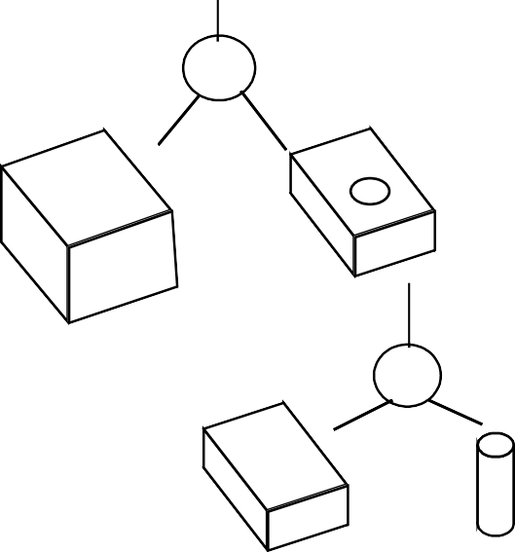
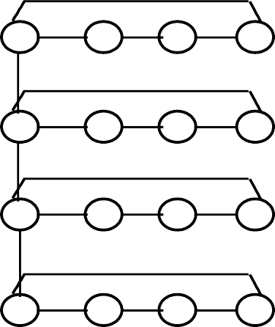
ENGINEERING DESIGN MODELING
_{2"} +0.01
0.001 A B
-0.01
_{10"} +0.01
-0.01
A
_{4"} +0.01
-0.01
_{7"} +0.05
-0.05
_{3"} +0.01
_{1'-4"} +0.01
-0.01
B
_{5"} +0.01
-0.01
-0.01
U*
S.F. 64 u inch
Fa c e
Lo o p
- *
Ed g e
V e rt e x
CSG MODEL
B-REP MODEL

Slide 36
INTERACTION OF
PLANNING FUNCTIONS
SETUP PLANNING
GEOMETRIC REASONING
global & local geometry
feature relationship
approach directions
process constraints
fixture constraints
PROCESS SELECTION
process capability
process cost
FIXTURE PLANNING
fixture element function
locating, supporting, and clamping surfaces
stability
CUTTER SELECTION
available tools
tool dimension and geometry
geometric constraints
CUTTER PATH GENERATION
feature merging and split
path optimization
obstacle and interference avoidance
MACHINE TOOL SELECTION
machine availability, cost
machine capability

