Slide 1
PERSONALITY - CONCEPT AND TYPES

Slide 2
THEORETICAL PERSPECTIVES OF PSYCHOLOGY
SUBMITTED BY : SANIYA ALI
: M.A. PSYCHOLOGY
: SEMESTER I
: UCSSH (MLSU)
SUBMITTED TO : Dr. HEMA MEHAR MAM

Slide 3
PERSONALITY - (CONCEPTS)
The word personality comes from the Latin root persona, meaning "mask." According to this root, personality is the impression we make on others; the mask we present to the world.
Personality is defined as "a unique set of traits and characteristics, relatively stable over time.“ The definition further suggests that personality does not change from day to day. Over the short-term, our personalities are relatively set or stable.
However, definition does not suggest that personality is somehow rigid, unchangeable, and cast in concrete. Definition recognizes that, over a longer term, personality may change.

Slide 4
PERSONALITY – (DEFINITION)
J.B. Watson (1930) : “ Personality is the sum of activities that can be discovered by actual observations over a long enough period of time to give reliable information.”
M. Prince (1929): Personality is the sum total of all biological innate dispositions, impulses, tendencies, appetites, and instincts of the individual and the dispositions and tendencies acquired by experience.”
Allport (1948) defined “Personality is the dynamic organization within the individual of those psychophysical systems that determine his unique adjustment to his environment.”

Slide 5
CHARACTERISTICS OF PERSONALITY
Personality is an internal process that guides behaviour.
Gordon Allport (1961) makes the point that personality is psychophysical, which means both physical and psychological.
Biological and genetic phenomena do have an impact on personality.
Child (1968) makes the point that personality is stable – or at least relatively stable.
Child (1968) includes consistency (within an individual) and difference (between individuals) in his definition.
Allport (1961) refers to characteristic patterns of behavior within an individual.

Slide 6
NATURE OF PERSONALITY
It is relatively stable but dynamic in nature.
Helps in adjusting the individual with the environment
It is consistent.
It is unique

Slide 7
DETERMINENTS OF PERSONALITY
Personal factors such as physique, sex, nervous system
Environmental factors such as home and family, school, society etc.
Another classification - 1. Biological factors 2. Psychological 3. Social and cultural

Slide 8
Biological determinents
Hereditary influences
Nervous system
Body chemistry

Slide 9
Psychological determinents
Intelligence and mental functioning
Level of aspiration and achievement motivation
Will power

Slide 10
Social and cultural determinents
Home and family
- Parents
- Parental attitude
School environment
Cultural environments

Slide 11
TYPES / THEORIES OF PERSONALITY
The earliest attempt to categories personality was made by Hippocrates a Greek Physician (400 BC).
He categorised people on the basis of body elements such as pitt (bile), vata(wind) and kufa (mucus) and prominent personality characteristics associated with them such as:

Slide 12
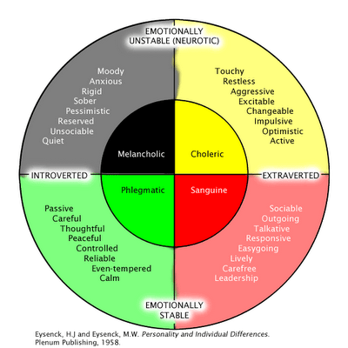

Slide 13
Types of Personality
Recently, psychologists have attempted to study personality in their own way.
They have formulated various theories to explain personality.
These are divided into two types, viz., types and traits theories.
Both these theories of personality focus on people’s personal characteristics
However, ‘type’ theorists and ‘trait’ theorists differ in the ways they use characteristics to describe people.

Slide 14
Type Theories
Type theorists have explained personality on the basis of physique and temperament. Temperament refers to emotional aspect of the personality like changes in mood, tensions, excitement, etc. A ‘type’ is simply a class of individuals said to share a common collection of characteristics.
Three important ‘Type theories’ of personality are explained here:
1. Jung’s Classification
2. Kretschmer’s Classification
3. Sheldon’s Classification
4. Friedman’s & Rosenman’s Classification

Slide 15
Jung’s Classification
CG Jung has classified personality on the basis of sociability character as Introverts and Extraverts.
Introverts are described as people who share characteristics such as shyness, social withdrawal, and tendency to talk less. Because of these characteristics these people appear to be self-centered, unable to adjust easily in social situations. They are not easily suggestible. They are future oriented, very sensible and rigid in ideas.

Slide 16
Jung’s Classification
Extraverts share a tendency to be outgoing, friendly, talkative, and social in nature. They prefer social contacts, generous, sportive, and courageous. They are happy-go-lucky persons and show interest in present reality than future. They express their feelings openly. Take decisions quickly and act upon quickly. They are not affected easily by difficulties.
Ambiverts: There are only few people who are pure introverts or pure extraverts. The remaining majority of people possess both the qualities of introverts and extraverts.

Slide 17
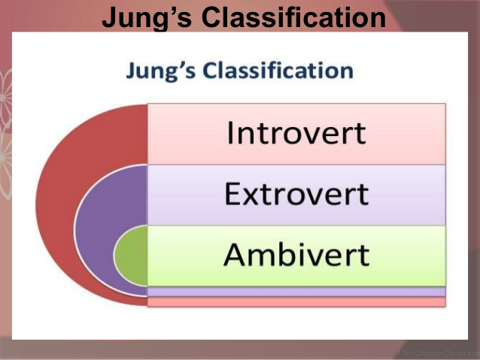

Slide 18
Kretschmer’s Classification
From his studies on mental patients, he found that certain body types are associated with particular types of mental disorders. He has classified personalities into four types:
Pyknic type: These are people who are short and having round body. They will have personality traits of extroverts. These people are more prone to suffer from a mental disorder called (MDP).
Asthenic type/Leptosomatic: These people will have a slender or slim body. They will have the personality traits of introverts. These people are more prone to suffer from a serious mental disorder called Schizophrenia.

Slide 19
Kretschmer’s Classification
Athletic type: These people will have strong body. They are more energetic and aggressive. They will be strong enough, determined, adventurous and balanced. They are comparable with ambiverts. They are more prone to suffer from MDP.
Dysplastic type: These people will have un- proportionate body and do not belong to any of the three types mentioned above. This disproportion is due to hormonal imbalance. Their behaviour and personality are also imbalanced.

Slide 21
Sheldon’s Classification
He has divided people into three types:
Endomorphic: These people will have soft, fat and round body, having predominance of abdominal region. They are sociable and relaxed (can be compared to pyknic type).
Ectomorphic: These are the people who are tall, thin and flat chested, having the skin, bones and neural structure predominantly. They are shy, reserved and self-conscious (can be compared with asthenic/Leptosomatic type).
Mesomorphic: These people are well built with heavy and strong muscles appear predominantly. They are physically active, noisy, adventurous by nature (can be compared to athletic type).

Slide 23
Friedman’s and Rosenman’s Classification
Type A and Type B personality theory describes two contrasting personality types.
Type A: The theory describes Type A individuals as rude, ambitious, rigidly organized, highly status- conscious, sensitive, impatient, anxious, proactive, and concerned with time management. People with Type A personalities are often high-achieving "workaholics." They push themselves with deadlines, and hate both delays and ambivalence.
Type A behavior is expressed through three major symptoms: (1) free-floating hostility/unfriendliness, which can be triggered by even minor incidents; (2) time urgency and impatience,(3) a competitive drive.

Slide 24
Friedman’s and Rosenman’s Classification
Type B personality, by definition, are noted to live at lower stress levels. They typically work steadily, and may enjoy achievement.
When faced with competition, they may focus less on winning or losing than their Type A counterparts, and more on enjoying the game regardless of winning or losing.
Type B individuals are sometimes attracted to careers of creativity: writer, counsellor, therapist, actor or actress.
However, network and computer systems managers, professors, and judges are more likely to be Type B individuals as well. Their personal character may enjoy exploring ideas and concepts. They are often reflective, and think of the "outer and inner world".

