Slide 1

“Supply, Demand, and Market Equilibrium”

Slide 2
Introduction to Demand
The forces of supply and demand work together to set prices.
Demand is the desire, willingness, and ability to buy a good or service.
– Supply can refer to one individual consumer or to the total demand of all consumers in the market (market demand).

Slide 3
Introduction to Demand
A demand schedule is a table that lists the various quantities of a product or service that someone is willing to buy over a range of possible prices.
Price per Widget ($) | Quantity Demanded of Widget per day
$5 | 2
$4 | 4
$3 | 6
$2 | 8
$1 | 10

Slide 4
Introduction to Demand
A demand schedule can be shown as points on a graph.
The graph lists prices on the vertical axis and quantities demanded on the horizontal axis.
Each point on the graph shows how many units of the product or service an individual will buy at a particular price.
The demand curve is the line that connects these points.

Slide 5
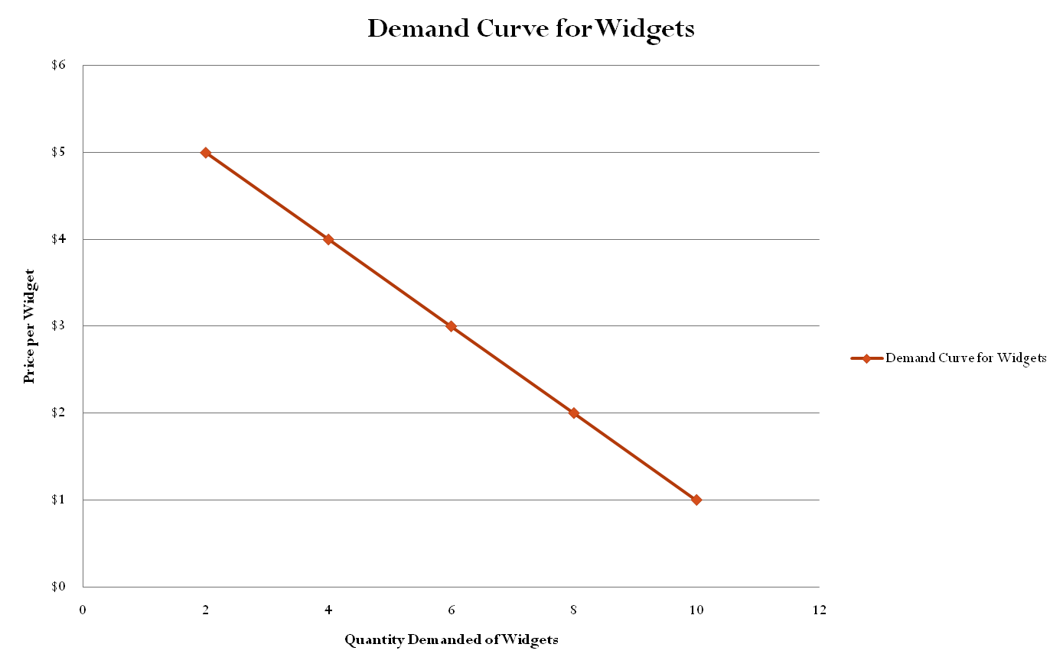

Slide 6
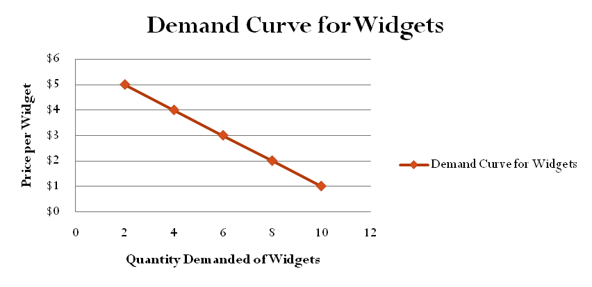
Introduction to Demand
The demand curve slopes downward.
This shows that people are normally willing to buy less of a product at a high price and more at a low price.
According to the law of demand, quantity demanded and price move in opposite directions.

Slide 7
Introduction to Demand
•
We buy products for their utility- the pleasure, usefulness, or satisfaction they give us.
What is your utility for the following products? (Measure your utility by the maximum amount you would be willing to pay for this product)
•

Slide 8
Introduction to Demand
•
One reason the demand curve slopes downward is due to diminish marginal utility
The principle of diminishing marginal utility says that our additional satisfaction tends to go down as we consume more and more units.
To make a buying decision, we consider whether the satisfaction we expect to gain is worth the money we must give up.
–
•

Slide 9
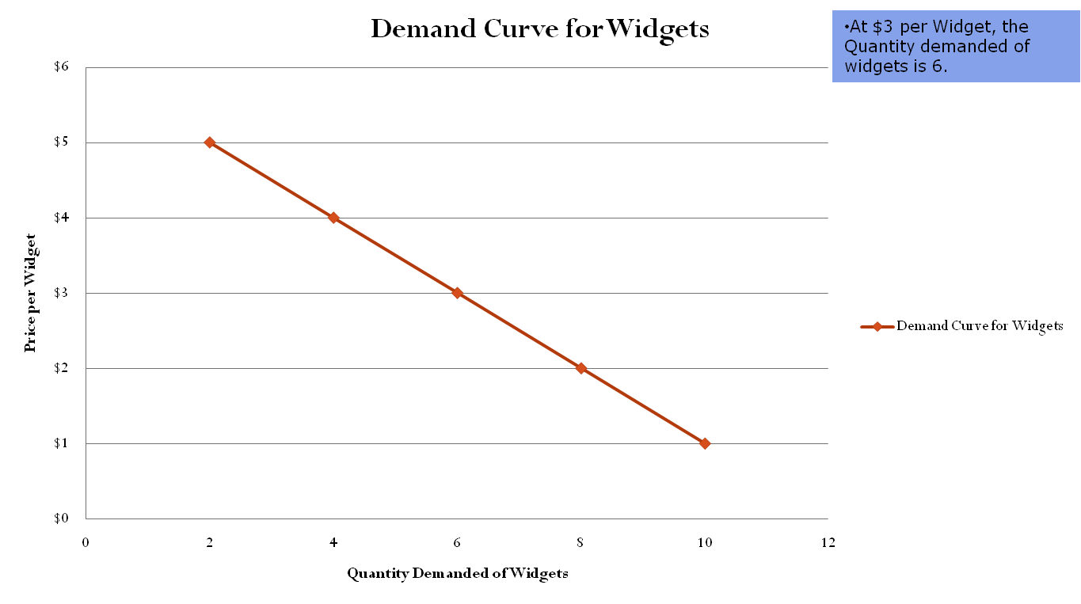
Changes in Demand
Change in the quantity demanded due to a price change occurs ALONG the demand curve
An increase in the Price of Widgets from $3 to $4 will lead to a decrease in the Quantity Demanded of Widgets from 6 to 4.

Slide 10
Changes in Demand
Demand Curves can also shift in response to the following factors:
  Buyers (# of): changes in the number of consumers
  Income: changes in consumers’ income
  Tastes: changes in preference or popularity of product/ service
  Expectations: changes in what consumers expect to happen in the future
  Related goods: compliments and substitutes
BITER: factors that shift the demand curve

Slide 11
Changes in Demand
Prices of related goods affect on demand
  Substitute goods→ a substitute is a product that can be used in the place of another.
    The price of the substitute good and demand for the other good are directly related
    For example, Coke Price Pepsi Demand
  Complementary goods→ a compliment is a good that goes well with another good.
    When goods are complements, there is an inverse relationship between the price of one and the demand for the other
    For example, Peanut Butter Jam Demand

Slide 12
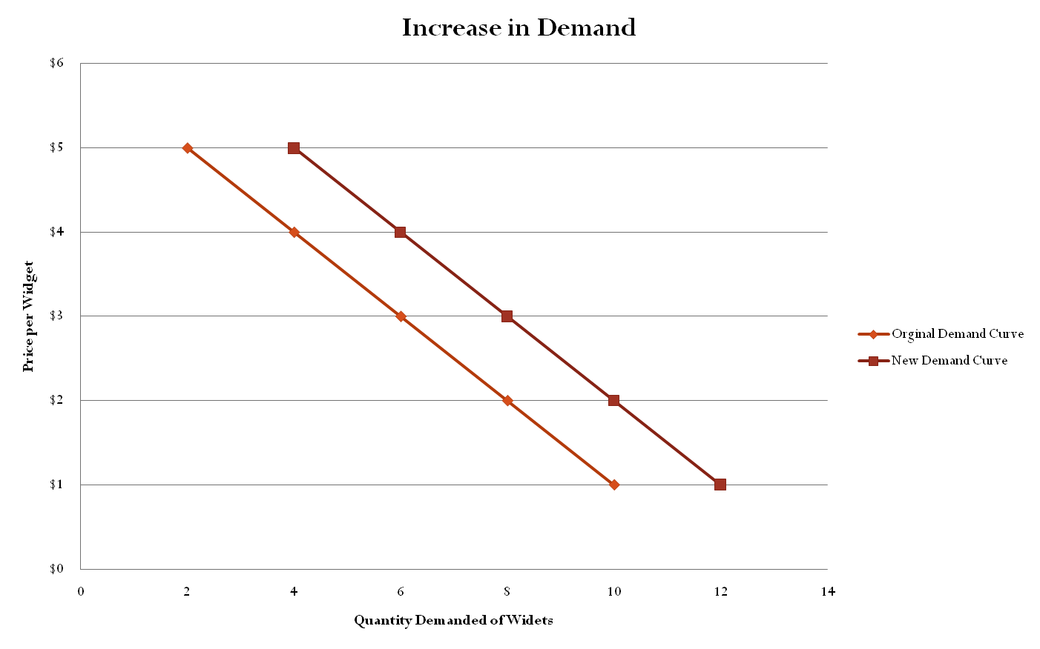
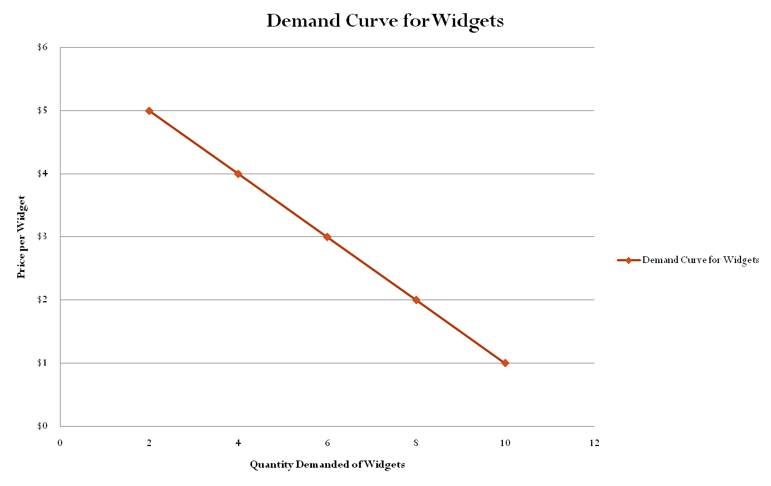
Changes in Demand
Several factors will change the demand for the good (shift the entire demand curve)
As an example, suppose consumer income increases. The demand for Widgets at all prices will increase.

Slide 13
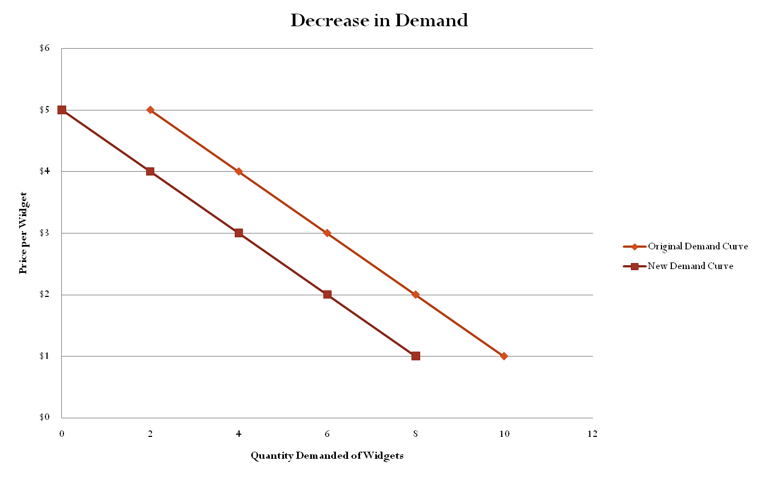
Changes in Demand
Demand will also decrease due to changes in factors other than price.
As an example, suppose Widgets become less popular to own.

Slide 14
Changes in Demand
Changes in any of the factors other than price causes the demand curve to shift either:
Decrease in Demand shifts to the Left (Less demanded at each price)
OR
Increase in Demand shifts to the Right (More demanded at each price)

Slide 15
Introduction to Supply
•
Supply refers to the various quantities of a good or service that producers are willing to sell at all possible market prices.
•
Supply can refer to the output of one producer or to the total output of all producers in the market (market supply).

Slide 16
Introduction to Supply
A supply schedule is a table that shows the quantities producers are willing to supply at various prices
Price per Widget ($) | Quantity per day | Supplied of Widget
$5 | 10
$4 | 8
$3 | 6
$2 | 4
$1 | 2

Slide 17
Introduction to Supply
A supply schedule can be shown as points on a graph.
The graph lists prices on the vertical axis and quantities supplied on the horizontal axis.
Each point on the graph shows how many units of the product or service a producer (or group of producers) would willing sell at a particular price.
The supply curve is the line that connects these points.

Slide 18
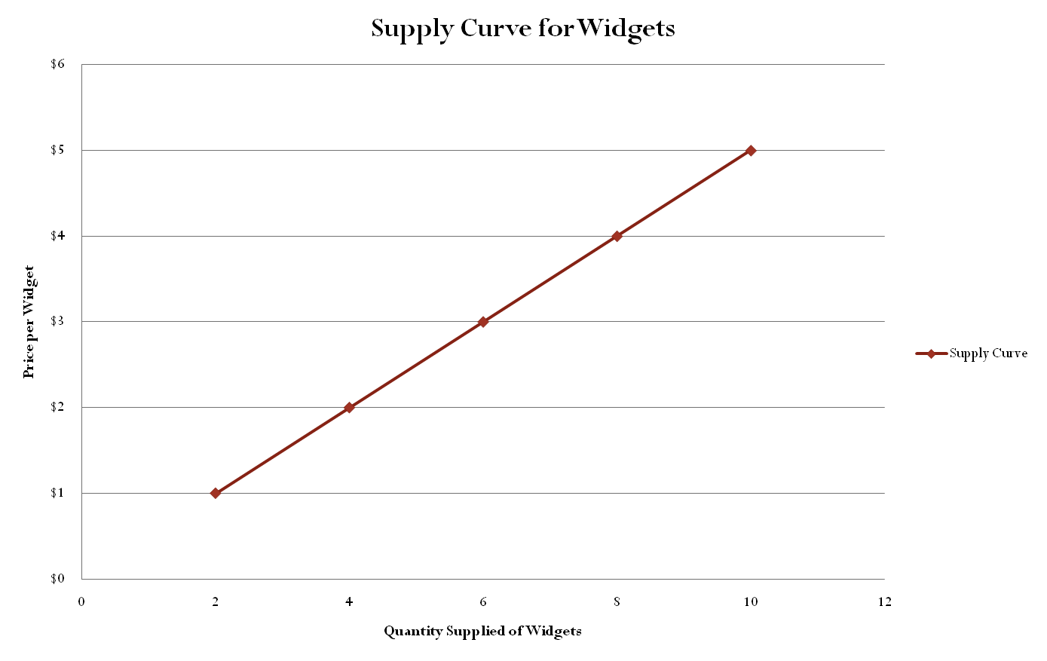

Slide 19
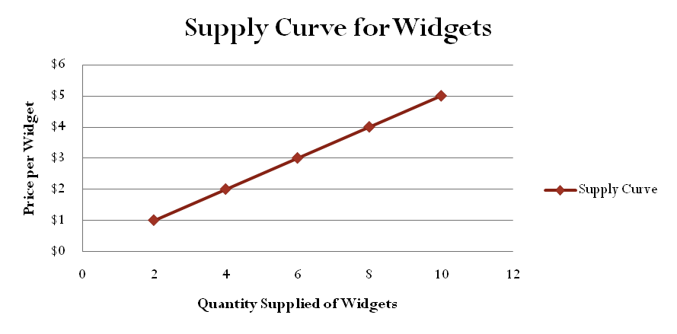
Introduction to Supply
•
As the price for a good rises, the quantity supplied rises and the quantity demanded falls. As the price falls, the quantity supplied falls and the quantity demanded rises.
The law of supply holds that producers will normally offer more for sale at higher prices and less at lower prices.
•

Slide 20
Introduction to Supply
The reason the supply curve slopes upward is due to costs and profit.
Producers purchase resources and use them to produce output.
Producers will incur costs as they bid resources away from their alternative uses.

Slide 21
Introduction to Supply
Businesses provide goods and services hoping to make a profit.
Profit is the money a business has left over after it covers its costs.
Businesses try to sell at prices high enough to cover their costs with some profit left over.
The higher the price for a good, the more profit a business will make after paying the cost for resources.




Slide 22
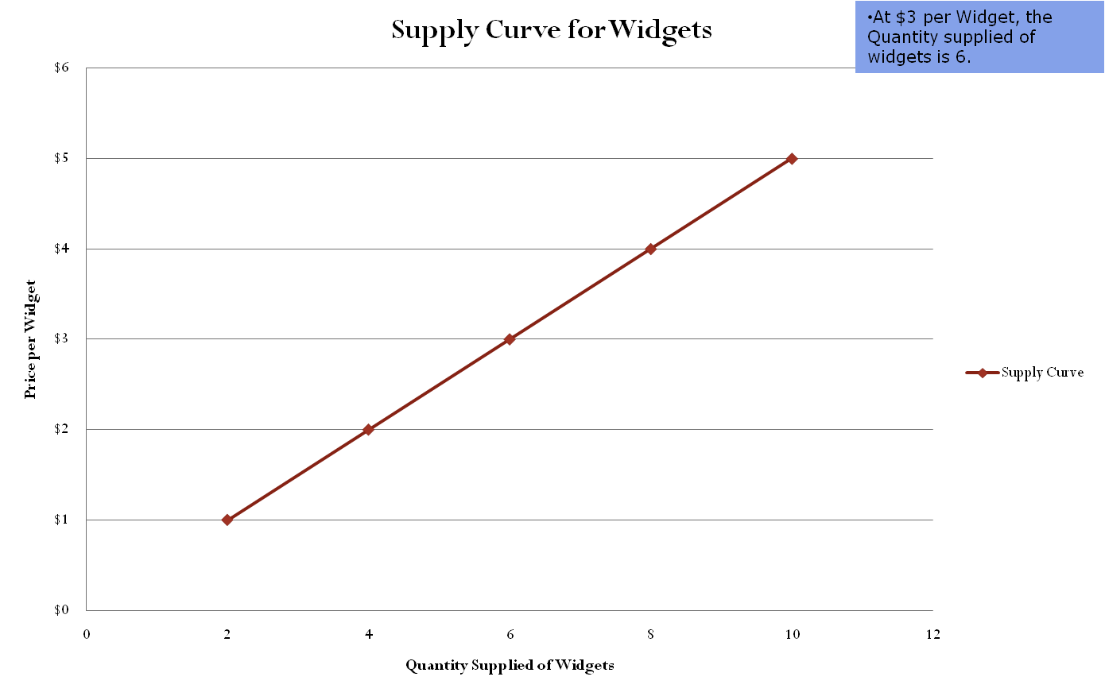
Changes in Supply
Change in the quantity supplied due to a price change occurs ALONG the supply curve
If the price of Widgets fell to $2, then the Quantity Supplied would fall to 4 Widgets.

Slide 23
Changes in Supply
Supply Curves can also shift in response to the following factors:
  Subsidies and taxes: government subsides encourage production, while taxes discourage production
  Technology: improvements in production increase ability of firms to supply
  Other goods: businesses consider the price of goods they could be producing
  Number of sellers: how many firms are in the market
  Expectations: businesses consider future prices and economic conditions
  Resource costs: cost to purchase factors of production will influence business decisions
STONER: factors that shift the supply curve

Slide 24
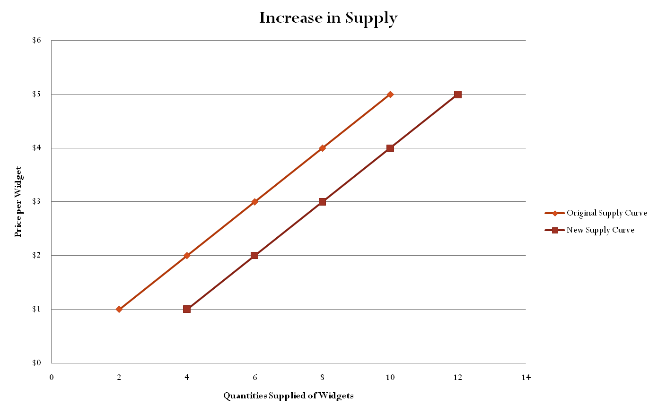
Changes in Supply
Several factors will change the demand for the good (shift the entire demand curve)
As an example, suppose that there is an improvement in the technology used to produce widgets.

Slide 25
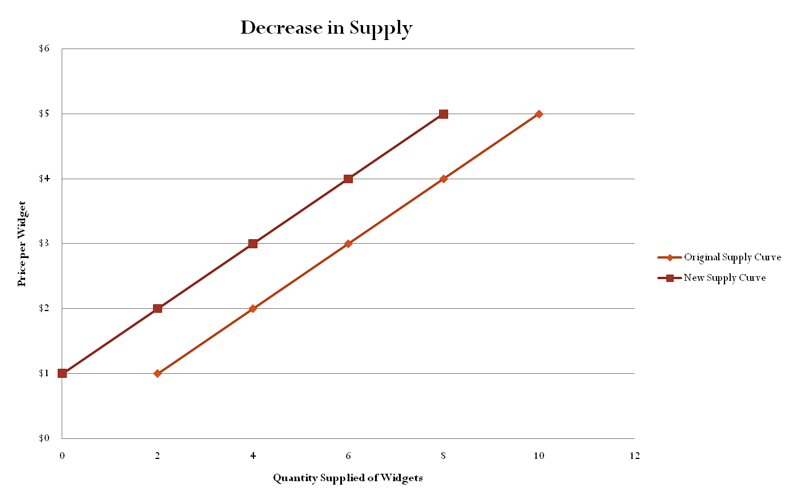
Changes in Supply
Supply can also decrease due to factors other than a change in price.
As an example, suppose that a large number of Widget producers go out of business, decreasing the number of suppliers.

Slide 26
Changes in Supply
Changes in any of the factors other than price causes the supply curve to shift either:
Decrease in Supply shifts to the Left (Less supplied at each price)
OR
Increase in Supply shifts to the Right (More supplied at each price)

Slide 27
Supply and Demand at Work
Markets bring buyers and sellers together.
The forces of supply and demand work together in markets to establish prices.
In our economy, prices form the basis of economic decisions.

Slide 28
Supply and Demand at Work
Supply and Demand Schedule can be combined into one chart.
Price per Widget ($) | Quantity Demanded of Widget per day | Quantity Supplied of Widget per day
$5 | 2 | 10
$4 | 4 | 8
$3 | 6 | 6
$2 | 8 | 4
$1 | 10 | 2

Slide 29
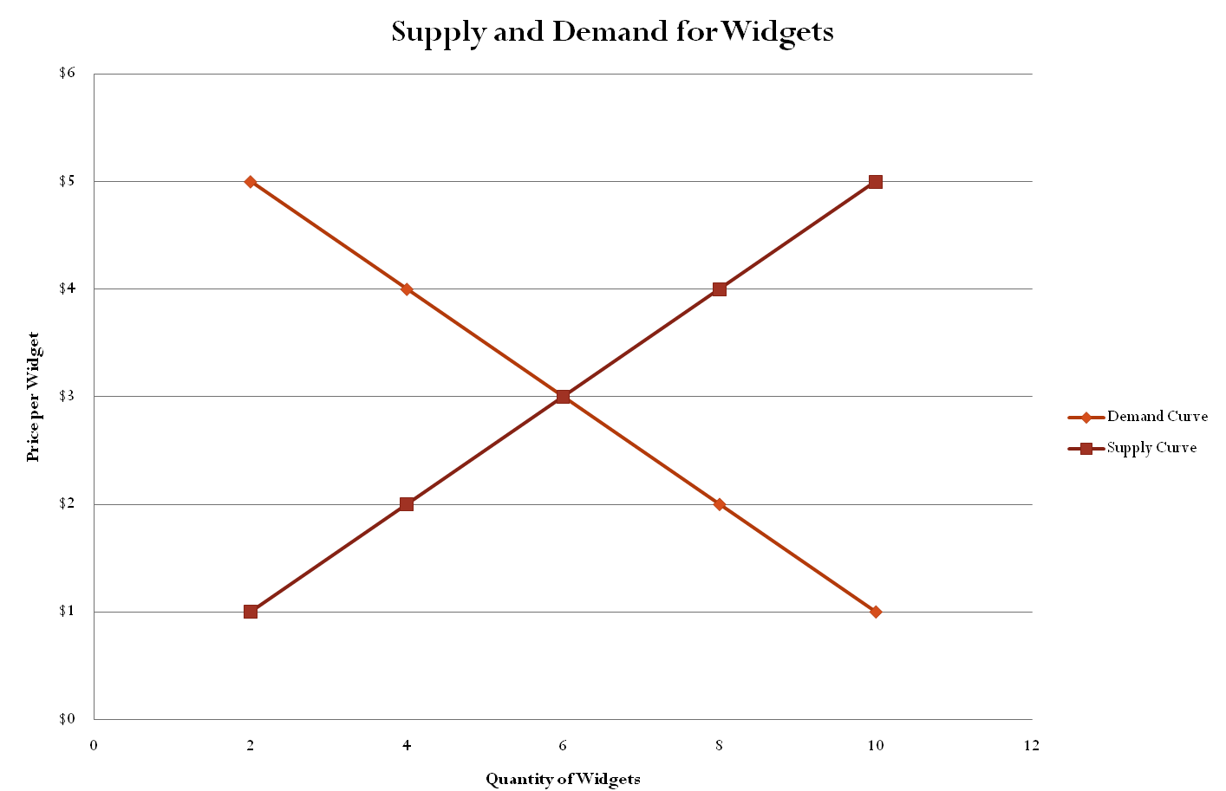
Supply and Demand at Work

Slide 30
Supply and Demand at Work
•
A surplus is the amount by which the quantity supplied is higher than the quantity demanded.
–
–
A surplus signals that the price is too high.
At that price, consumers will not buy all of the product that suppliers are willing to supply.
In a competitive market, a surplus will not last. Sellers will lower their price to sell their goods.
–

Slide 31
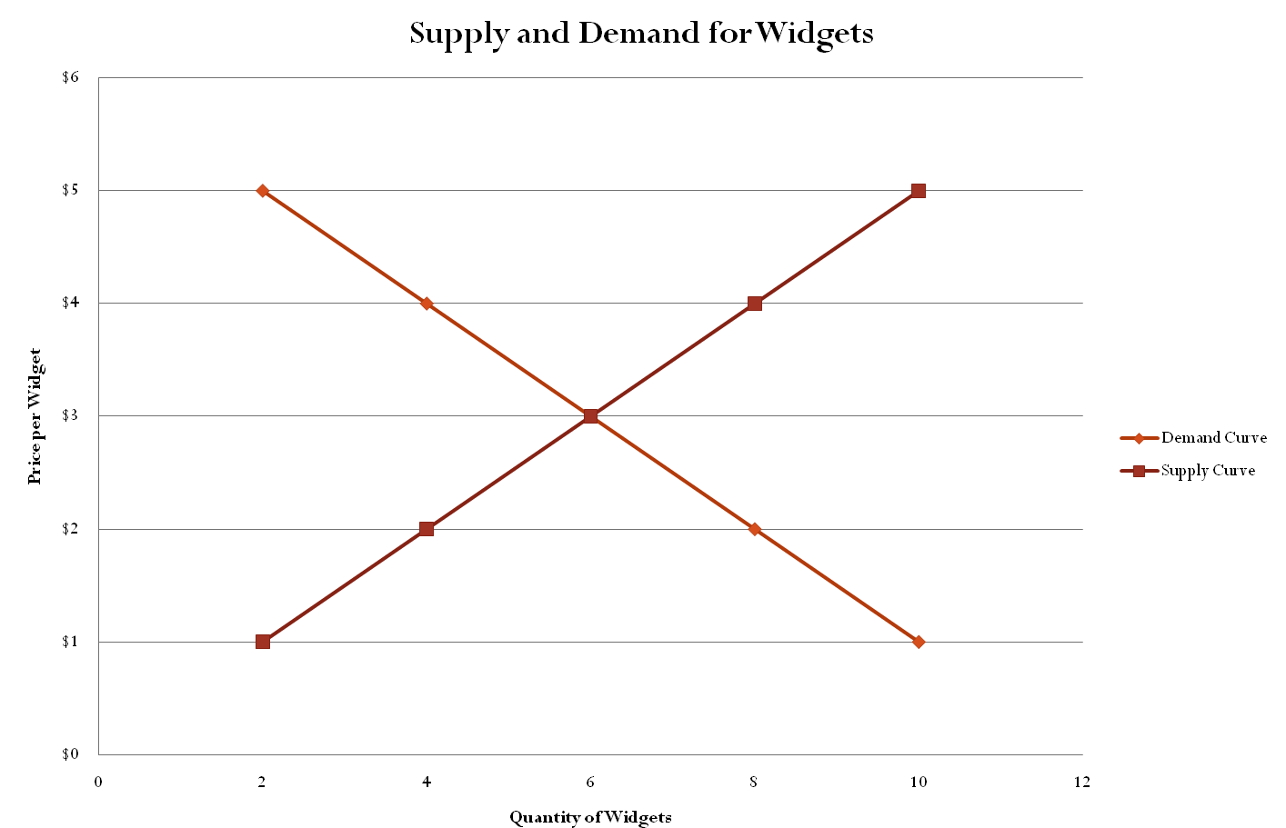
Supply and Demand at Work
Suppose that the price in
the Widget market is $4.
At $4, Quantity demanded will be 4 Widgets
Surplus
At $4, Quantity supplied will be 8 Widgets.
At $4, there will be a surplus of 4 Widgets.

Slide 32
Supply and Demand at Work
A shortage is the amount by which the quantity demanded is higher than the quantity supplied
A shortage signals that the price is too low.
At that price, suppliers will not supply all of the product that consumers are willing to buy.
In a competitive market, a shortage will not last. Sellers will raise their price.

Slide 33
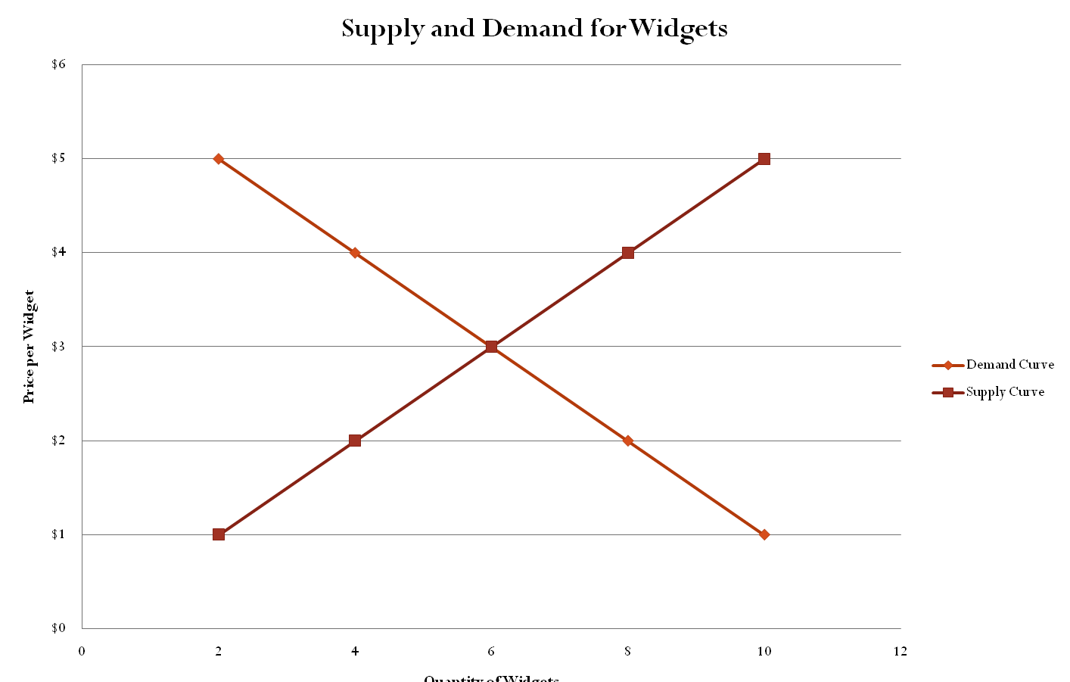
Supply and Demand at Work
Suppose that the price in
the Widget market is $2.
At $2, Quantity supplied will be 4 Widgets
At $2, Quantity demanded will be 8 Widgets.
At $2, there will be a shortage of 4 Widgets.
Shortage

Slide 34
Supply and Demand at Work
•
When operating without restriction, our market economy eliminates shortages and surpluses.
–
Over time, a surplus forces the price down and a shortage forces the price up until supply and demand are balanced.
The point where they achieve balance is the equilibrium price. At this price, neither a surplus nor a shortage exists.
–
•
Once the market price reaches equilibrium, it tends to stay there until either supply or demand changes.
–
When that happens, a temporary surplus or shortage occurs until the price adjusts to reach a new equilibrium price.

Slide 35
Supply and Demand at Work
Suppose that the price in
the Widget market is $3.
At $3, Quantity supplied will be 6 Widgets
At $3, Quantity demanded will be 6 Widgets.
At $3, there will be neither a surplus or a shortage.

